Slide 1
HIV causes AIDS
social.rollins.edu
http://aidsresponseeffort.org

Slide 2
HIV does not kill people. It just kills T cells.

Slide 3
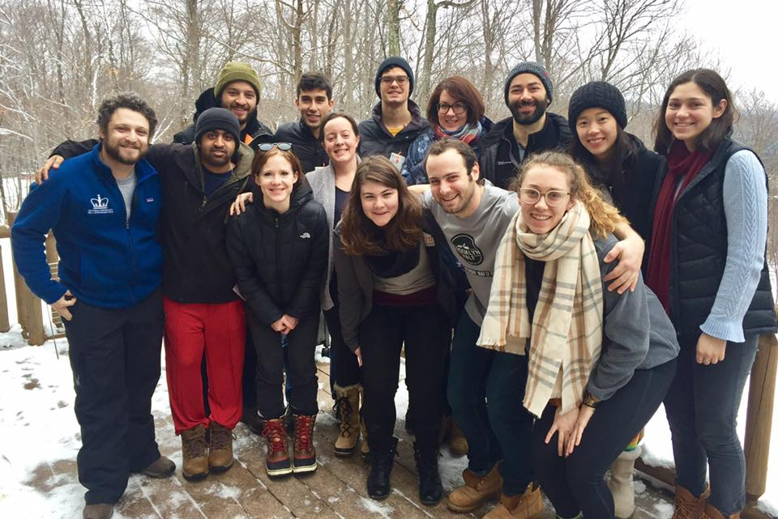
Day 1:
Why do we need an immune system?
Sarah Nyquist
Andrew Navia
Sam Allon

Slide 4
Your science alliteration name, Your number 1-3
Statistical Sarah, 1
Atomic Andrew, 2
Sequencing Sam, 3

Slide 5
Course Outline
Viral and bacteria infections
Zoo of white blood cells
Innate immune response
Adaptive immune response
Cancer
Vaccines

Slide 6
3 groups of 10
What do we know about HIV?

Slide 7
Outline for today’s class
Viruses, bacteria, and the diseases they cause
What viruses and bacteria do to cells
How the immune system fights back

Slide 8
Viruses and bacteria – what’s the difference?

Slide 9
Viruses and bacteria can cause diseases
Virus or bacterium | Disease
Rabies virus | Rabies
Poliovirus | Polio
Human Immunodeficiency Virus | AIDS
Rhinovirus | Common cold
Adenovirus | Common cold
E. coli bacterium | Food poisoning
M. tuberculosis bacterium | Tuberculosis

Slide 10
How do viruses and bacteria contribute to disease globally?
https://vizhub.healthdata.org/gbd-compare/

Slide 11
3 groups of 10, 10 groups of 3
Lytic viruses
Latent viruses
Bacteria

Slide 12
How viruses destroy cells
schoolworkhelper.net

Slide 13
Some viruses can go latent (like HIV)

Slide 14
Blow your mind: endogenous retroviruses
pre-sperm cell or pre-egg cell
98,000 endogenous retroviruses in every human genome
(don’t worry, they’re all inactive)

Slide 15
Bacterial infections can be intracellular like a virus
Franco et al (2009)

Slide 16
Extracellular bacteria can also cause disease
wou.edu

Slide 17
Blow your mind: most bacteria are totally cool
amnh.org

Slide 18
Scenario
You accidentally poke yourself with a dirty pin. 10,000 bacteria enter the wound.
Mission
Design an immune response that will stop the bacteria from establishing an infection. Choose 4 actions to take, in some order.
Possible actions
Protect the wound with a scab. | Lure bacteria into the bloodstream. | Tell immune system to calm down. | Recognize bacteria from earlier wound.
Flush out bacteria by bleeding more. | Kill all cells that might be infected. | Figure out the weak point of the bacteria. | Welcome the bacteria as guests.
Sound the alarm: there are invaders! | Try to poison the bacteria. | Turn the bacteria against one another. | Prevent new cells from entering area.
Move the bacteria safely to the gut. | Have cells eat and digest the bacteria. | Release acid into blood to burn them. | Make up your own custom action!

Slide 19
Steps of an immune response to injury
studyblue.com

Slide 20
Immune system lines of defense
thetwinapproach.com

