Slide 1
What if you are born without an immune system?

Slide 2
SCID: Severe Combined Immunodeficiency

Slide 3
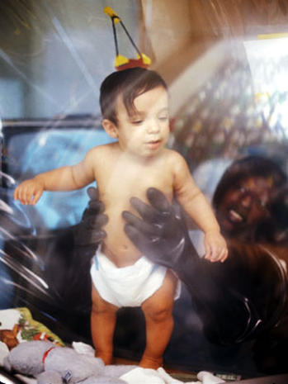
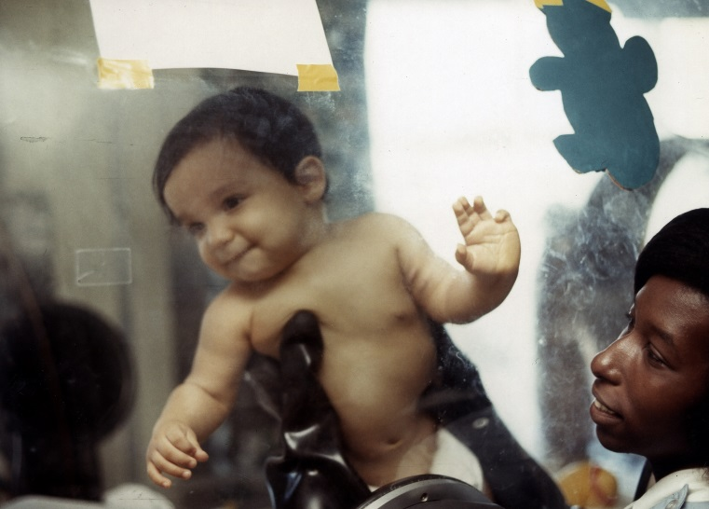
David Vetter was born in 1971 with SCID
was immediately placed in a plastic bubble to protect him from germs
http://www.everydayhealth.com/columns/my-health-story/mother-of-the-boy-in-the-bubble-gives-his-short-life-a-long-legacy/
http://www.cbsnews.com/pictures/bubble-boy-40-years-later-look-back-at-heartbreaking-case/3/

Slide 4
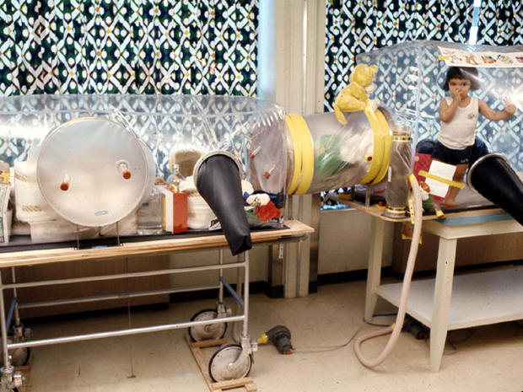
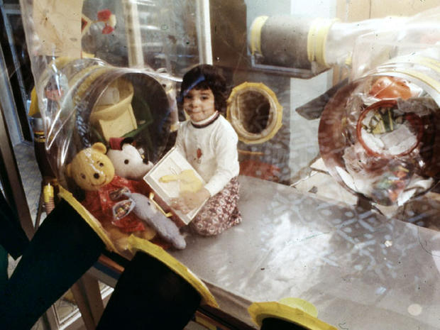
He remained in the bubble for 12 years
http://www.cbsnews.com/pictures/bubble-boy-40-years-later-look-back-at-heartbreaking-case/

Slide 5
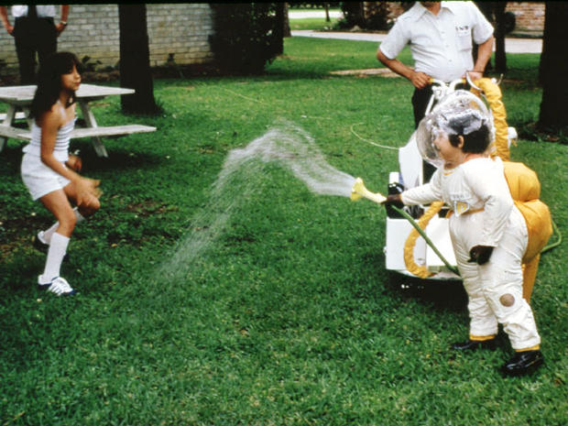
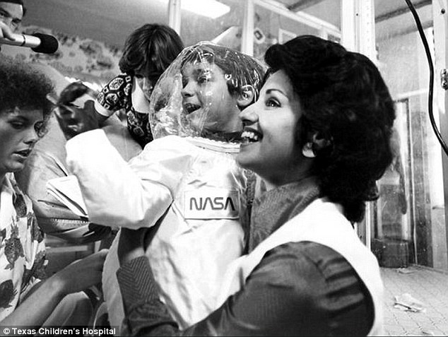
NASA designed a suit that allowed David to leave the bubble
http://www.cbsnews.com/pictures/bubble-boy-40-years-later-look-back-at-heartbreaking-case/

Slide 6
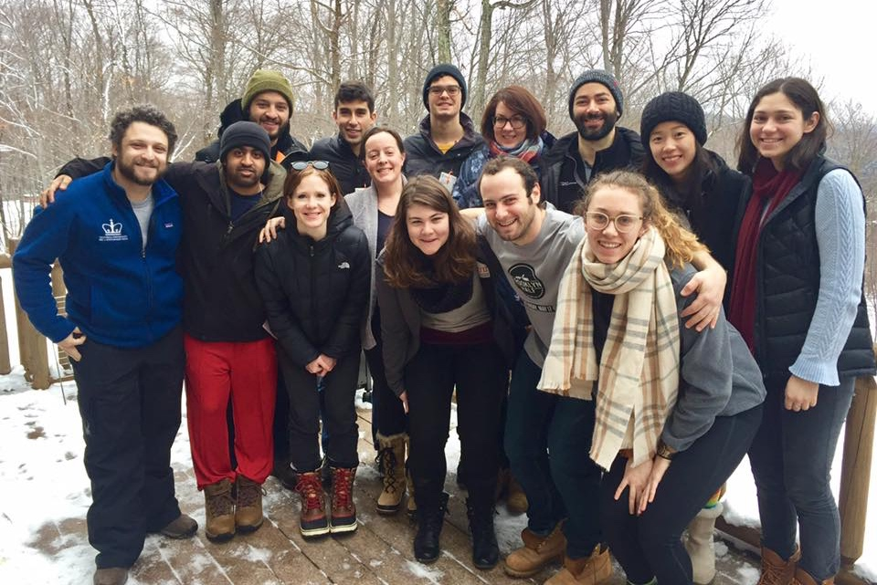
Day 2: What does the immune system look like?
Sarah Nyquist
Andrew Navia
Sam Allon

Slide 7
Course Outline
Viral and bacteria infections
Zoo of white blood cells
Innate immune response
Adaptive immune response
Cancer
Vaccines

Slide 8
3 groups What do we know about white blood cells?

Slide 9
Outline for today’s class
Anatomy of the immune system
Innate vs. adaptive immune system
Cell types of the immune system

Slide 10
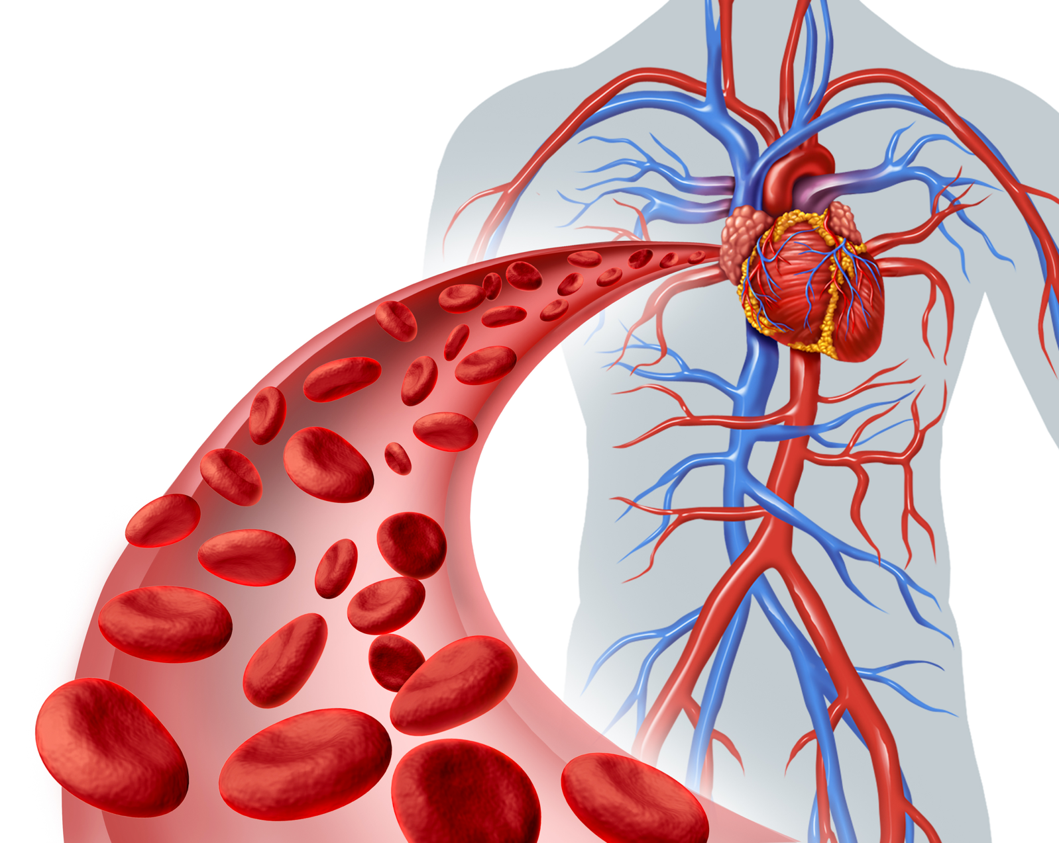
Immune cells (white blood cells) travel via the bloodstream
wikihow.com
Notes:
Ask them why the bloodstream is a good way for immune cells to get around
Ask them what else the blood does (it’s obviously not just for the immune system)

Slide 11
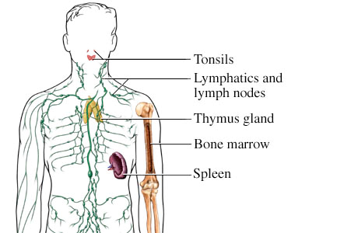
The immune system has specialized organs too
webmd.com

Slide 12
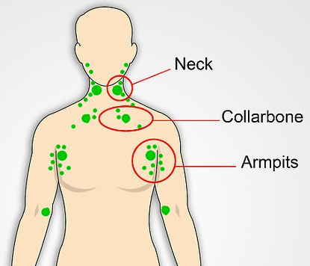
Lymph nodes are home-base for many white blood cells
wikihow.com
treatcure.com

Slide 13
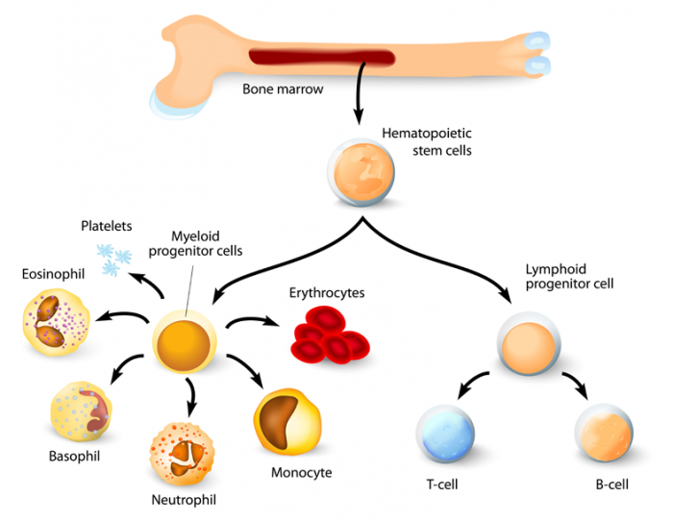
White (and red) blood cells made in the bone marrow
http://www.medicalnewstoday.com/articles/285666.php
Notes:
http://www.medicalnewstoday.com/articles/285666.php

Slide 14
Immune system lines of defense
Innate immune response
Adaptive immune response
thetwinapproach.com

Slide 15
What are the differences between adaptive and innate? 2 groups of 10, 5 groups of 4
Innate immune response
Adaptive immune response

Slide 16
Immune system lines of defense
Innate immune response
Adaptive immune response
thetwinapproach.com

Slide 17
Innate vs. adaptive immune response
 | Innate response | Adaptive response
At birth | Totally functional | Start from nothing
Speed after infection | Immediate response | Takes a few days
What it recognizes | Common features of viruses and bacteria | Specific viruses and bacteria
Teamwork | Operates on its own | Needs help from innate response
Memory | Same response every time | Second encounter stronger and faster
thetwinapproach.com

Slide 18
Innate immune response seeks and destroys bacteria
https://www.youtube.com/watch?v=Z_mXDvZQ6dU
Some paper

Slide 19
Innate immune response prepares cells for virus attack
!!!
Innate immune cell
Mosby's Medical Dictionary

Slide 20
Adaptive immune response tags bacteria for destruction
Y
X
B cell X
Y
B cell Y
Y
(not to scale)
slideshare.net

Slide 21
Adaptive immune response kills infected cells
blogs.shu.edu

Slide 22
Debate: Which is more important – innate or adaptive immune response?

Slide 23
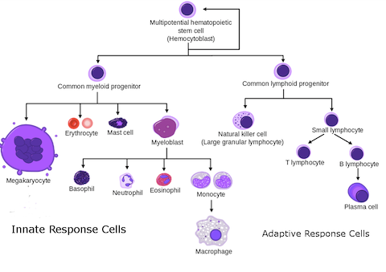
There are many types of white blood cells
Dendritic cell
wikipedia

Slide 24
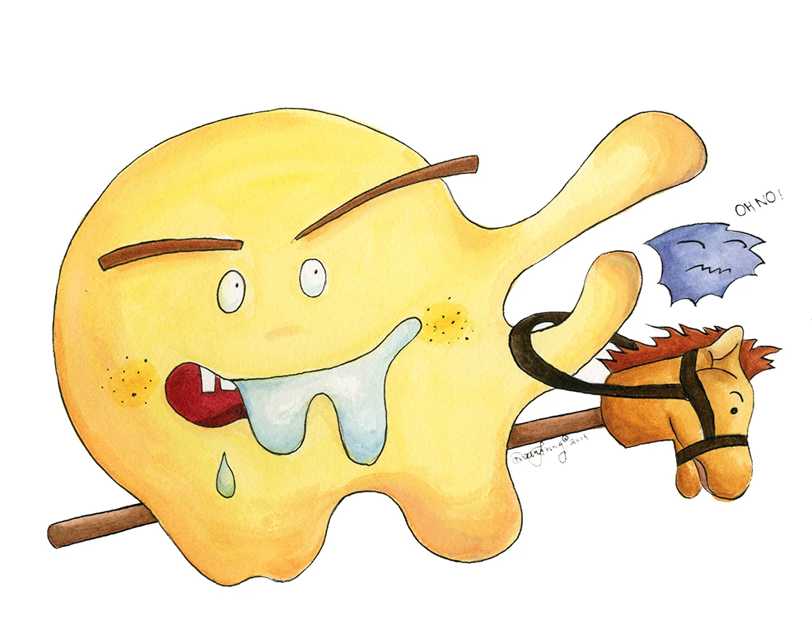
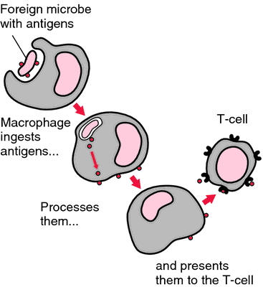
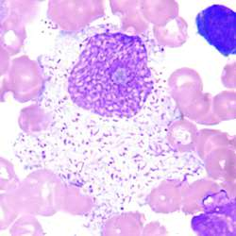
Macrophages wait in tissues and trigger inflammation
http://medical-dictionary.thefreedictionary.com/macrophage
Daisy Cheung

Slide 25
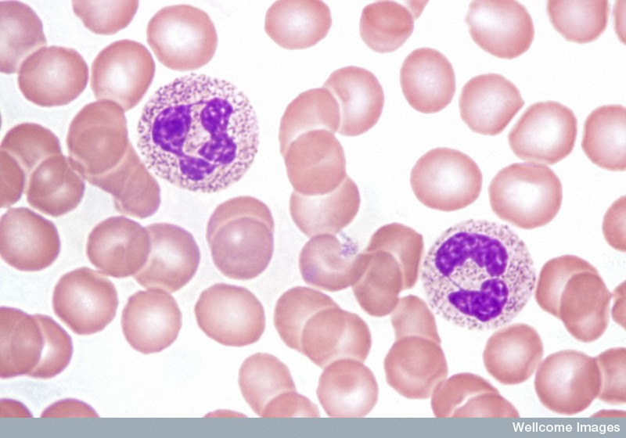
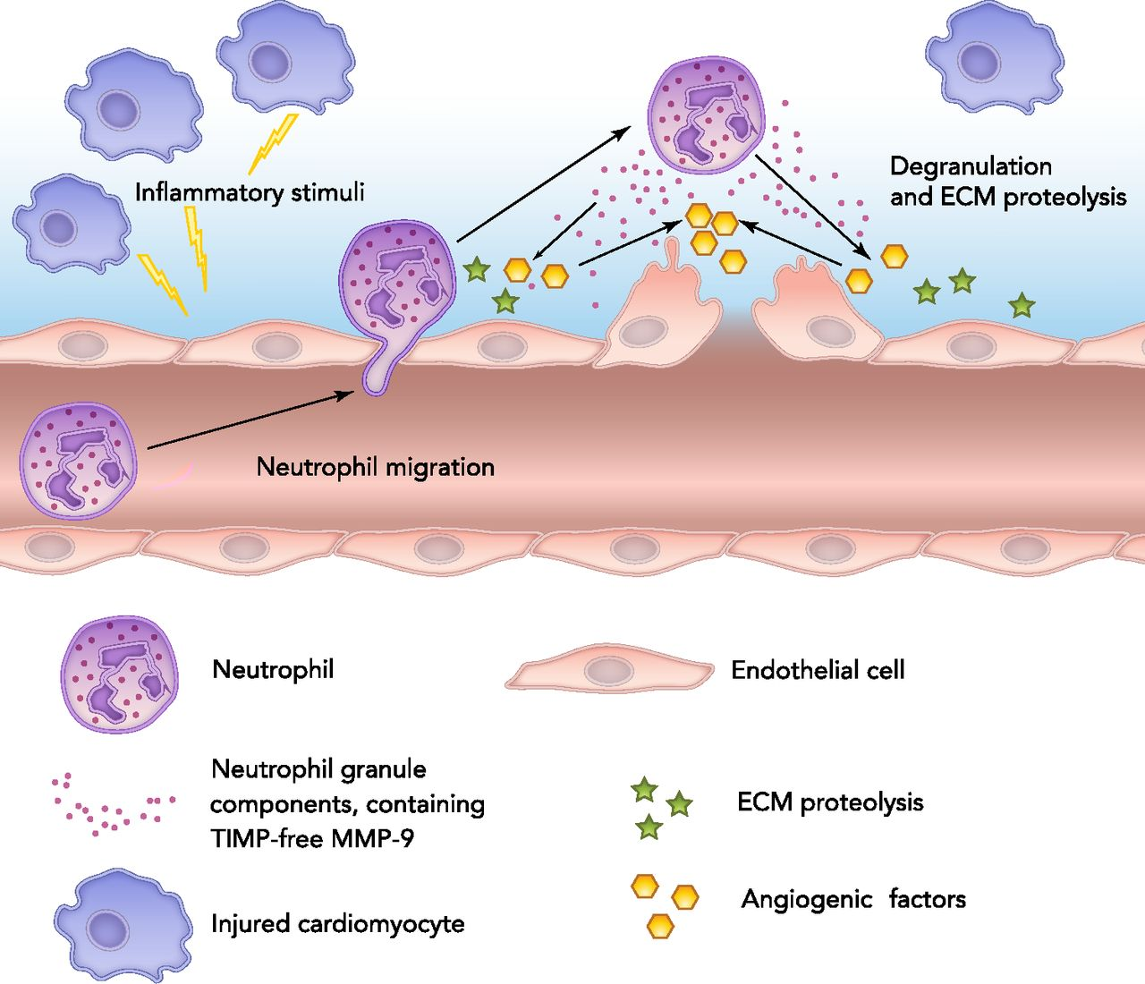
Neutrophils arrive from blood and consume microbes
Spike Walker, Wellcome Images
Daisy Cheung
http://physiologyonline.physiology.org/content/28/6/391

Slide 26
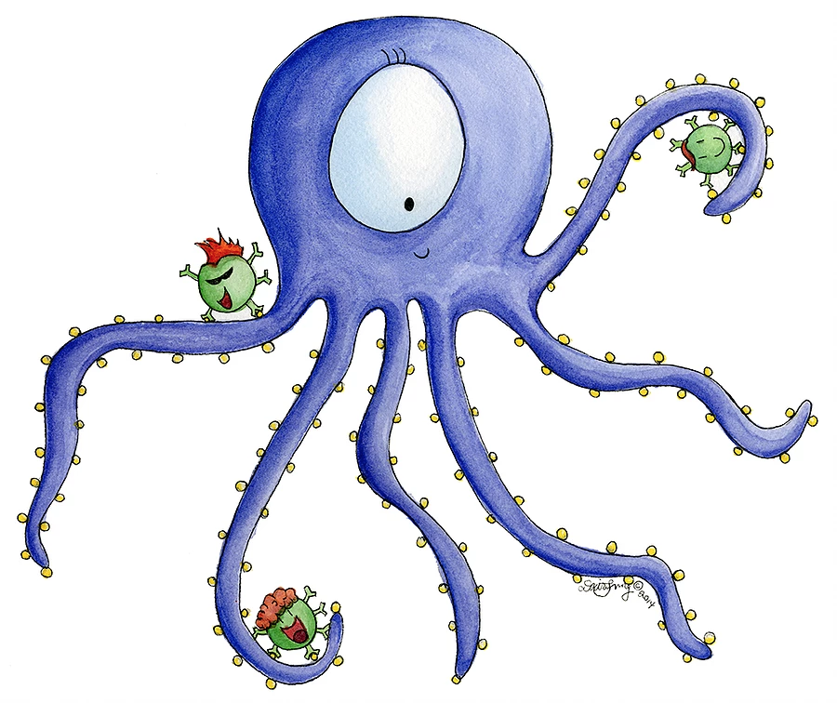
Dendritic cells pass information to adaptive immune system
washington.edu
Daisy Cheung

Slide 27
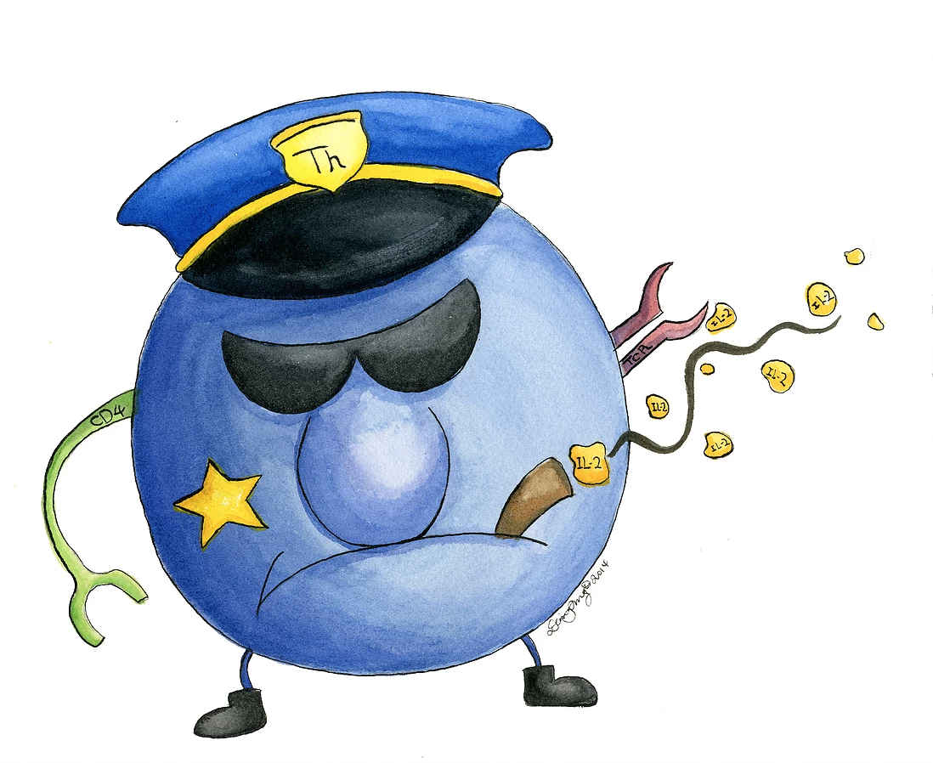
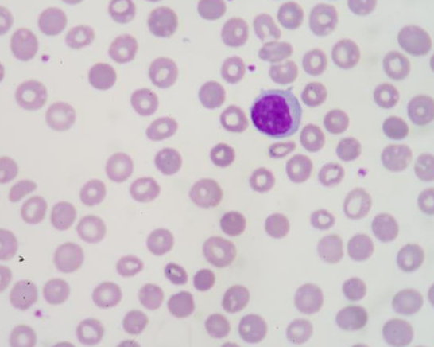
T cells detect infected cells
http://www.wisegeek.com/what-is-a-t-cell.htm
Daisy Cheung

Slide 28
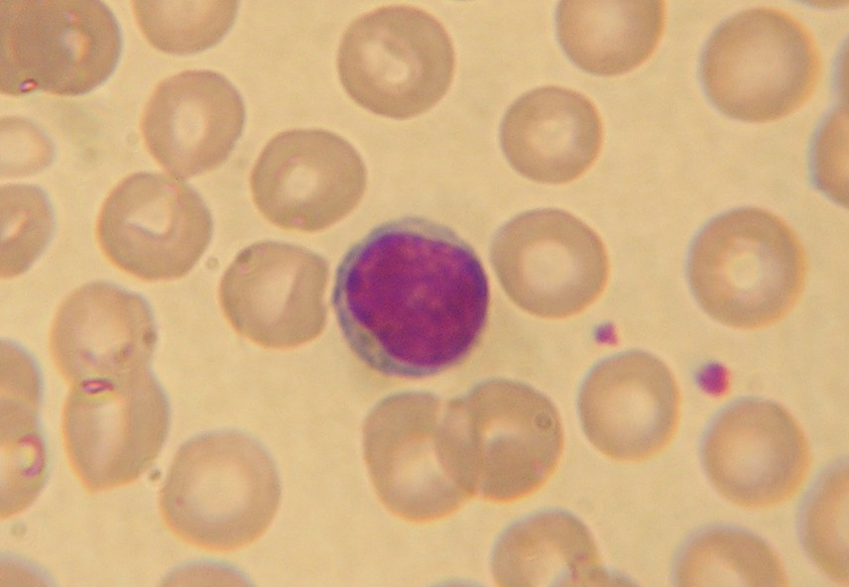
B cells produce antibodies against viruses and bacteria
boundless.com
Daisy Cheung

Slide 29
Draw table of 5 major immune cell types on the board

