Slide 1
phonetics & phonology
HSSP Spring 2016, Week 5
Juliet Stanton

Slide 2
overview
So far in this class, we’ve covered…
  Morphology: how morphemes combine to form words.
  Syntax: how words combine to form sentences.
  Semantics: how combinations of words can lead to certain meanings.
But there are a lot of things we haven’t covered: namely, that utterances are made up of sounds.*
  Phonetics: the study of the sounds of human speech
  Phonology: the study of how sounds are organized and used in natural language.
Today we’ll do a little bit of both.
*or gestures. but I know regrettably little about signed languages.

Slide 3
outline
Sound != Spelling.
Phonemic inventories
  English
  Sounds in other languages
  How do we know which sounds a language has?
Perception
  Categorical perception
  Sine wave speech
Phonotactics (sound sequencing)
  English
  Some differences in other languages

Slide 4
some questions
How many consonant letters are there in English?
  20 or 21, depending on whether or not you count <y>.
  b, c, d, f, g, h, j, k, l, m, n, p, q, r, s, t, v, w, x, (y), z

Slide 5
some questions
How many consonant sounds are there in English?
  At least 25.

Slide 6
Sound | Word | Sound | Word
/b/ | bark | /ʒ/ | garage
/p/ | park | /ʃ/ | shine
/d/ | dark | /m/ | mine, lamb
/t/ | tarp | /n/ | nine
/dʒ/ | jury | /ŋ/ | ring
/tʃ/ | chirp | /l/ | line
/g/ | glow | /f/ | rough fur
/k/ | car, kick | /v/ | vine
/θ/ | thin | /ɹ/ | rind
/ð/ | then | /w/ | wind
/z/ | zone | /ʍ/ | which
/s/ | scone | /j/ | you
/ʔ/ | uh-oh

Slide 7
some questions
How many vowel letters are there in English?
  5 or 6, depending on how you count <y>.
  a, e, i, o, u, (y)

Slide 8
some questions
How many vowel sounds are there in (American) English?
  Somewhere around 15.

Slide 9
Sound | Word | Sound | Word
/i/ | beat | /ɔ/ | caught
/ɪ/ | bit | /a/ | father
/ɛ/ | bet | /e͜ɪ/ | play
/æ/ | bat | /aɪ/ | my
/ə/ | banana | /ɔɪ/ | boy
/ʌ/ | but | /oʊ/ | boat, tow
/u/ | boot | /aʊ/ | house
/ʊ/ | book

Slide 10
some questions
How many sounds (not letters) are there in these words?
  aloof
  mix
  timid
  coup
  lugged
Answers:
  aloof: 4 /əluf/
  mix: 4 /mɪks/
  timid: 5 /tɪmɪd/
  coup: 2 /ku/
  lugged: 4 /lʌgd/

Slide 11
some questions
How many sounds (not letters) are there in the following words:
  bird
  windows
  mitten
Sketchy answers:
  bird: 3 /bɹd/? 3 /bɝd/? 4 /bɛɹd/?
  windows: 6 /wɪndo͜ʊz/
  mitten: 5 /mɪtən/, 4 /mɪʔn/

Slide 12
some questions
How many sounds can <ough> (as in hiccough) correspond to?
Sound | Word | Sound | Word
/o͜ʊ/ | though | /u/ | through
/ʌf/ | tough | /ɔ/ | nought
/af/ | cough | /ax/ | lough (loch?)
/ʌp/ | hiccough (hiccup?) | /ə/ | borough
/aʊ/ | plough (plow?) | /ak/ | hough

Slide 13
some questions
How many ways are there to spell /i/ (as in <me>)?*
Spelling | Word | Spelling | Word | Spelling | Word
e | be | i | ski | a | bologna
ae | algae | ay | quay | ea | beach
ee | bee | ei | deceit | eo | people
ey | key | eye | volleyed | ie | field
oe | amoeba | oi | chamois | ue | dengue
ui | beguine | uy | guyot | y | city
*(according to Wikipedia, anyway)

Slide 14
some questions
How many ways are there to spell /eɪ/ (as in play)?
  There are at least 34.
  Examples: ez in chez, ete in crocheted, ae in reggae, au in gauge...
  We won’t go through the whole list.
The larger point here: that in English (and many other languages), the spelling-to-orthography conversion is not one-to-one. So when we study the sounds of a language, we are not studying its spelling.

Slide 15
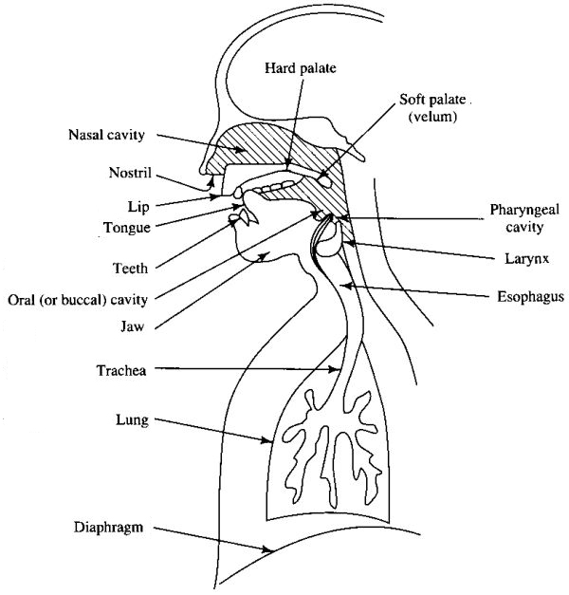
articulatory phonetics
How and where are the sounds of English made?
All English sounds start with air in the lungs.
The diaphragm raises, pushing air through the vocal tract.
Different sounds are formed by making different kind of constrictions in the vocal tract.

Slide 16
articulatory phonetics
One way we can identify consonants (we will be ignoring vowels… sorry ☹): where the constriction is made.
  Can you identify some consonants that are produced with your lips (labial consonants)?
  Can you identify some consonants that are produced with your teeth and your tongue (interdental consonants)?
  Can you identify some consonants that are produced with the front part of your tongue (coronal consonants)?
  Can you identify some consonants that are produced with the back part of your tongue (dorsal consonants)?
  And how about some consonants that are produced with the middle of your tongue (so: not coronal, but not dorsal, either)?

Slide 17
articulatory phonetics
Another way we can identify consonants: how the constriction is made. There are a number of parameters here; we’ll focus on the roles of voicing and airflow.

Slide 18
articulatory phonetics
Voicing
  Voicing refers to the activity of the vocal folds during production. In English, consonants can be either voiceless (no vibration) or voiced (vibration).
  Some examples of voiced consonants: v, z.
  Some examples of voiceless consonants: f, s.
  Can you think of other examples, in either category?

Slide 19
articulatory phonetics
Airflow
  Sounds differ in the amount of air expelled from the mouth (or the nose) during production. For example: what is the difference between /t/ (as in tee) and /s/ (as in see)?
    Stops completely stop the flow of air; there is a pressure buildup, and then a release. Some examples: /p/, /d/, /k/. Others?
    Fricatives create a narrow path for the air; there is no complete stop of airflow. Some examples: /v/, /f/, /ʒ/. Others?
    Nasals are weird cousins of stops that also allow air to escape through the nasal cavity. Some examples: /m/, /n/.
    Affricates: more or less, a stop immediately followed by a fricative. Example: /tʃ/, /dʒ/.
    Approximants: consonants with a lesser degree of constriction than those listed above. Examples: /l/, /w/, /j/.

Slide 20
articulatory phonetics
We can categorize consonant sounds according to the articulatory properties listed above.
For example, /z/ is a…
  voiced (the vocal cords vibrate during production)
  alveolar (the front of the tongue makes contact with the alveolar ridge)
  fricative (the airstream is constricted to a narrow stream of air)
And /k/ is a…
  voiceless (the vocal cords do not vibrate during production)
  velar (the back of the tongue makes contact with the velum)
  stop (airflow stops, pressure builds up, constriction is released)

Slide 21
articulatory phonetics
Being able to categorize sounds in this way makes arranging them into a table very easy!
 | Bilabial |  | Labiodental |  | Interdental |  | Alveolar |  | Palato-Alveolar |  | Palatal |  | Velar |  | Glottal
Stop
Fricative
Affricate
Nasal
Lateral Approx.
Retroflex Approx.
Glide

Slide 22
articulatory phonetics
For example, /z/ is voiced,
 | Bilabial |  | Labiodental |  | Interdental |  | Alveolar |  | Palato-Alveolar |  | Palatal |  | Velar |  | Glottal
Stop
Fricative
Affricate
Nasal
Lateral Approx.
Retroflex Approx.
Glide

Slide 23
articulatory phonetics
For example, /z/ is voiced, alveolar,
 | Bilabial |  | Labiodental |  | Interdental |  | Alveolar |  | Palato-Alveolar |  | Palatal |  | Velar |  | Glottal
Stop
Fricative
Affricate
Nasal
Lateral Approx.
Retroflex Approx.
Glide

Slide 24
articulatory phonetics
For example, /z/ is voiced, alveolar, and a fricative…
 | Bilabial |  | Labiodental |  | Interdental |  | Alveolar |  | Palato-Alveolar |  | Palatal |  | Velar |  | Glottal
Stop
Fricative |  |  |  |  |  |  |  | z
Affricate
Nasal
Lateral Approx.
Retroflex Approx.
Glide

Slide 25
articulatory phonetics
…and /k/ is voiceless,
 | Bilabial |  | Labiodental |  | Interdental |  | Alveolar |  | Palato-Alveolar |  | Palatal |  | Velar |  | Glottal
Stop
Fricative
Affricate
Nasal
Lateral Approx.
Retroflex Approx.
Glide

Slide 26
articulatory phonetics
…and /k/ is voiceless, velar,
 | Bilabial |  | Labiodental |  | Interdental |  | Alveolar |  | Palato-Alveolar |  | Palatal |  | Velar |  | Glottal
Stop
Fricative
Affricate
Nasal
Lateral Approx.
Retroflex Approx.
Glide

Slide 27
articulatory phonetics
…and /k/ is voiceless, velar, and a stop.
 | Bilabial |  | Labiodental |  | Interdental |  | Alveolar |  | Palato-Alveolar |  | Palatal |  | Velar |  | Glottal
Stop |  |  |  |  |  |  |  |  |  |  |  |  | k
Fricative
Affricate
Nasal
Lateral Approx.
Retroflex Approx.
Glide

Slide 28
inventories
We can follow this practice for the entire consonantal inventory of (American English). It looks (more or less) like this:
 | Bilabial |  | Labiodental |  | Interdental |  | Alveolar |  | Palato-Alveolar |  | Palatal |  | Velar |  | Glottal
Stop | p | b |  |  |  |  | t | d |  |  |  |  | k | g | ʔ
Fricative |  |  | f | v | θ | ð | s | z | ʃ | ʒ |  |  |  |  | h
Affricate |  |  |  |  |  |  |  |  | tʃ | dʒ
Nasal |  | m |  |  |  |  |  | n |  |  |  |  |  | ŋ
Lateral Approx. |  |  |  |  |  |  |  | l
Retroflex Approx. |  |  |  |  |  |  |  | ɹ
Glide |  | w |  |  |  |  |  |  |  |  |  | j

Slide 29
inventories
A language’s consonantal inventory: the set of consonants that can combine (with vowels) to form words in that language.
 | Bilabial |  | Labiodental |  | Interdental |  | Alveolar |  | Palato-Alveolar |  | Palatal |  | Velar |  | Glottal
Stop | p | b |  |  |  |  | t | d |  |  |  |  | k | g | ʔ
Fricative |  |  | f | v | θ | ð | s | z | ʃ | ʒ |  |  |  |  | h
Affricate |  |  |  |  |  |  |  |  | tʃ | dʒ
Nasal |  | m |  |  |  |  |  | n |  |  |  |  |  | ŋ
Lateral Approx. |  |  |  |  |  |  |  | l
Retroflex Approx. |  |  |  |  |  |  |  | ɹ
Glide |  | w |  |  |  |  |  |  |  |  |  | j

Slide 30
inventories
Other language have different sets of consonants.
For example, English looks very different than Hawaiian (below)…
 | Bilabial |  | Labiodental |  | Interdental |  | Alveolar |  | Palato-Alveolar |  | Palatal |  | Velar |  | Glottal
Stop | p |  |  |  |  |  |  |  |  |  |  |  | k |  | ʔ
Fricative |  |  |  |  |  |  |  |  |  |  |  |  |  |  | h
Affricate
Nasal |  | m |  |  |  |  |  | n
Lateral Approx. |  |  |  |  |  |  |  | l
Retroflex Approx.
Glide |  | w

Slide 31
inventories
...it also looks different from French...
 | Bilabial |  | Labiodental |  | Interdental |  | Alveolar |  | Palato-Alveolar |  | Palatal |  | Velar |  | Uvular
Stop | p | b |  |  |  |  | t | d |  |  |  |  | k | g
Fricative |  |  | f | v |  |  | s | z | ʃ | ʒ |  |  | (x) |  |  | ʁ
Affricate
Nasal |  | m |  |  |  |  |  | n |  | ɲ |  |  | (ŋ)
Lateral Approx. |  |  |  |  |  |  |  | l
Retroflex Approx.
Glide |  | w |  |  |  |  |  |  | j, ɥ
Note: one factor that contributes to foreign accents is a difference in category structure among languages. So French natives have trouble with /θ/, /ð/.

Slide 32
inventories
…and very different from Ewe.
 | Bilabial |  | Labiodental |  | Interdental |  | Alveolar |  | Retroflex |  | Palatal |  | Velar |  | Labio-Velar |  | Glottal
Stop | p | (b) |  |  |  |  | t | d |  | (ɖ) |  | (ɟ) | k | (g) | kp | gb
Fricative | ɸ | β | f | v |  |  | s | z |  |  |  |  | x | ɣ |  |  | ɦ
Affricate |  |  |  |  |  |  | ts | dz
Nasal |  | (m) |  |  |  |  |  |  |  | (ɳ) |  | (ɲ) |  | (ŋ)
Approx. |  |  |  |  |  |  |  | l
Labiovelars (in another language): http://www.phonetics.ucla.edu/appendix/languages/idoma/idoma.html
Bilabial vs. labiodental fricatives: http://www.phonetics.ucla.edu/course/chapter11/ewe/ewe.html

Slide 33
articulatory phonetics
Question: how do researchers know such detailed information about how speech sound are produced?
  One approach: stick your fingers in your mouth.
  Another (better) approach: study these things instrumentally.

Slide 34
articulatory phonetics
One way to study articulator properties of language is to use various kind of imaging: for example, with MRI, you can observe the tongue in fascinating detail.
  https://www.youtube.com/watch?v=Nvvn-ZVdeqQ
There’s also electropalatography, where a device containing many electrodes measures where the tongue makes contact with the roof of the mouth. But this isn’t so interesting to watch.

Slide 35
articulatory phonetics
And if these kinds of studies are unavailable (e.g. if you’re trying to figure out what the sounds of a language are that’s spoken in a really remote area), there’s always palatography…
  https://www.youtube.com/watch?v=8Sh5hFnIuS4

Slide 36
perception
Let’s go back to Ewe for a bit.
I, and probably many of you, have difficulty telling the bilabial and labiodental fricatives apart: they sound like the same sounds.
This is not a personal deficit: it’s a fact about how our auditory systems work.

Slide 37
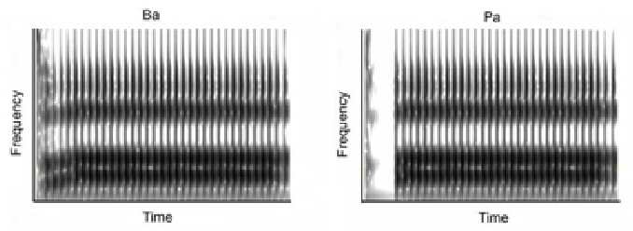
perception
We tend to perceive speech sounds categorically, not continuously.
In other words: when we hear speech sounds, we place them into categories (i.e. that was a X, or that was a Y). We have a hard time telling the difference among particular instances of X and Y.
We’ll illustrate with two categories, /b/ and /p/. The only difference between these is that /p/ is voiceless, but /b/ is voiced.

Slide 38
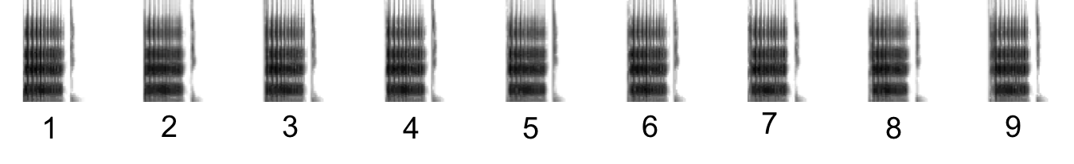
perception
We can create a voicing continuum: the sounds to the left (lower #s) are more /b/-like, while the sounds to the left (higher #s) are more /p/-like.
Audio here: http://ucalgary.ca/pip369/mod6/speech/principles

Slide 39
perception
Many of you probably started to hear a /p/ starting around 6.
For labial stops, that’s approximately where English speakers place the boundary: lower numbers are /b/s, while higher numbers are /p/s.
But notice something: while you were doing this task, you heard categories, not sounds.
  Each sound in the continuum is slightly different from each other.
  Yet we hear them all as /p/, /b/, etc.

Slide 40
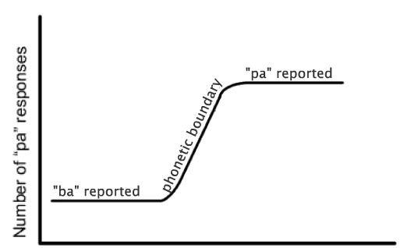
perception
When we graph the results of a task like the one we just did, they typically look like this:
Point of note here: humans are very good at discriminating between instances of different categories in their native languages.
Amount of voicelessness

Slide 41
perception
With a voicing continuum, we can also perform discrimination tasks: is sound A different than sound B?
  Audio here: http://ucalgary.ca/pip369/mod6/speech/principles
Listeners tend to report all sounds that are on the same side of the phonetic boundary as “same”, while sounds on either side of the boundary are reported as “different”.
Point of note here: humans are very bad at discriminating within categories in their native languages.

Slide 42
perception
Why do our perceptual systems work this way?
  Allows us to “ignore” irrelevant variations in the speech signal. It doesn’t matter if a /p/ is extremely or just mostly voiceless, it’s still a /p/.
  The difference between a /b/ and a /p/, however, is very important! (e.g. back up vs. pack up)
Sort of interestingly however, categorical perception is not something only humans display…

Slide 43
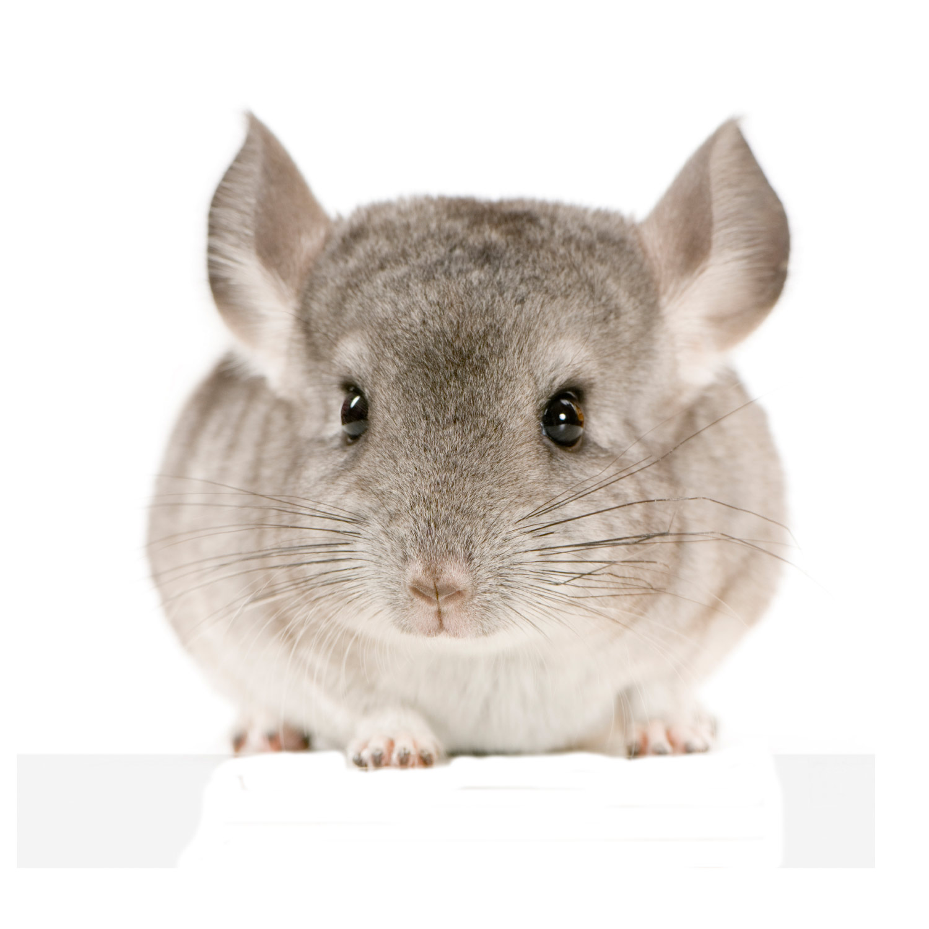
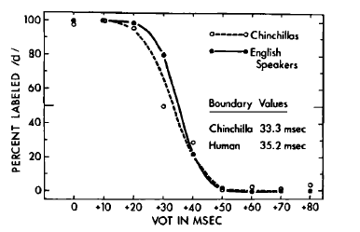
perception
Chinchillas (below, right) also have categorical perception of VOT, and somewhat surprisingly, the phonetic boundary resembles that of an English speaker…

Slide 44
perception
This suggests the following: there are general, cross-species auditory sensitivities that lead to effects like categorical perception.
The categories that we find in speech capitalize on these sensitivities.

Slide 45
perception
We’ve learned from categorical perception that what we hear is not what we perceive.
  What do we hear? What you saw in the spectrograms: a bunch of formant frequencies and noise.
  What do we perceive? Categories, more or less.
But it’s not even this simple. There’s a good amount of evidence that “speech perception” involves a complex interplay of a number of factors: what we hear, what we see, what we know about the speaker, what we know about ourselves…
We’ll discuss some of this other factors next.

Slide 46
perception
What does the listener recover from the acoustic signal? And how is that information present in the input signal?
There’s no universally accepted answer, but there are a number of different theories.
  Gestural theories: the objects of speech perception are articulatory/gestural. Speakers control, and listeners perceive, vocal tract gestures.
  Auditory theories: domain of articulation is acoustic/auditory. Speakers control, and listeners perceive, the acoustic signal.

Slide 47
perception
Some evidence that neither (and both) of these theories are correct comes from the McGurk effect:
https://www.youtube.com/watch?v=G-lN8vWm3m0
The effect is automatic and mandatory: visual speech information, when present, cannot be ignored.
So when we perceive speech sounds, we are synthesizing at least two types of information:
  Auditory information: what we hear.
  Gestural information: what we see.

Slide 48
perception
There are a lot of questions about what it means to perceive a gesture.
There are also questions about what it means to perceive a sound.
  Question: which acoustic elements are essential for the perception of speech?
  Rubin et al.’s answer: none of them.
  Sine wave speech discards all of the acoustic elements of the speech signal, keeping only the changing pattern of vocal resonances. Yet to some speakers, the percept of speech is still there…
  http://www.haskins.yale.edu/featured/sws/swssentences/sentences.html#

Slide 49
perception
When we perceive speech sounds, we also take into account a lot of other information:
  Coarticulatory context:
    A /k/ before an /i/ sounds different than a /k/ before an /a/.
    Yet we perceive them both as /k/s.
  Knowledge of the speaker’s native language (you can adapt to foreign accents pretty well).
  Socio-indexical knowledge (e.g. dialect, age, ethnicity, occupation).
  Lexical knowledge: the Ganong Effect.
    Ganong (1980): speakers, when presented with a sound that is ambiguous between “duke” and “tuke”, for example, speakers will respond that they heard “duke.”
    We are biased to perceive real words.

Slide 50
phonotactics
Reminder: English’s consonantal inventory is below.
 | Bilabial |  | Labiodental |  | Interdental |  | Alveolar |  | Palato-Alveolar |  | Palatal |  | Velar |  | Glottal
Stop | p | b |  |  |  |  | t | d |  |  |  |  | k | g | ʔ
Fricative |  |  | f | v | θ | ð | s | z | ʃ | ʒ |  |  |  |  | h
Affricate |  |  |  |  |  |  |  |  | tʃ | dʒ
Nasal |  | m |  |  |  |  |  | n |  |  |  |  |  | ŋ
Lateral Approx. |  |  |  |  |  |  |  | l
Retroflex Approx. |  |  |  |  |  |  |  | ɹ
Glide |  | w |  |  |  |  |  |  |  |  |  | j

Slide 51
phonotactics
How to form words: pick some consonants out of the set below, add vowels. For example: if we pick /m/, /v/, /r/ we get mover, or remove.
 | Bilabial |  | Labiodental |  | Interdental |  | Alveolar |  | Palato-Alveolar |  | Palatal |  | Velar |  | Glottal
Stop | p | b |  |  |  |  | t | d |  |  |  |  | k | g | ʔ
Fricative |  |  | f | v | θ | ð | s | z | ʃ | ʒ |  |  |  |  | h
Affricate |  |  |  |  |  |  |  |  | tʃ | dʒ
Nasal |  | m |  |  |  |  |  | n |  |  |  |  |  | ŋ
Lateral Approx. |  |  |  |  |  |  |  | l
Retroflex Approx. |  |  |  |  |  |  |  | ɹ
Glide |  | w |  |  |  |  |  |  |  |  |  | j

Slide 52
phonotactics
But not all orderings of consonants within the word results in a possible English word. mvro? mver? rvome? vroom?
 | Bilabial |  | Labiodental |  | Interdental |  | Alveolar |  | Palato-Alveolar |  | Palatal |  | Velar |  | Glottal
Stop | p | b |  |  |  |  | t | d |  |  |  |  | k | g | ʔ
Fricative |  |  | f | v | θ | ð | s | z | ʃ | ʒ |  |  |  |  | h
Affricate |  |  |  |  |  |  |  |  | tʃ | dʒ
Nasal |  | m |  |  |  |  |  | n |  |  |  |  |  | ŋ
Lateral Approx. |  |  |  |  |  |  |  | l
Retroflex Approx. |  |  |  |  |  |  |  | ɹ
Glide |  | w |  |  |  |  |  |  |  |  |  | j

Slide 53
phonotactics
Although English has a lot of consonantal phonemes, therir combinatorial properties (which ones can be adjacent to one another) are limited.
For example, let’s figure out which combinations of consonants (consonant clusters) can occur at the beginnings of English words…

Slide 54
(on blackboard)

Slide 55
(on blackboard)

Slide 56
phonotactics
What we’ve seen: there are laws that govern the composition of initial consonant clusters in English.
Only certain groups of consonants can combine with other groups of consonants (and then, only in certain orders).
What are some generalizations that you noticed?

Slide 57
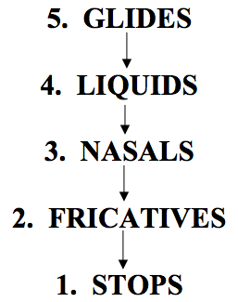
phonotactics
We can rank different groups of sounds along a scale, according to their relative sonority.
What is sonority? Relative vowel-ness, roughly speaking; probably intensity (loudness), technically speaking.

Slide 58
phonotactics
In English initial clusters (generally speaking), the first consonant must have lower sonority than the second consonant.
Not only that: it must be lower by at least 2, according to the scale on the right.

Slide 59
phonotactics

Slide 60
phonotactics

Slide 61
phonotactics
So far, we’ve just focused on initial consonant clusters. Final consonant clusters work differently.
Which consonant clusters can occur at the ends of English words? And which can’t? Think of as many as you can…

Slide 62
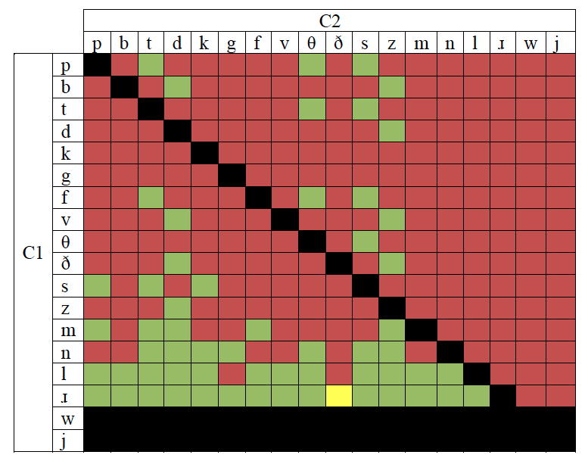
(on blackboard)

Slide 63
(on blackboard)

Slide 64
phonotactics
Again, you might have noticed that there are laws governing the composition of final consonant clusters in English.
What are some generalizations that you noticed?
How do the laws that govern the composition of initial clusters in English differ from those that govern the composition of final consonant clusters?

