Slide 1
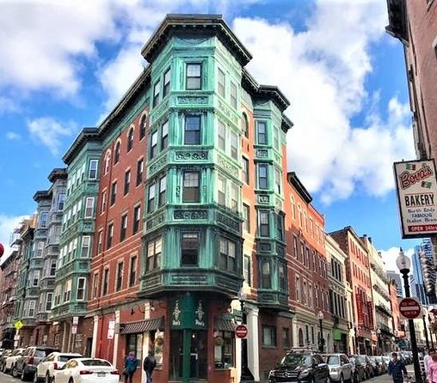
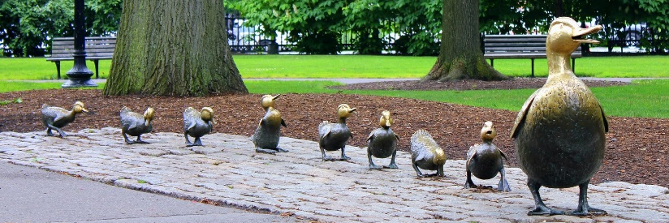
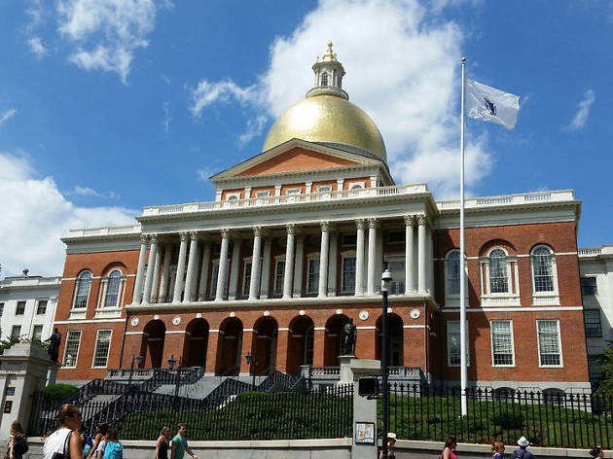
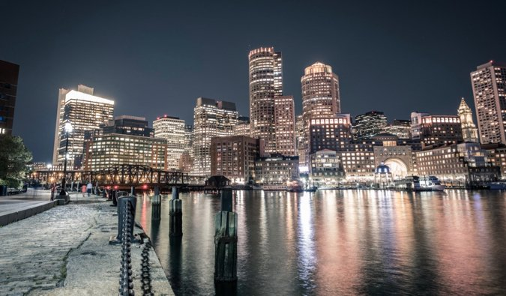
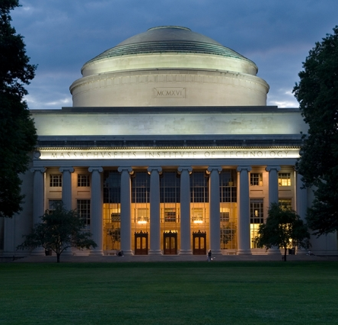
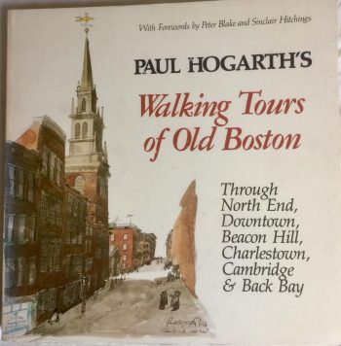
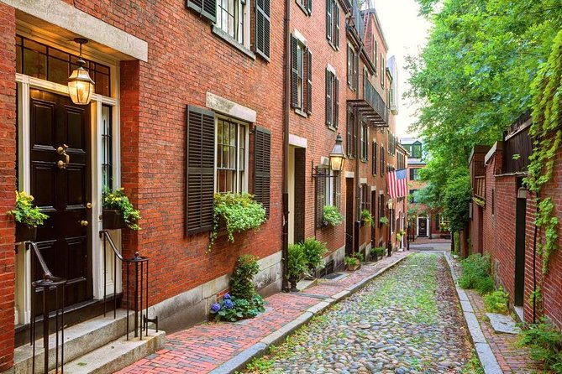
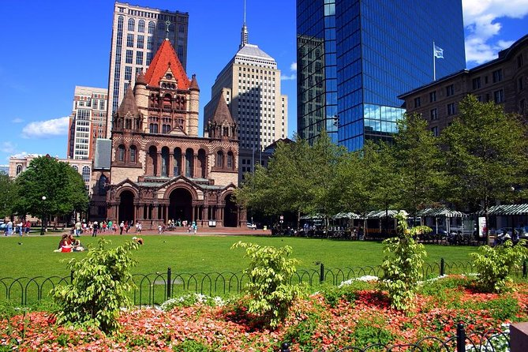
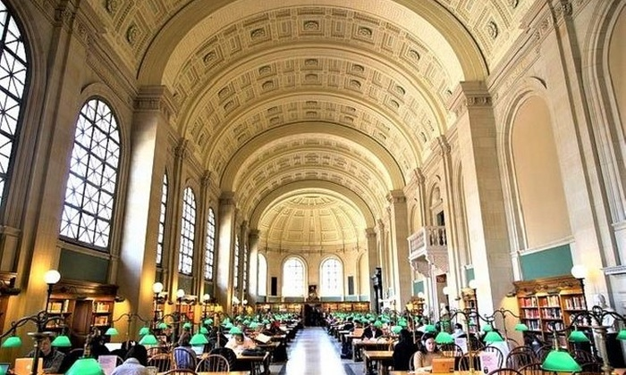
(Virtual) Walking Tours of the
Greater Boston Area
HSSP Summer 2020

Slide 2
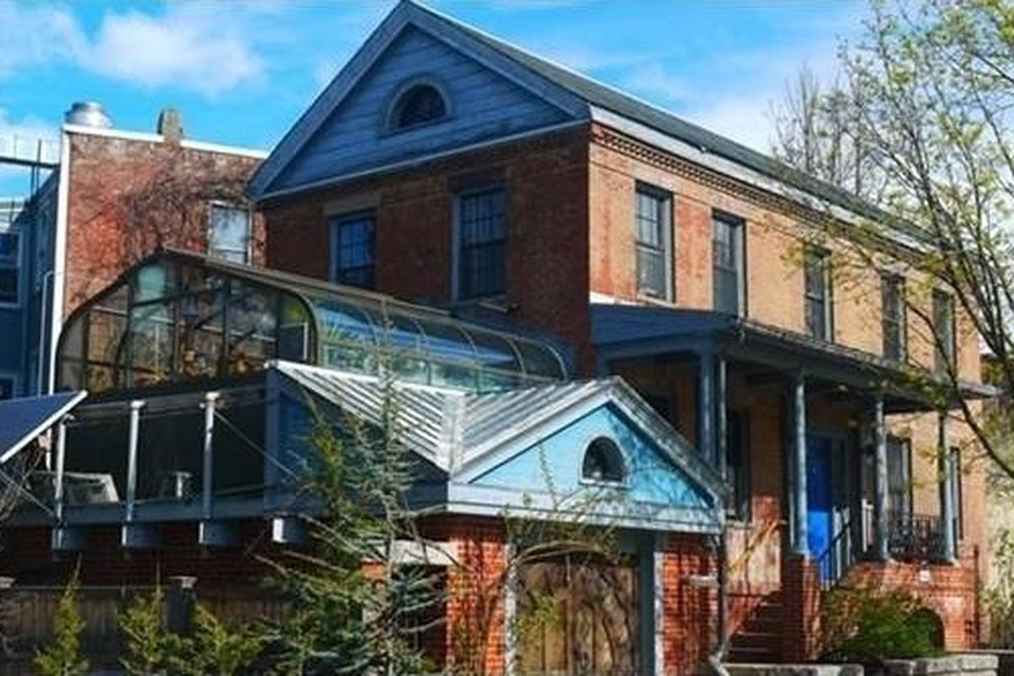
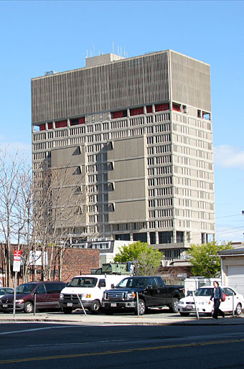
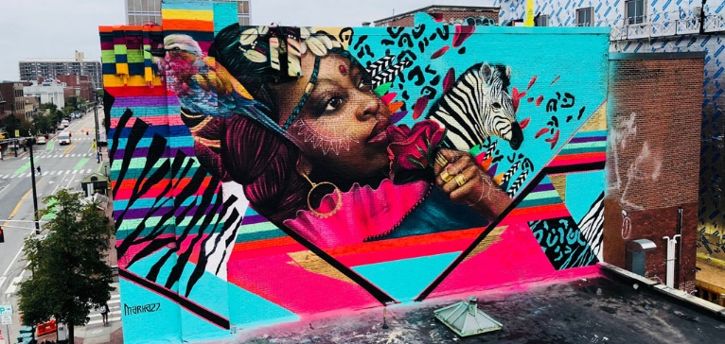
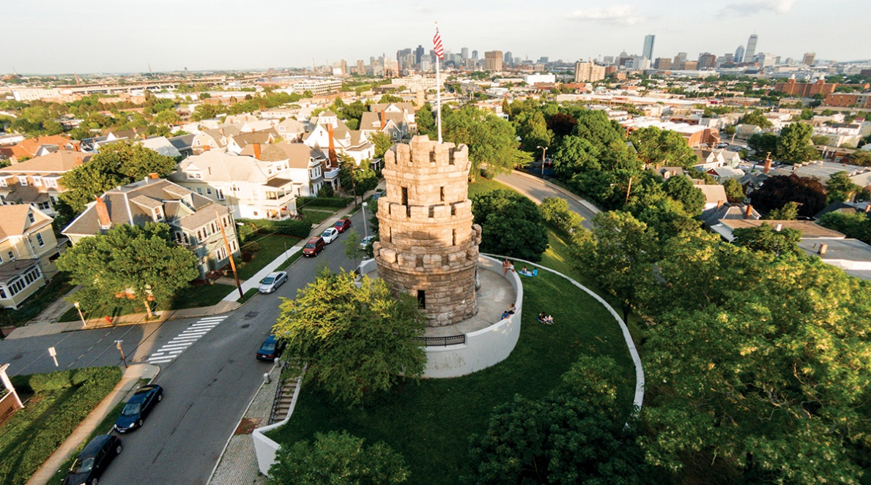
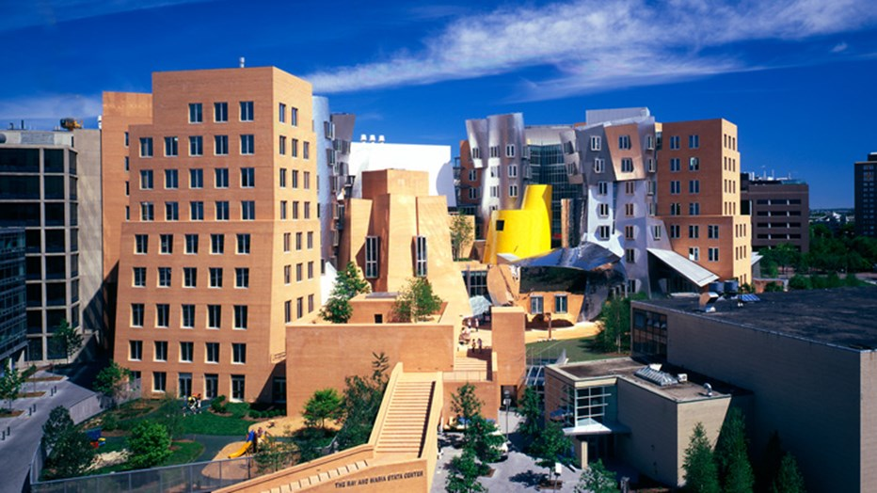
Week 1: See Sam’s Neighborhood
Ivory Sands House (145 Elm Street)
Middlesex County Jail (Prison in the sky)
Prospect Hill Tower
Stata Building (Frank Gehry)
Bathtub Mary’s (and Jesus)
Kendall Square T stop
Church Court Condos (492 Beacon St)
Calf Pasture Pumping Station
Standard triple decker apartment building
Central Square artwork

Slide 3
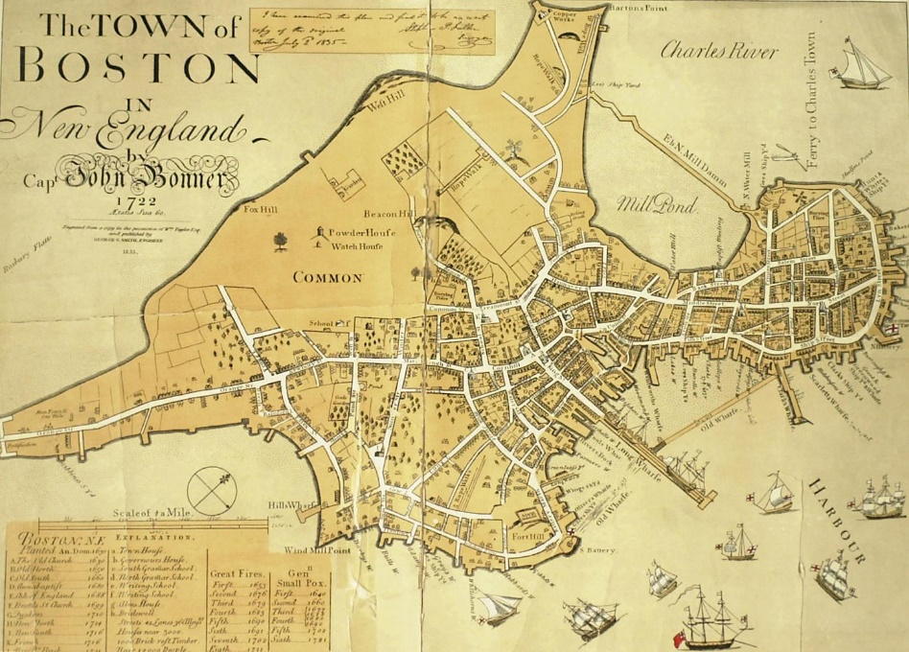
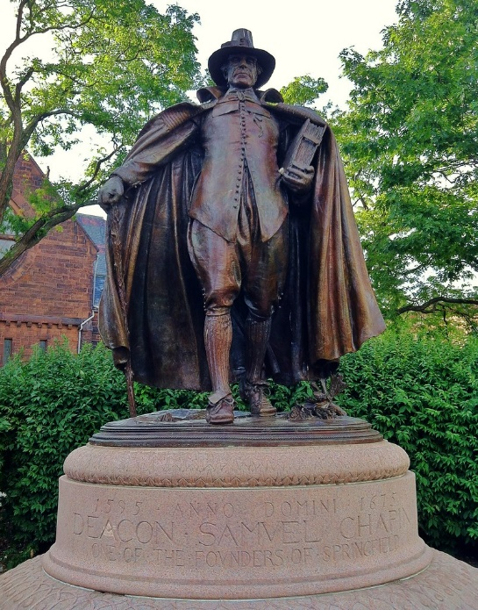
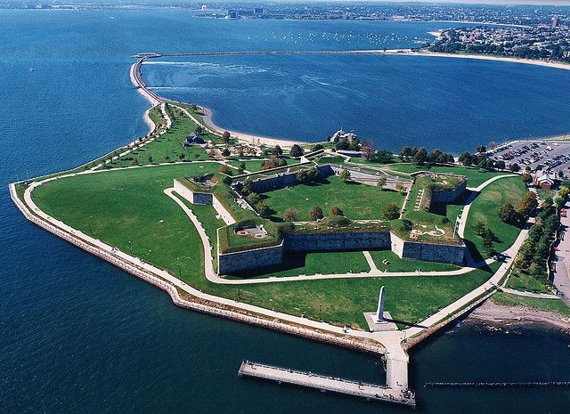
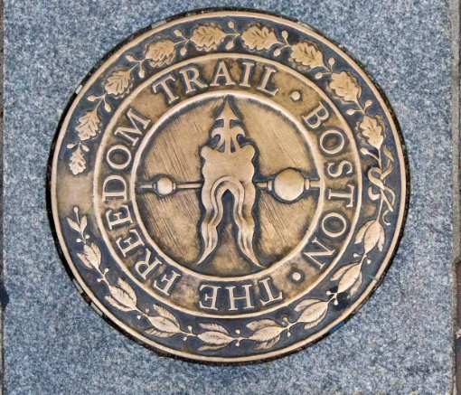
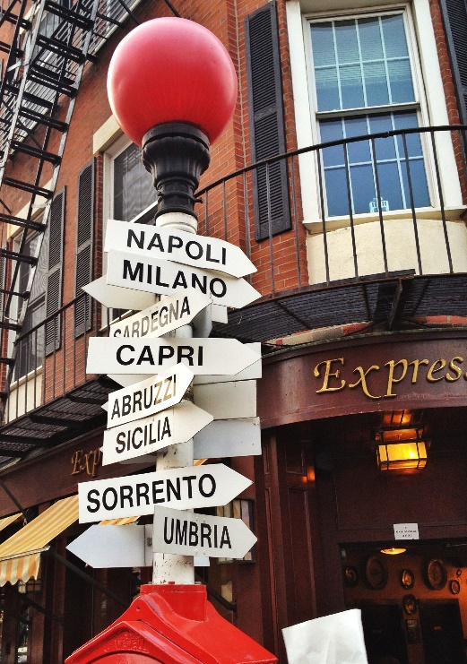
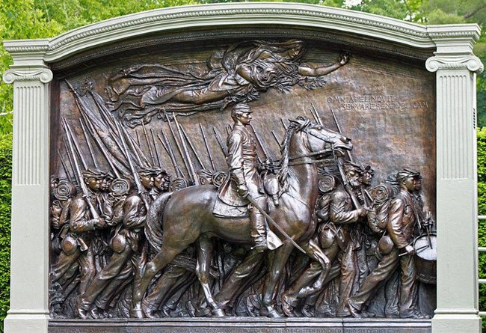
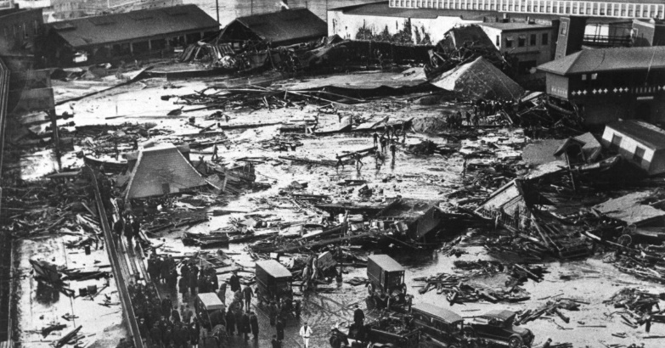
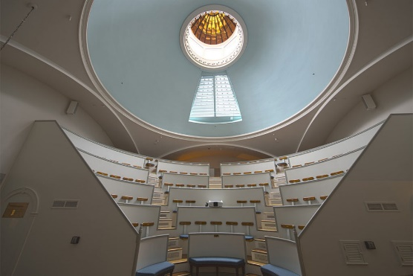
Week 2: Boston through the ages
A (brief) history of Boston
The Puritans & Government
Role in Revolutionary War
North End
Freedom Trail
Role in Civil War
Castle Island
54th Regiment Memorial
Waves of immigration
Major industries over the years
The Great Molasses Flood
History of Boston hospitals
The Ether Dome

Slide 4
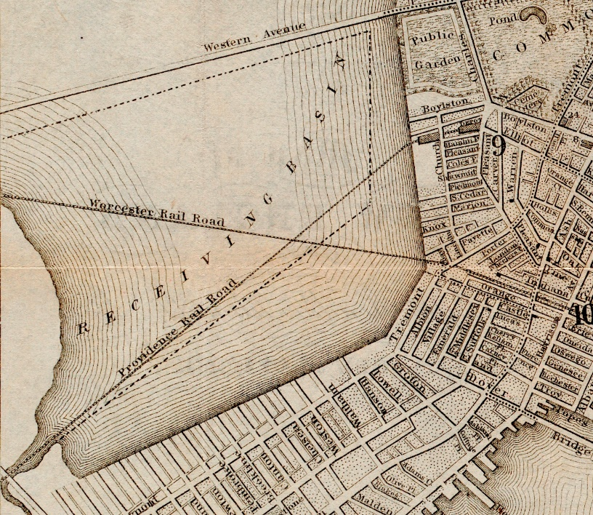
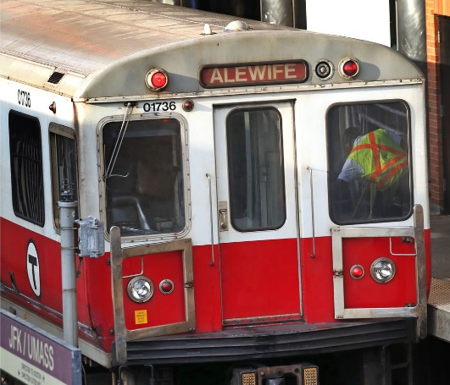
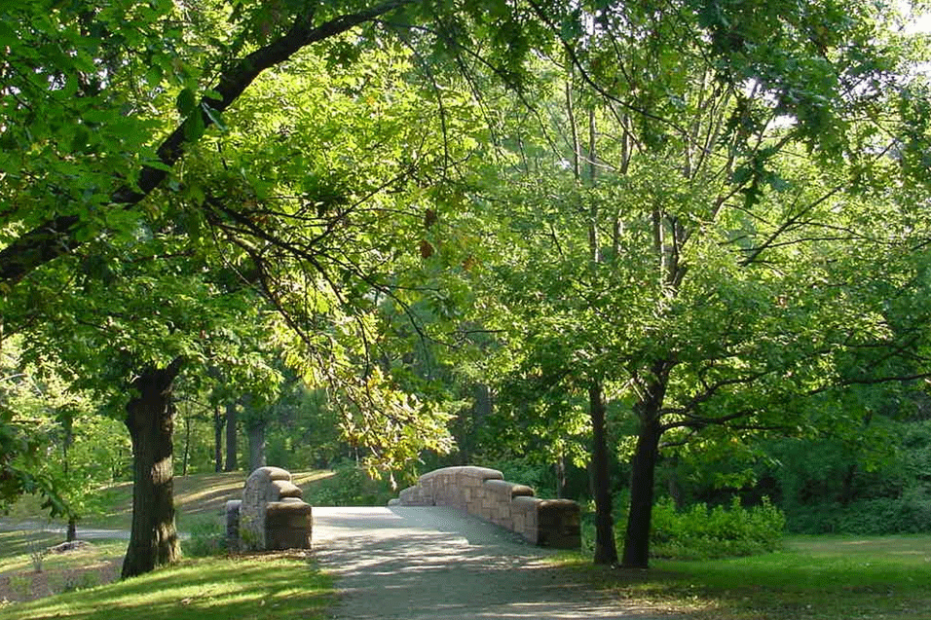
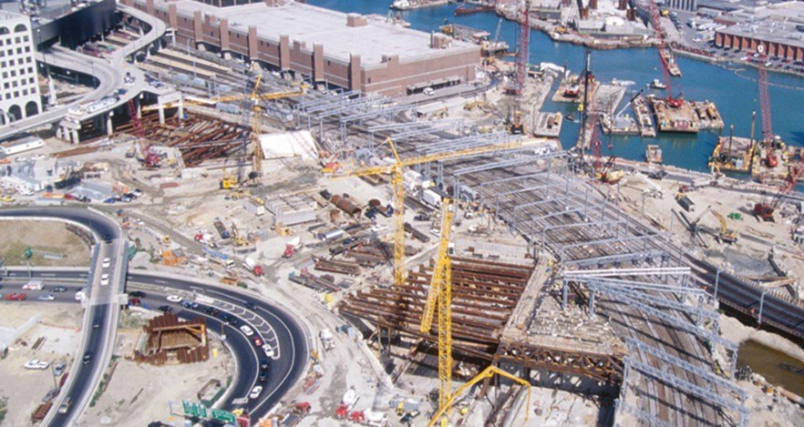
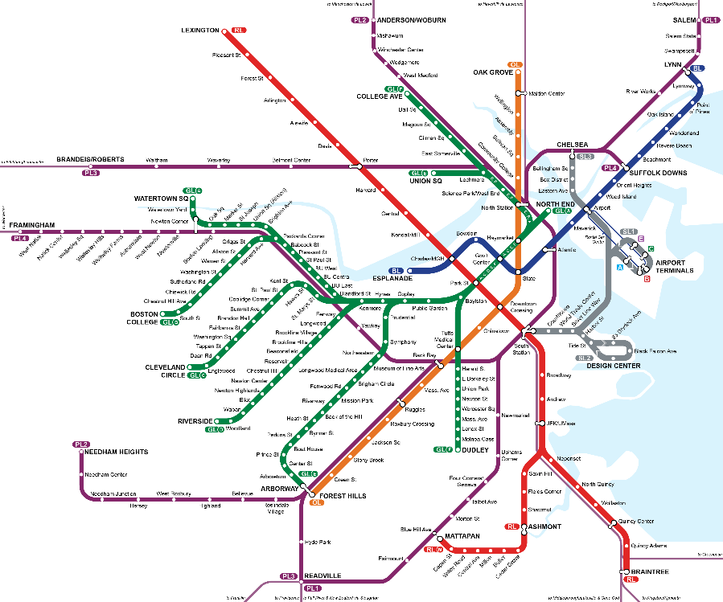
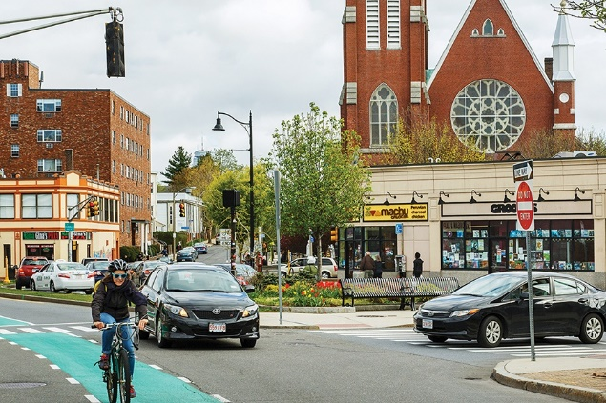
Week 3: Boston City Planning and Transportation
Maps of Boston
Changing waterfront
Filling in the Back Bay
The grid (or lack of one) - City of Squares
The T!
The Big Dig
Slum clearance
Public art
Make Way for Ducklings
Boston Common/The Public Garden
The Emerald Necklace

Slide 5
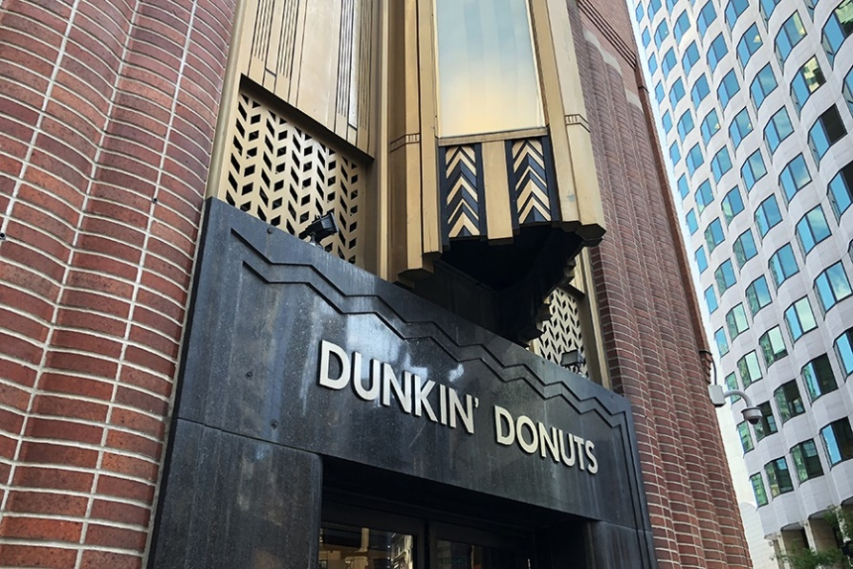
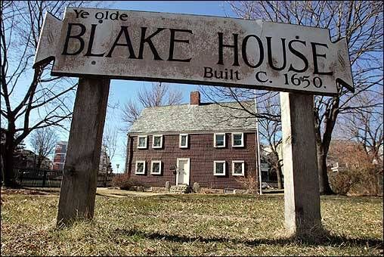
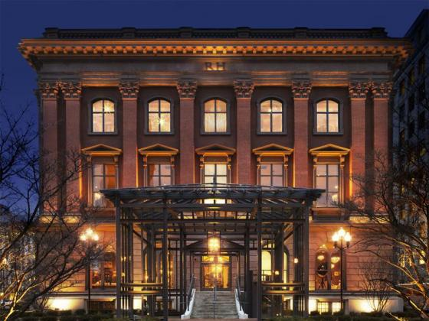
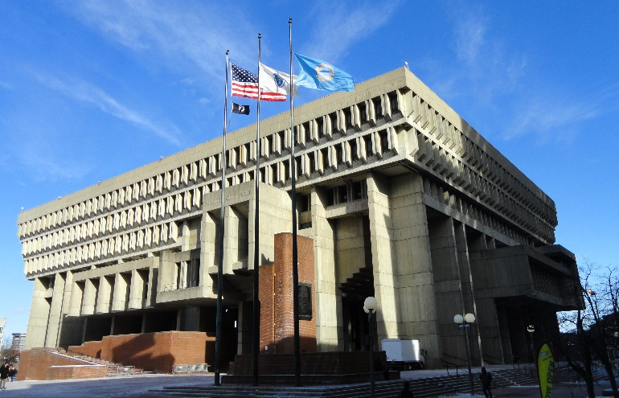
Week 4: Boston architecture
James Blake house (Dorchester)
North End
Paul Revere house
New England brick
Federalist style
Beacon Hill
State House
Greek revival
Museum of Natural History (Restoration Hardware)
Gothic revival
Boston Public Library – John Singer Sargent
Isabella Stewart Gardner museum
Christian Science Center
Art Deco –
Business District
Works Progress
Administration buildings
Brutalism
Boston City Hall
Hancock Building

Slide 6
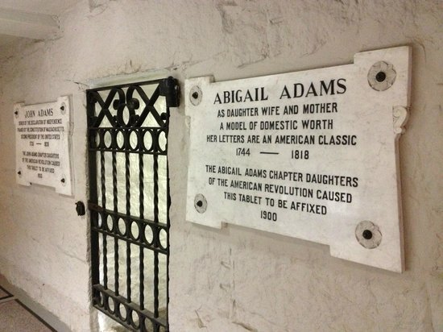
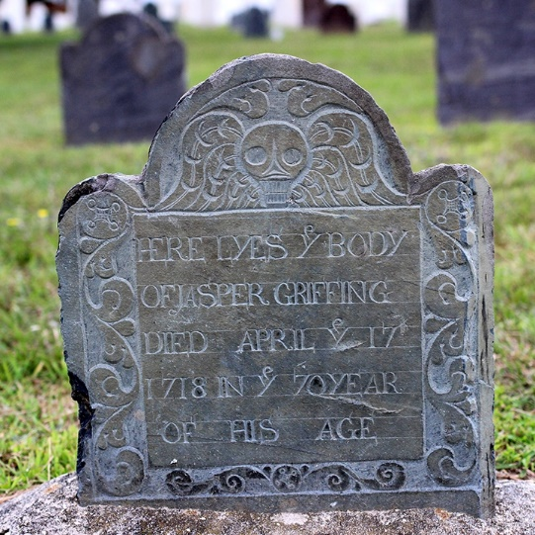
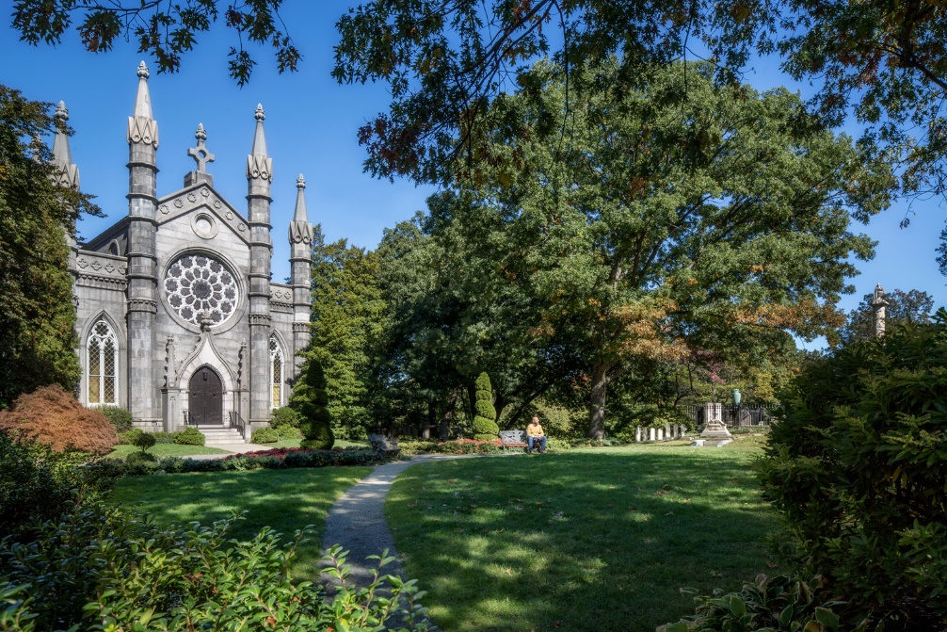
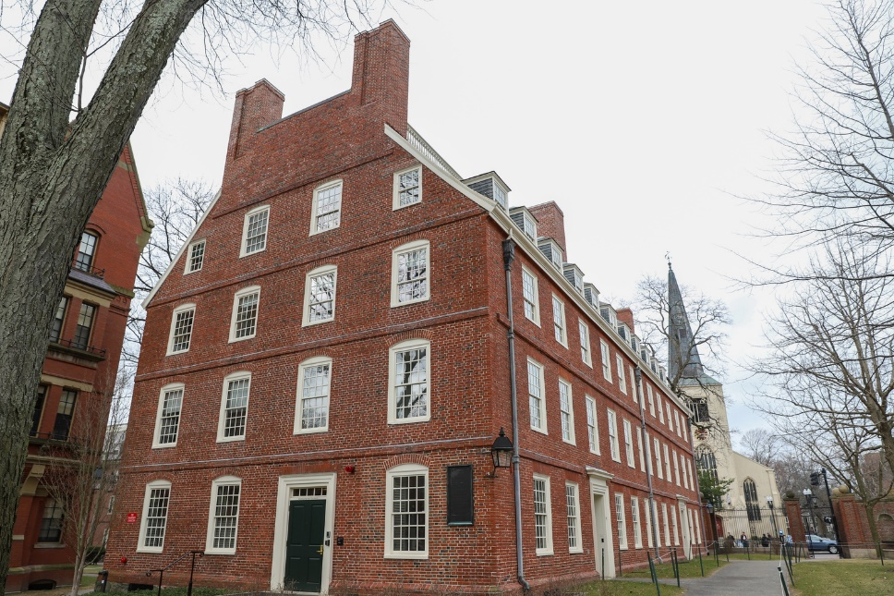
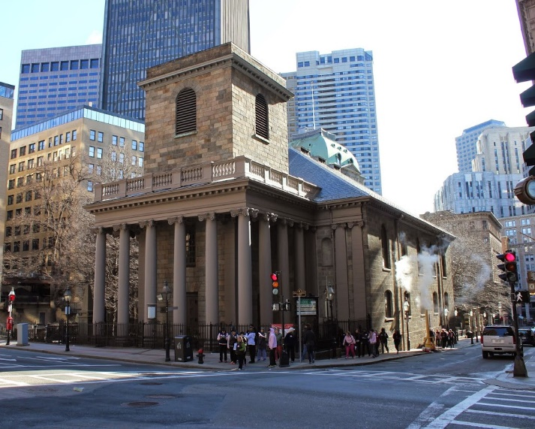
Week 5: Cemeteries, Churches, and Harvard Square
All about Mount Auburn Cemetery
Old North Church
King’s Chapel – attached graveyard, crypt
United First Parish Church – crypt with John Adams, etc.
General background on Puritans/Congregationalists, Anglicans, etc.
Churches/graveyards in Harvard square
Short background on Harvard, interesting buildings
Overview of grave art, changes over time

Slide 7
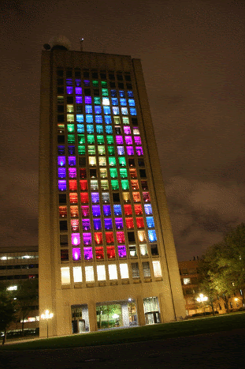
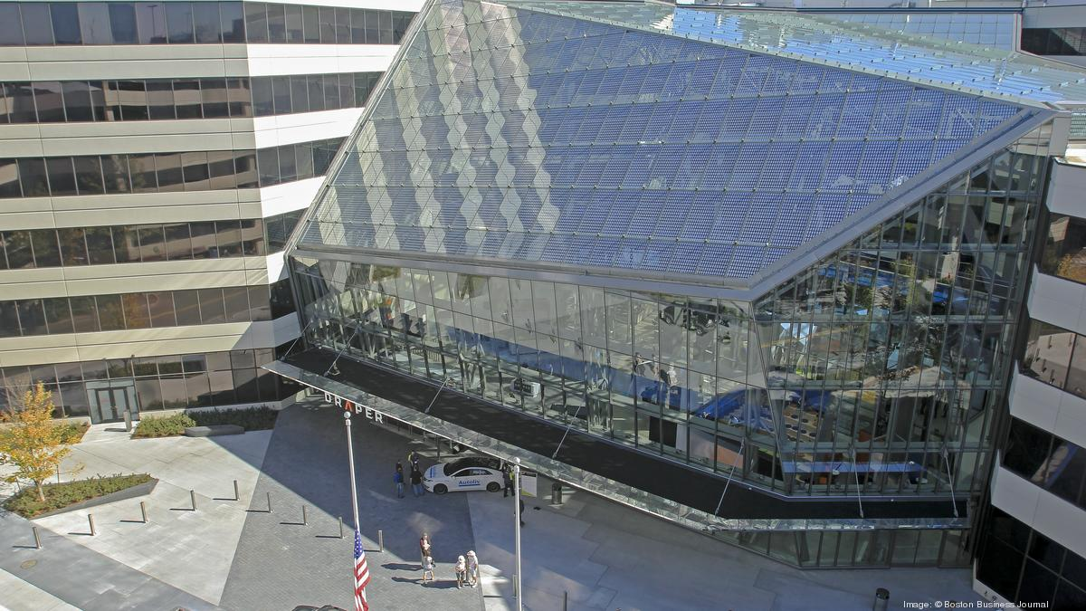
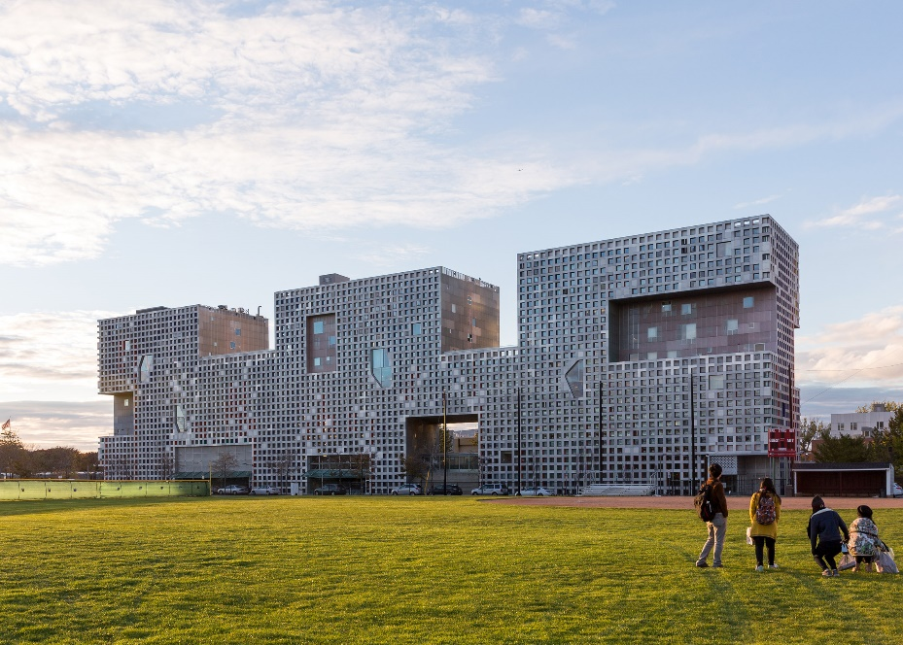
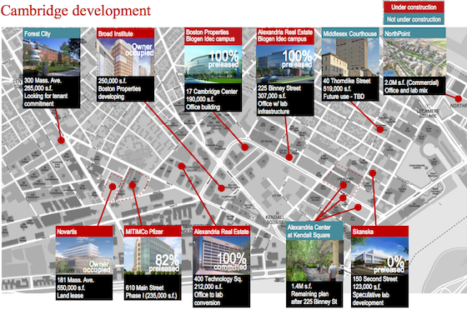
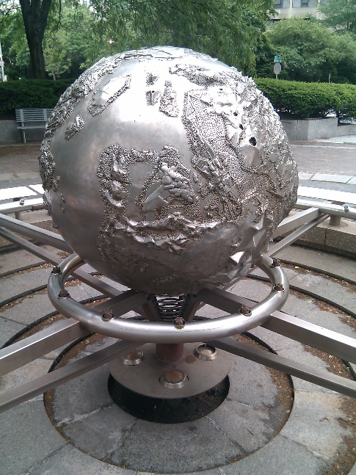
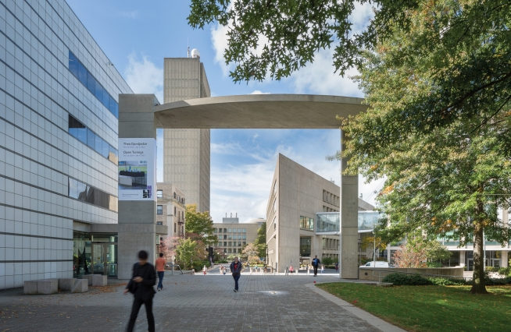
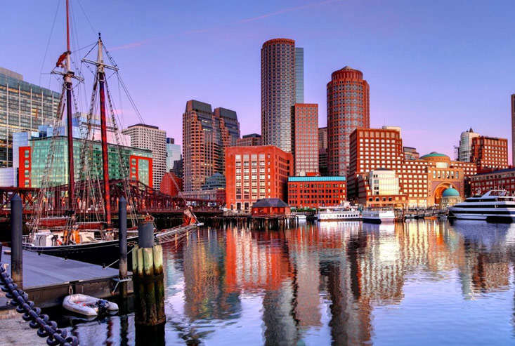
Week 6: Tech boom (Kendall Square, Seaport & MIT)
Maps of Kendall square changing over the years
Maps of different tech/pharma companies
Spotlight a few cool buildings/companies
Talk about a few cool MIT buildings
Media lab – I.M. Pei
Tall Tetris building
MIT chapel
Student center
Tunnels – Forge!
Seaport

