Slide 1
The Financial Crisis
Class 3- The Crash
October 16, 2010

Slide 2
Last week, we talked about…
House prices rose rapidly from 2000 to 2006
Subprime mortgages expanded rapidly as well
Increase in house prices slowed down in 2007
Households with excessive debt began to face problems

Slide 3
Case-Schiller House Price Index

Slide 4
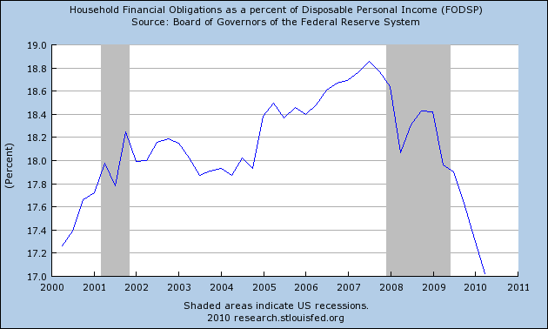

Slide 5
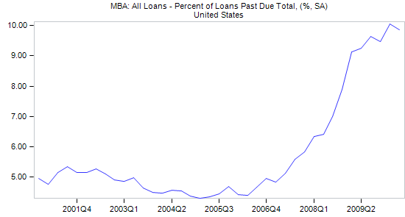

Slide 6
Subprime Crisis begins
April 2007: New Century Financial, a large subprime lender, files for Chapter 11 bankruptcy
Summer 2007: Major funds invested in MBSs are liquidated one after another
Summer 2007: Many subprime MBSs are downgraded

Slide 7
Subprime Crisis continues
February 2007: HSBC wrote down $10.5 billion of subprime MBS-related holdings
2007-08: Further writedowns occur
August 2007: Countrywide Financial, the largest mortgage lender in US, narrowly avoids bankruptcy

Slide 8
Bank Run on Northern Rock
A mid-sized British bank
Suffered a bank run in summer 2007
Nationalized in February 2008
Borrowed from money markets, gave out mortgages with the money, and sold the securitized mortgage

Slide 9
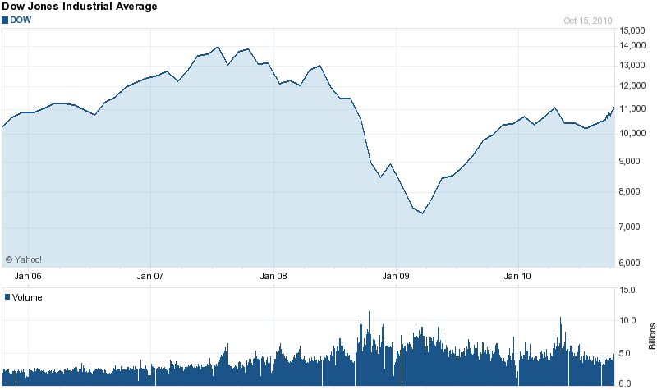
Precarious Stability

Slide 10
Early 2008: Another wave of crisis
Stock market begins to fall
  It falls by nearly 20% from its peak in 2007
January: Bank of America acquires Countrywide Financial

Slide 11

Fall of Bear Stearns

Slide 12
Bear Stearns
Investment bank founded in 1923
Heavily leveraged (35:1)
Its hedge funds that traded in subprime MBSs had lost nearly everything

Slide 13
March 2008
Bear Stearns is no longer able to meet its obligations due to lack of liquidity
It requests bailout from the Fed
The New York Fed provides support to JP Morgan, which, in exchange, would acquire Bear Stearns
  Maiden Lane Holdings
  Originally at $2/share, later raised to $10

Slide 14
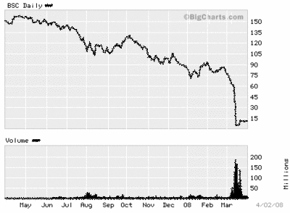

Slide 15
Crisis accelerates
Fannie Mae and Freddie Mac face problems in the summer of 2008
  The Federal Reserve and the Treasury provide emergency funding
The big crash occurs after Lehman Brothers fails

Slide 16
Collapse of Lehman Brothers
Major investment bank
  Twice as big as Bear Stearns in terms of number of employees and assets
It had a large position in lower rating MBSs
2008Q2: Lehman reports loss of $2.8 billion
2008Q3: Loss of $3.9 billion

Slide 17
Collapse of Lehman Brothers
It faces dire crisis as Korea Development Bank pulls out of acquisition
  No bailout this time
Sep. 15, 2008: Lehman files for Chapter 11 bankruptcy
Its NA operations are taken over by Barclays Capital

Slide 18
Aftermath of the Collapse
Stock market plunges
Dramatically increases counterparty risk
AIG receives a bailout the next day (September 16)
The crisis hits its peak

Slide 19
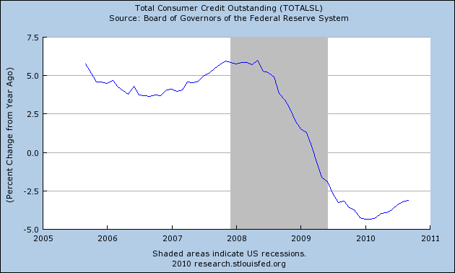
The Effects on the Real Economy
Consumer credit and other types of loans dry up very quickly

Slide 20
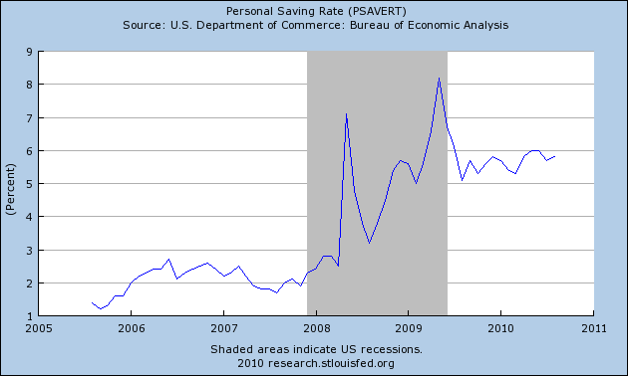
Effects on the Real Economy
Consumers begin to cut down on consumption

Slide 21
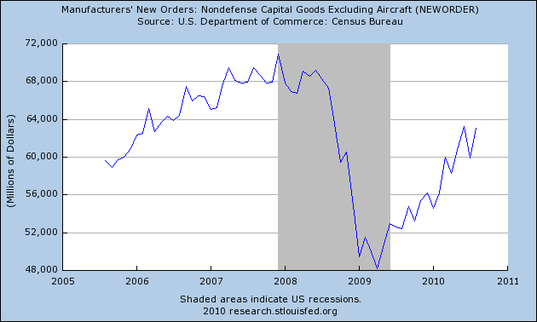
Effects on the Real Economy
Investment also falls sharply

Slide 22
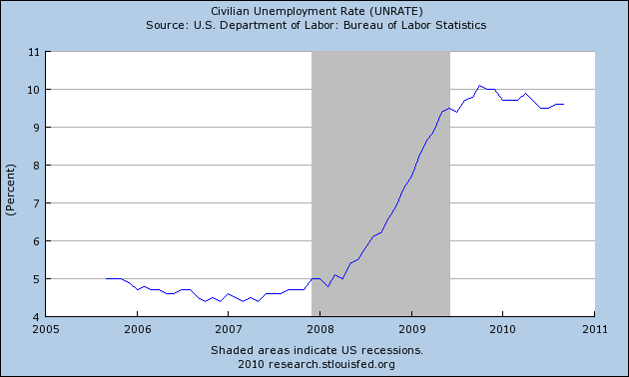
Effects on the Real Economy
As a result, unemployment rate rises sharply

Slide 23


Next week:
What did the Treasury and the Federal Reserve do to combat the crisis?

