Slide 1
Everything One Could Possibly Want to Learn About the T*
Splash 2023
*that I also know about the T

Slide 2
Introductions!
If I can remember all the T station stops, surely I can remember all of your names!

Slide 3
Structure
I’ll show you a picture or video, possibly with some redacted information, each with some leading questions
You give me answers, or tell me more things you know about it
And I’ll add onto what you know!

Slide 4
General themes
Change in public transportation is costly, yet good public transportation is necessary
Corporate consolidation of smaller companies helped standardization but contributed to difficult-to-manage bureaucracies

Slide 5
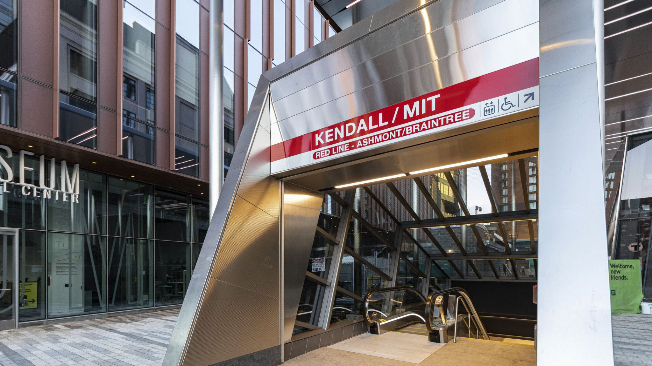

Slide 6
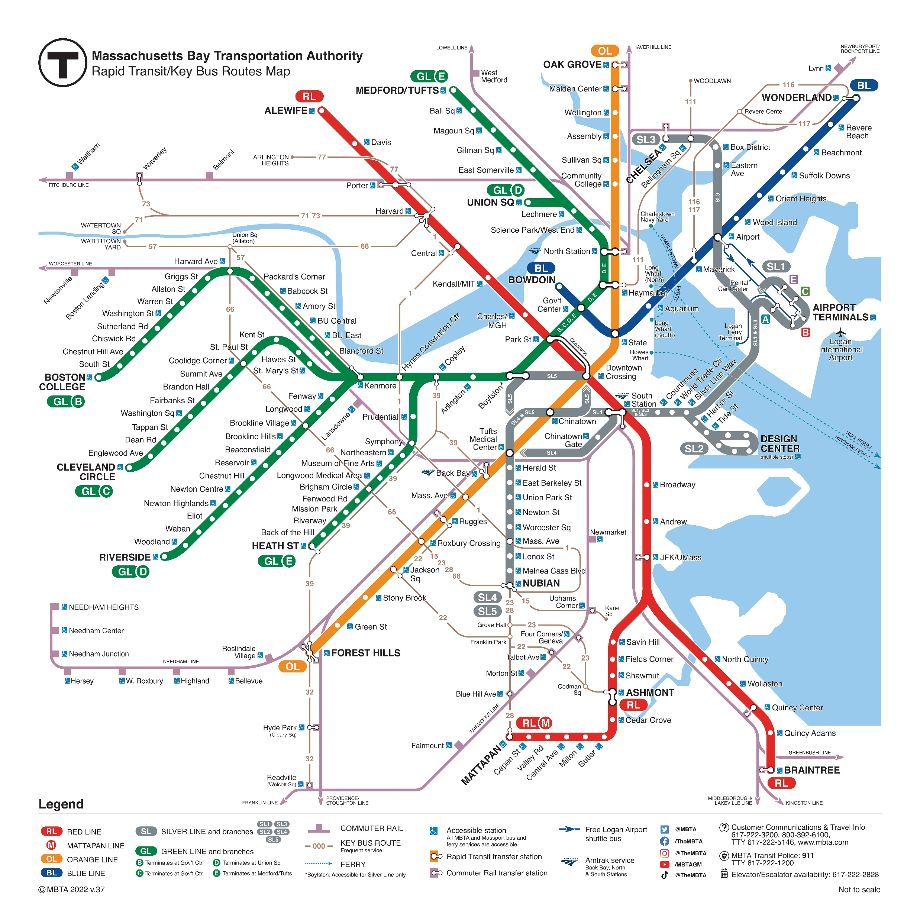

Slide 7
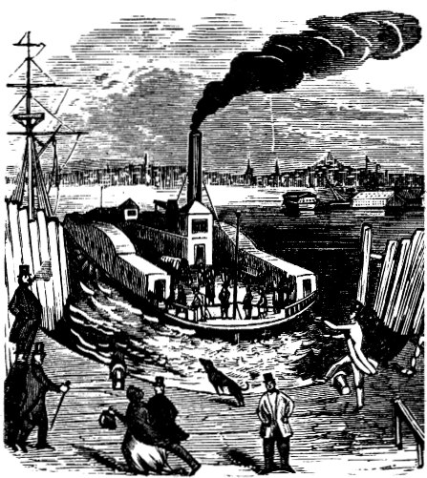

Slide 8
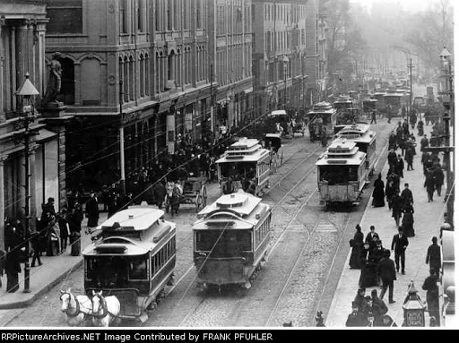
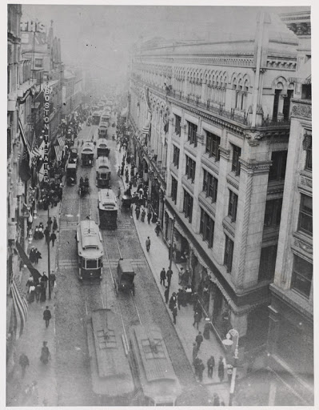

Slide 9
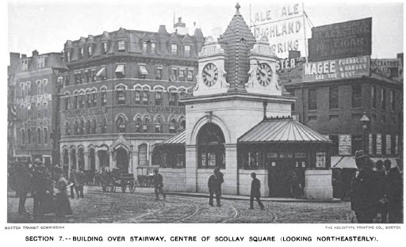
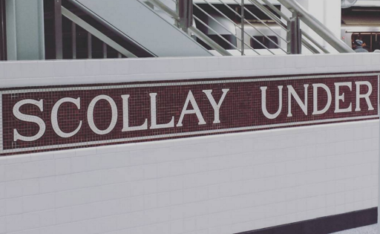

Slide 10


Slide 11
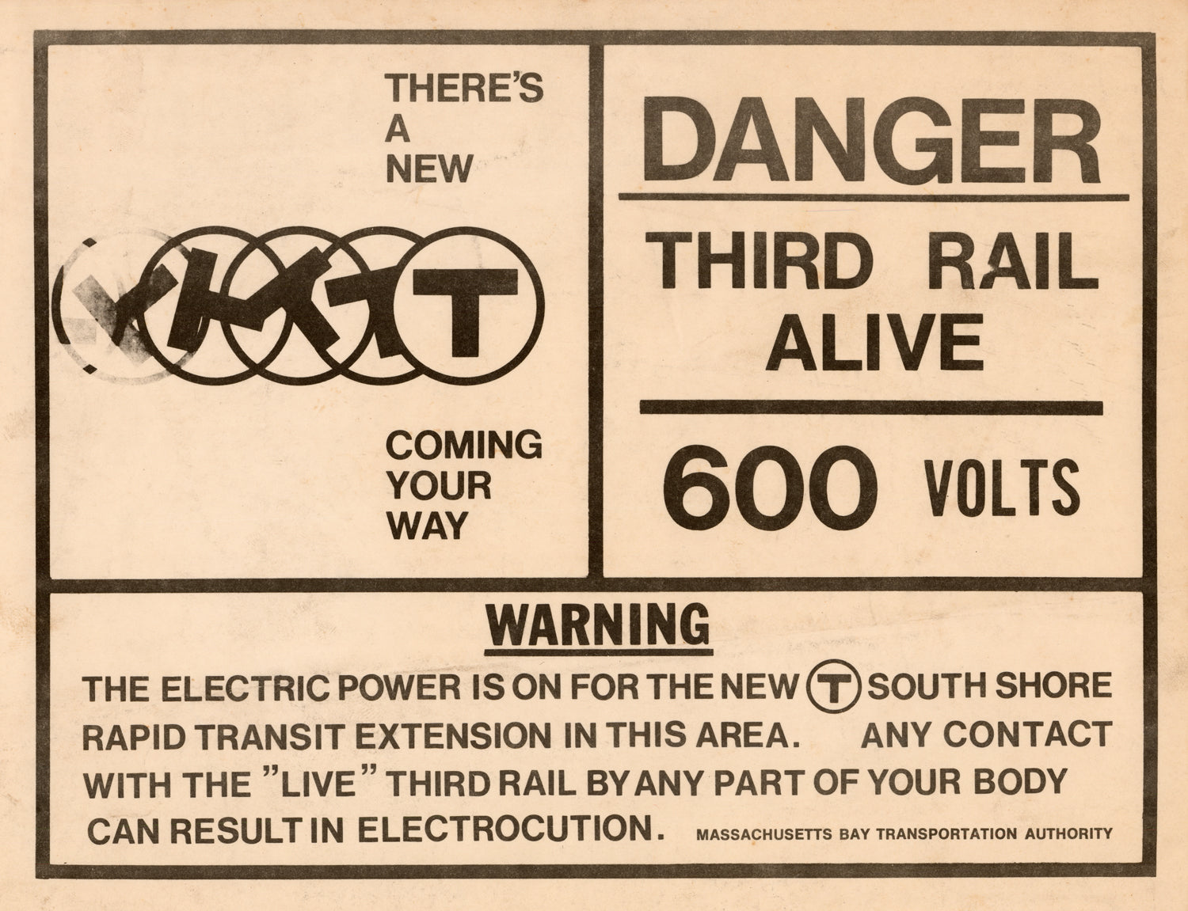

Slide 12


Slide 13
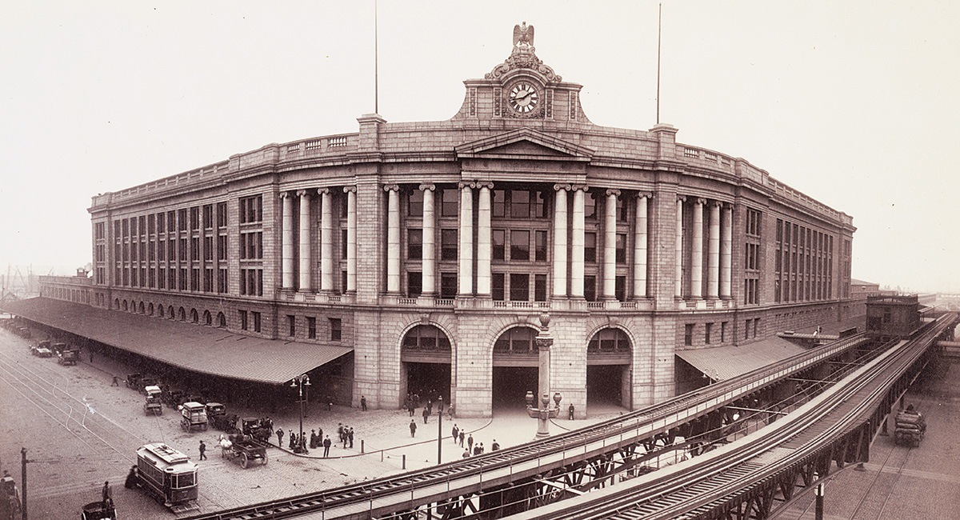

Slide 14
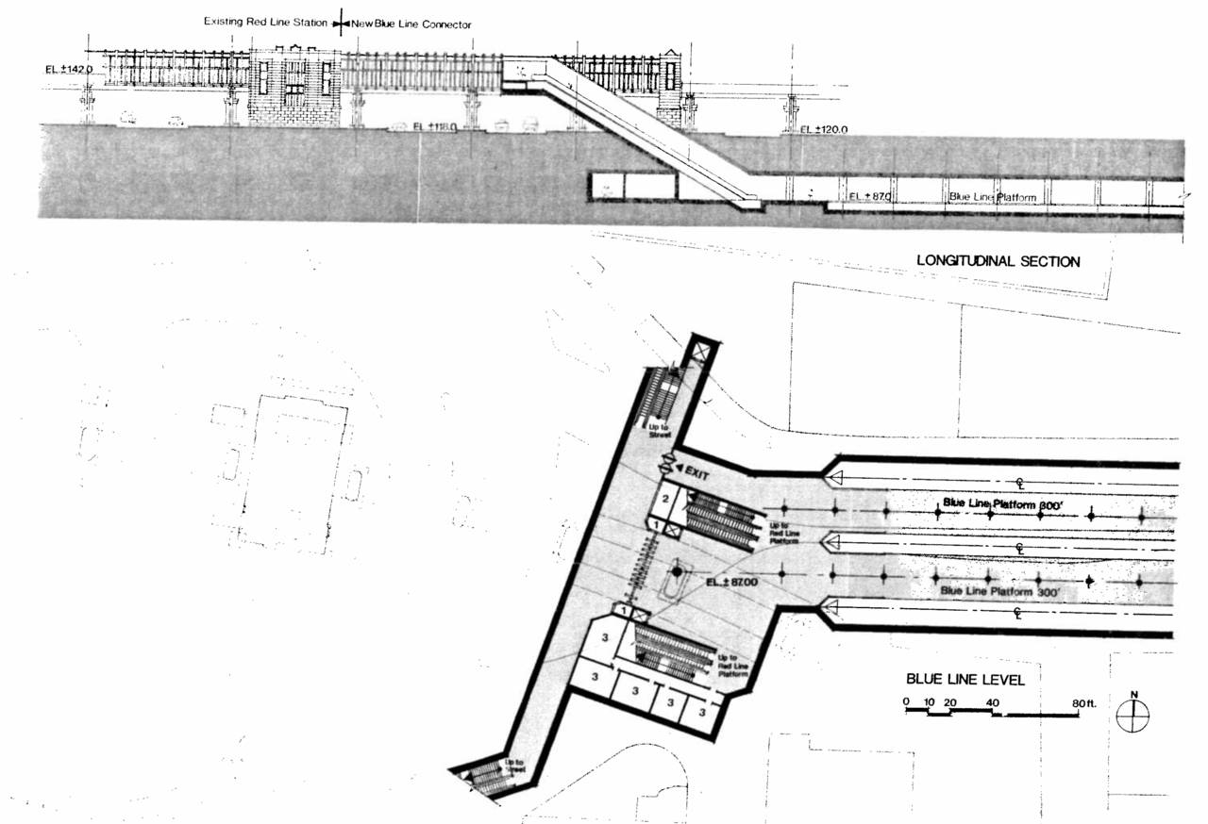

Slide 15
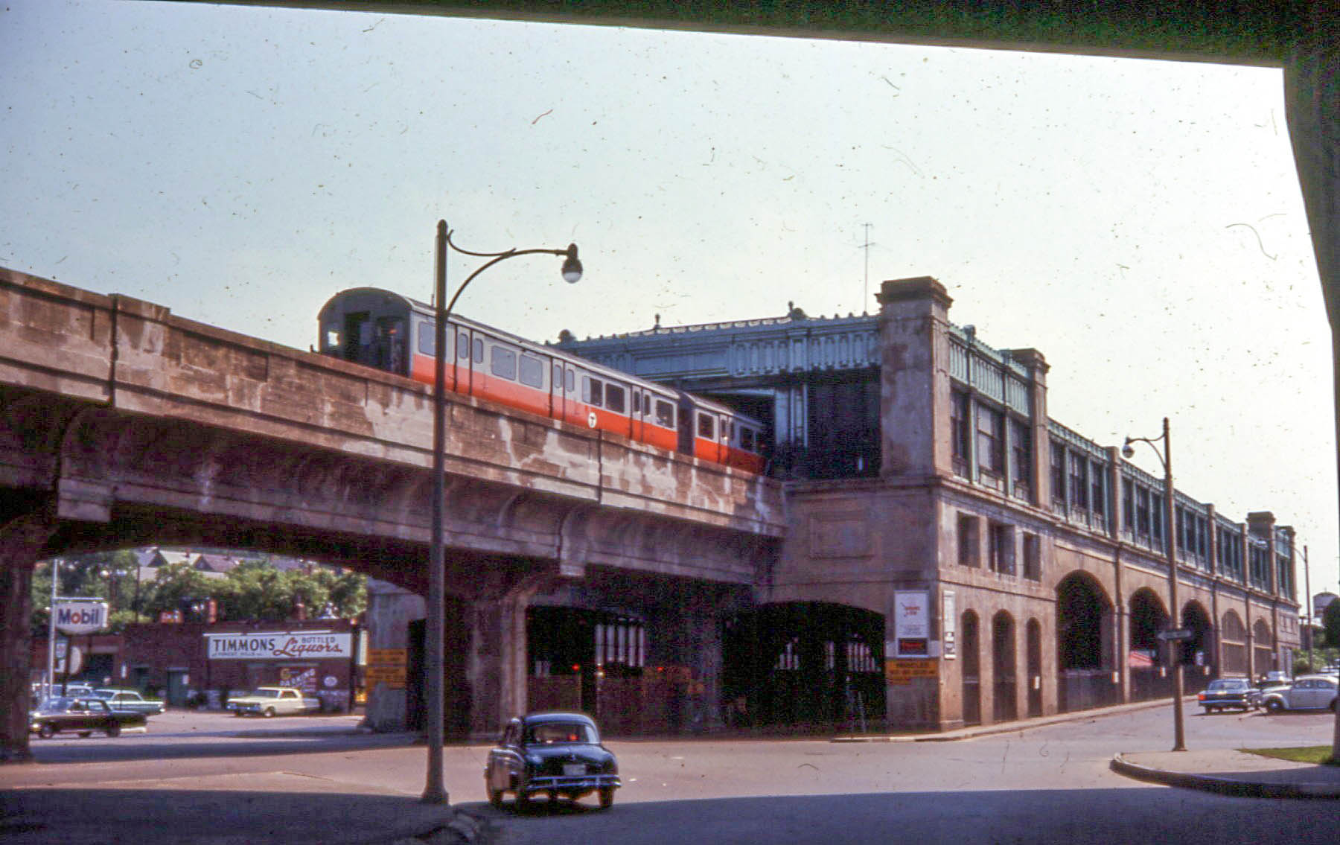
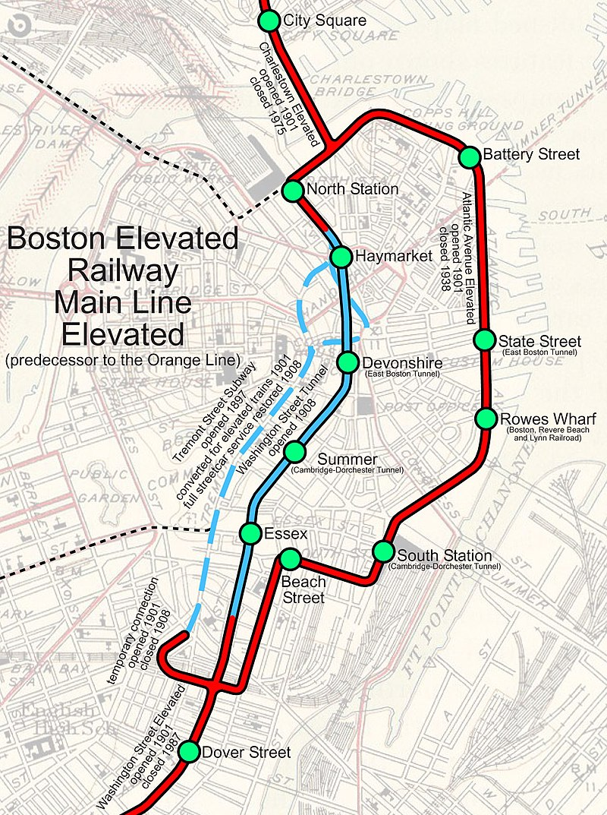

Slide 16
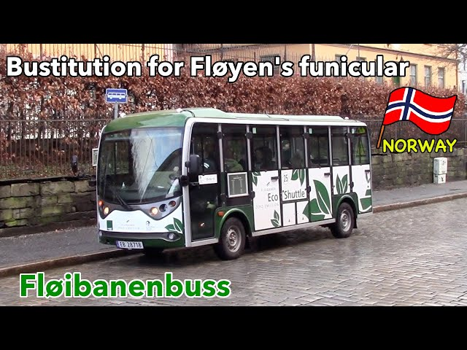

Slide 17
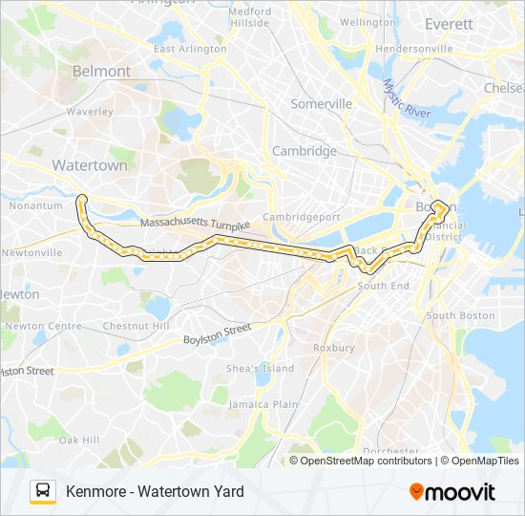

Slide 18
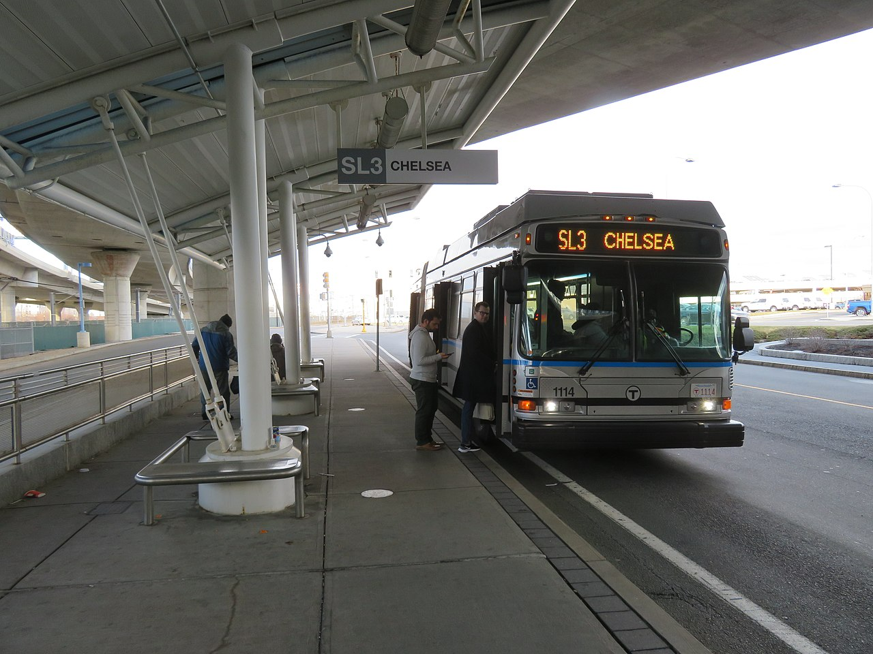

Slide 19
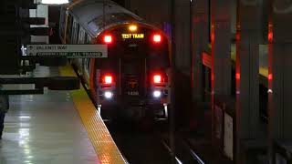

Slide 20
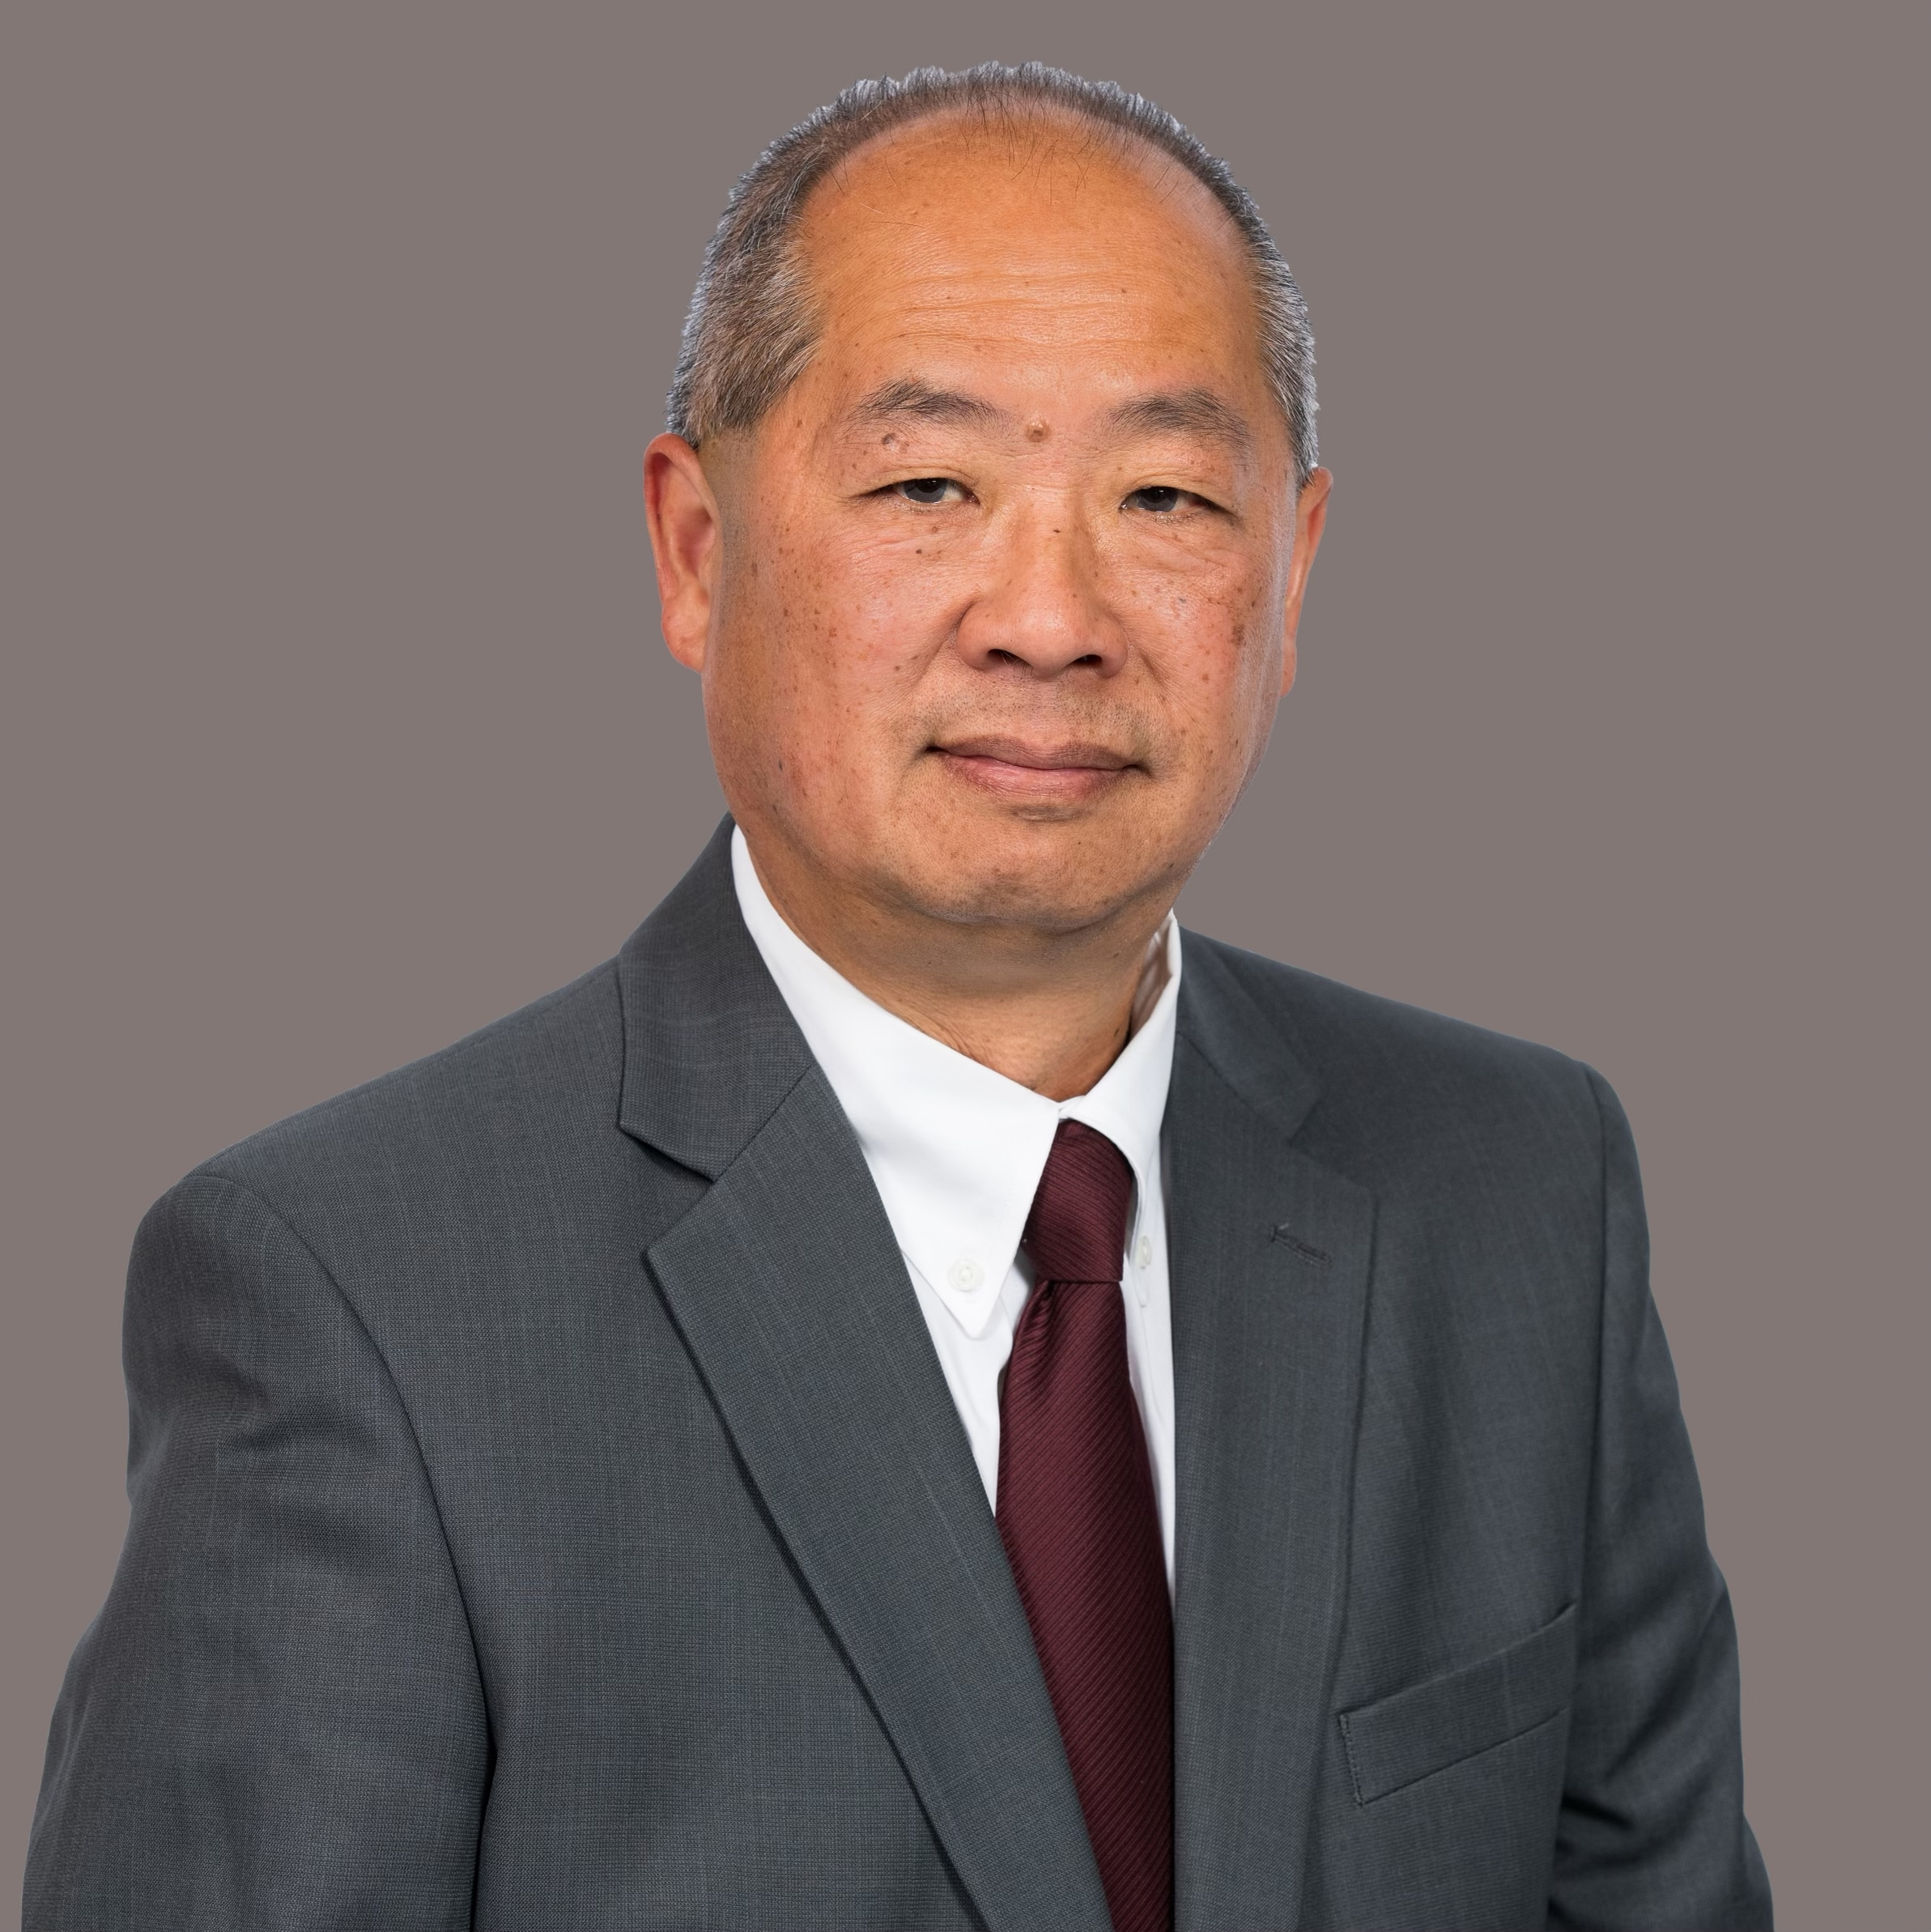

Slide 21
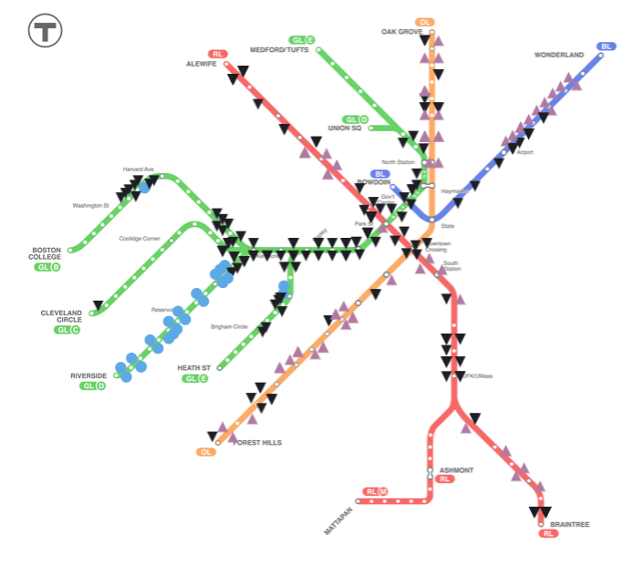

Slide 22
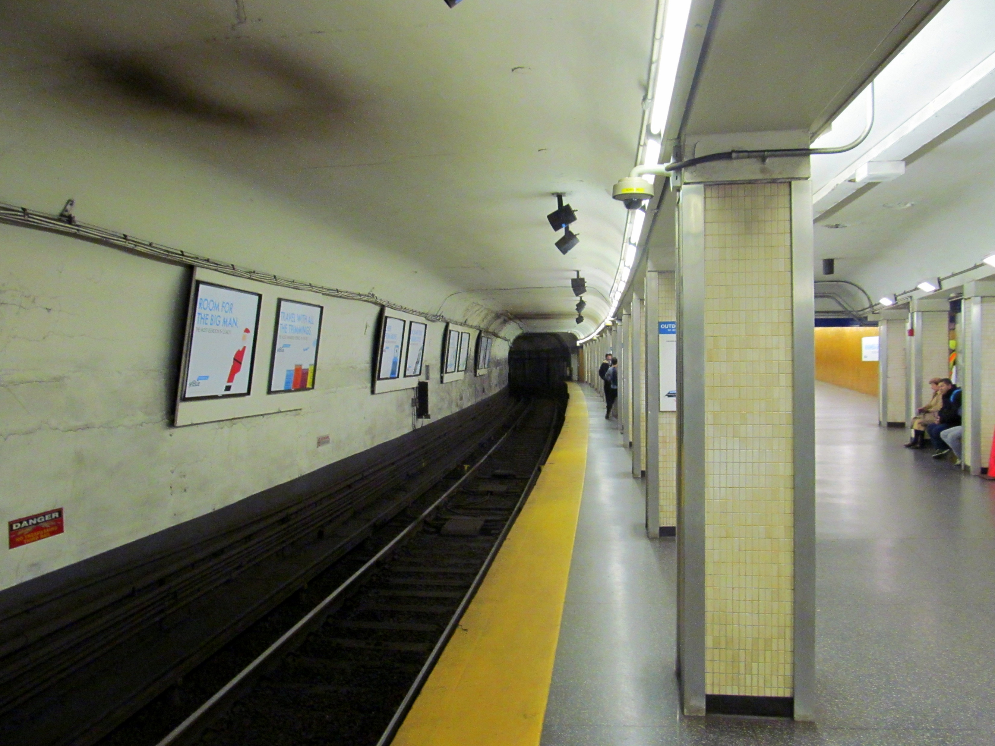

Slide 23
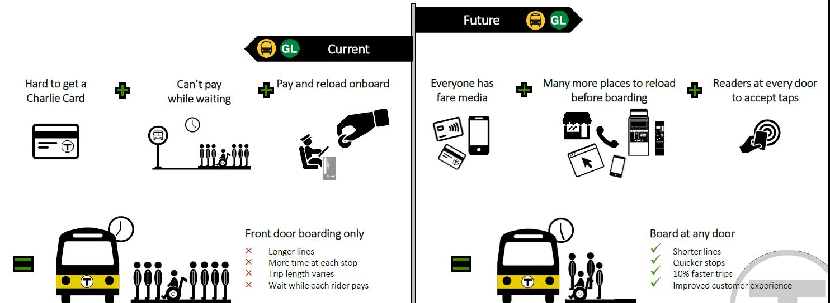

Slide 24
Thanks for coming!

