Slide 1



Determinants of Health and Diseases
Srunphut Pukma Sc.D.
Human Immunodeficiency Virus
Acquired Immune Deficiency Syndrome

Slide 2


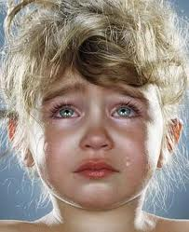


Last Determinants Lecture…

Slide 3
USMLE Stage 1 Exam
Jonathan Smith was assisted by his wife to the BIDMC Emergency Room at 5:09am this morning. He had complaints of extreme diarrhea, dehydration, and pain in his lower abdominal tract.
  What test would your team do to further analyze Jonathan's symptoms?
  What medical condition is it? Explain how Jonathan could have contract it?

Slide 4
USMLE Stage 2
Barbra Goodwill is checking in with you, her primary care, about constant pains in her lower abdomen area. She explained that she has been experiencing amenorrhea. The pain is mostly targeted in the left lower abdomen area.
  What test might you order for Barbra?
  As an initial prediction, what condition might you believe Barbra has.

Slide 5
USMLE Stage 3
Winston Lee is a cancer patient of Dr. Srunphut Pukma, you are his residents. Winston is checking into the Cancer ward today, and Dr. Pukma is teaching at MIT.
  With your team, what vitals would you monitor of Winston’s conditions?
  Winston woke up with extreme hunger pangs, but he complains about not being able to hold food bolus in, what do you give him?

Slide 6
USMLE Stage 4
Stephanie Johnston has progeria. You are doing a Post-Doc at Children’s Hospital Texas after getting your Ph.D. from Georgetown University.
  Propose a drug therapy plan for Stephanie.
  Is it alright to give a 7 year old Progeria patient a Combinatorial Drug Treatment ?

Slide 7
USMLE Stage 5
George Martinez is admitted into the emergency room for strange behavior, he has been talking to himself and hitting his head constantly. You check his records and he is a initial (stage 1) cancer patient of Dr. Steve Shapiro.
  What test might you perform on George, why?

Slide 8
Review
What is the importance of Mitotic Chromosomal Segregation ?
What are the symptoms of Turner Syndrome ?
What are the problems that occur during Aneuploidy ?
What are gonads and what do they produce? What is Gonadal Genesis and Gonadal Dysgenesis?

Slide 9

HIV AIDS
Historical Context
CD4 Cells (Immunology)
Integrative Biology
Molecular Biology
HIV Virus
AIDS Pathology
Viral Antigenic Shift
Combinatorial Drug Therapy
http://www.youtube.com/watch?v=9oenTf9BUcw

Slide 10
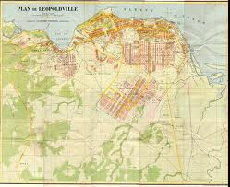
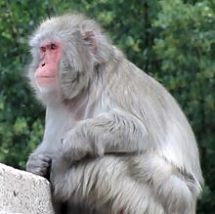
Origin of HIV
1959 Leopoldville, Congo L70 Zero positive Serum.
Isolated in 1983, Paris.
SIV Uganda (Simian Immunodeficiency Virus)
Hunter Theory, Failed.
Polio Vaccine Theory

Slide 11
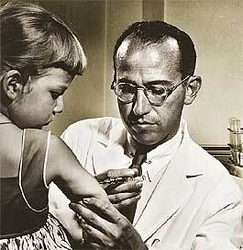
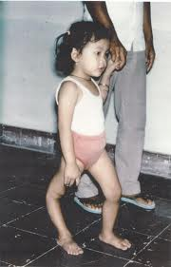
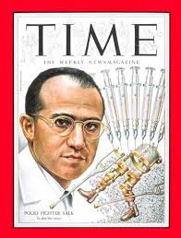
Polio Vaccine, Jonas Salk

Slide 12
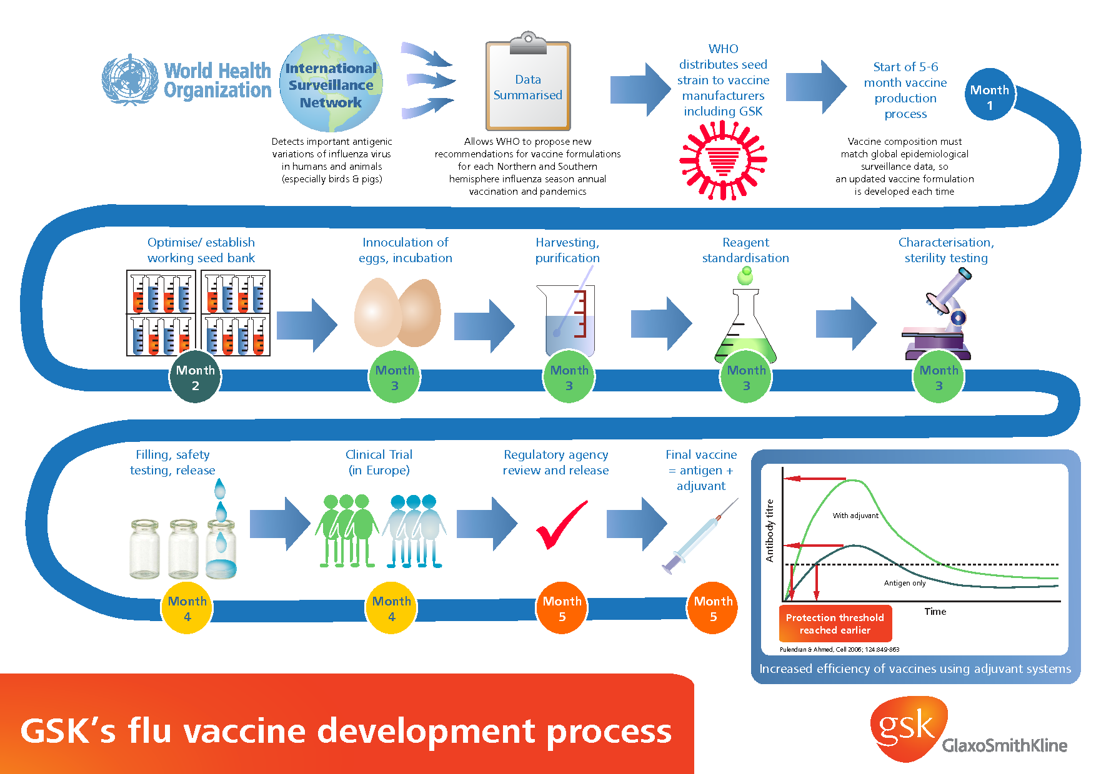
Vaccine Production (Municipally)

Slide 13
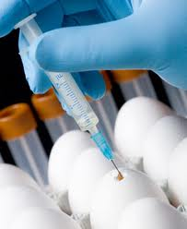
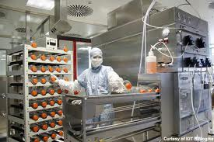
** Discussion Question **
Please discuss the Pros and Cons of Vaccine productions at the municipal level.

Slide 14
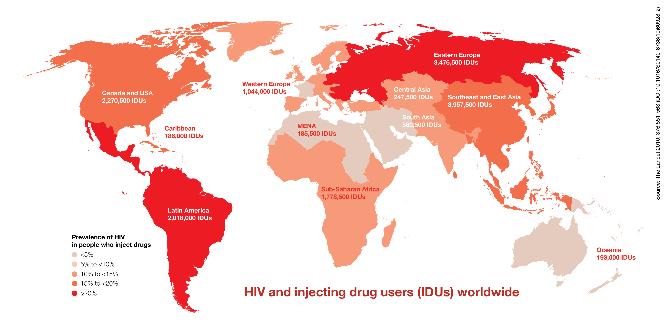
** Discussion Questions **
HIV AIDS is a prevalent disease that exists in human populations through out the world. Today, is AIDS an Outbreak, Epidemic, or Pandemic ?

Slide 15
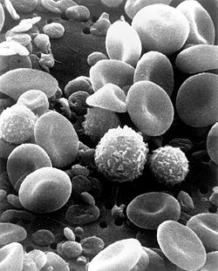
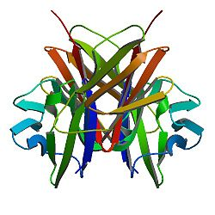
CD4 Cells (Immunology)
Notes:
Cluster of Differentiation

Slide 16
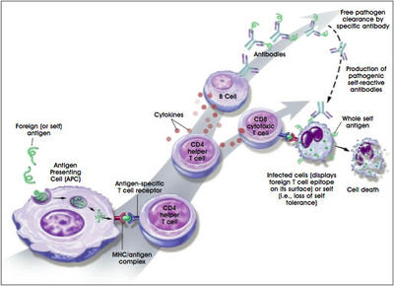
CD4 Cells

Slide 17
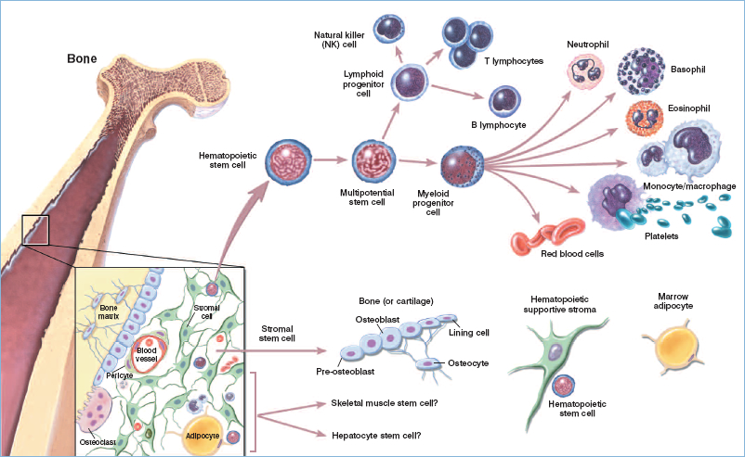
Leukocytes Differentiation

Slide 18
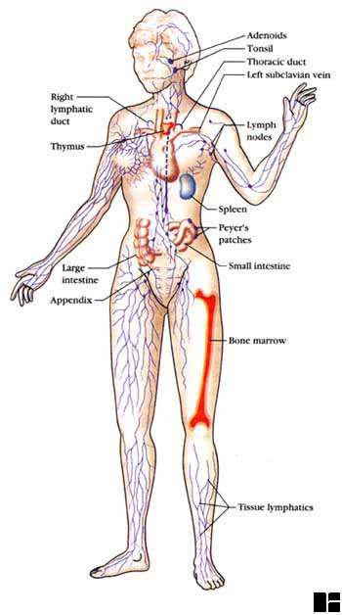
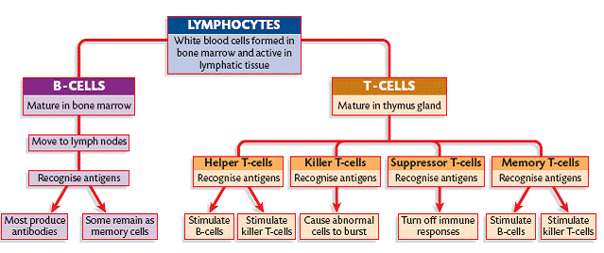
Human Immune System

Slide 19
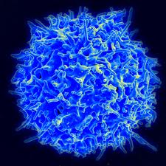
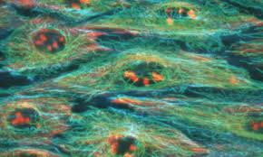
** Mid Semester Review **
Please review Transcription and Translation.
  A. What are the products of Replication ?
  B. What are the products of Transcription ?
  C. What are the products of Translation ?

Slide 20
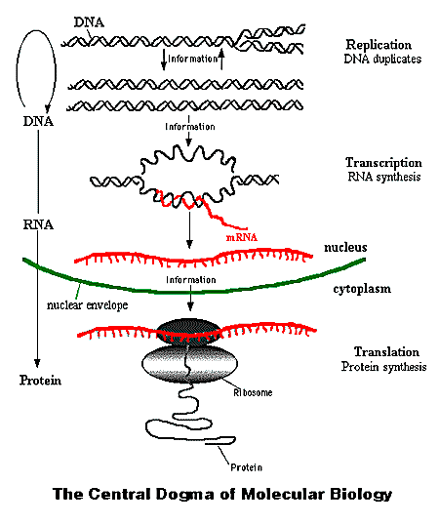
Molecular Biology

Slide 21
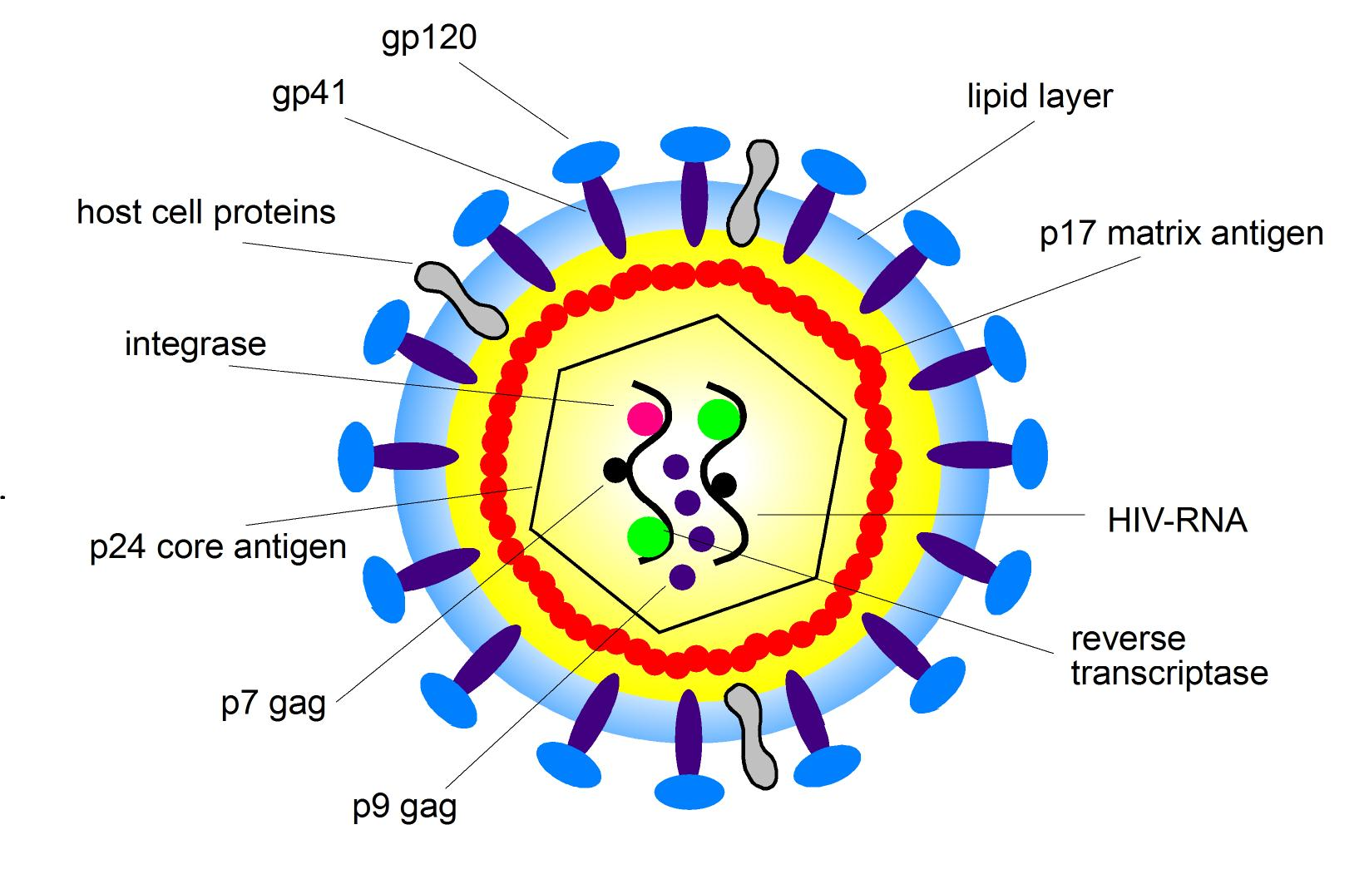
Human Immunodeficiency Virus

Slide 22
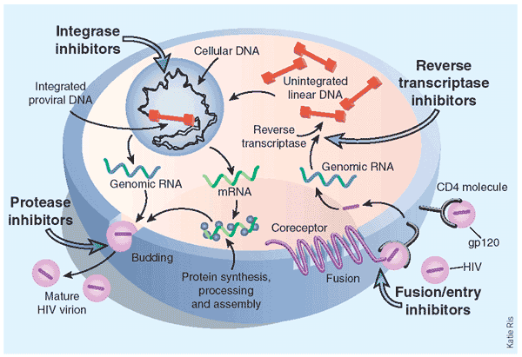
HIV Mechanics

Slide 23
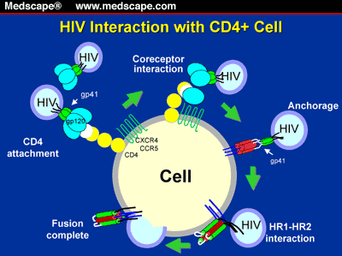
Stage 1: Attachment

Slide 24
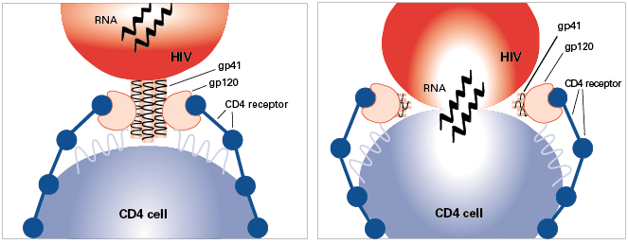
Stage 2: Fusion

Slide 25
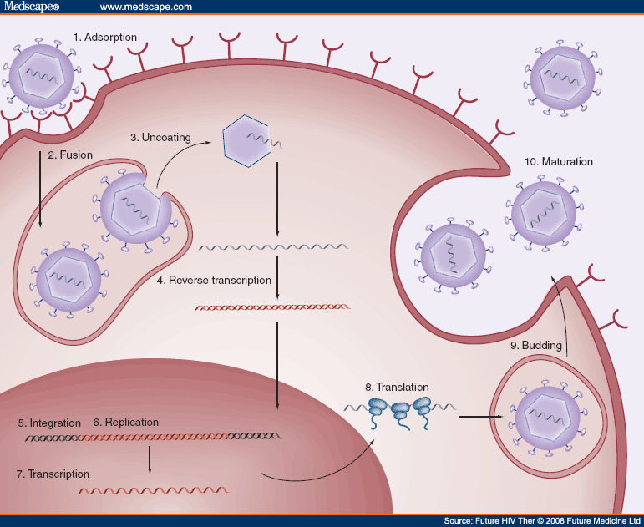
Stage 3: Entry

Slide 26
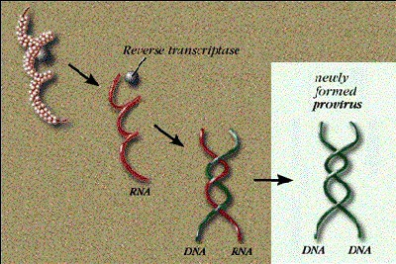
Stage 4: Reverse Transcriptase

Slide 27
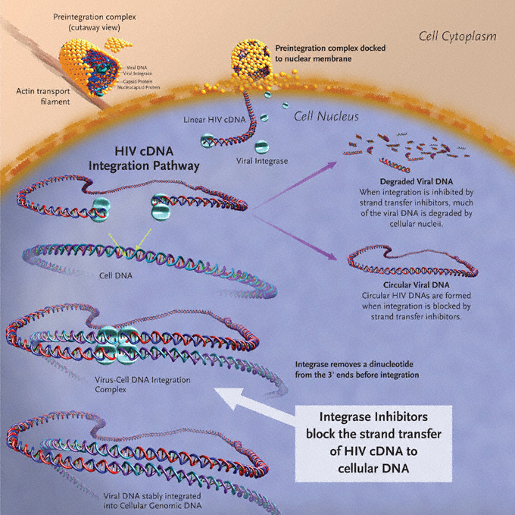
Stage 5: Integration

Slide 28
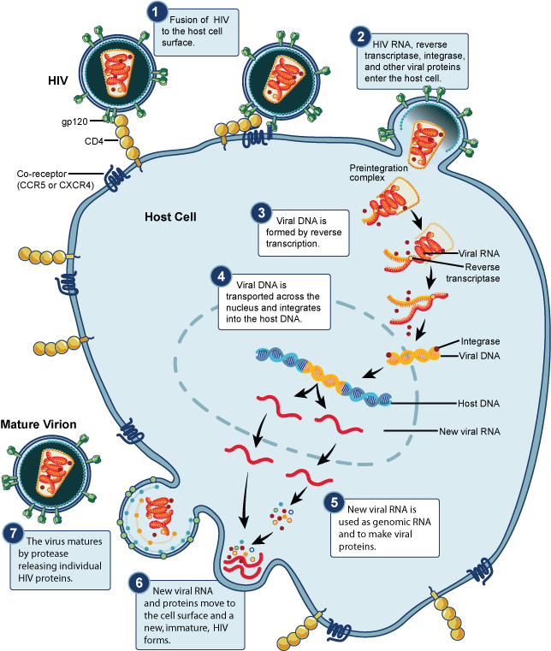
Stage 6: Biosynthesis and Cleavage

Slide 29
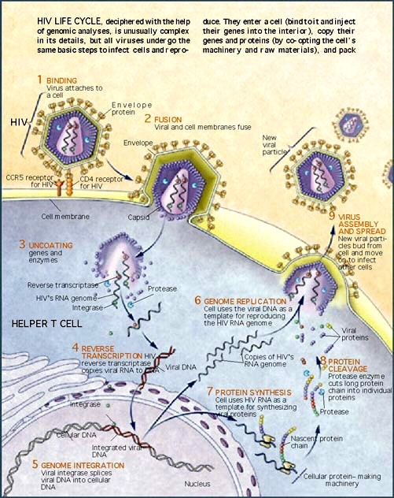
Stage 7: Assembly

Slide 30
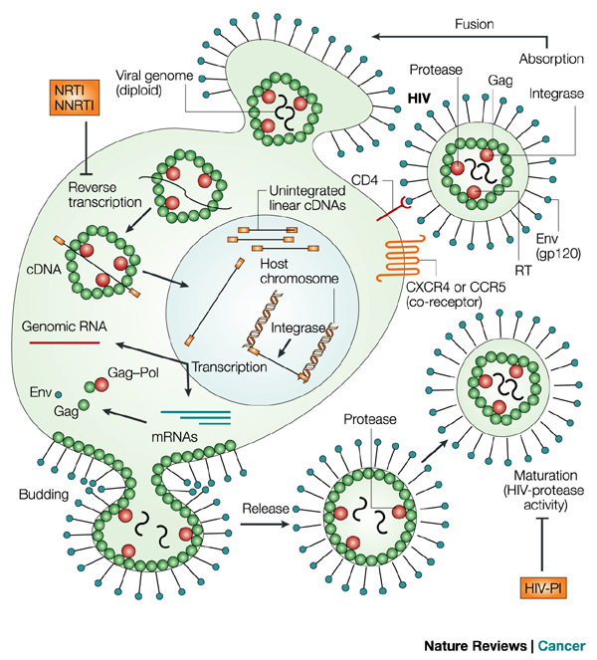
Stage 8: Budding and Repeat

Slide 31
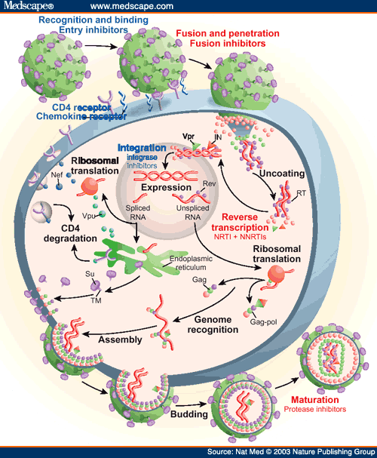
HIV Cycle Review

Slide 32
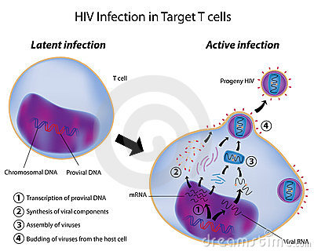
Latency and Progeny Formation

Slide 33
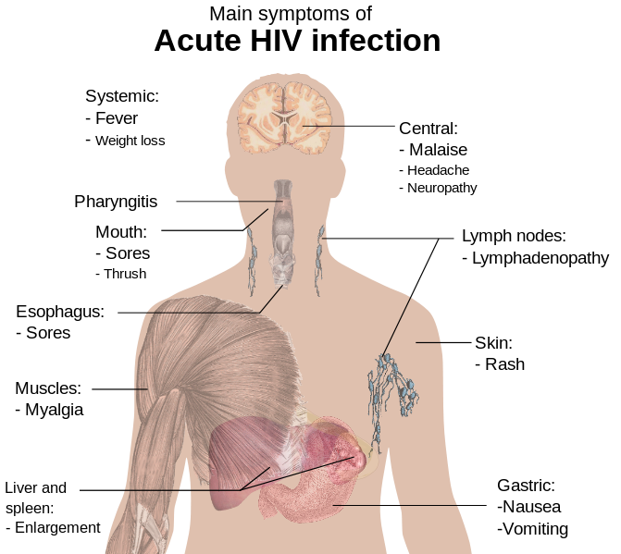
AIDS Pathology

Slide 34
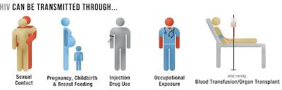
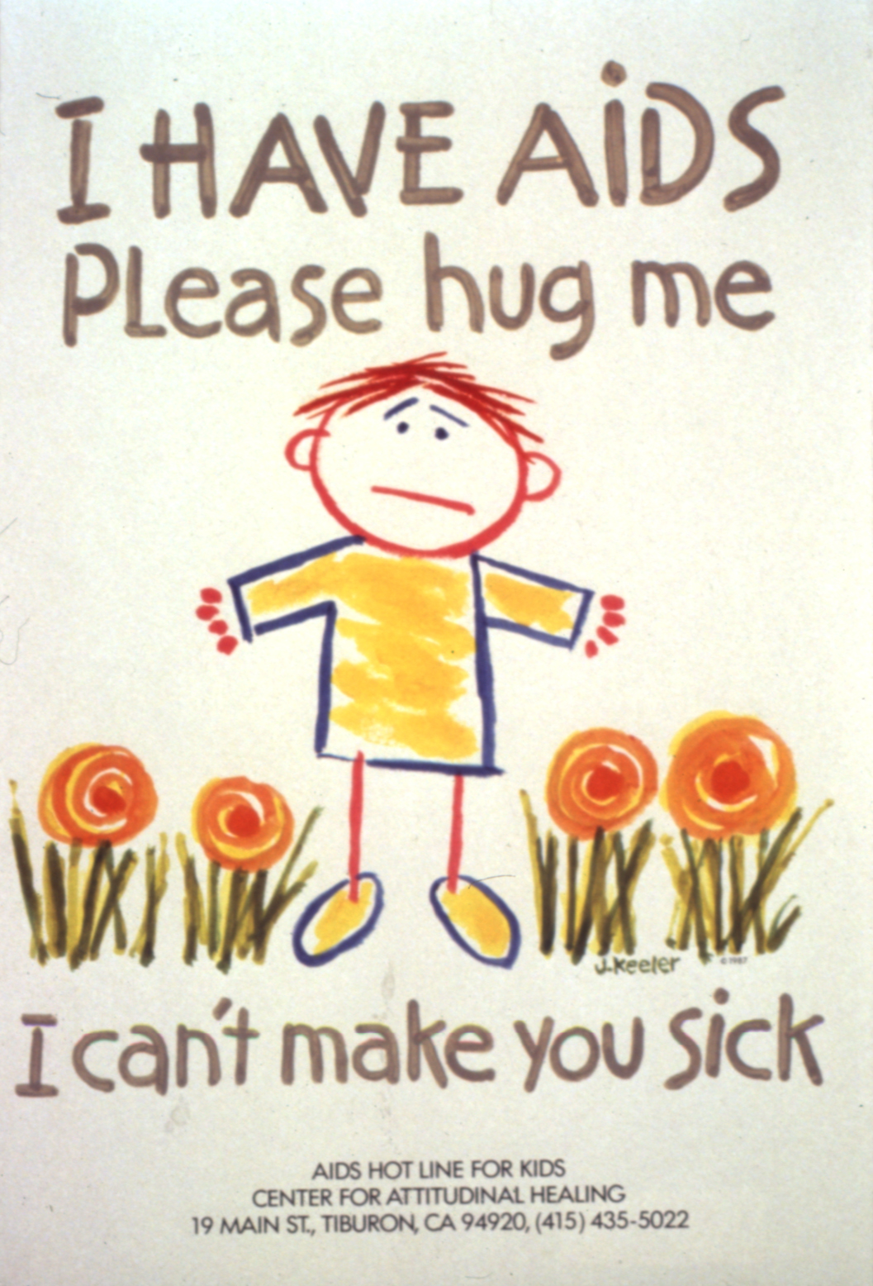
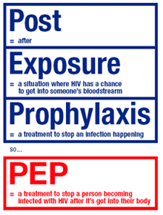
HIV Transmission Pathways

Slide 35
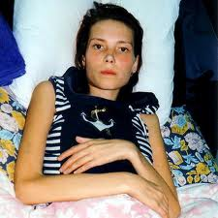
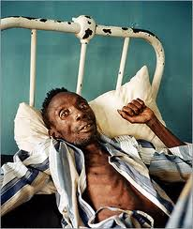
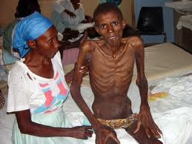
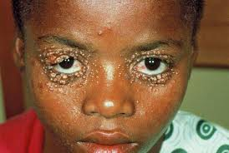
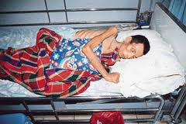
AIDS Patients

Slide 36
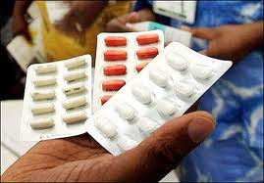

** Discussion Question **
As a new graduate of Princeton University, you wanted to use your degree at Merck Pharmaceuticals. You are joining the HIV-AIDS study clinic. Propose a mechanism that you would like to study in treating AIDS.

Slide 37
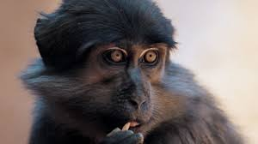
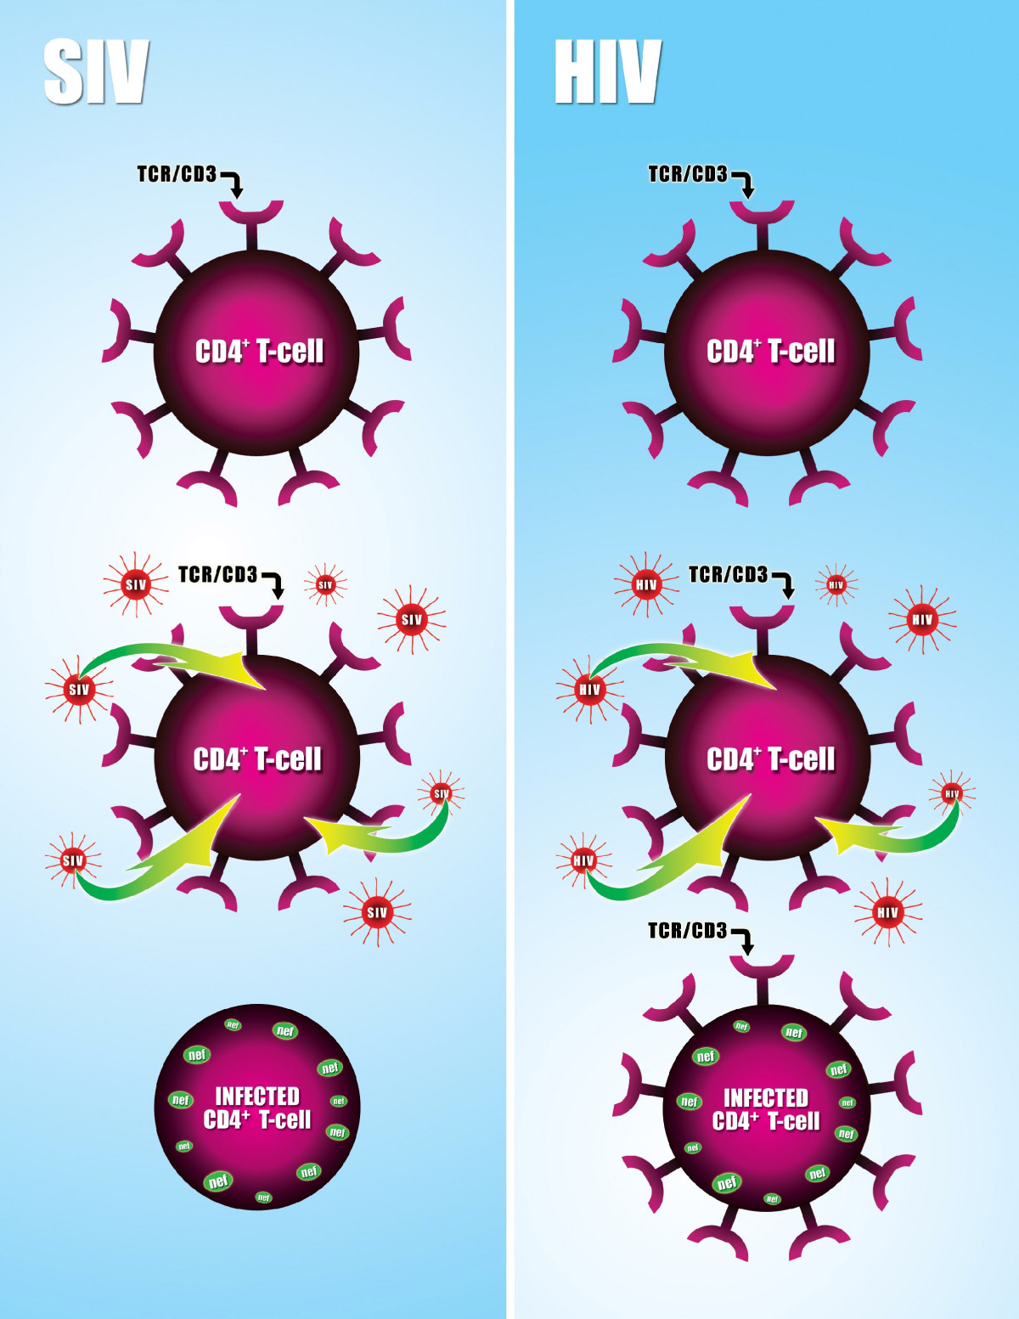
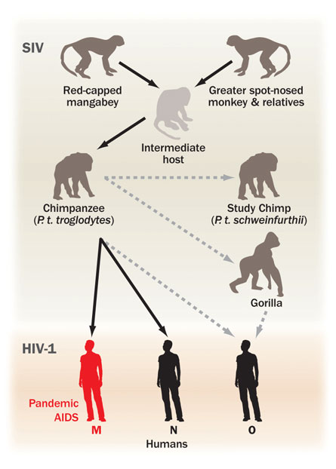
Disease Antigenic Shift

