Slide 1
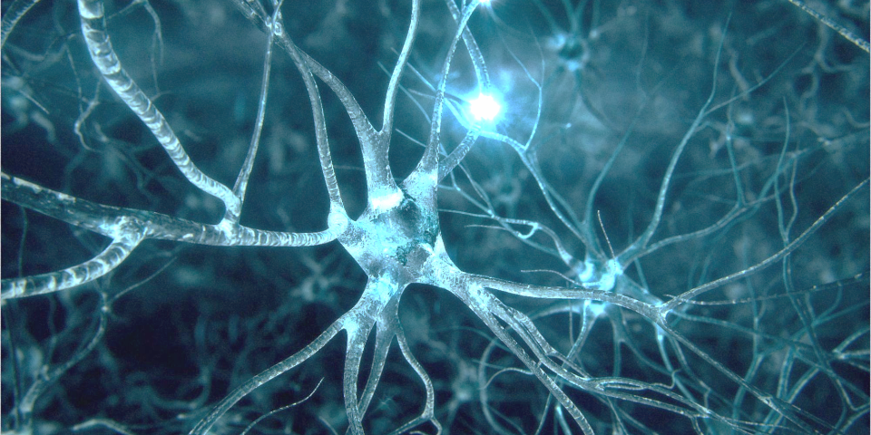
Neurological Diseases:
Alzheimer’s Disease & Dementia
03.07.2020
Djuna & Audrey

Slide 2
Notes:
Dory the fish from Finding Nemo - an iconic character who has short-term memory loss. Short term memory loss can be caused by many things. Sudden causes can be events like concussions, seizures, or strokes. However, a gradual decline in memory (especially in older adults) can be a sign of dementia.

Slide 3
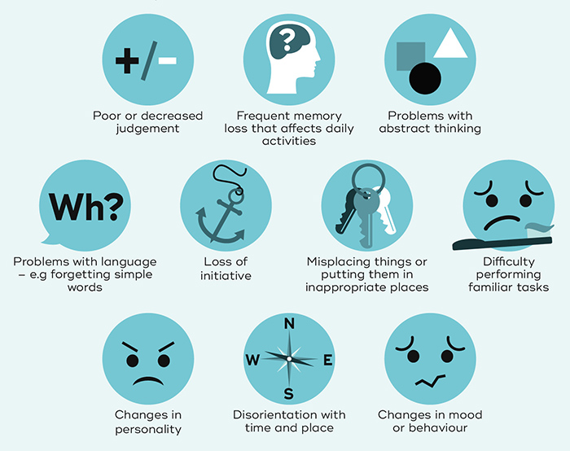
What is dementia?
Notes:
Discussion question: do you know what dementia is? Can you suggest some symptoms or ways to define/diagnose it?
Dementia is an overall term for the symptoms observed in certain diseases and conditions. Dementia is characterized by a decline in memory, language, problem-solving and other thinking skills that affect a person's ability to perform everyday activities.

Slide 4
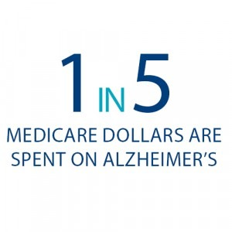
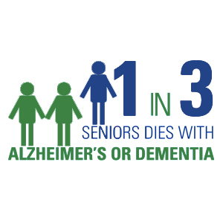
Alzheimer’s disease (AD)
Most common cause of dementia
Associated with age
Life expectancy after diagnosis: 3-9 years
Notes:
Alzheimer’s disease is the most common cause of dementia -- up to three-quarters of cases of dementia are thought to be due to AD.

Slide 5
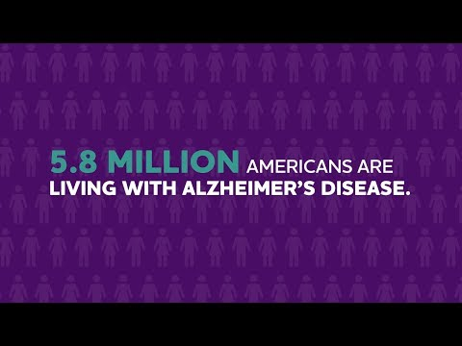
Notes:
End video at 1:00

Slide 6
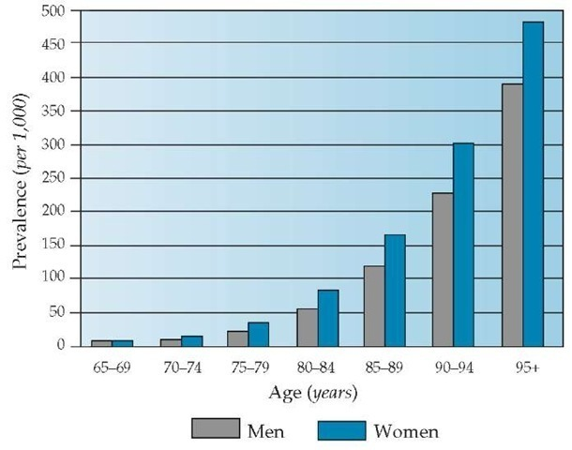
Age is the biggest AD risk factor
Notes:
Age is biggest risk factor for many neurodegenerative diseases, and AD is no exception.
Discussion question: Can you think of any other potential big risk factors that you may have heard of?
1: Age
2: APOE allele - e4 increases risk, e2 decreases risk
3: Family History - increases risk, does not guarantee you will get it. Also it happens sporadically
4: Modifiable risk factors: smoking, diabetes, obesity, hypertension, education, social and mental activity, mild traumatic brain injury = 2x risk

Slide 7
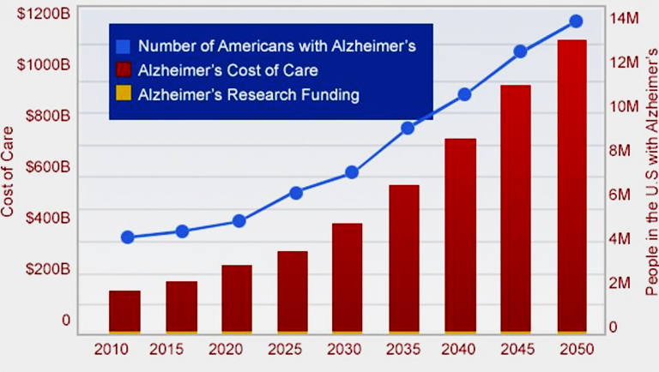
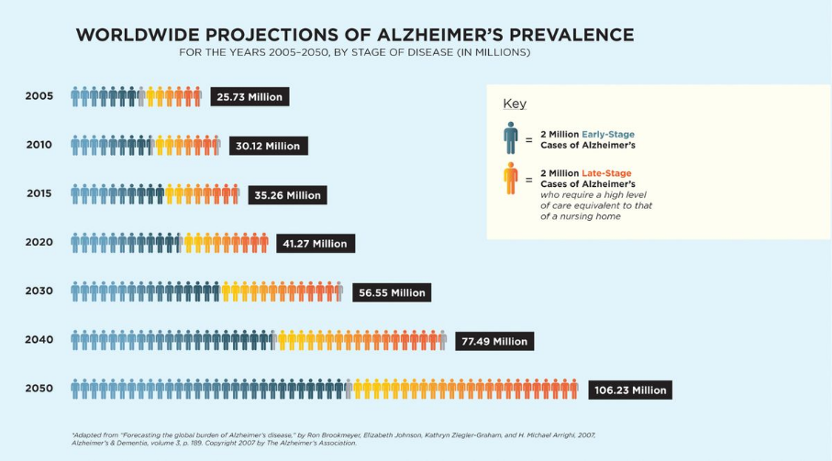
The projected costs of AD
Notes:
Discussion question: why are costs going up?
Not just inflation or overall population growth.
World’s population is aging -- birth rates are decreasing in developed countries, so number and proportion of older individuals is increasing
Caring for people with AD can be expensive -- around the clock nursing and care to make sure that AD patients who can’t perform daily tasks or care for themselves stay safe
Notice: the extremely tiny yellow portion of each bar is AD research funding.

Slide 8
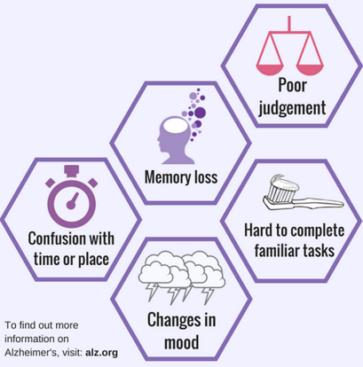
Early stages of AD
General forgetfulness
Impaired short-term memory
Confusion in unfamiliar places or situations

Slide 9
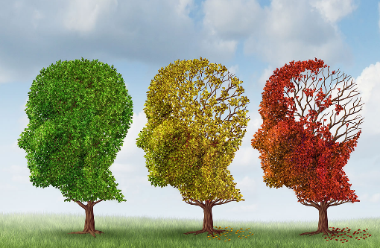
Middle stages of AD
Substantial memory impairments
Difficulty performing everyday tasks
Problems with speech, coordination, and attention
Personality changes

Slide 10
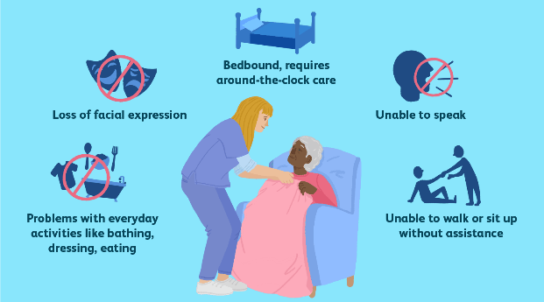
Late stages of AD
Complete dependence on caregivers
Near total loss of speech
Loss of mobility and muscle mass

Slide 11
Notes:
Video of a woman with AD talking to her daughter (who is filming the video).

Slide 12
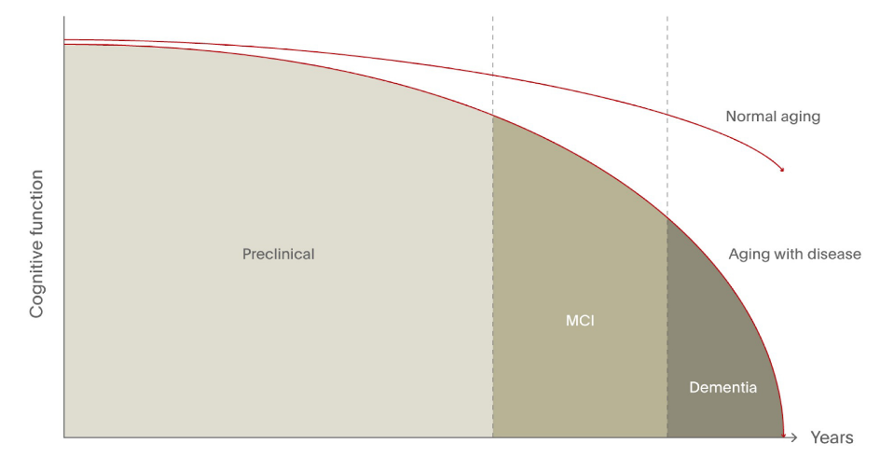
Progression of AD
Mild cognitive impairment
Threshold for clinical diagnosis
Clinically normal adult
Early AD?
Mid
Late
Notes:
AD is a progressive neurodegenerative disease, meaning that as certain brain regions become damaged and different cognitive functions are lost, they do not regenerate or come back. If we plot “cognitive function” (as a general value, no quantification here) over time, we see that normal adults (top red line) experience some cognitive decline as they age. This may eventually enter the territory of “mild cognitive impairment” -- noticeable declines in certain things like memory, language, or thinking. However, for people with AD, the rate of decline becomes much steeper over time, and eventually becomes severe enough to receive a diagnosis of dementia as damage accumulates.

Slide 13
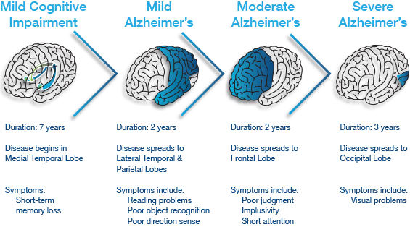
Anatomy of AD progression
Notes:
The order in which different anatomical regions are affected (remember: brain lobes from first lecture) nearly matches the order in which different cognitive functions are affected. To understand what’s going on, we need to dive into the biology of AD.

Slide 14
The biology of AD

Slide 15
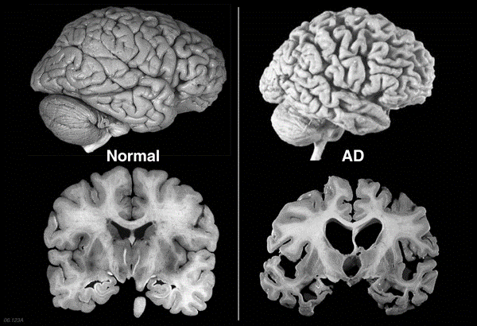
Large-scale changes in AD
Notes:
Discussion question: what specific changes can you point out between these two brains? Can you predict what effect these changes have on brain function?

Slide 16
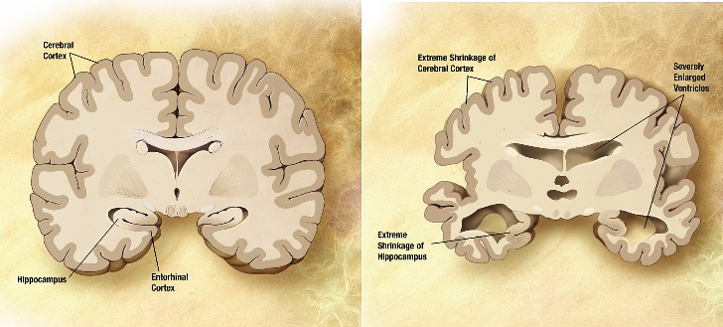
Neurodegeneration
The progressive loss of structure or function of neurons
Reduced cell number (cell death)
Reduced brain volume (atrophy)
Region-specific degeneration can cause specific cognitive deficits.
Notes:
Certain parts of the brain tissue appear to shrink, and empty spaces like the ventricles seem to enlarge -- not because they’re literally enlarging, but because the surrounding brain tissue is shrinking. The brain tissue is shrinking because the neurons that make up the tissue are dying. This phenomenon is called neurodegeneration, a general term for when neurons lose their normal structure and function due to disease.
Existing treatments can slow progression, but not stop or reverse it.

Slide 17
AD at the microscopic level
Notes:
Alois Alzheimer 1907 paper: first published definition of AD
Knowledge check: What is a cell? (basic unit of living things) What is a protein? (biomolecule, one of essential building blocks of cells) What are the instructions for how to make proteins? (genes)

Slide 18
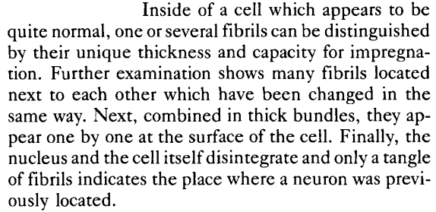
Notes:
With more modern techniques, we’ve been able to better understand how cells and proteins in the brain change during AD, as originally described by Alois Alzheimer.

Slide 19
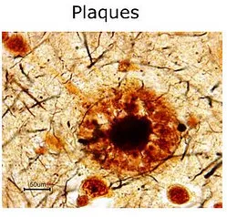
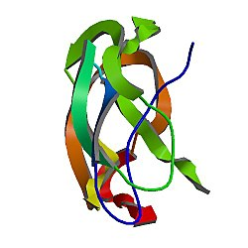
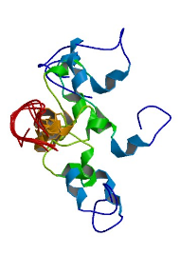
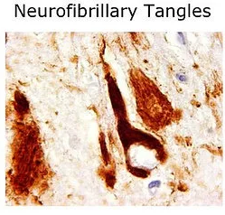
Molecular signature of AD
Amyloid beta
Tau
Notes:
Autopsy and antibody staining required to confirm some of the unique hallmarks of AD: amyloid plaques (Alzheimer’s “substance”) and neurofibrillary tangles (Alzheimer’s “fibrils”).

Slide 20
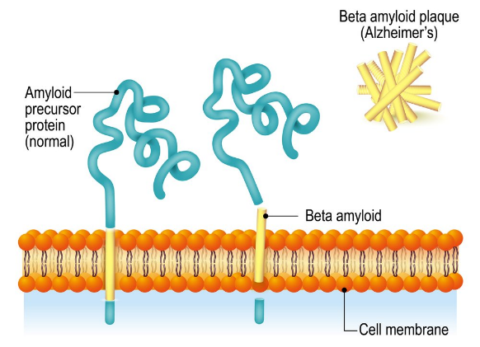
Role of amyloid in AD
Extracellular amyloid beta deposits contribute to neuronal damage in AD.
Notes:
Amyloid precursor protein (APP) and beta amyloid’s normal function is unclear. What we do know about APP is that it is a transmembrane protein, meaning that it passes through the membrane, and part of it sits in the extracellular space (in this diagram, the squiggly part of the blue and yellow protein). APP can be cleaved (cut) by different enzymes, such as beta and gamma secretase. When APP is cleaved, the resulting fragments of the protein are released. One of these fragments is amyloid beta. Amyloid beta can stick to itself to form a dense, insoluble structure called a plaque. These amyloid beta plaques are one of the defining features of AD.

Slide 21
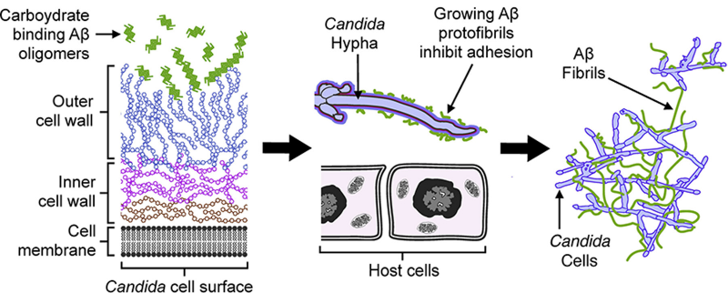
Why do we have amyloid?
Amyloid beta could have a protective anti-microbial function:
Binds to cell wall of microbes
Blocks microbes from sticking to healthy host cells
Traps bacteria within a resistant matrix
Notes:
Amyloid beta presence has been demonstrated to inhibit bacterial growth.
AD could occur when the normal regulation of amyloid beta levels and processing becomes uncontrolled.

Slide 22
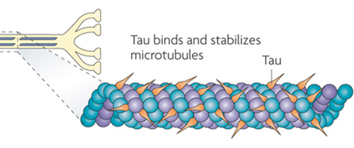
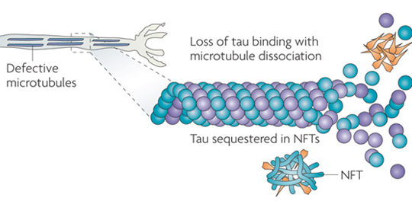
Role of tau in AD
Healthy tau:
Normally found in axons
Stabilizes cytoskeleton
Neurofibrillary tangles:
Tau separates from cytoskeleton
Tau aggregates within NFTs
Cytoskeleton becomes unstable
Notes:
Tau is a small protein that stabilizes microtubules.
Same idea as amyloid beta: serves a useful purpose in the healthy neuron, but can be harmful when normal regulation breaks down

Slide 23
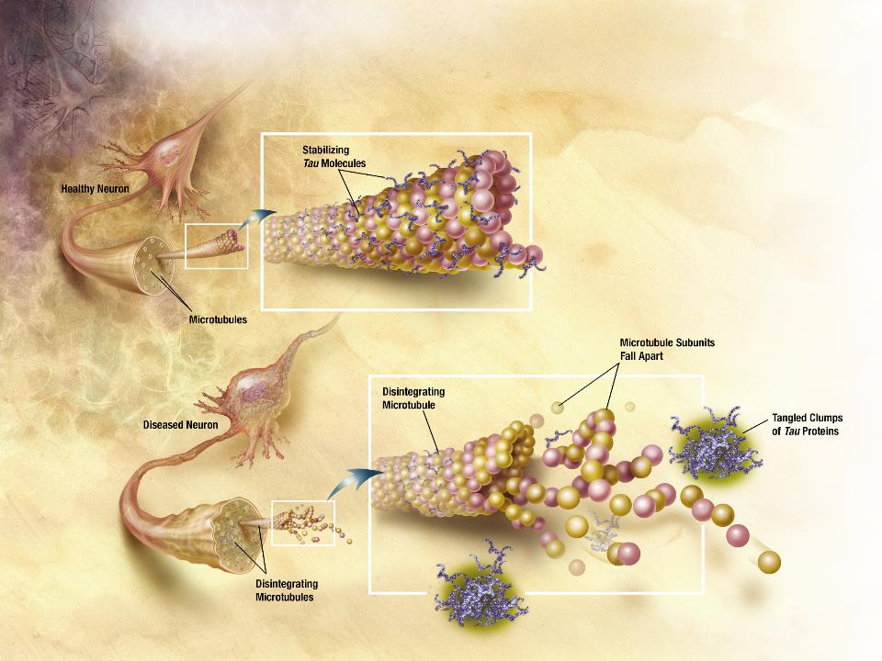
Notes:
Illustration of stabilizing tau molecules in a healthy neuron, versus tangled clumps of tau and disintegrating microtubules in a diseased neuron.

Slide 24
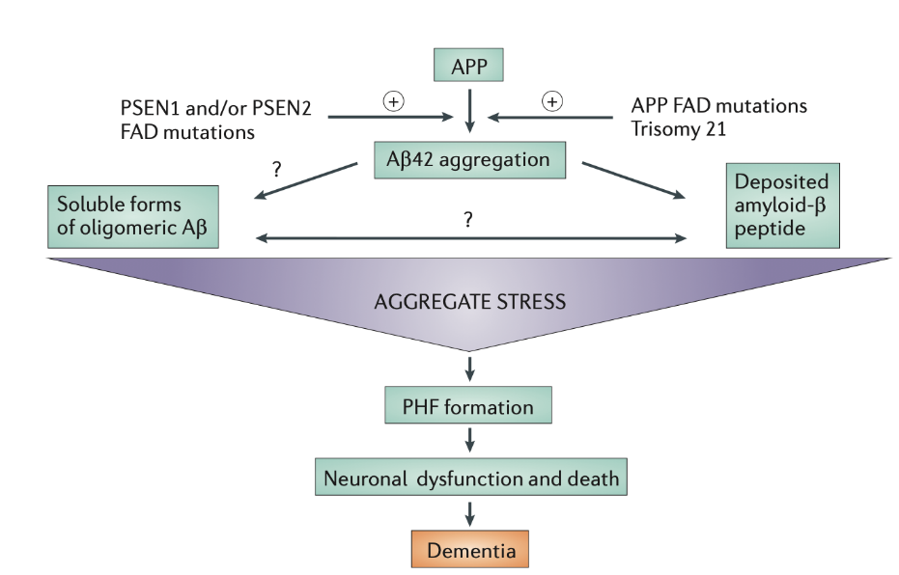
What comes first?
(tau)
Karran et al., 2011
Notes:
What comes first? Some researchers have proposed a sequence of molecular steps that lead to dementia. Here, we see a proposed model where amyloid beta plaques cause stress to neurons, leading to the formation of “paired helical filaments” (made of tau). These PHFs are thought to be toxic to neurons. Finally, large amounts of neuron death result in dementia. (However, it’s also possible that amyloid itself can be toxic to neurons.)

Slide 25
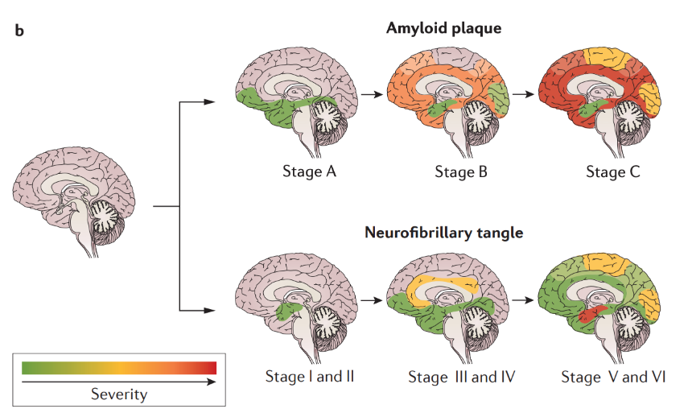
Spread of amyloid, tau, and neurodegeneration

Slide 26
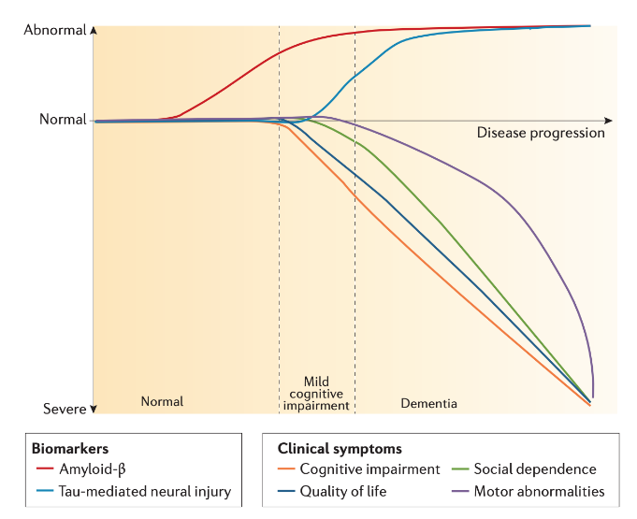
Spread of amyloid, tau, and neurodegeneration
Notes:
Amyloid beta is often observed long before cognitive symptoms appear, whereas tau levels seem to increase hand-in-hand with the severity of clinical symptoms.
https://www.nature.com/articles/nrdp201556.pdf

Slide 27
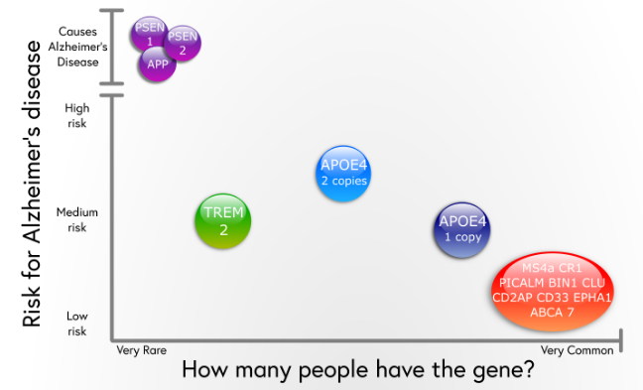
Genetic risk factors for AD
Related to amyloid
Notes:
Many mutations which increase AD risk affect proteins related to amyloid and tau.
However, other, more common mutations which increase risk have been found that relate to other brain cells and potential disease processes.
While it might seem really promising that we know which genes can definitely cause AD, let’s pause to understand how many AD cases have a genetic cause.

Slide 28
Not all AD is inherited
Familial AD (fAD)
Inherited (genetic) cause
Sporadic AD (sAD)
No family link
Likely caused by genetics and lifestyle
Early onset (<10% of cases)
Before age 65
Genetic causes
More likely to be fAD
Late onset (>90% of cases)
After age 65
More likely to be sAD
Notes:
Sporadic = random
Genetic causes include Down’s syndrome (extra copy of chromosome 21, where APP is)

Slide 29
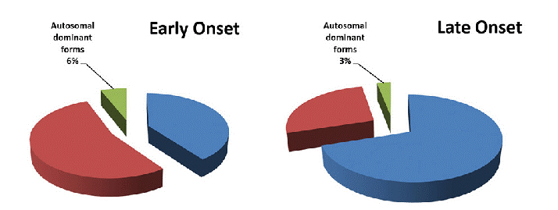
Breakdown of AD cases
Early Onset
Late Onset
Autosomal dominant 6%
Autosomal dominant 3%
sAD
40%
fAD 27%
fAD
54%
sAD
70%

Slide 30
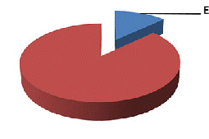
Breakdown of AD cases
Early Onset
Late Onset
Autosomal dominant 6%
Autosomal dominant 3%
sAD
40%
fAD 27%
fAD
54%
sAD
70%
Early onset
13%
Late onset
87%
Notes:
Conclusion: direct genetic causes account for small fraction of total AD cases
Discussion question: What else could contribute to developing AD?

Slide 31
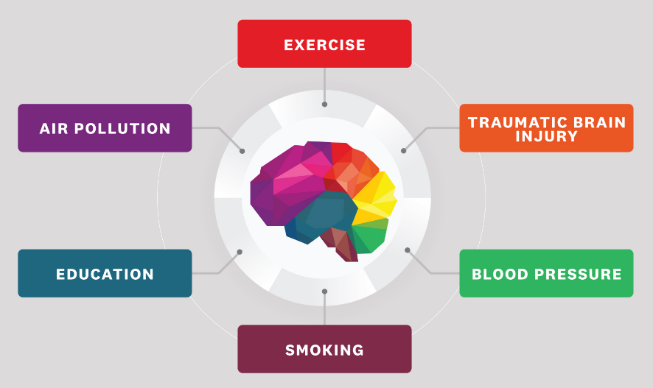
Other risk factors for AD
Notes:
Regular exercise, education level, and regular social/mental activity can lower risk.
Environmental harms (e.g. air pollution or environmental toxins), smoking, diabetes, obesity, hypertension (high blood pressure) can increase risk.
Mild traumatic brain injury = 2x risk

Slide 32
(Nov 4, 2019)
High amyloid/tau No cognitive decline = AD resilience
Why do some people develop severe disease while others don’t?
Amyloid pathology
Tau pathology
Cognitive decline
AD
Notes:
On the flip side, not everyone with amyloid or tau pathology gets the disease. Some people appear to have high cognitive reserve, meaning their minds have greater resistance to damage of the brain. In other words, someone with high cognitive reserve would need to accumulate more damage before exhibiting symptoms of AD or dementia. Notable examples of people with cognitive reserve:
Woman in a Colombian family with history of fAD (Stat News, New York Times)
Priests, nuns, and monks (Newsweek)
Part of it could be preventative habits or lifestyle, but it also suggests that the biology of the disease is much more complex than amyloid and tau.

Slide 33
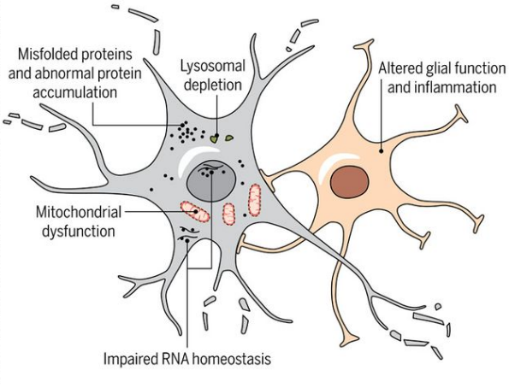
Beyond amyloid and tau
Other mechanisms of AD progression:
Neural circuit disturbances
Interactions between neurons and other brain cells (glia)
Disrupted blood flow to the brain
Immune reaction
Notes:
Amyloid could be an early contributor, but much more happens to perpetuate the disease.
As we discussed in the first lecture, the brain consumes a lot of energy and is highly metabolically active in order to generate ATP, send signals, make and maintain connections, etc. Maintaining all of these processes is crucial for the health and survival of all the cells in the brain. When one, some, or all of these processes get disrupted, neurons become unhealthy and eventually die. Some well-studied phenomena include the buildup of toxic products or depletion of protective structures, which happens because the processes that normally maintain homeostasis (balance) are no longer working as effectively. Furthermore, a feedback loop can occur, where unhealthy or dying cells can release molecules that trigger inflammation or disease in nearby cells, both neurons and glia. At this point, the disease could be progressing independently of the initial triggering molecules like amyloid beta or tau.
ASK FOR QUESTIONS IF STUDENTS WANT ANY OF THE CONCEPTS CLARIFIED!!

Slide 34
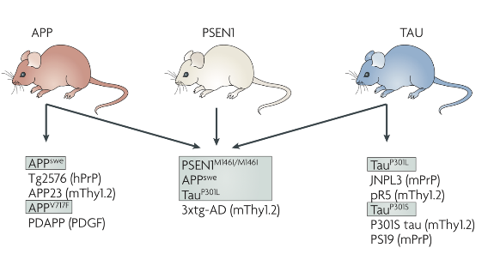
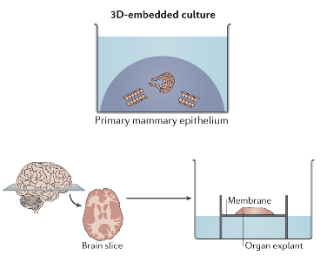
Modeling AD in the lab
Knowledge of amyloid and tau has allowed scientists to create models of AD to study potential mechanisms and treatments for AD.
Mouse models
Cell culture
Human tissue
Notes:
(1) Mouse models (2) Cell culture, mini-brain organoids (3) Human tissue (ex vivo studies or analysis of tissue)

Slide 35
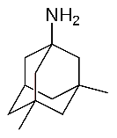
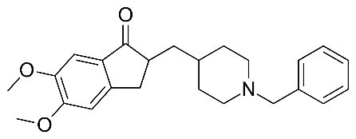
Treatments for AD
Exercise, memory training, and social engagement can lower risk and improve quality of life.
Two classes of approved drugs:
Acetylcholinesterase (AChE) inhibitors
NMDA receptor (NMDAR) antagonists
These treat disease symptoms, but don’t slow/stop AD.
Memantine:
Donepezil:
Notes:
Also only “sort of” treat symptoms for a short period (like a year), don’t stop or slow disease at all
Discussion question: Why don’t we have more AD drugs?
To understand the challenges of making an AD drug, we have to understand a little bit about how all drugs are developed

Slide 36
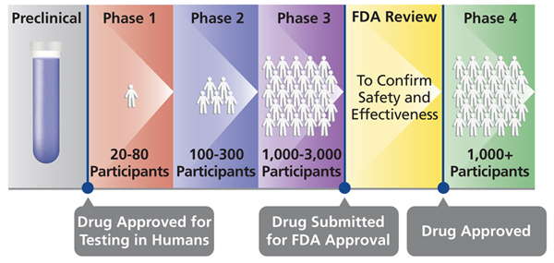
Clinical trials in the US
Notes:
Discussion questions:
How long do you think each step takes?
How much do you think it costs to get a drug all the way to FDA review? (over $1B)
How much do you think it costs to get an AD drug all the way? (as of 2014, $5.7B)
Clinical trial difficulties: biomarkers of disease and of patient subpopulations
Need for standard, validated cognitive assessments and endpoints
How many drugs do you think have made it all the way to Ph4 for AD?

Slide 37
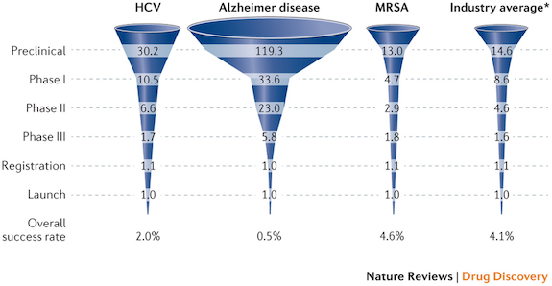
Many try, but few succeed
Notes:
Discussion questions:
Why do you think the success rate is low?
Is it surprising to you that there are so many drugs in the preclinical stage?
Many different kinds of targets to test, because there’s no single mechanism of the disease
Business perspective: even though it’s expensive to develop, the large # of potential patients means they can earn lots of money

Slide 38
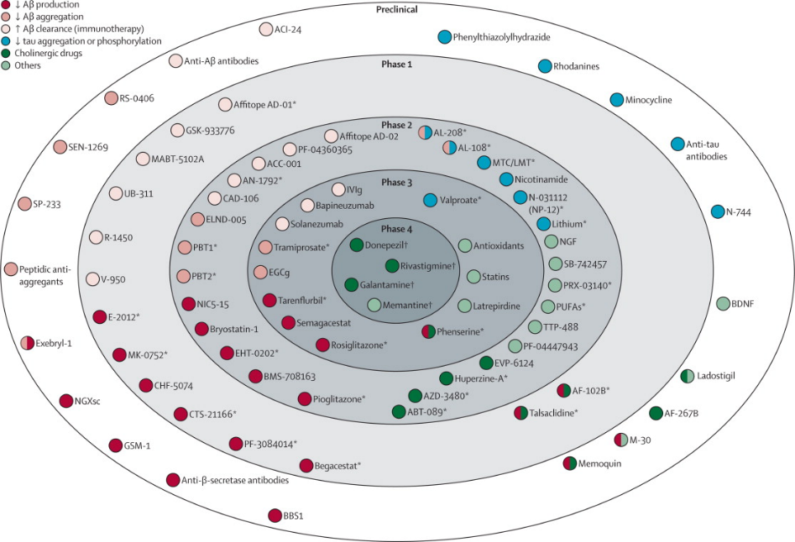
Notes:
Over 400 clinical trials were run between 2002 and 2012, but only one drug was approved
Many drugs focus on AB (all red-tinted circles here). Too little, too late to remove AB? Damage already done.

Slide 39
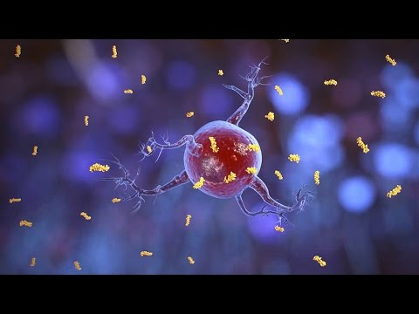
Potential new treatments
Notes:
Gamma stimulation for AD -- being developed here at MIT Picower Institute, and in clinical trials. Completely non-invasive 40Hz flashes of visible light or sound.
https://picower.mit.edu/innovations-inventions/genus

Slide 40
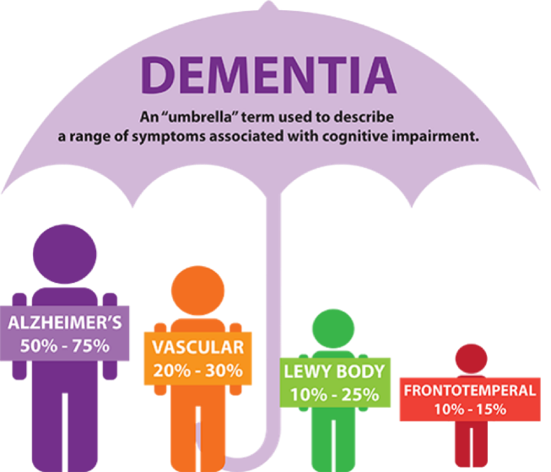
Other causes of dementia
Notes:
Returning to the beginning of this lecture, we can now understand that the behavioral presentation of dementia has an extremely complicated biological foundation. AD is the most common cause of the syndrome (group of symptoms) called dementia, but there are other causes that are independent of what we discussed today.

Slide 41
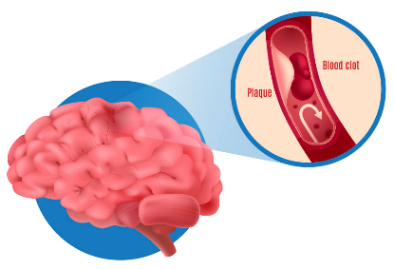
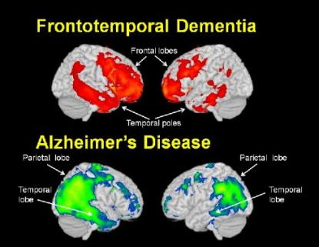
Non-AD dementia
Vascular dementia:
Caused by lack of proper blood flow to brain
Strokes or blood vessel narrowing
Lack of oxygen kills brain cells
Can happen in addition to AD
Other forms of dementia:
Unknown causes
Notes:
Second most common cause of dementia is vascular dementia. As the name implies, the cause has to do with the cardiovascular system -- your heart, blood vessels, and blood. When blood flow to the brain is reduced or completely blocked in the case of a stroke, the lack of oxygen kills brain cells and damages the region of the brain which was deprived of blood. It can actually happen at the same time as AD, and is differentiated by its cause (in this case, specifically linked to strokes or cardiovascular events). Risk factors for vascular dementia include high blood pressure/cholesterol, history of heart disease/strokes, diseases/conditions of blood vessels such as atherosclerosis, diabetes, smoking, obesity...
Other forms of dementia, like Lewy body dementia or frontotemporal dementia, are basically variants of dementia which have different molecular signatures from AD. For example, the brain regions affected in FTD (the frontal and temporal lobes) are the opposite of the brain regions typically affected by AD, and there are usually few plaques. Lewy body dementia is characterized by the accumulation of a different protein called alpha-synuclein, which is distinct from amyloid, and is actually related to Parkinson’s disease, a different neurodegenerative disorder. The causes of these rarer forms of dementia are not well understood.

Slide 42
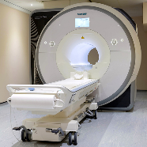
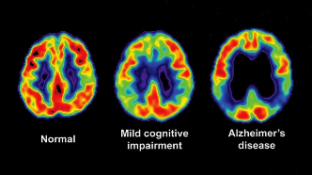
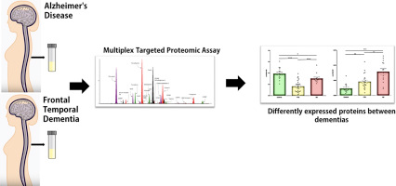
Diagnostics for AD/dementia
The challenge of developing better diagnostics revolves around detecting AD/dementia early.
MRI and PET imaging
Structure
Brain activity
Metabolism
Amyloid/tau presence
Cerebrospinal fluid (CSF) sampling
Notes:
The colorful brain images show general brain activity levels (impaired in disease), but PET can also be used to measure amyloid plaque / tau tangles accumulation

Slide 43
A researcher’s perspective
Rudolph Tanzi: ‘Make It Your Goal to Come Up With Something That Lasts’
https://time.com/collection-post/4011453/rudolph-tanzi-alzheimers-research/

Slide 44
Discussion
How can we develop effective treatments for Alzheimer’s or dementia?

Slide 45
Questions?

Slide 46
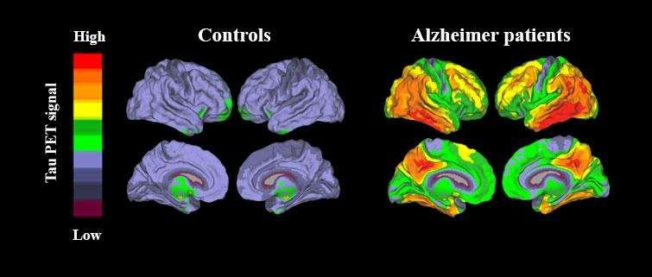
Detecting tau via neuroimaging

Slide 47
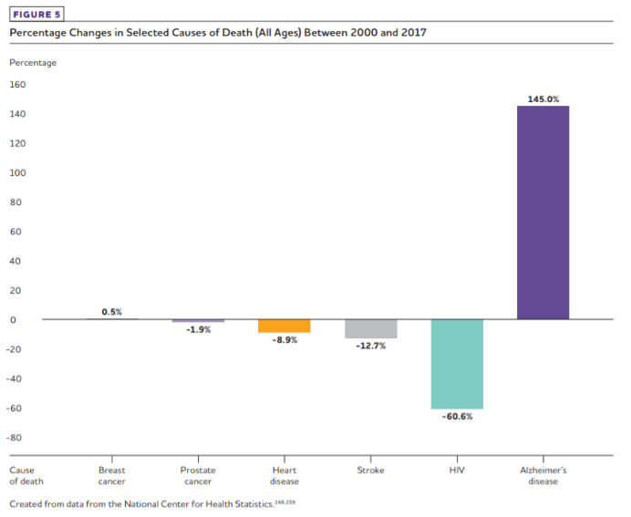
AD is the 6th most common cause of death, and rising
Notes:
As we develop treatments for other disorders, reduce the infection rate of certain diseases, and improve public health such that more people live long enough to develop AD, the overall percentage of people who then die with AD will increase.

Slide 48
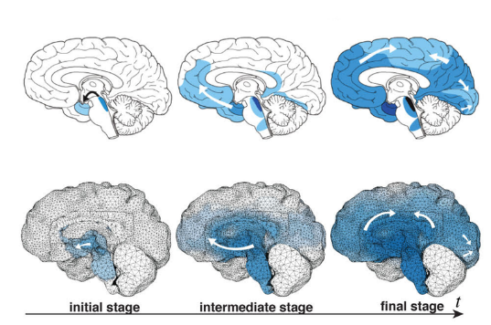

Slide 49
Amyloid and tau

