Slide 1
Introduction to Genetic Analysis
Lecture I

Slide 2
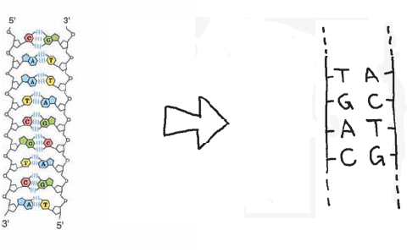
What is a gene?

Slide 3
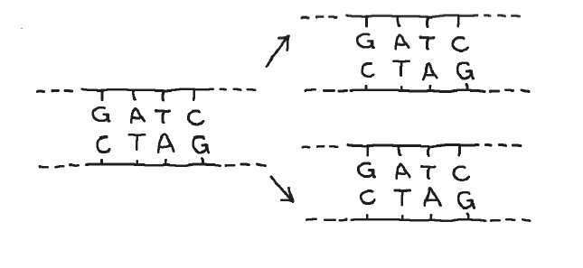
DNA Replication

Slide 4

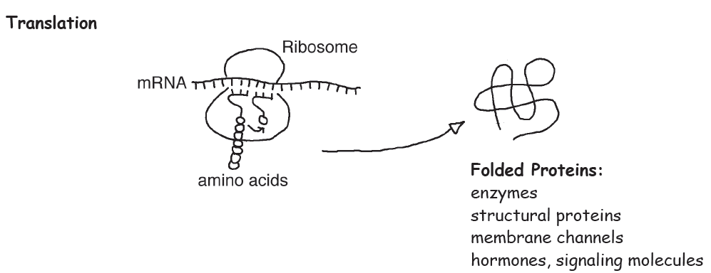
Protein Synthesis

Slide 5

What is a gene?

Slide 6
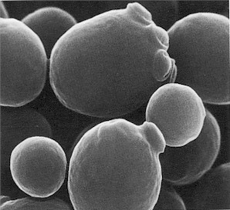
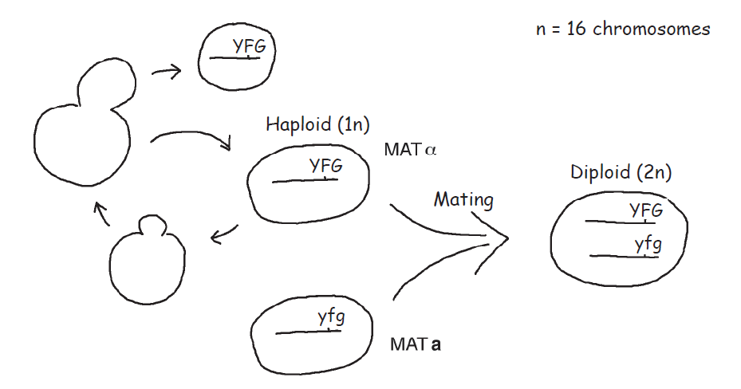
Saccharomyces cerevisiae

Slide 7

Dominance/Recessive Test

Slide 8

Dominance/Recessive Test

Slide 9

Complementation Test

Slide 10
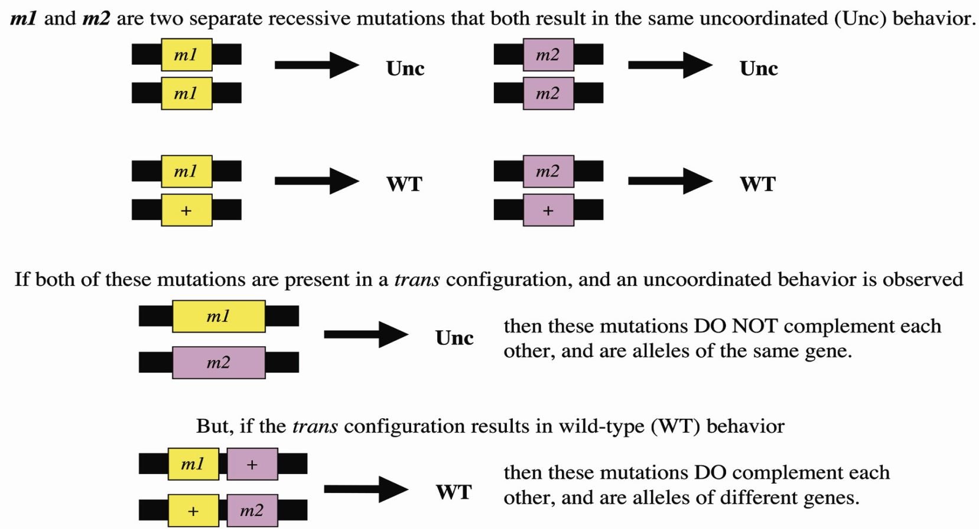
Complementation Test

