Slide 1
Memory, Bears, and South Dakota
Splash 2023

Slide 2
Introductions!
Name, grade, anything you’ve memorized

Slide 3
Structure
I tell you about an experiment or image.
You teach me what it means.
Then I’ll say what you said, but with fancier words.

Slide 4


Slide 5
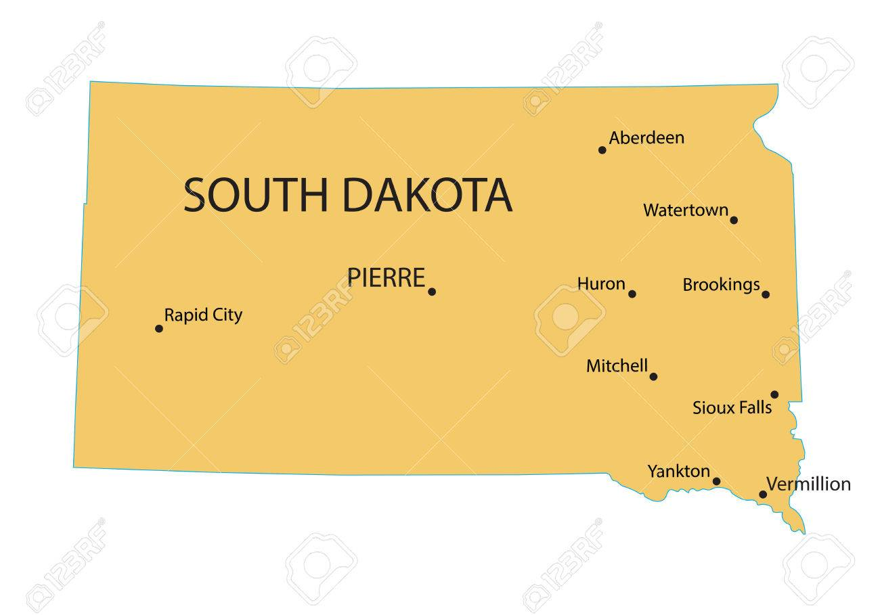

Slide 6
Why could I remember one list better than the other?
How often I tried to recall the list
What representation the items had in my head
How I organized the items in my head
Prior knowledge with bears vs. South Dakota cities

Slide 7
General questions
What information do we remember?
How can we try to remember information better?
How big of a role is memorization in learning?

Slide 8
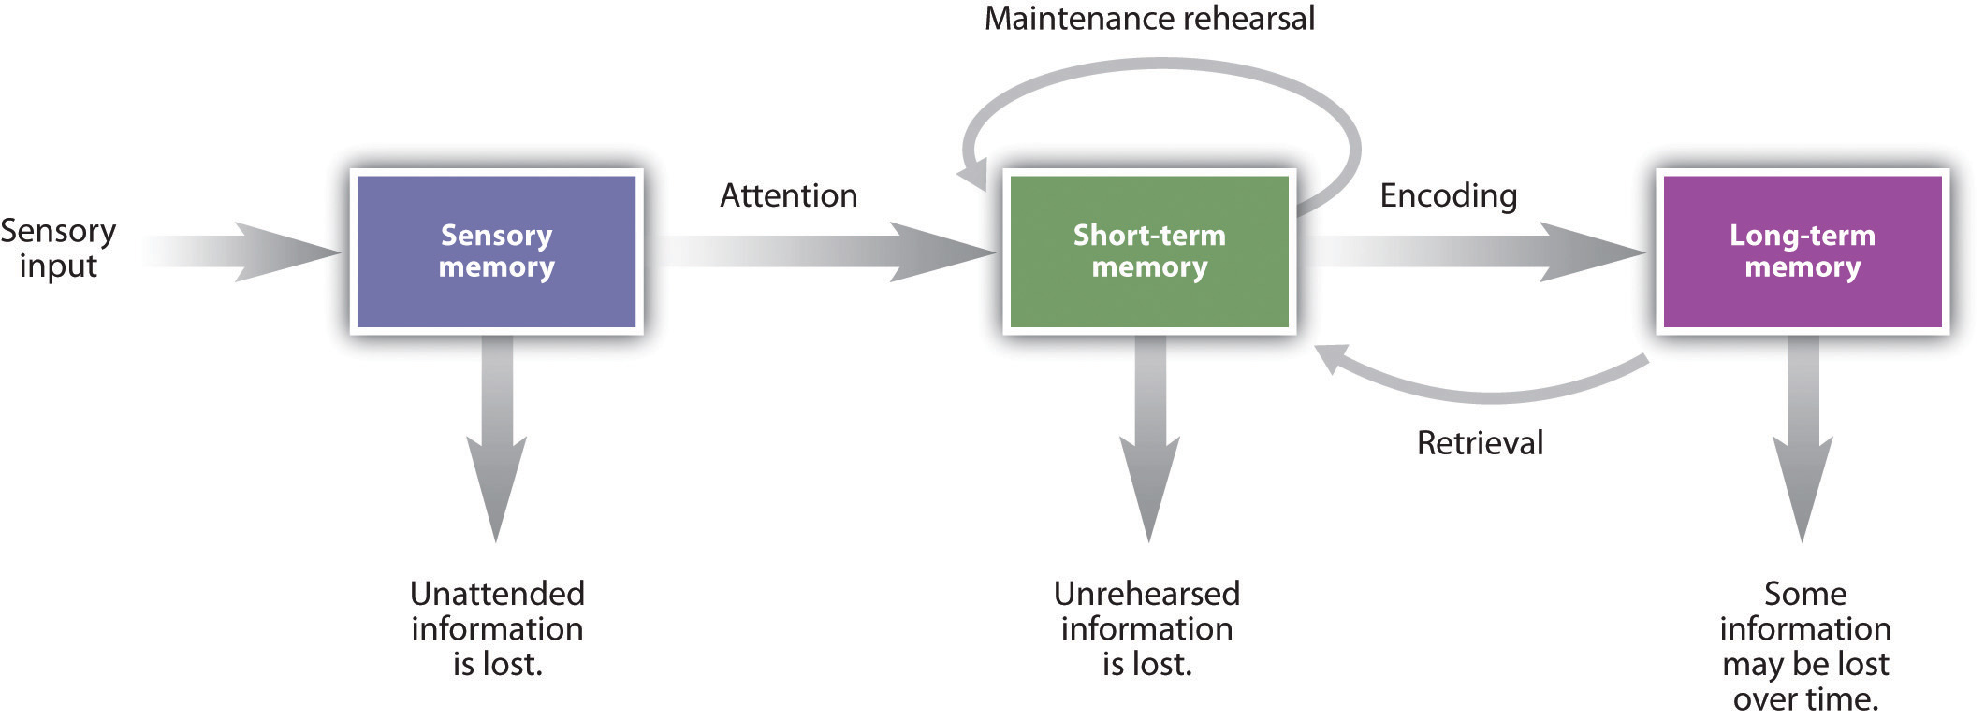
Everything today will be based on the three-stage memory model

Slide 9
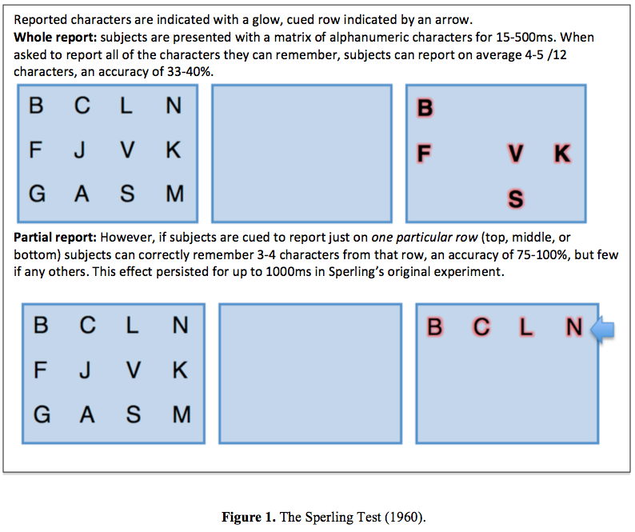

Slide 10
We have a large capacity for sensory memory, but not much for short-term memory

Slide 11
Volunteer time! (1)
Close your eyes.
I’ll read out some numbers, then I’ll ask you to repeat them.
The numbers will be on the board for the rest of us.

Slide 12
Memory span game
Span of 4: 6 1 9 4
Span of 5: 3 7 8 5 2
Span of 6: 9 6 5 2 8 3
Span of 7: 4 2 6 9 8 5 1
Span of 8: 8 1 6 3 7 2 4 9
Span of 9: 6 2 5 7 3 4 9 8 1
Span of 10: 9 3 8 2 4 7 1 5 3 6
Span of 11: 5 8 1 4 7 9 3 2 6 1 7

Slide 13
Our short-term memory can only store so many chunks of information at once.
“The Magical Number Seven, Plus or Minus Two: Some Limits on Our Capacity for Processing Information”
Applies to bits, digits, and words identically

Slide 14
People were asked to memorize chess positions…

Slide 15
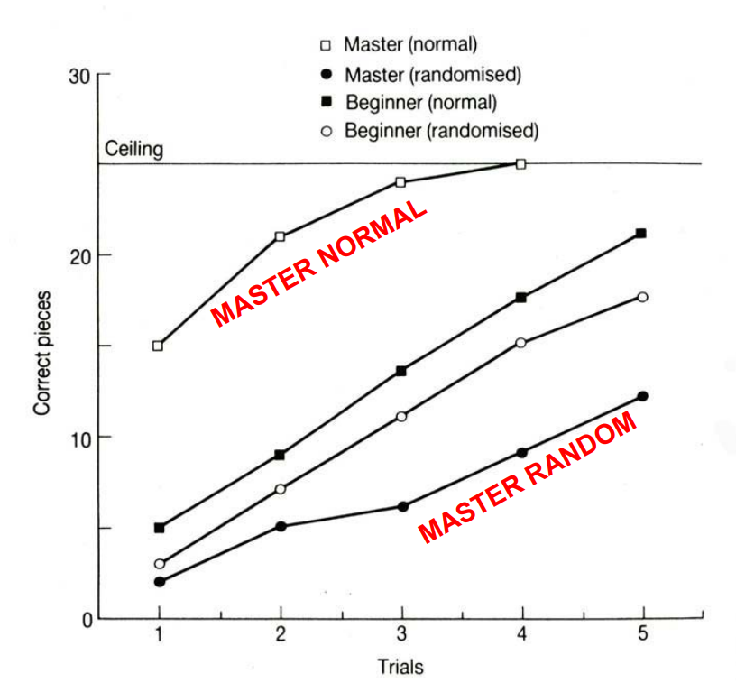

Slide 16
Background knowledge is both a benefit and a cost.

Slide 17
Volunteer time! (everyone)
I’ll read out ten words.
After I’m done reading, write as many as you can on a piece of paper (or log on your phone).

Slide 18
Answers
Mailbox
Sardine
Shotgun
Peacock
Credit
Detail
Flicker
Airline
Spinach
Clarinet

Slide 19
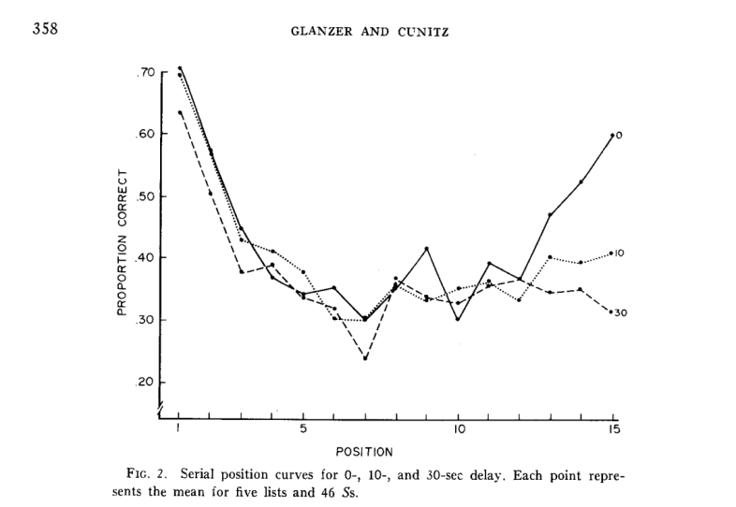

Slide 20
The first and last words are memorized more often.
Primacy effect is on long-term memory.
Recent effect is on short-term memory.

Slide 21
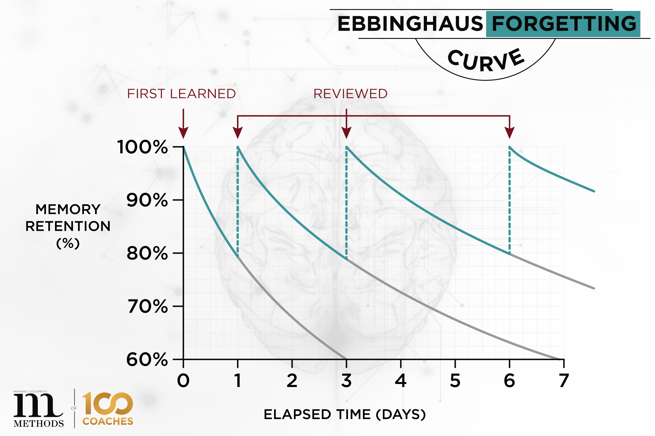

Slide 22
The Ebbinghaus forgetting curve tells us we forget things quickly over time unless we review them.

Slide 23
Volunteer time! (everyone)
Group A:
  If the word is in CAPITAL letters, tap your left hand.
  If the word is in lowercase letters, tap your right hand.
Group B:
  If the word names a living thing, tap your left hand.
  If the word names a non-living thing, tap your right hand.

Slide 24
Words!
SPIDER
chair
FOX
TRUCK
lamp
BEE
tiger
boat
RABBIT
tractor
bed
BUTTERFLY

Slide 25
The method of encoding the information changes how much is committed to short-term memory.
Shallow encoding (noting capital/lowercase) is like cramming.
Deep encoding (noting living/non-living) is like studying for meaning.

Slide 26
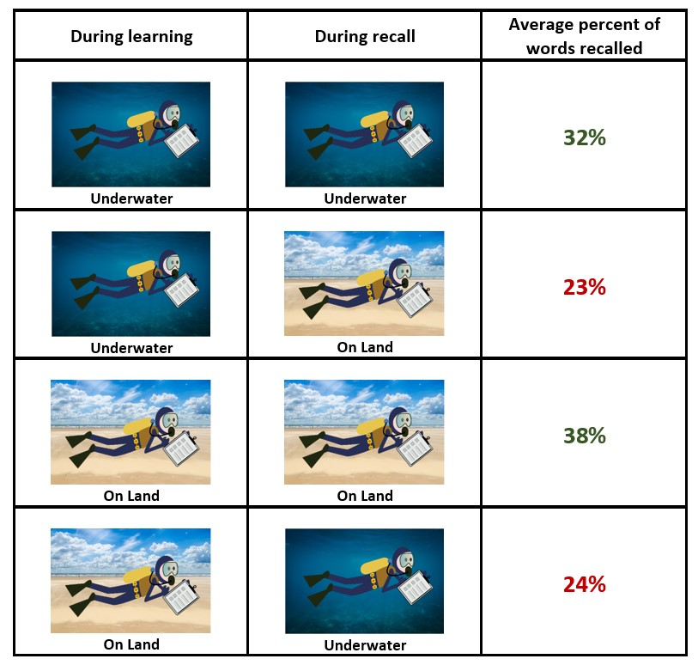

Slide 27
Memory under the same context as learning the information is better.

Slide 28
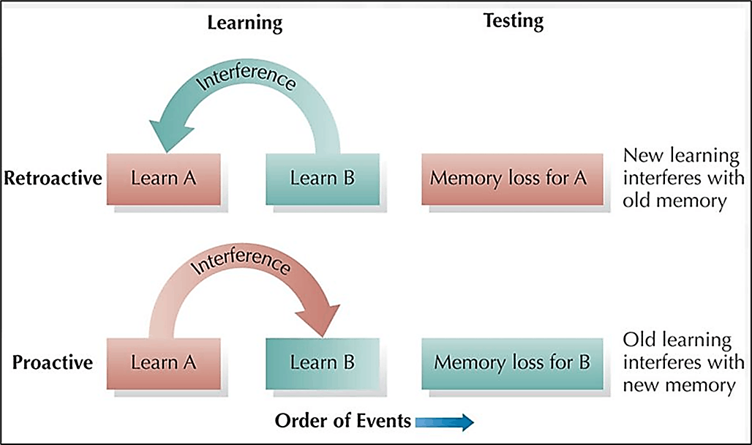

Slide 29
People were asked to memorize random syllables…

Slide 30
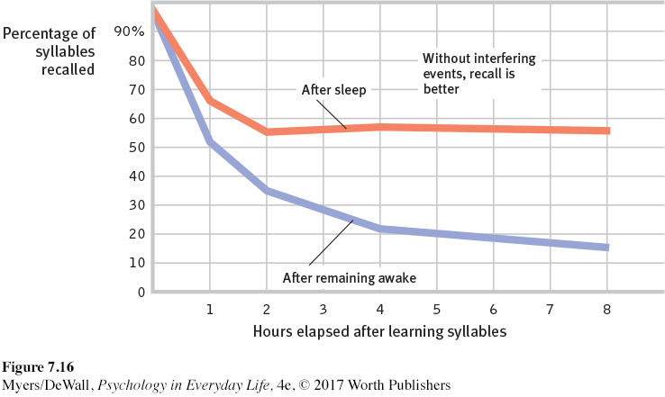

Slide 31
Sleep improves memory because no retroactive interference + it helps solidify memories.
Lots of deep biology here that people are still investigating

Slide 32
People were asked to memorize lists of items followed by long pauses between trials…
For example:
  Banana, peach, apple [count down from 138]
  Plum, apricot, lime [count down from 245]

Slide 33
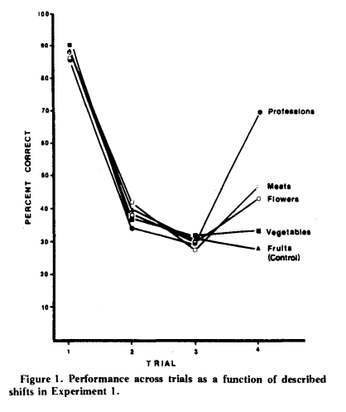

Slide 34
Proactive interference results from previous trials affecting future trials.
But with an entirely different group, interference is erased.

Slide 35
Volunteer time! (everyone)
I’m going to read a list of words.
Then I’ll ask you whether a word was on the list.

Slide 36
Answers
Door
Glass
Pane
Shade
Ledge
Sill
House
Open
Curtain
Frame
View
Breeze
Sash
Screen
Shutter
[no window!]

Slide 37
False memories can result from proactive or retroactive interferences.

Slide 38
The Mind of a Mnemonist
Alexander Luria studied a man named Solomon Shereshevsky, the only well-documented example of someone with perfect memory.
Shereshevsky was a journalist who never took notes.
When tested, he could perfectly recall everything, including examples where he had no background knowledge.
This level of memory had its downsides – sensory overload.
He was not aware that other people did not have perfect memory like him.

Slide 39
Flashbulb memories are memories made around extremely emotional moments.
Memory researchers interview people around traumatic events (9/11, Challenger disaster, Kennedy assassination).
Then they interview them a year later to see how their memory changed.
On average, people were too overconfident and their memories were subject to distortion.

Slide 40
People were shown a video then asked for information about the video…
The video contained a sports car hitting a pedestrian at a yield sign.
They were then asked one of three questions about what happened before the incident:
  A) Did another car pass the sports car while it was stopped at the yield sign? (consistent)
  B) Did another car pass the sports car while it was stopped at the stop sign? (inconsistent)
  C) Did another car pass the sports car while it was stopped at the sign? (neutral)

Slide 41
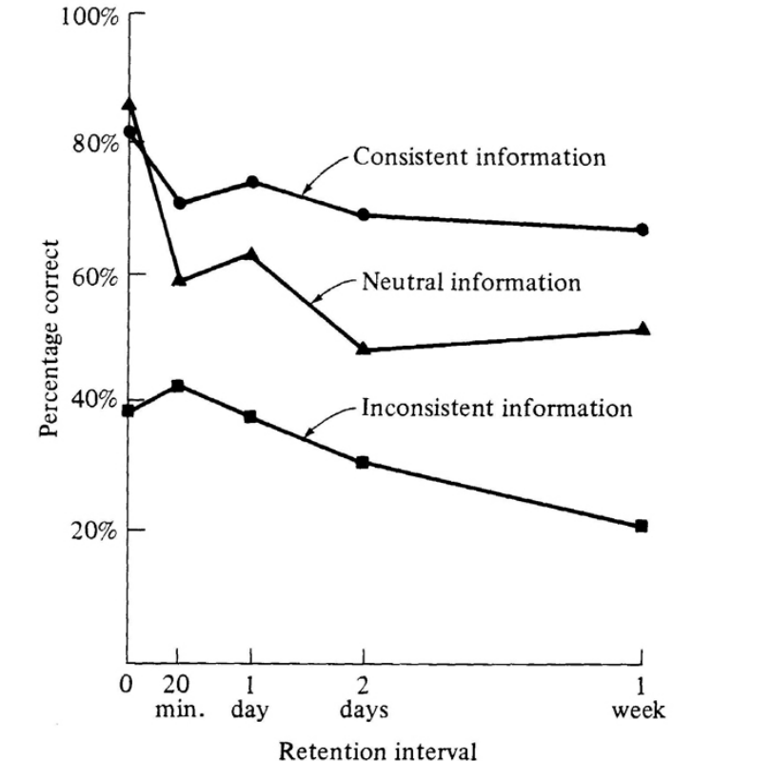

Slide 42
People’s eyewitness testimonies are malleable to the phrasing of questions.
Proper investigation and interrogations are important!

Slide 43
Moving onto memory techniques…
What are some techniques you use to memorize a list?
How big is memorization in your life?

Slide 44
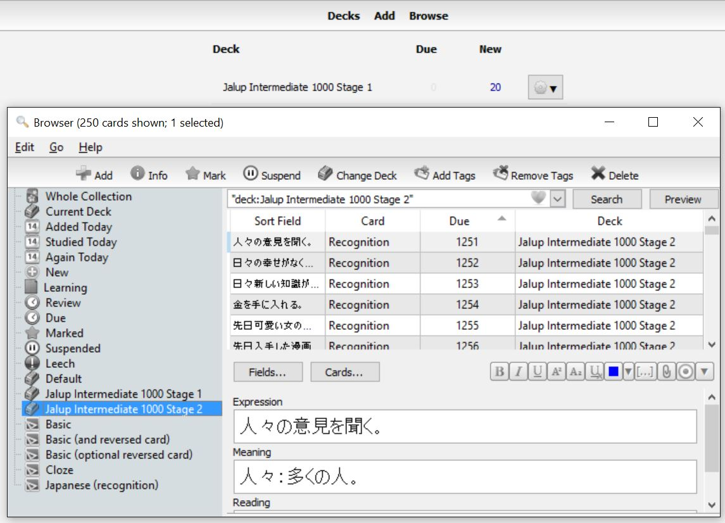

Slide 45
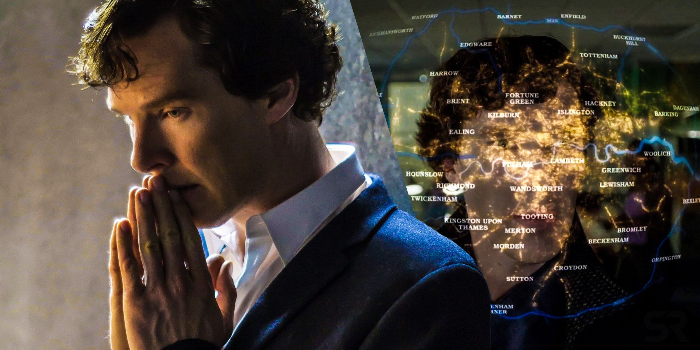

Slide 46
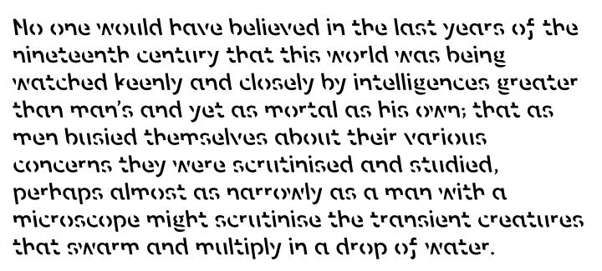

Slide 47
Thank you for coming!

