Slide 1
Photography Composition
Kiarash Adl

Slide 2
Introduction

Slide 3
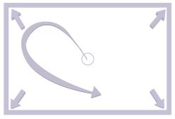
Frame Dynamics
The empty frame

Slide 4
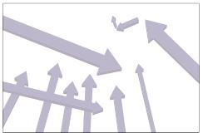
Frame Dynamics
Diagonal Tension

Slide 5
Frame Dynamics
Intersecting for Abstraction

Slide 6
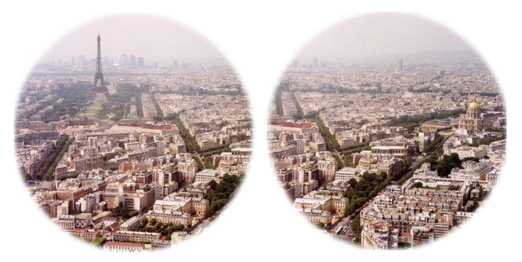
Frame Shape
Human Vision

Slide 7
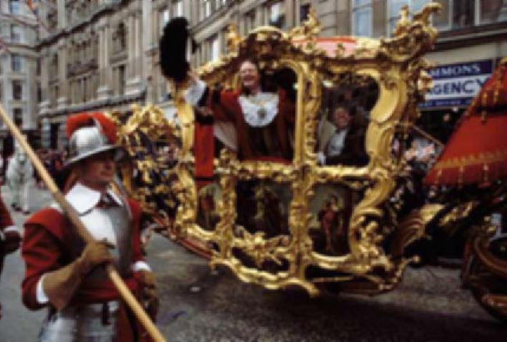
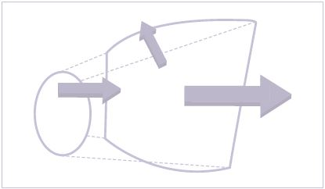
Frame Shape
Panorama of Blenheim Palace, Paris “the finest view in all of England”
The Standard 3:2 Frame

Slide 8
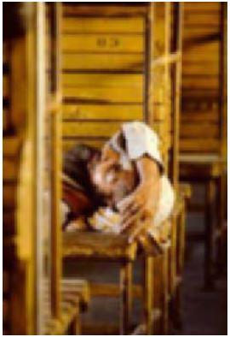
Frame Shape

Slide 9
Frame Shape
The multi-hued Grand Prismatic Spring in Yellowstone National Park

Slide 10
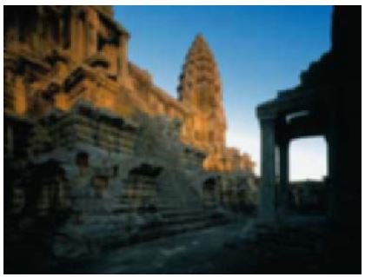
Frame Shape
An Uninsistent Frame
Vertical Subject in Horizontal Frames

Slide 11
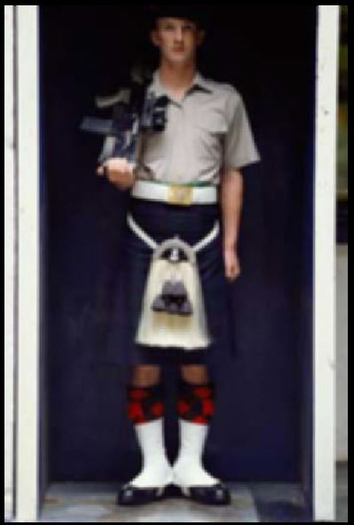
Frame Shape
Low in the Frame
Standing Figure

Slide 12
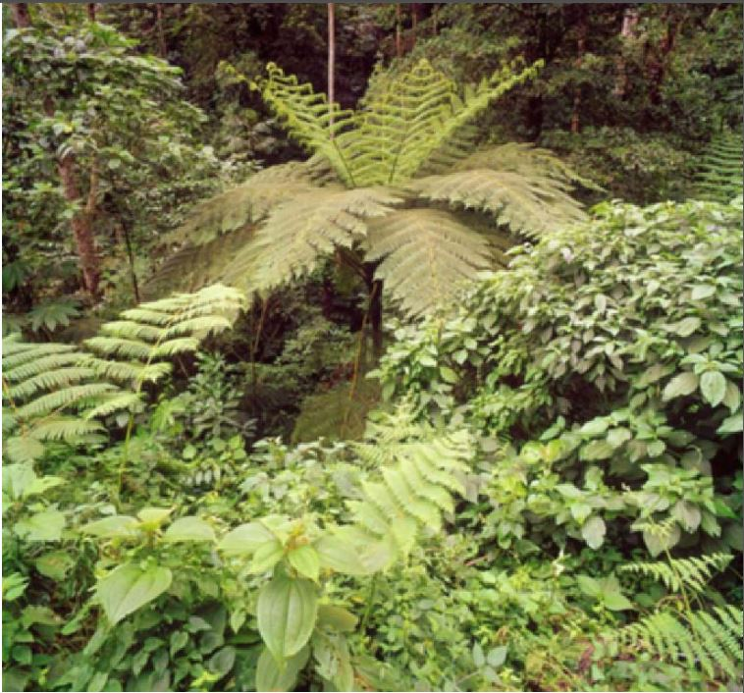
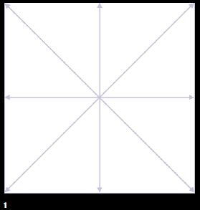
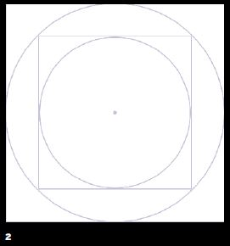
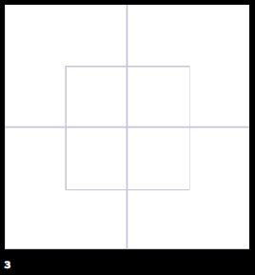
Frame Shape
The Square Frame

Slide 13
Stitching and Extending

Slide 14
Stitching and Extending
Large-Scale Image and Extra-Wide Coverage

Slide 15
Stitching and Extending

Slide 16
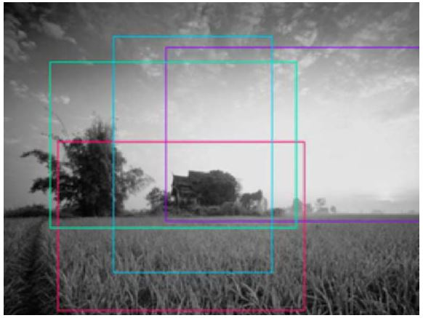
Cropping

Slide 17
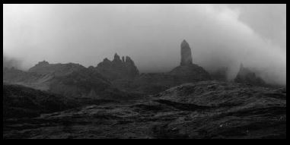
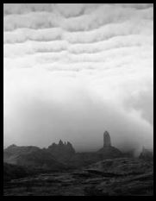
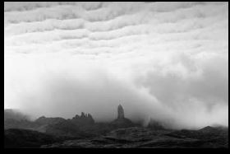
Cropping

Slide 18
Filling The Frame
Guinea Worm Filters

Slide 19
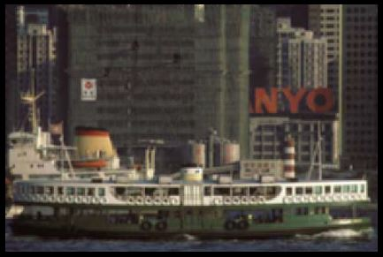
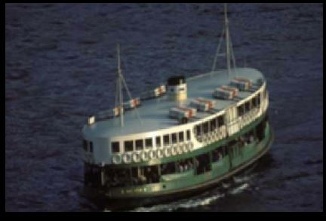
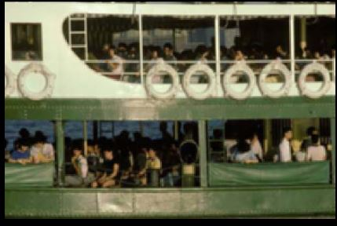
Filling The Frame

Slide 20
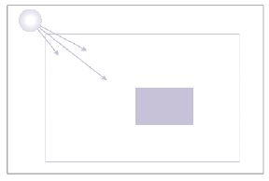
Placement
Stilted houses built in the middle of the Sulu sea

Slide 21
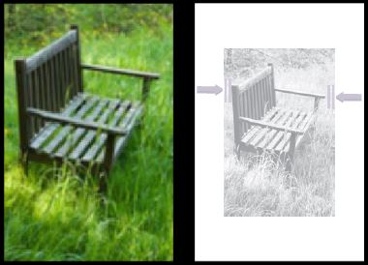
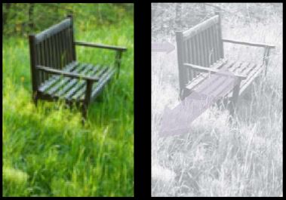
Placement

Slide 22
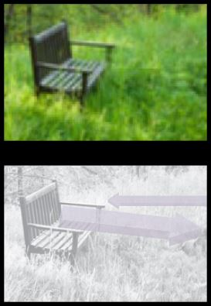
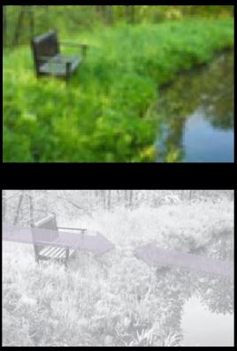
Placement

Slide 23
Dividing The Frame
On the left is a frame in the ratio 1.618 and on the right a standard 35mm frame

Slide 24
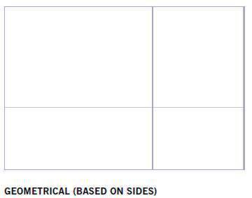
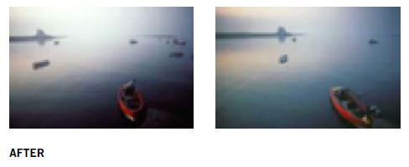
Dividing The Frame

Slide 25
Horizon
A natural, low position (Mono Lake, California)

Slide 26
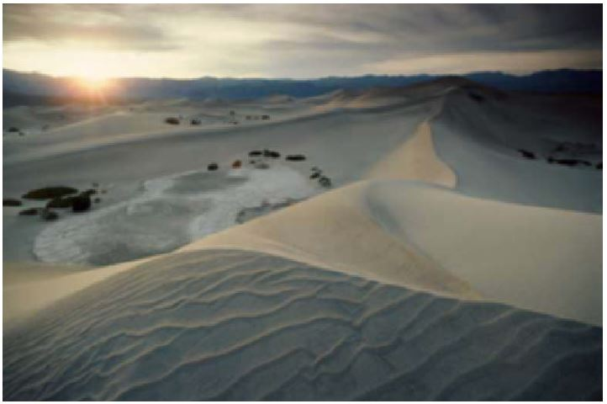
Horizon
Favoring The Sky vs. Neglecting The Sky

Slide 27
Horizon
A Choice of High or Low

Slide 28
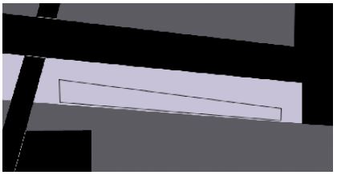
Frames Within Frames

Slide 29
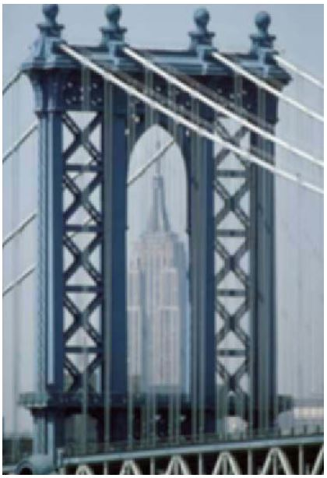
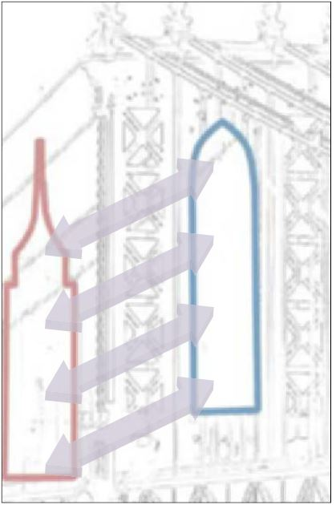
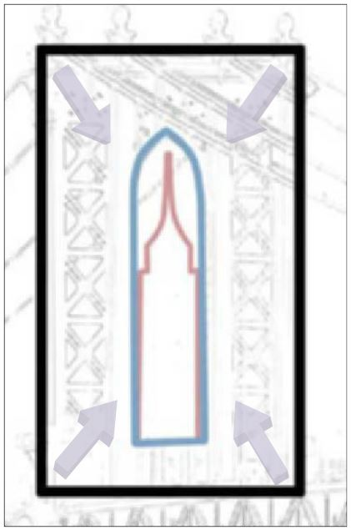
Frames Within Frames

Slide 30
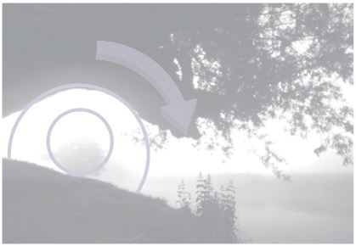
Frames Within Frames

Slide 31
What do you think?

Slide 32
What do you think?

