Slide 1
Introduction to Mycology!
Welcome to Summer HSSP 2019!

Slide 2

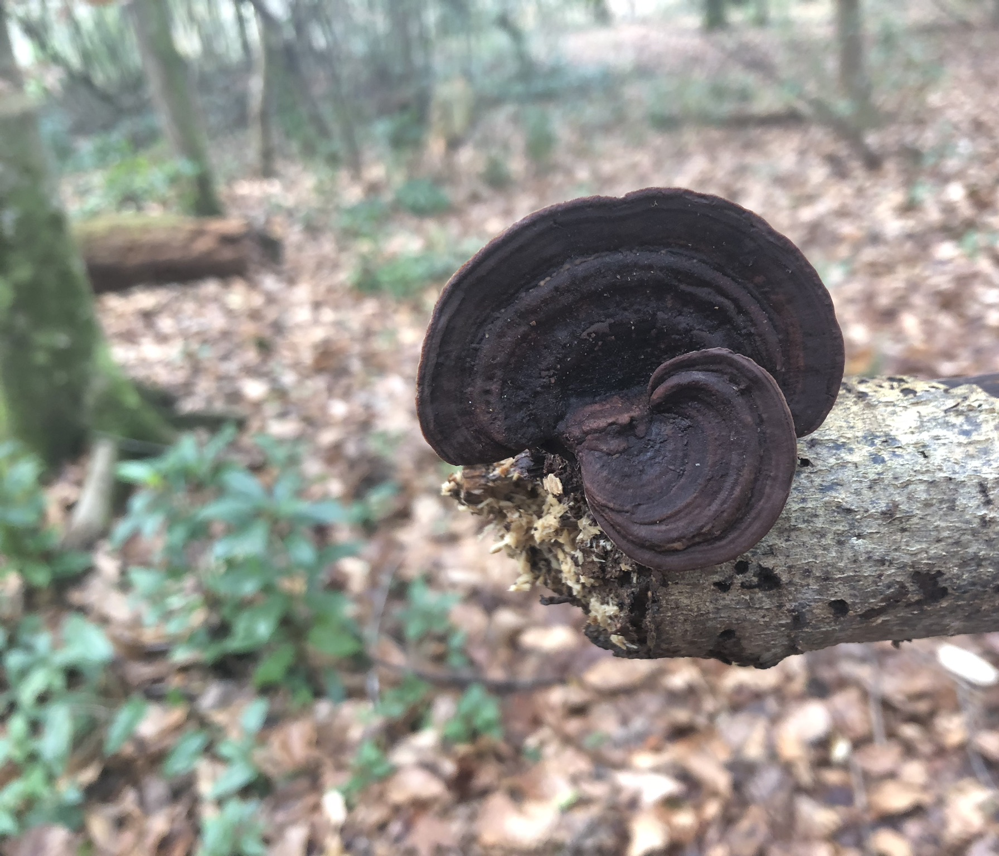
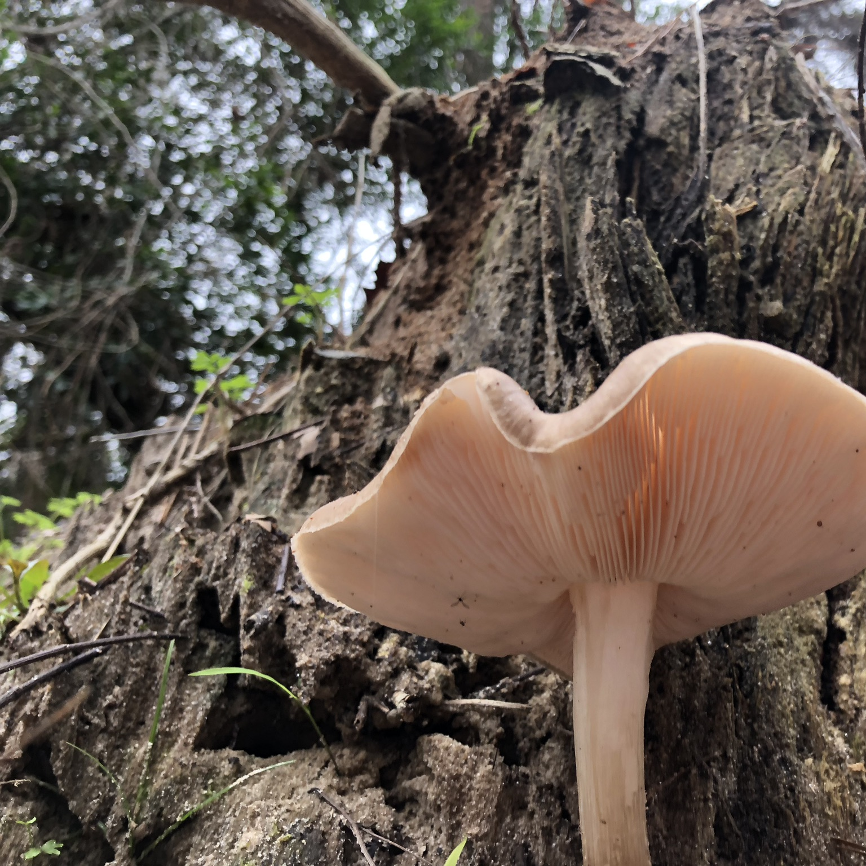
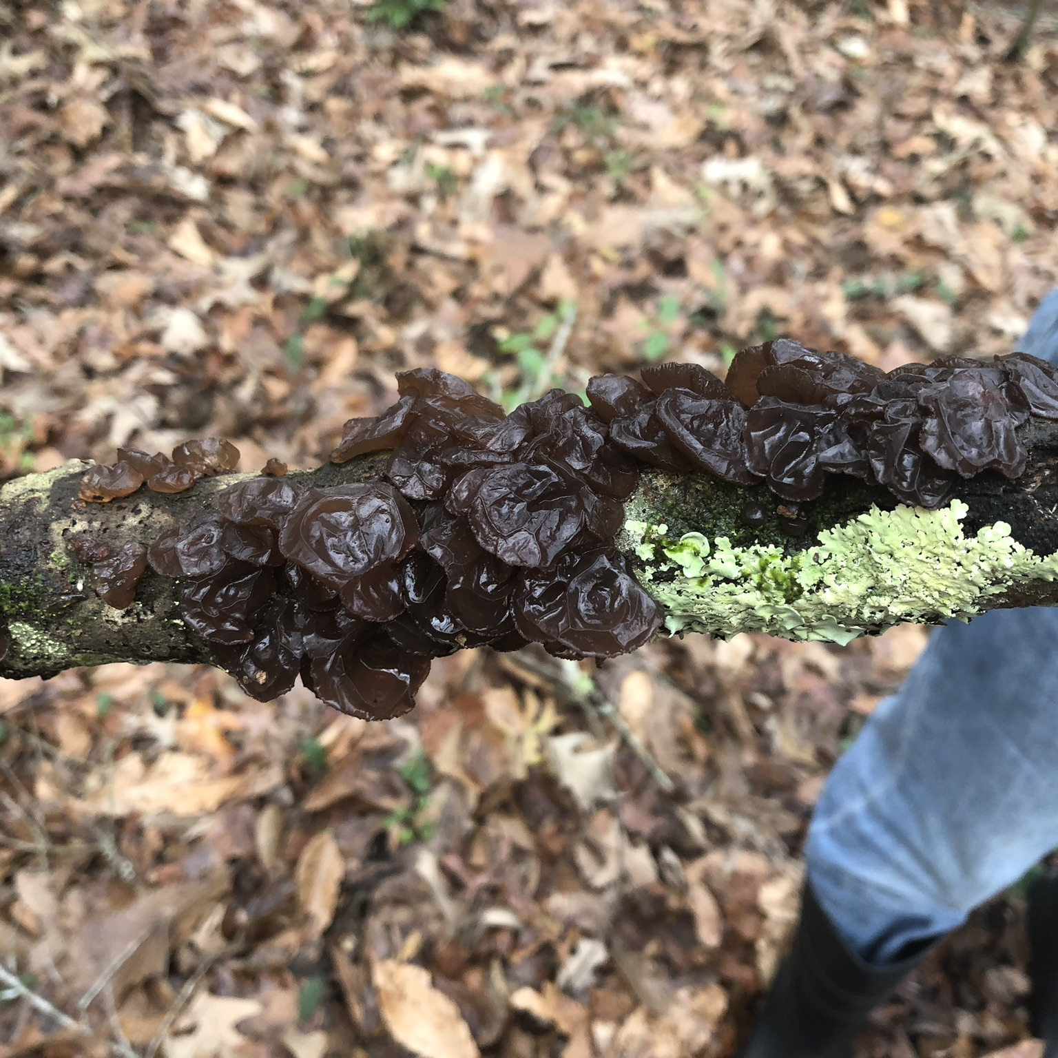
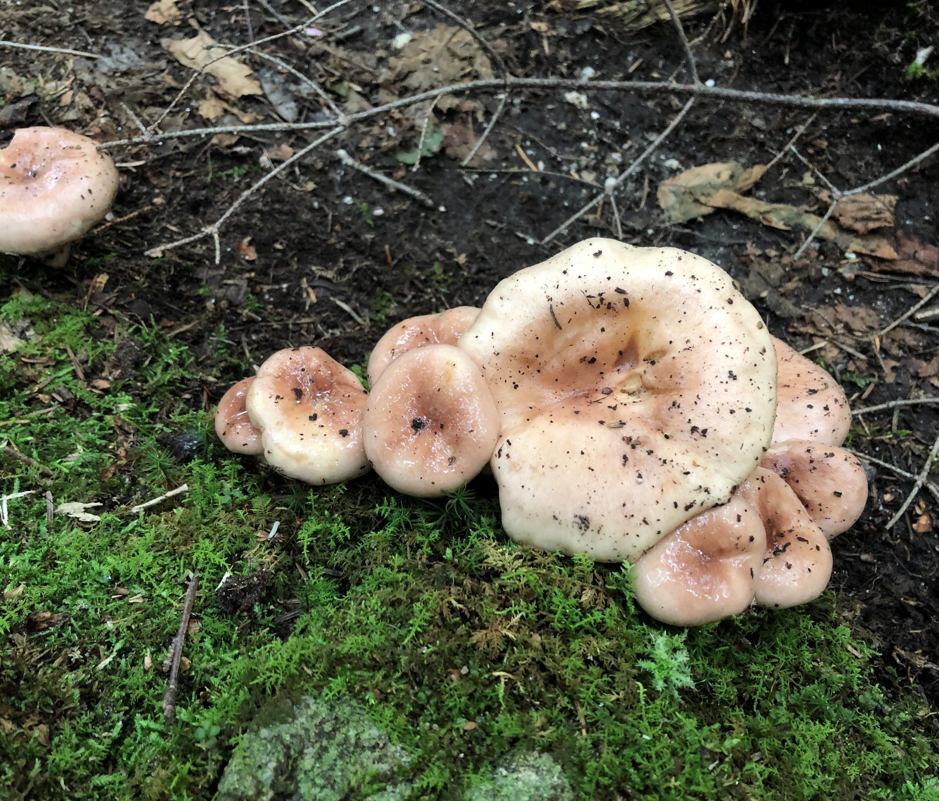
About your teacher!
Jenni!
From Portland, Maine
Student at Wellesley College (Wellesley, MA)
Doing research at MIT for the summer, doing this for fun
Very passionate mycologist and do it as a hobby on the side – taking pictures and identifying them
  Check out some of the pictures that I’ve taken!
Notes:
I decided to teach this class because I feel like it’s an underappreciated form of life that we don’t pay very much attention to even though it’s everywhere! Plants and animals get their spotlight but fungi often do not

Slide 3
Introduce yourselves!
Name
Grade
What school you go to
A fun fact about yourself! Or, why did you decide to take this class?

Slide 4
Class Overview
7 July
Introduction to Fungi
14 July
Reproductive and Life Cycle
21 July
Biochemistry of Fungi
28 July
Fungal Genetics
4 Aug.
Biology of Decomposition (WILL HAVE SUB)
11 Aug.
Fungal Symbioses – Lichens, Mycorrhizae
18 Aug.
Positive Applications of Fungi

Slide 5
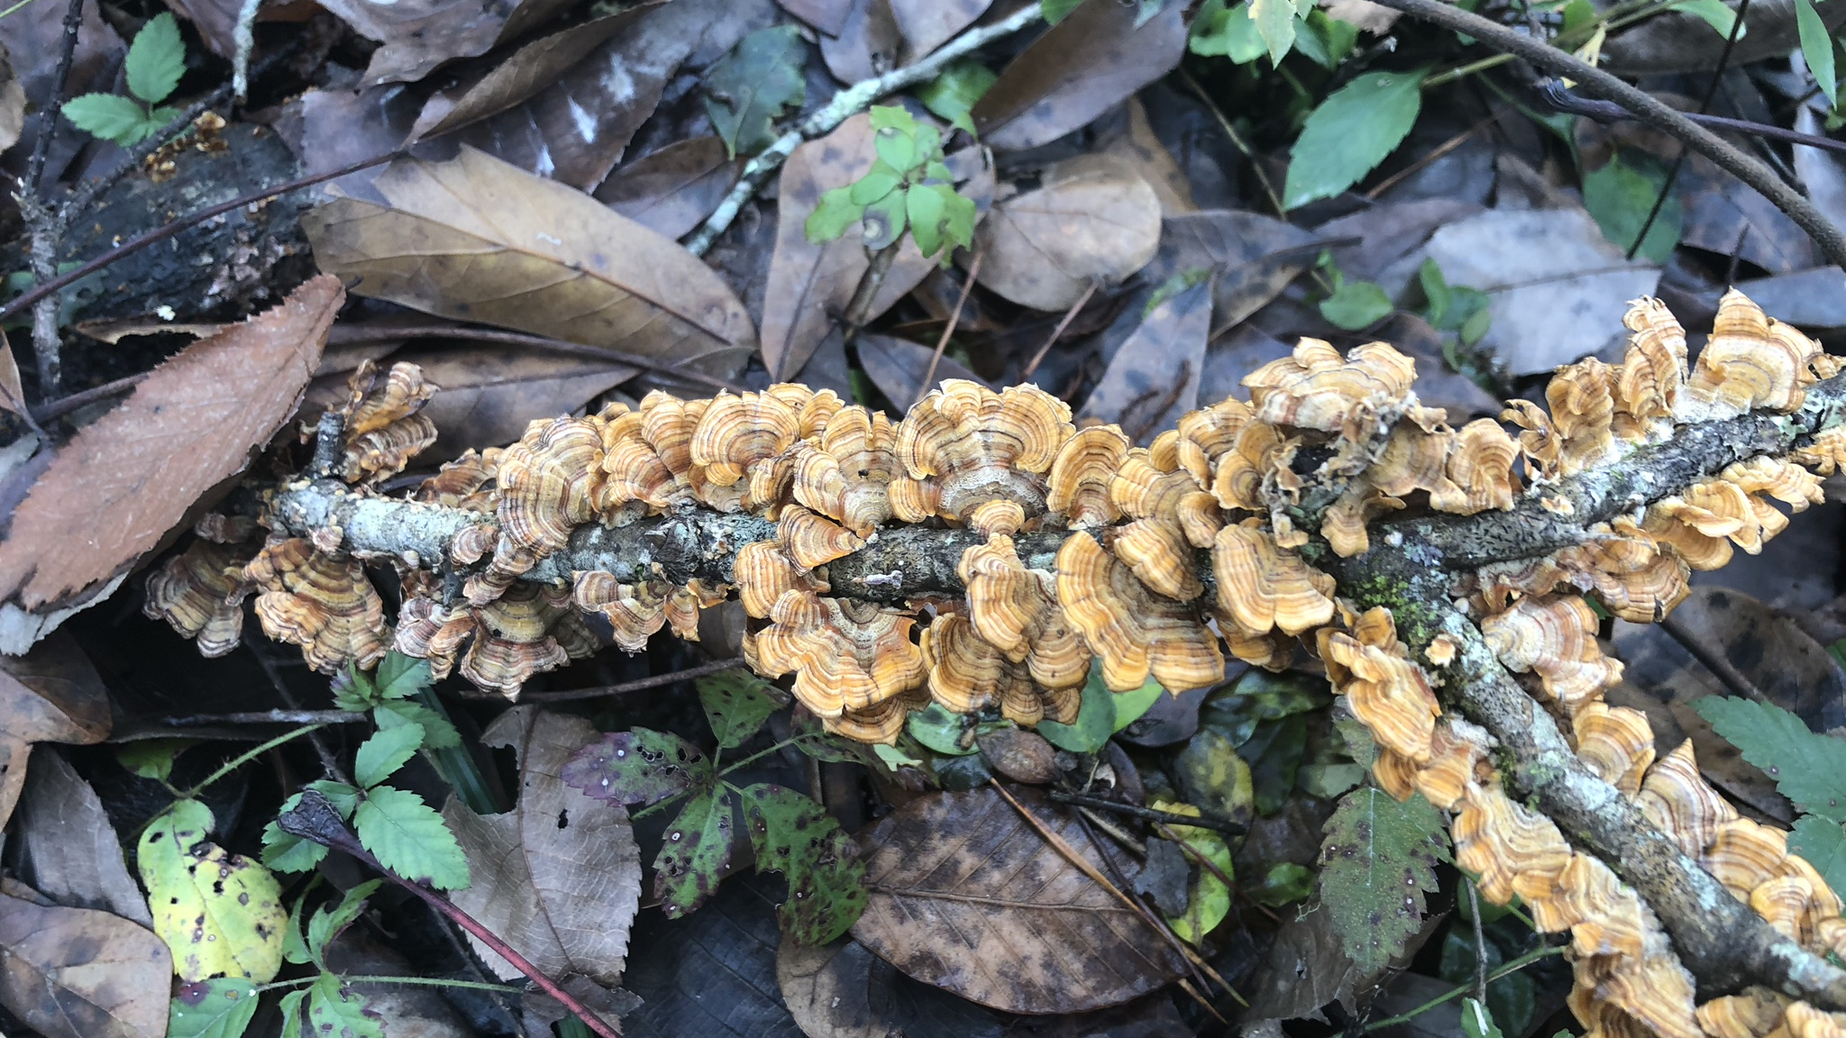
What is Mycology?
“Mycology is the branch of biology concerned with the study of fungi, including their genetic and biochemical properties, their taxonomy and their use to humans, as well as their dangers, such as toxicity or infection.”
Notes:
How would you describe what fungi are?

Slide 6
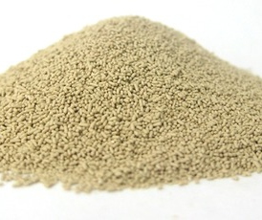
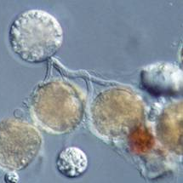
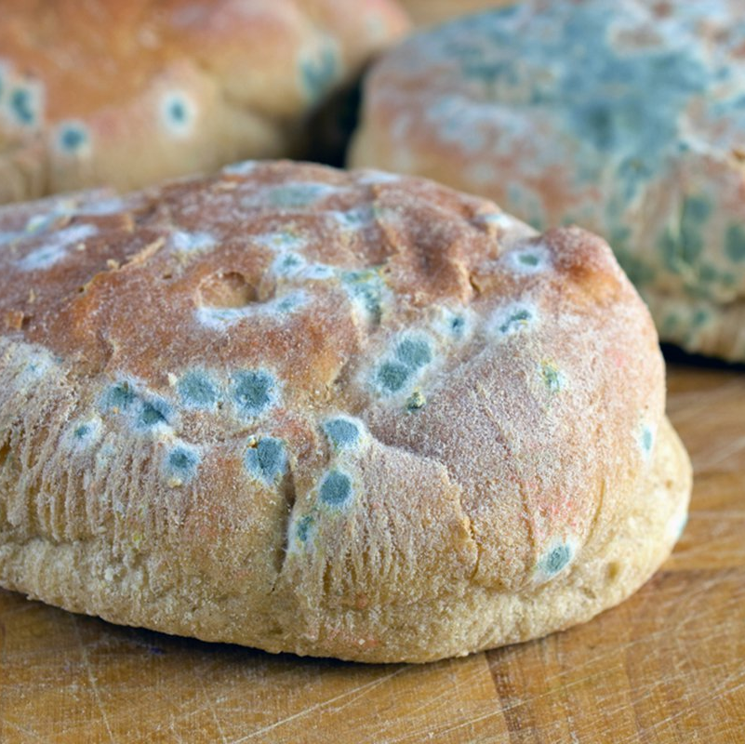
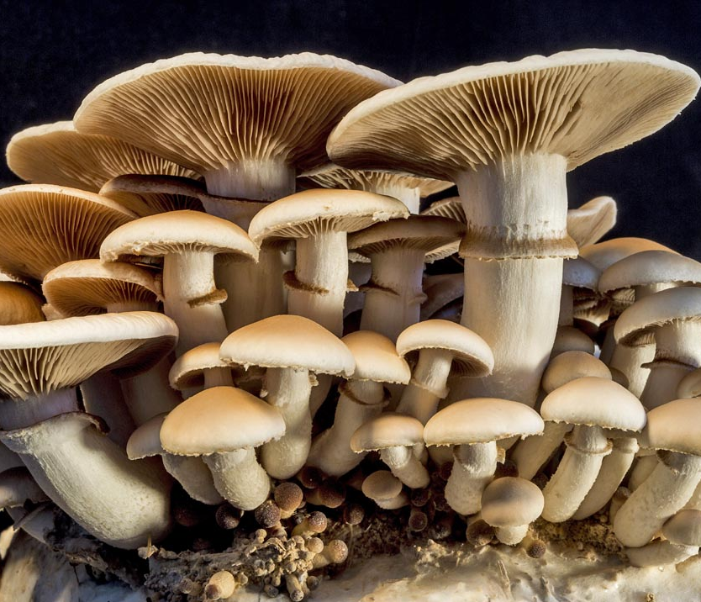
So, what even ARE fungi?
“A eukaryotic organism that fall under the classification Fungi”
Macroscopic, form fruiting bodies (mushrooms)
Multicellular molds
Single celled yeasts
Chytrids
Notes:
So, even though the first thing we think about is typically the mushrooms that we see in the grocery store, fungi are actually a very diverse group of organisms that include these types.
Chytrids – which give amphibians the disease chytridiomycosis
However, for the most part, we will be focusing on the most common form, which are the ones that form fruiting bodies, as they are the largest and most common group of fungi
Before we go into the specifics of fungi, it is important to understand what fungi are in relation to every other form of life. And conveniently, there’s a scientific method that is dedicated to doing just that. Is anyone familiar with what that method is?

Slide 7
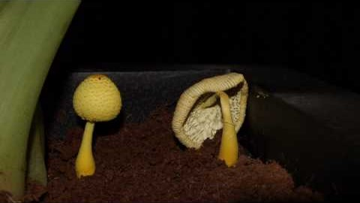
Notes:
Here’s a typical life span of a mushroom, which is what you typically think of when you hear fungi

Slide 8
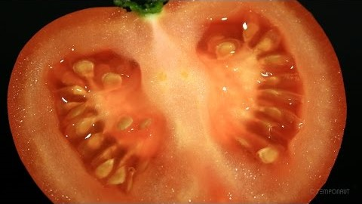
Notes:
Here’s mold, which is a different type of fungi that you see from time to time in your everyday life

Slide 9
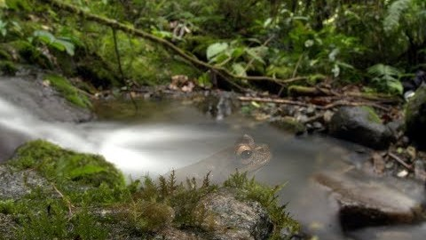
Notes:
And of course, there are the kinds of fungi that are pathogenic and do harm to organisms, such as chytrids which have been killing off and making many amphibians extinct
So, I just showed you guys a bunch of different organisms that seem like they do not fit in a group together. You are probably wondering, why are they all grouped together? and also, how are they related to other organisms we know such as animals, plants, or bacteria? How do we classify these groups, or show how they are related to each other?

Slide 10
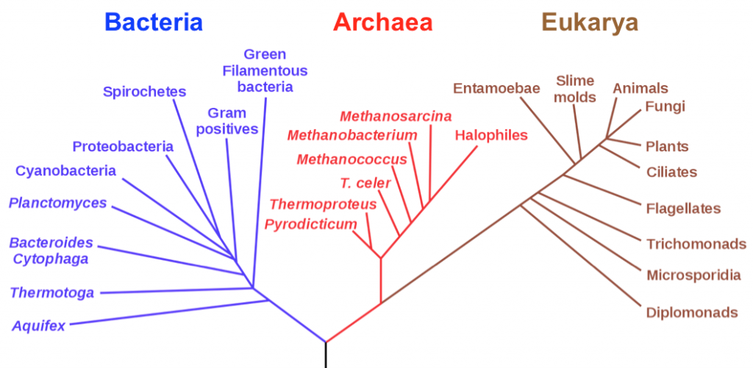
The Phylogenetic Tree
Diagram which shows relationships between organisms (related to taxonomy)
Can be evolutionary, characteristic based, or genetics based
All forms of life have come from a common ancestor, hence the fact that they are all connected
Notes:
The phylogenetic tree!
This one shows specifically the three domains of life, in which each branch represents a kingdom. Are you all familiar with taxonomy? As you can see, all forms of life have come from a common ancestor, which explains the fact that they are all connected, even if It is distantly so. Within the domain Eukarya, you can see that fungi are most closely related to animals and plants. Which one do you think fungi are more related to, animals or plants?

Slide 11
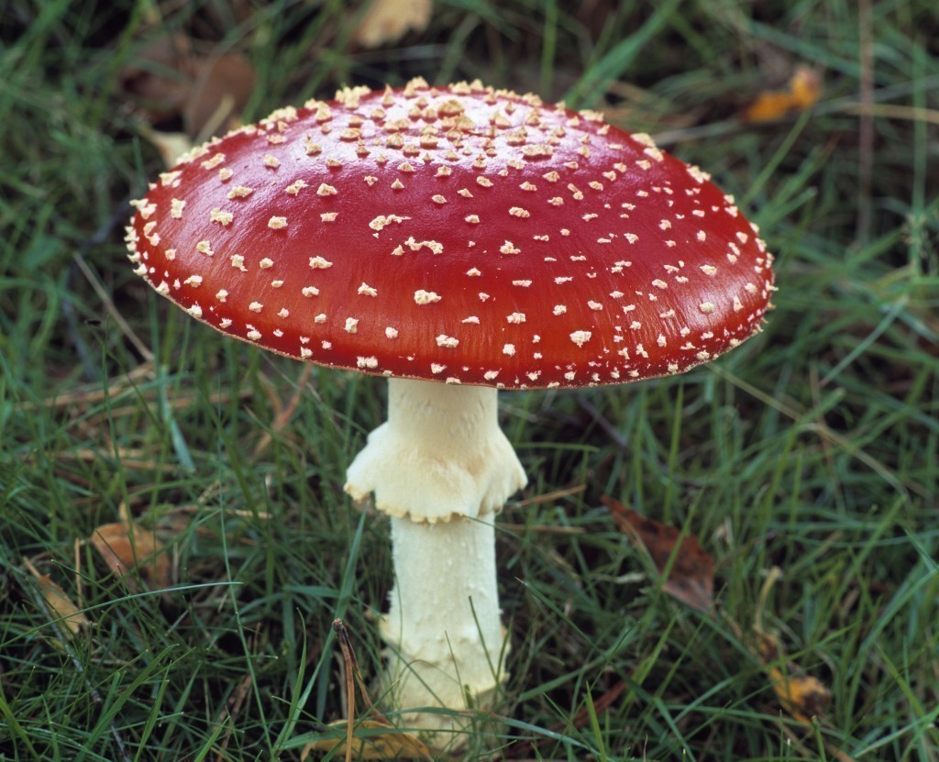

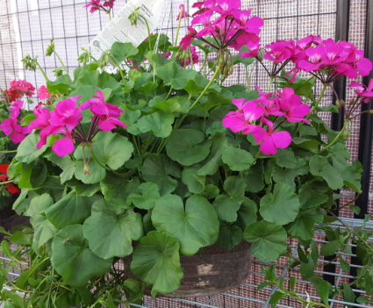
More related!
Notes:
While fungi were actually put under the plantae category until the late 20th century because of their superficial similarities, it actually turns out that fungi and animals are more closely related than fungi and plants, even though it may look like otherwise. So why is it that the cat and this mushroom are more related? If you look on a more cellular level of each of these groups of organisms, it makes a lot more sense.

Slide 12
What are the similarities?
Similar protein structures
Both do not contain chlorophyll, unlike plants
Both are heterotrophs (cannot make their own food)
Both use chitin
Fungi: an element in their cell walls
Animals: used in structure of insect exoskeletons
Notes:
While plants primarily use cellulose for cell wall

Slide 13
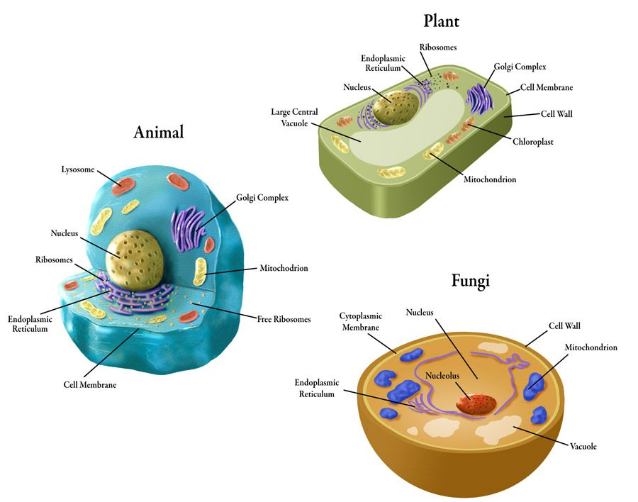

Slide 14
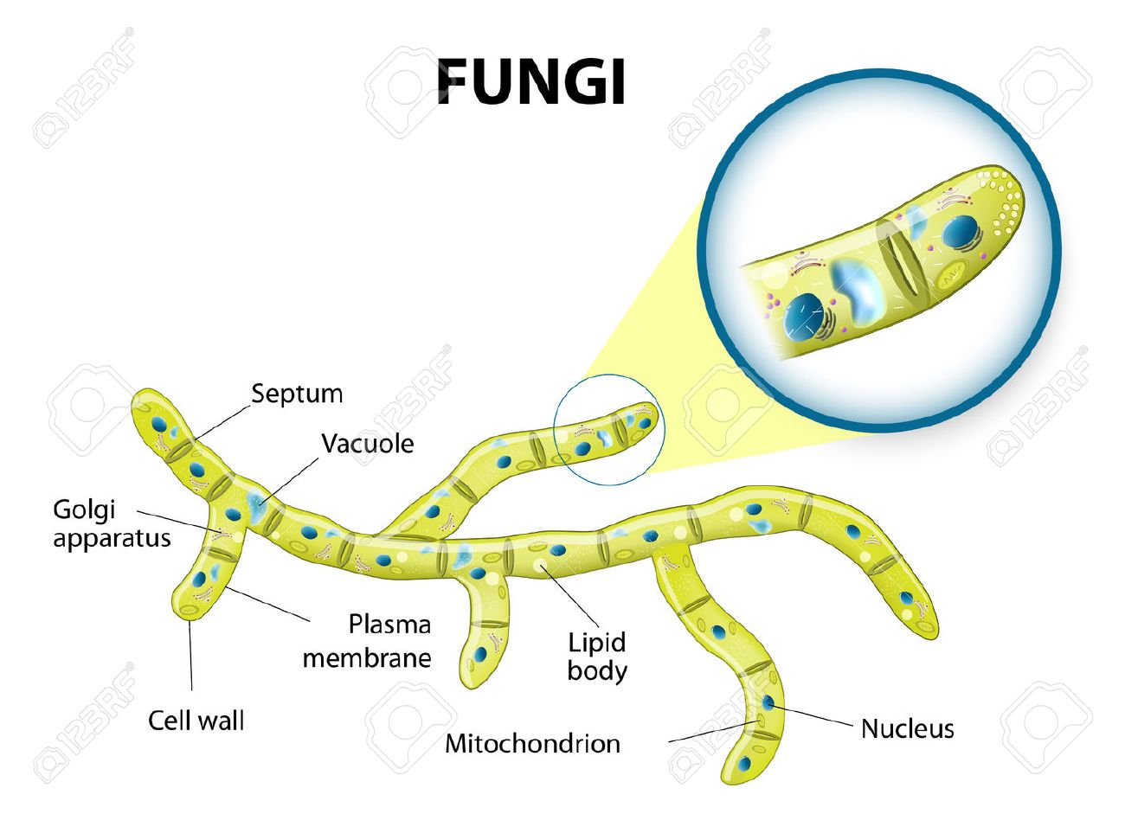
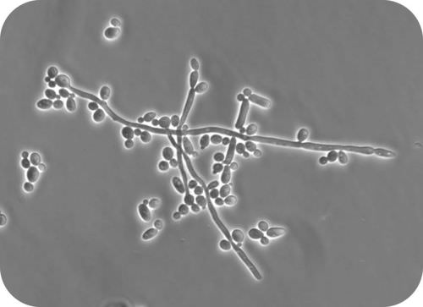
Notes:
Except for yeasts, which grow as single cells, most fungi grow as thread-like filaments, like those shown in Figure below. The filaments are called hyphae (singular, hypha). Each hypha consists of one or more cells surrounded by a tubular cell wall. A mass of hyphae make up the body of a fungus, which is called a mycelium (plural, mycelia).
The hyphae of most fungi are divided into cells by internal walls called septa (singular, septum). Septa usually have little pores that are large enough to allow ribosomes, mitochondria and sometimes nuclei to flow among cells. Hyphae that are divided into cells are called septate hyphae. However, the hyphae of some fungi are not separated by septa. Hyphae without septae are called aseptate hyphae.
As a matter of fact, mycelia can get so large that the largest organism on earth is not actually the blue whale, but a fungus!

Slide 15
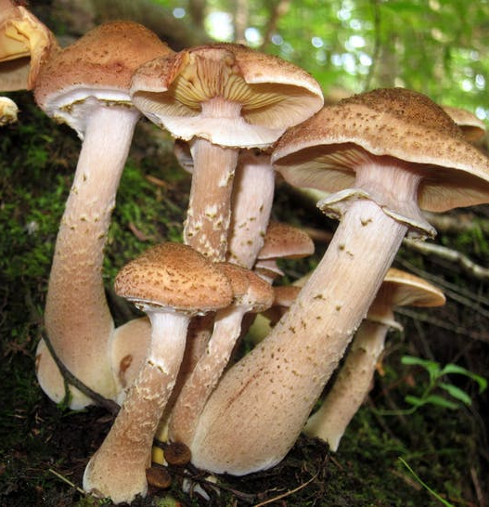
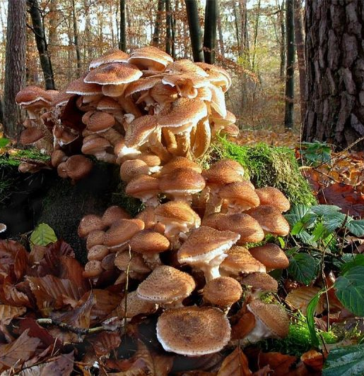

“Humongous Fungus”

Slide 16
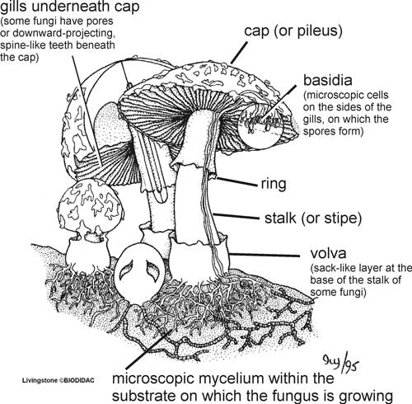
Mushrooms: The Fruiting Body

Slide 17
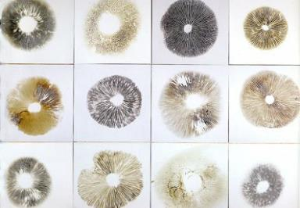
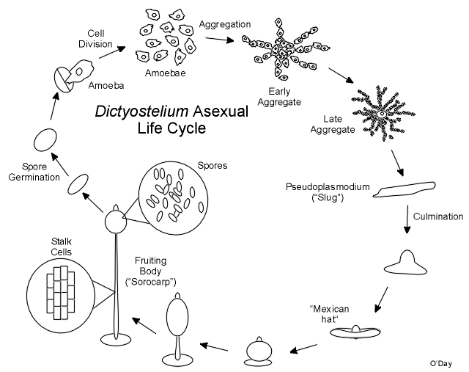
Spores + Spore Prints
Fungi can reproduce both sexually and asexually
In both cases, they use spores to reproduce – can think of as the equivalent of seeds for plants
Form on basidia of the fruiting body and spread into the air in order to germinate
Spore prints are used to identify and grow mushrooms, as well as for art!

Slide 18
Spore Printing Activity!
On the piece of paper you are given, write:
  Your name
  Date
  “Lentinula edodes” – species of the mushroom we are spore printing
Pick your desired mushroom – all shiitakes from the grocery store
Carefully cut or rip off the stem, put it face down on the paper
Hand it to me when you’re done – I will place it in a Tupperware for proper humidity
Wait until next week to see results!

Slide 19
