Slide 1
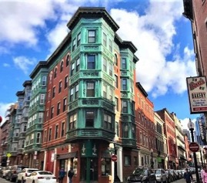
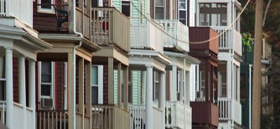
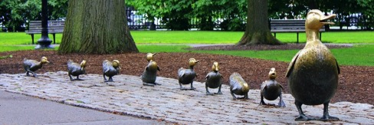
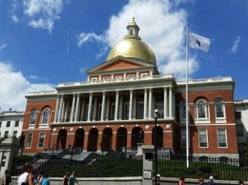
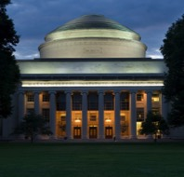
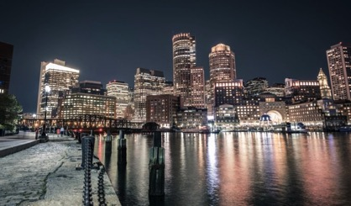
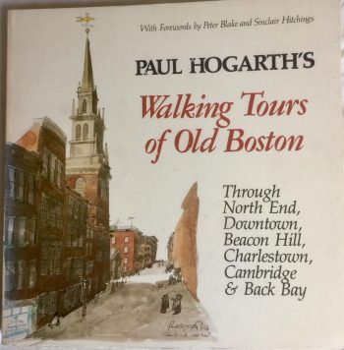
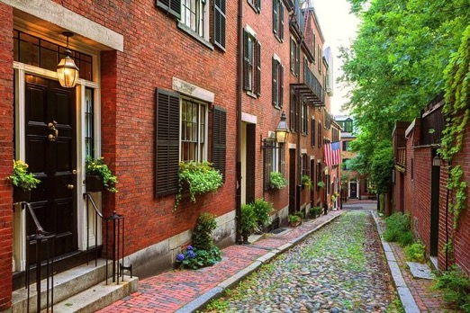
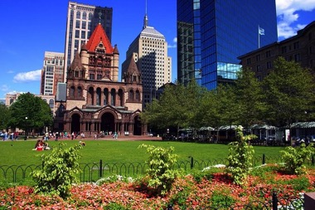
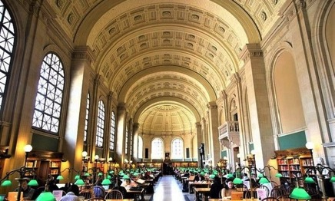
(Virtual) Walking Tours of the Greater Boston Area
HSSP Summer 2020 – X14023

Slide 2
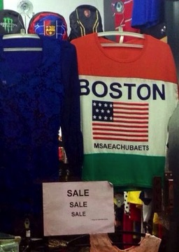
Six weeks of “walking”:
Week 1: See Sam’s Neighborhood
Week 2: Boston Through the Ages
Week 3: Boston City Planning and Transportation
Week 4: Boston Architecture
Week 5: Cemeteries, Churches, and Harvard Square
Week 6: Tech Boom (Kendall Square, Seaport & MIT)
Slides will be uploaded every week to the HSSP class site (Class X14023)
If you have any issues, you can email me at X14023-teachers@esp.mit.edu
Notes:
Don’t need to attend every week, don’t worry if you miss a week. I might refer to something but shouldn’t be an issue. Will upload all slide decks to HSSP class site. Please email me if you can’t access it. This class will be lecture based, with some optional assignments outside of class. I usually enjoy being interrupted but there are 87 of you signed up, so you can raise your hand in Zoom or type in the chat but know it’s possible I won’t get to you. If there’s something you’re dying for me to talk about (that you know or you want me to research) I’d love to hear it! We have five more weeks and can almost certainly fit it in.

Slide 3
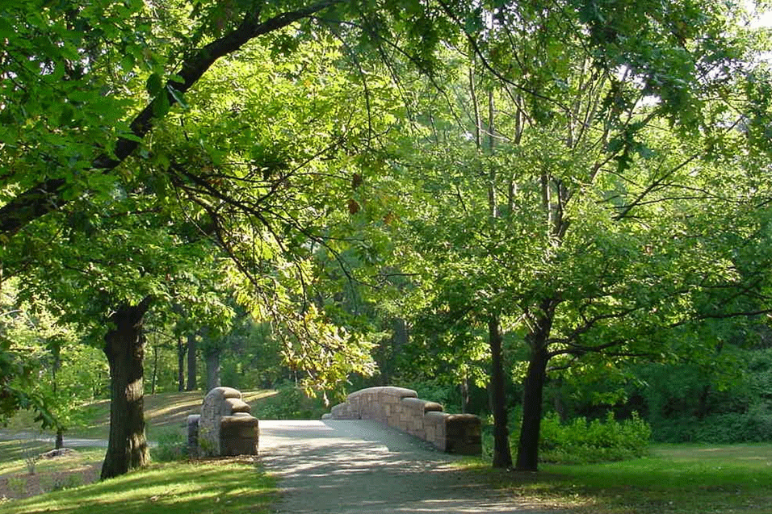
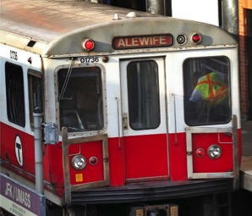
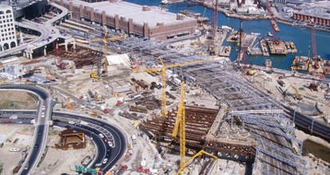
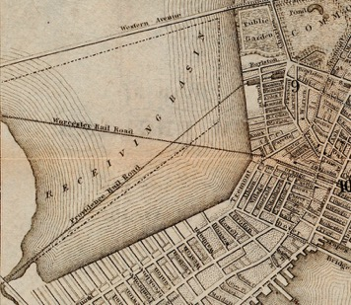
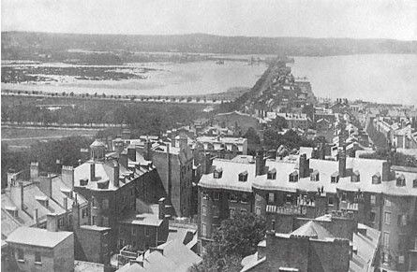
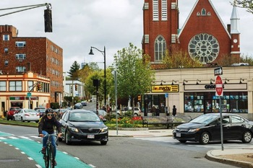
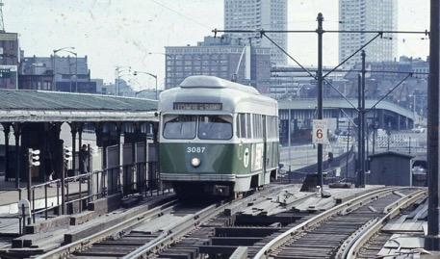
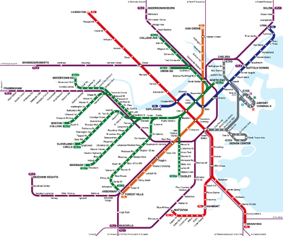
Week 3:
Boston City Planning
and Transportation

Slide 4
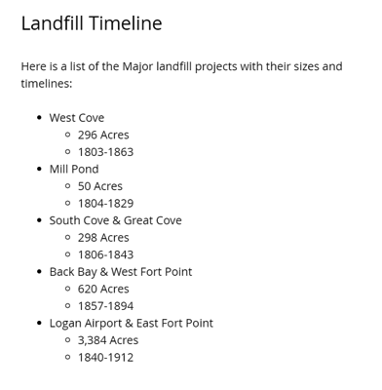
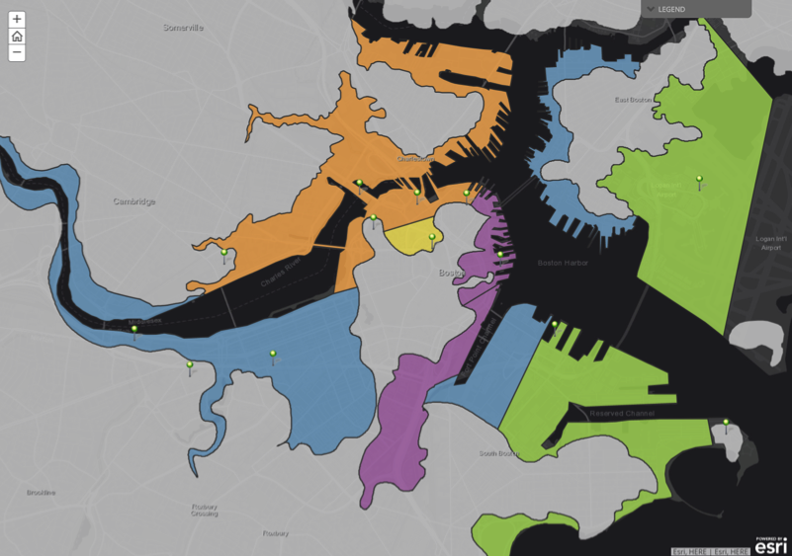
Filling in Boston

Slide 5
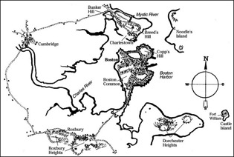
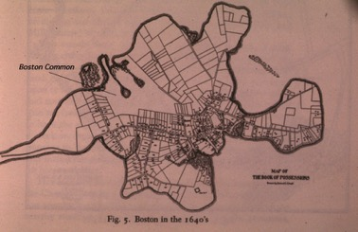
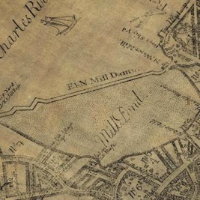
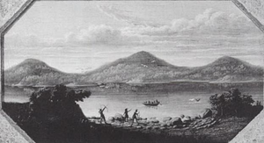
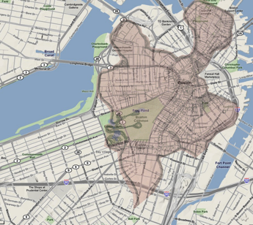
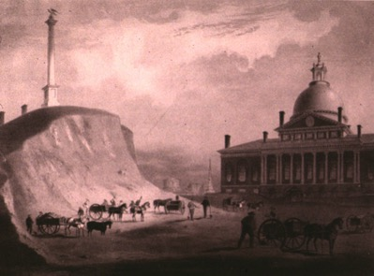
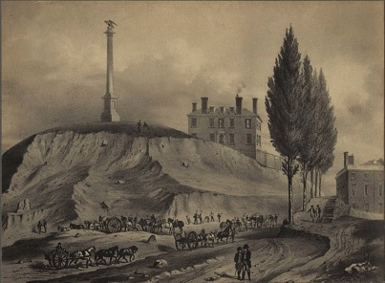
How Boston Lost Its Hills
Trimount - 1630
(Mt. Vernon, Beacon Hill, and Pemberton Hill)
Cutting down Beacon Hill – 1807-1828
Notes:
Mt. Vernon, Beacon hill and Pemberton hill, and two other hills the settlers later called Copp’s Hill and Fort Hill
Massachusetts is an Algonquin Indian word which roughly translates to “large hill place” or “at the great hill.”
refers to the Great Blue Hill in Milton, Massachusetts which is an ancient volcano that was last active over 400 million years ago.

Slide 6
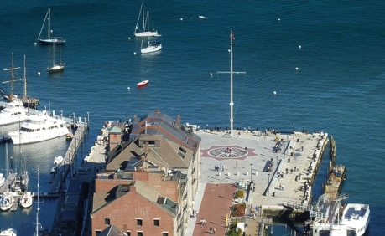
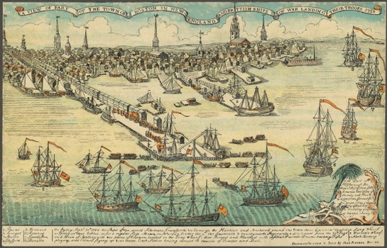
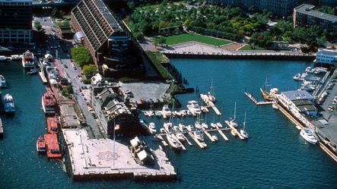
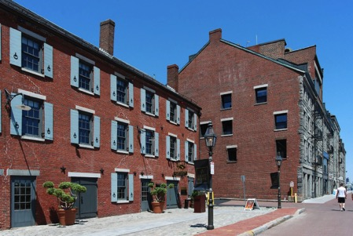
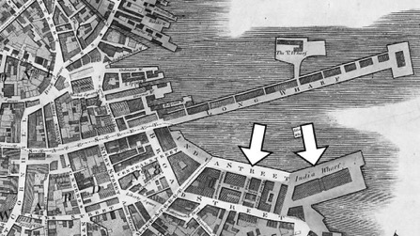
Long Wharf

Slide 7
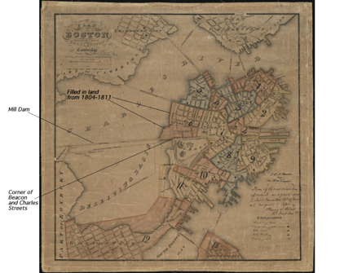
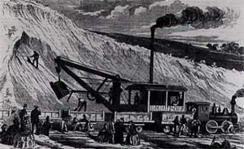
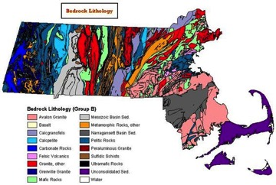
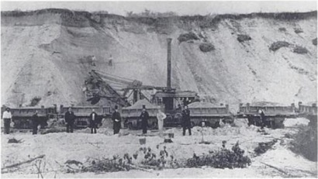
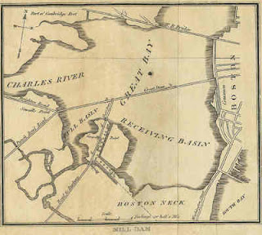
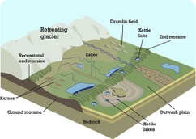
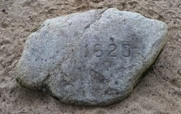
Filling in Back Bay
A steam shovel digging out gravel in Needham (~1860's).
A gravel train in a Needham gravel pit (~1860's)
Plymouth Rock – an erratic left over from the last Ice Age

Slide 8
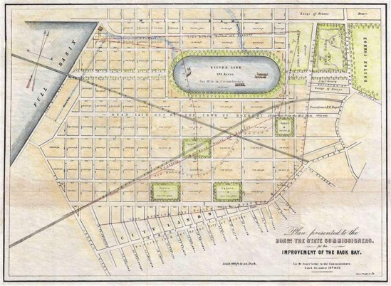
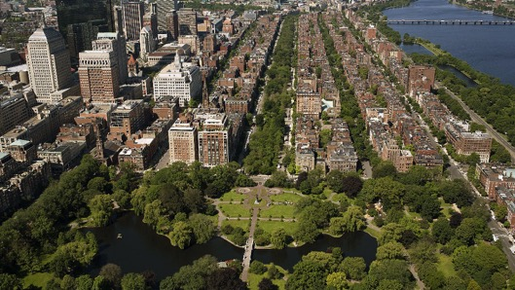
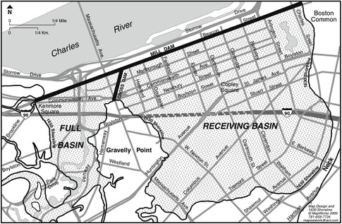
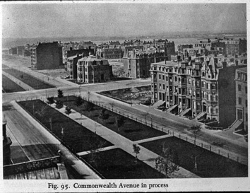
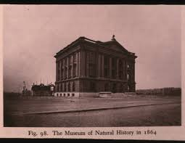
Planning the Back Bay Neighborhood

Slide 9
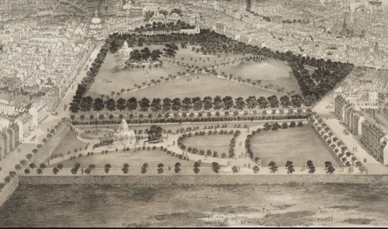
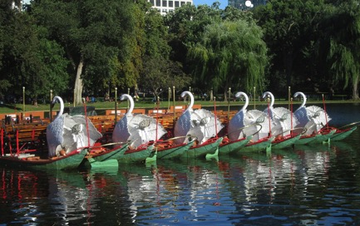
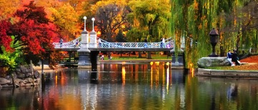
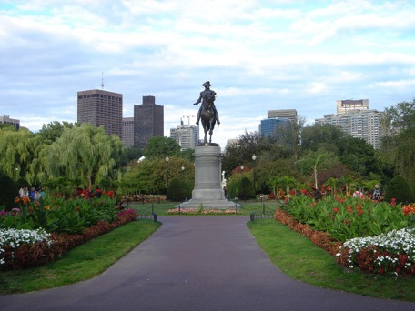
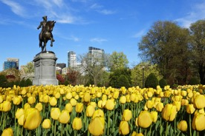
The Public Garden
Public Garden 1850’s – foreground is mud flats
Public Garden 1890’s – Back Bay is now filled in

Slide 10
Make Way For Ducklings
Artist Nancy Schön

Slide 11
The Emerald Necklace
Frederick Law Olmsted

Slide 12
Building the Esplanade
The Esplanade as it looked in the 1920's.
The Esplanade in the 1930's. In the 1930's, the park was widened and artificial lagoons constructed to promote boating.
The bank of the Charles River along Back Bay, just before the Esplanade was constructed
View overlooking Storrow Drive from the Dartmouth Street footbridge. The rock wall at the edge of the highway is part of the seawall built in the 1860's.

Slide 13
Calf Pasture Pumping Station - 1883

Slide 14
Public Transportation
The Omnibus – 1850s-1880s
Constructing Tremont Street Subway Tunnel – finished 1897
MBTA incorporated 1964
Electric Street Cars – 1890s
Boston Elevated Railway – 1910’s
Park Street Station - 1898

Slide 15
Lechmere Station. Opened on July 10, 1922, Lechmere Station in East Cambridge was designed for easy transfers across streetcar lines under the Boston Elevated Railway. For 97 years, Lechmere Station has served subway and bus riders. On May 24, 2020, the current station will close to make way for the future Lechmere Station off of Monsignor O'Brien Highway in support of the Green Line Extension and rehabilitation of the Lechmere Viaduct.
Courtesy: Boston Elevated Railway photographs, 9800.018. City of Boston Archives, Boston

Slide 16
The Fight for Accessible Transit
In 1973, the Rehabilitation Act required that any programs or services funded by the federal government be made accessible. In 1990, The Americans with Disabilities Act (ADA) reiterated these responsibilities. Despite early progress, by the 2000s, customers with disabilities still could not safely or reliably access key MBTA services, even though it was required under both federal and state laws.
Motorized wheelchair boarding equipment today
Plaintiffs in the 2006 MBTA/BCIL Settlement Agreement, along with the MBTA, announcing the signing of the settlement.

Slide 17
MBTA Today

Slide 19
The Future?
The North-South Rail Link
If all proposed line extensions were completed…
Bus Only lanes to speed up commuting times

Slide 20
City of Squares
Inman Square Redesign

Slide 21
Making Boston Bike-Friendly

Slide 22
Before
The Big Dig
The Green Monster – 1980s
Construction
Zakim Bridge
After
Notes:
YouTube videos:
https://www.youtube.com/watch?v=eF5aUClwJ9w
https://www.youtube.com/watch?v=-0zAA7GNgWM

Slide 23
The Green Way

Slide 24
Optional At-Home Activity!
How was your city built?
When was it built? How has it changed?
Is it easy to bike in your city? Are there good public transportation options?
Is it easier to get around in a car? Why?
Who is best served by city infrastructure?
Are there any streets now closed to through-traffic due to the pandemic?
Where are the green spaces in your city? How were they made?
Join a Facebook group! (Do you all still use Facebook?)
New Urbanist Memes for Transit-Oriented Teens

