Slide 1
From ULTRACOLD Atoms to
SUPERSTRING Theory!
Hiro Miyake and Nabil Iqbal
Spark!
March 12, 2011

Slide 2
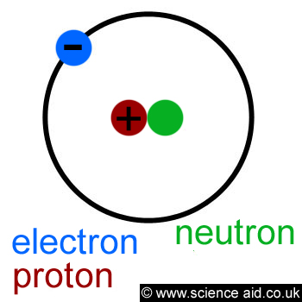
We are All Made of Atoms
Atoms are made of electrons, protons, and neutrons
http://scienceaid.co.uk/chemistry/fundamental/atom.html

Slide 3
OK, Now What?
-What happens when atoms are really COLD?
-Are ELECTRONS, PROTONS, and NEUTRONS made up of smaller stuff?

Slide 4
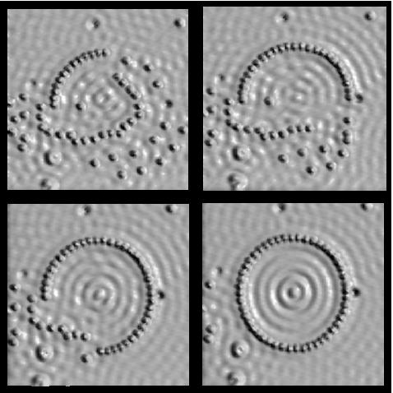
Why go COLD?
Things different from everyday intuition occur
  You can see individual atoms
  See weird states of matter: Bose-Einstein Condensation (BEC), Superfluidity, superconductivity
http://mrsec.wisc.edu/Edetc/background/STM/

Slide 5
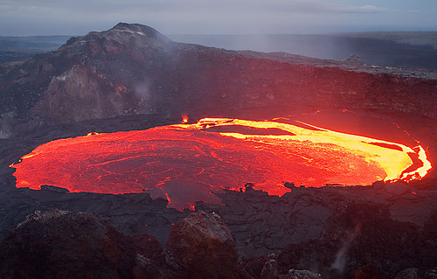
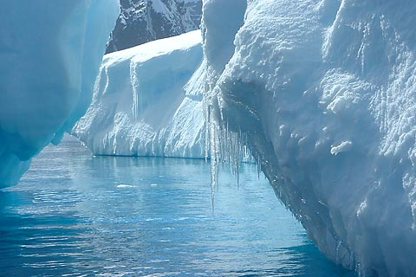
What is temperature?
Motion of atoms
  Fast moving atoms are hot
  Slow moving atoms are cold
http://www.flickr.com/photos/volcanoes/988326099/sizes/m/in/photostream/
http://www.treehugger.com/files/2009/12/melting-polar-ice-raise-sea-levels-4-feet-2100.php

Slide 6
What is “Ultracold”?
Everyday temperatures
    32 °F = 0 °C = 273 Kelvin
Absolute zero
    -460 °F = -273 °C = 0 Kelvin
Typical ultracold temperatures in lab
    100 nanoKelvin, billionth the temperature of a nice day
  Outerspace is 3 Kelvin = -454 °F
    Colder than space by more than a millionth the temperature of space!
What happens at ultracold temperatures?
  All atoms behave like one big atom!

Slide 7
Very Weird Fact About the World
Everything in this world is both a particle and a wave

Slide 8
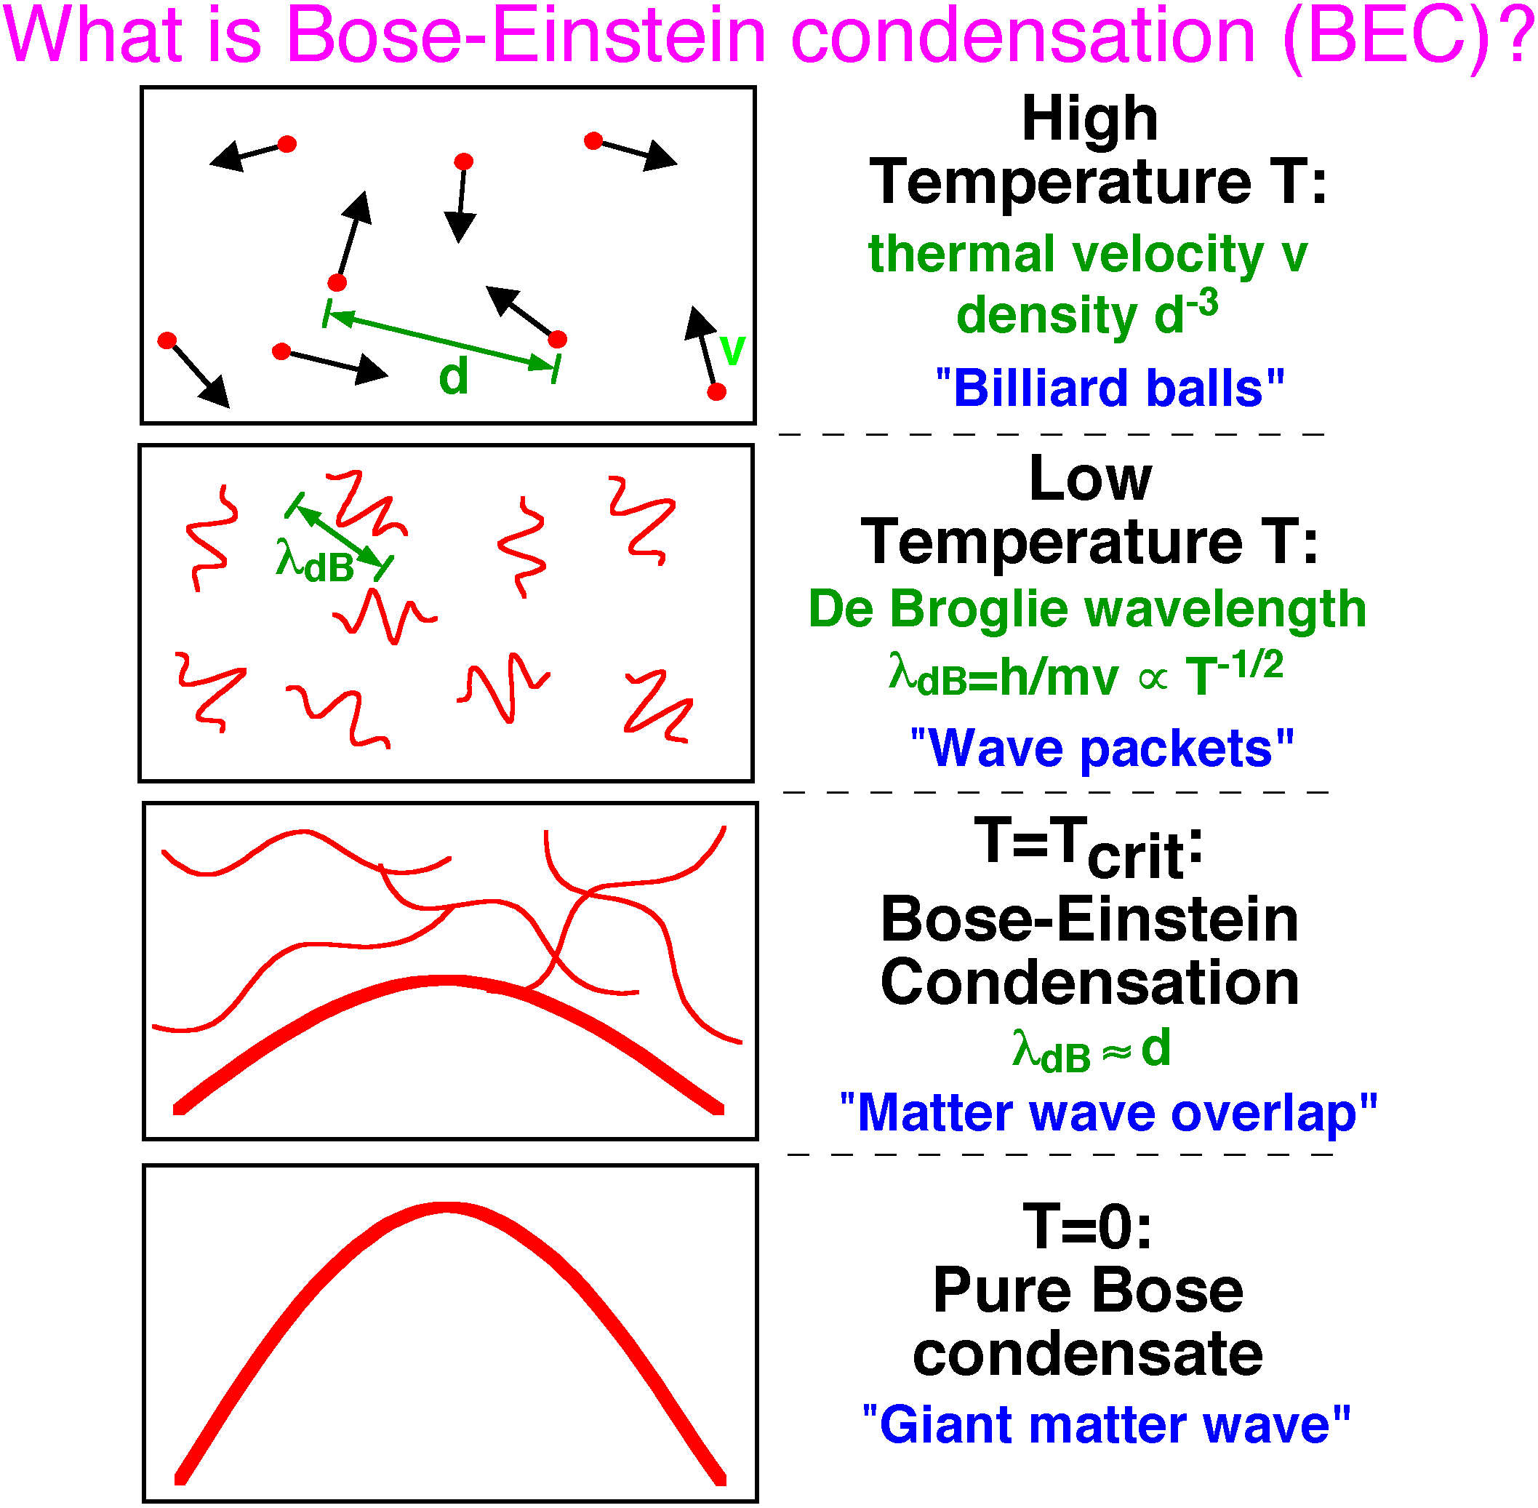
High temperature
Lower temperature
Even lower temperature
Zero temperature
http://cua.mit.edu/ketterle_group/Nice_pics.htm

Slide 9


Laser Cooling of Atoms I
Shine light on atoms to slow them down
  Zeeman slowing

Slide 10
Laser Cooling of Atoms II
Trap atoms in a valley (with light and magnets)
Lower the top of the hill slowly so atoms with a lot of energy escape (evaporative cooling)

Slide 11
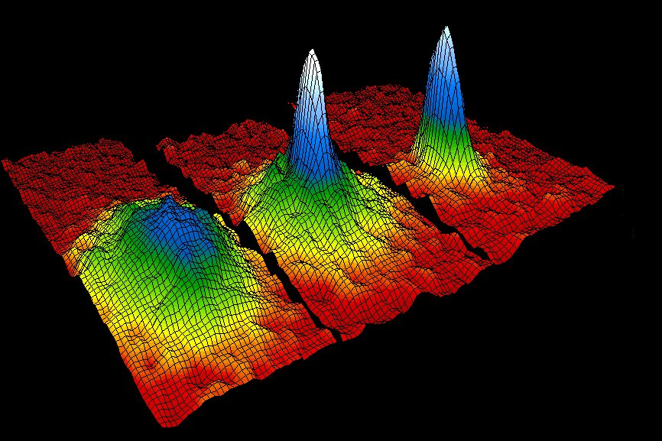
Ultracold Atoms!
All individual atoms act as one giant atom
  Bose-Einstein condensation (BEC)
    2001 Nobel Prize in Physics
http://www.colorado.edu/physics/2000/bec/three_peaks.html

Slide 12
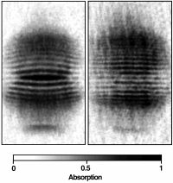
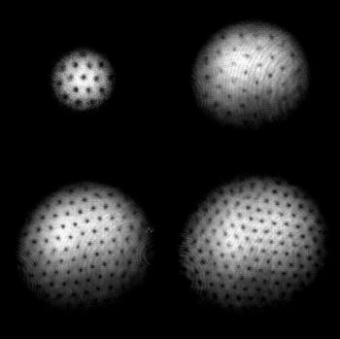
Cool Stuff with a BEC
You can interfere two BECs like a water wave
You can create holes in BECs by rotating it
http://cua.mit.edu/ketterle_group/Nice_pics.htm
http://cua.mit.edu/ketterle_group/projects_2001/vortex_lattice/vortex.htm

Slide 13
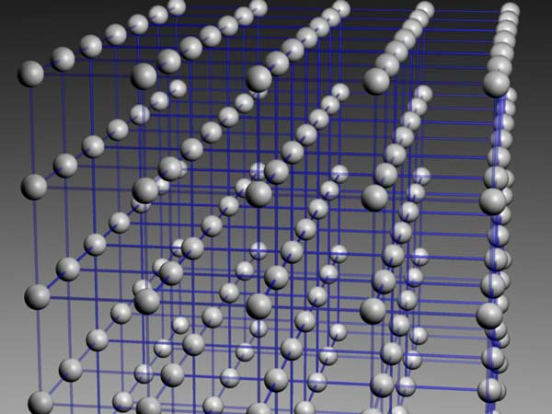
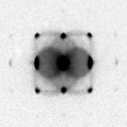
BEC in a Lattice
You can put a BEC in a regular pattern (lattice)
Similar structure to solids in our everyday lives
http://olaqui.df.unipi.it/beginners.html
http://www.quantum-munich.de/media/optical-lattices/

Slide 14
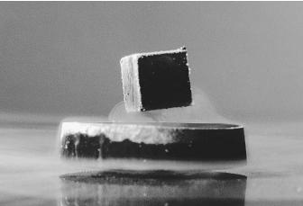

BEC in a Lattice as a Simulator
Ultracold atoms in a lattice behave like real crystals
Use these to study real-world materials
High-Temperature Superconductors
Magnets
http://www.chemistryexplained.com/St-Te/Superconductors.html
http://www.sciencedaily.com/releases/2007/10/071009083859.htm

Slide 15
ULTRACOLD Atoms Summary
Laser cooling techniques have allowed us to cool atoms to 100 nanoKelvins
At 100 nanoKelvins, the atoms all behave as a single giant atom called a Bose-Einstein condensate (BEC)
BECs have fascinating properties
BECs can also be used to understand and explore real-world material properties such as superconductivity and magnetic materials

Slide 16
Particles and string theory
The weird and wonderful world of small stuff.

Slide 17
Particles are important.
Let’s start with some that you probably already know about.

Slide 18
<cinematic interlude>
In YouTube, search for “micro-cosmos IMAX Powers of Ten”

Slide 19
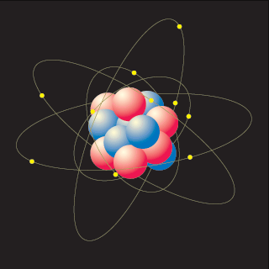
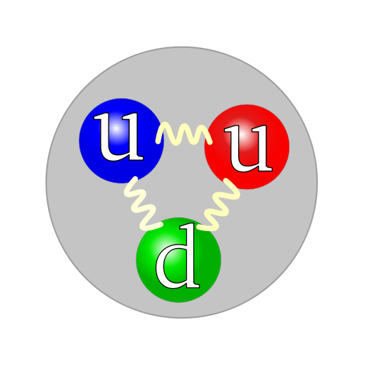
Things are made of smaller things.
Stuff around us is made of atoms.
Atoms are made of electrons and protons and neutrons.
Protons and neutrons are made of smaller things called quarks.
These are matter particles.

Slide 20
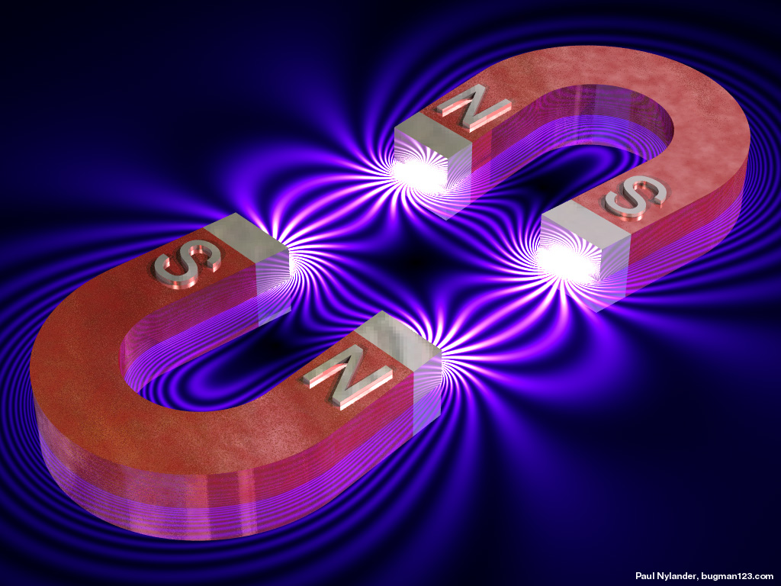
But is matter all?
It should seem plausible that particles make up matter.
But it turns out that particles make up forces too!
…what?
Let’s start with our favorite force…

Slide 21
Our favorite force:
+
+
+
-
Electricity!
More precisely, electromagnetism.

Slide 22
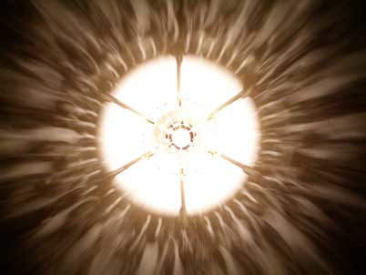
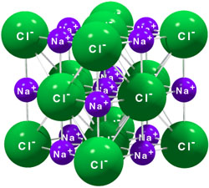
Why is it our favorite?
Holds the electrons in the atom.
Holds atoms together in matter.
In fact, almost everything you feel comes from electromagnetism.
Even light is a form of electromagnetism.

Slide 23
But what is it, really?
+
+
+
-
Tiny particles flying back and forth!
They’re called photons.

Slide 24
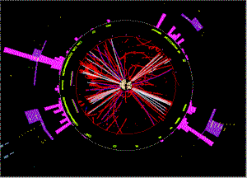
All forces come from particles.
What are the forces?
Electromagnetism
Strong nuclear
-
Photons
Gluons
Weak nuclear
Gravity?
W and Z bosons

Slide 25
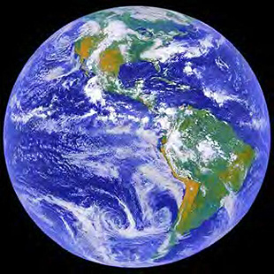
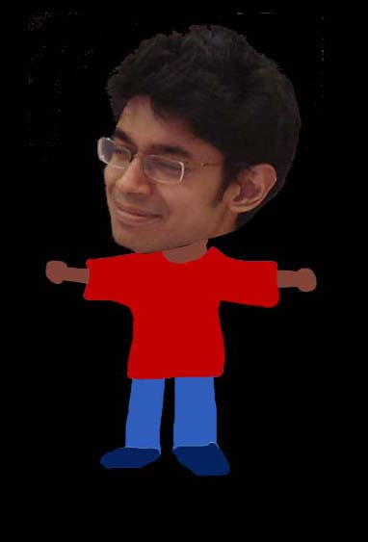
The problem of gravity
Everything feels it. It’s kind of a big deal.
But its particles (“gravitons”) don’t make sense!
There are too many of them (at short distances).
This is a big problem.

Slide 26
What do we do?
Something radical:
Suppose every particle is actually a miniscule loop of vibrating string!

Slide 27
Enter string theory
A single string can vibrate in many ways; when it vibrates in a different way it looks (from a distance) like a different particle!
An electron…
A photon…
Even a graviton…
Gravity now works out!

Slide 28
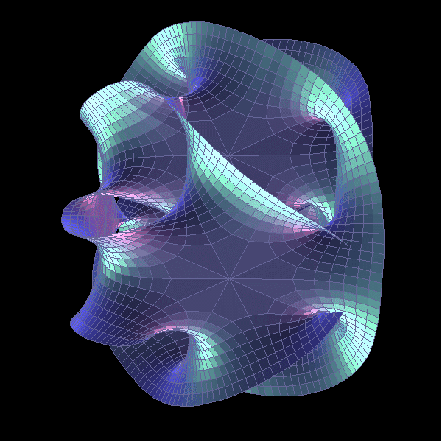
The problems…
The gravitons work out.
But: string theory says there are ten dimensions!
We need to curl up the extra six somehow.
Many ways to do it -- each way gives us a different universe!

Slide 29
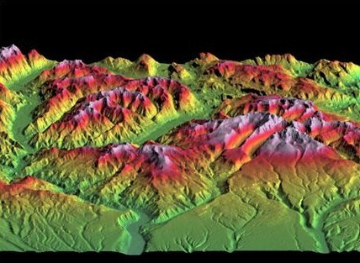
The “Multiverse”
A landscape of many universes– the multiverse!
We don’t know how to find our one!
If string theory is correct, our universe is in there somewhere…
?

Slide 30

Is string theory right?
We don’t know.
We need you to find out!

Slide 31
Summary of Particles and Strings
Everything in this world is made of particles (even forces!)
Gravity only works if we say all particles are vibrations of strings.
But then we get awkward stuff – extra dimensions and an extremely large number of possible universes!
Nobody knows how to resolve this (yet)!

Slide 32
Summary of Atoms and Strings
Atoms, which make up everything on earth, behave in weird ways at very low temperatures
  What other useful and interesting things can you do with ultracold atoms?
The things that make up atoms and forces can be described as vibrations of strings
  How do you explain the extra dimensions and numerous possible universes?
These are many interesting and fun questions to be answered for a long time to come!

Slide 33

Thank you!
niqbal@mit.edu
hmiyake@mit.edu

