Slide 1
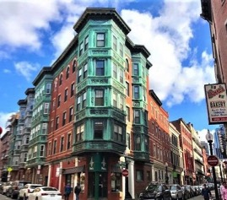
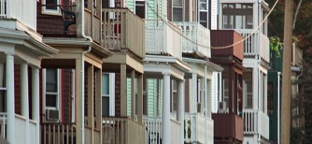
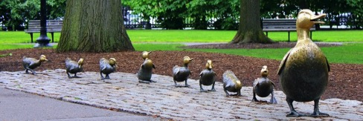
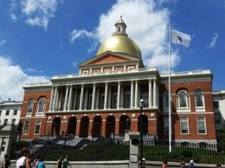
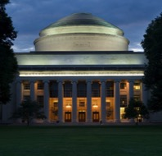
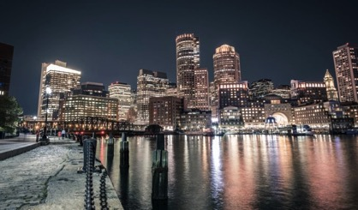
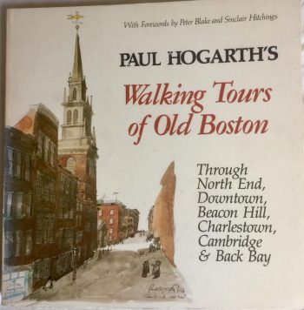
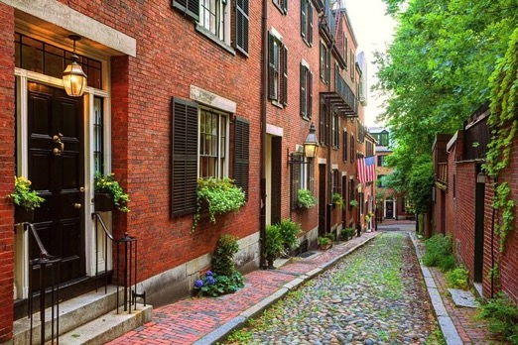
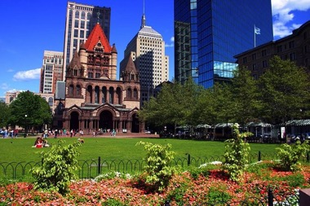
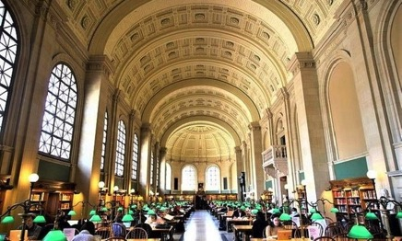
(Virtual) Walking Tours of the Greater Boston Area
HSSP Summer 2020 – X14023

Slide 2
Who am I?
Name: Samantha Webster (call me Sam)
Occupation: 3rd year doctoral candidate in the Biology Department
Field of Study: Structural Biology/Biochemistry, specifically studying ribosome degradation and ribophagy
Origin: Boulder, Colorado
Currently live in: Cambridge, Massachusetts
Why am I leading (virtual) walking tours on history and architecture: I consider myself a veteran walker, have always loved history, and before ye olde plague hit I was training to be a volunteer tour guide with Boston by Foot
Notes:
Have lived here for three years now. Moving from Colorado, where everything is relatively new (oldest building I ever visited there was from the 1870s) to here where everything is super old. New perspective.

Slide 3
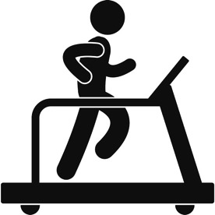
Six weeks of “walking”:
Week 1: See Sam’s Neighborhood
Week 2: Boston Through the Ages
Week 3: Boston City Planning and Transportation
Week 4: Boston Architecture
Week 5: Cemeteries, Churches, and Harvard Square
Week 6: Tech Boom (Kendall Square, Seaport & MIT)
Slides will be uploaded every week to the HSSP class site (Class X14023)
If you have any issues, you can email me at X14023-teachers@mit.edu
Notes:
Don’t need to attend every week, don’t worry if you miss a week. I might refer to something but shouldn’t be an issue. Will upload all slide decks to HSSP class site. Please email me if you can’t access it. This class will be lecture based, with some optional assignments outside of class. I usually enjoy being interrupted but there are 87 of you signed up, so you can raise your hand in Zoom or type in the chat but know it’s possible I won’t get to you. If there’s something you’re dying for me to talk about (that you know or you want me to research) I’d love to hear it! We have five more weeks and can almost certainly fit it in.

Slide 4
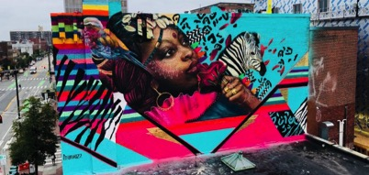
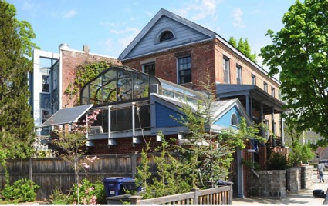
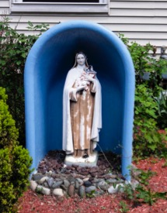
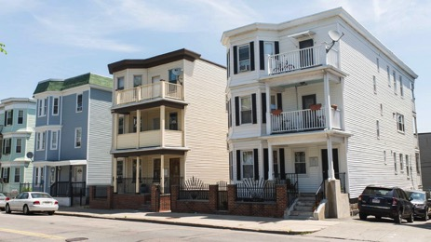
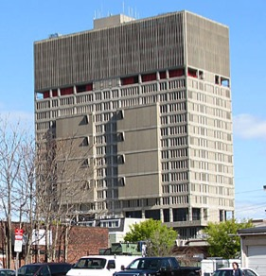
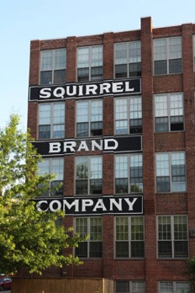
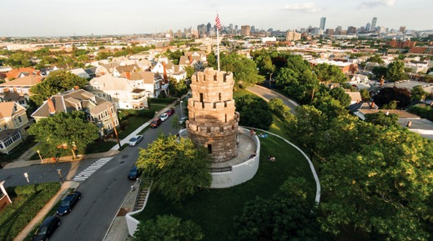
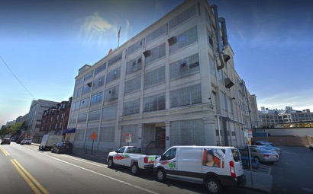
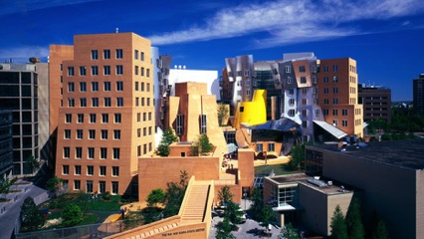
Week 1:
See Sam’s Neighborhood
Notes:
This is week one, no rhyme or reason to what I’m showing you this week except that I like the locations and they’re near me. We’re just boppin’ around this week. Some themes we talk about today will definitely come back in future tours.

Slide 5
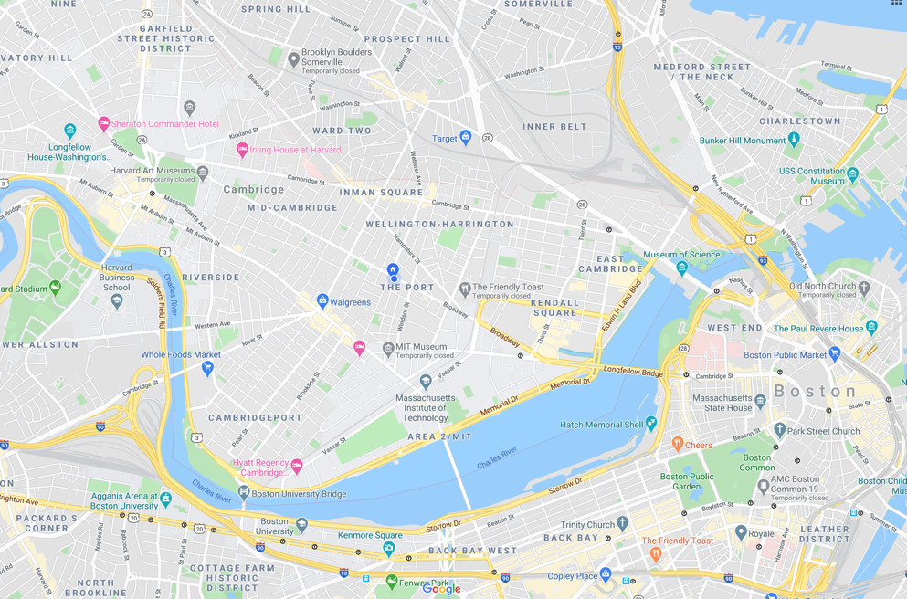
Notes:
Explain regions of Cambridge to them. Say this is a pretty far distance, couldn’t do this if we were actually walking, not going to show these places in any logical geographic order

Slide 6
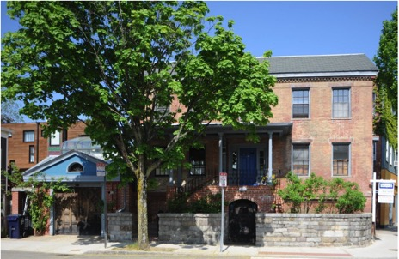
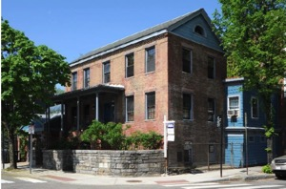
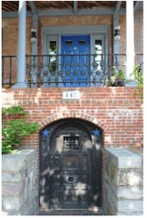
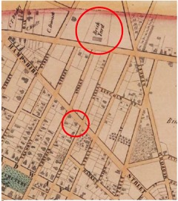
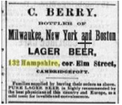
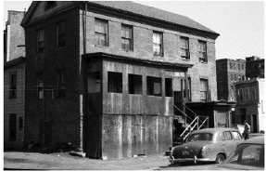
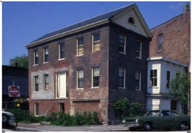
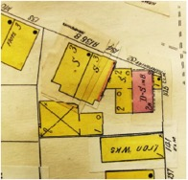
Ivory Sands House
Built in 1839 by Ivory Sands, of the Sands family of brick makers, in the Federal Style
Listed on National Register of Historic Places in 1986
Basement used to bottle beer in the 1880’s; in 1887 listed as one of 113 saloons operating in Cambridge
1934 map showing “Dwelling, Store in Basement”
1854 map shows house location and nearby brick yard
1965
1979

Slide 7
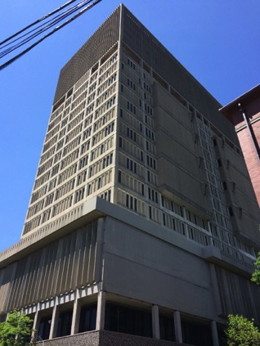
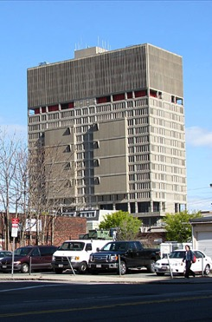
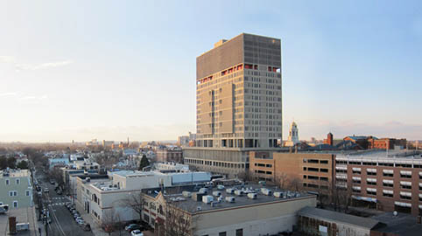
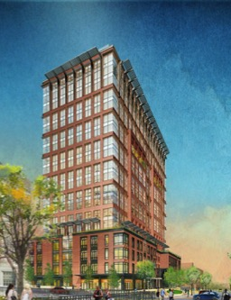
Middlesex County Jail
‘The Slammer in the Sky’
Issues with power, water, sewage, etc.
Built in 1971 in the Brutalist style.
Housed:
District Attorney office (bottom)
Superior Court (middle)
District Court (higher)
Middlesex County Jail (‘above the red’)
DA’s office and courts evacuated in 2008
Jail was overcrowded (411 prisoners when it was built for 150), no air conditioning. Finally evacuated in 2014.
The future??
Notes:
A supervillain lair

Slide 8
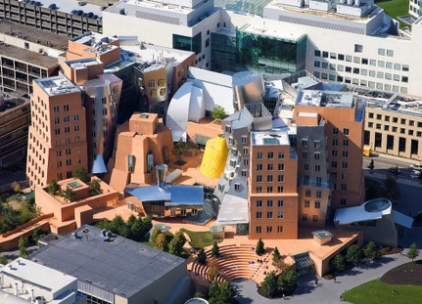
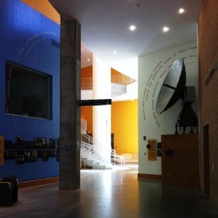
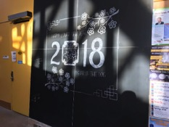
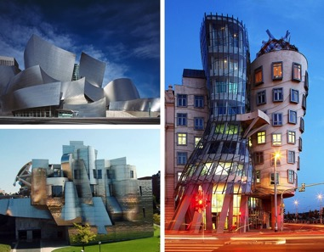
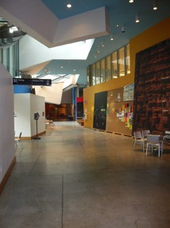
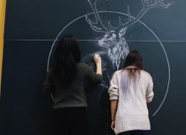
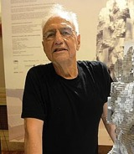
Frank and Maria Stata Center
Designed by Frank Gehry, opened for use in 2004
Houses classrooms, offices, and lecture halls for EECS, CSAIL, LIDS, and Philosophy/Linguistics. Contains offices of Noam Chomsky, Ron Rivest, and Tim Berners-Lee.
Other Frank Gehry masterpieces:
Blackboard art!
The MIT Museum has semi-permanent exhibits on the ground floor
Notes:
Built on site of Building 20, used to house Radiation Lab in the 40’s, now an exhibit on the ground floor of State.
Other Gehry buildings: Weisman art center (Minnesota), Walt Disney Hall (LA), Dancing House (Prague)

Slide 9
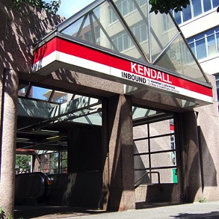
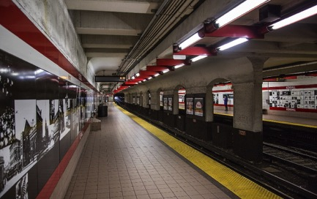
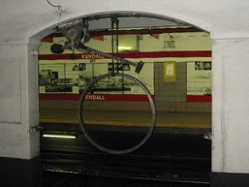
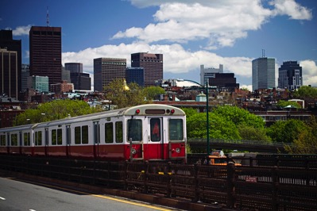
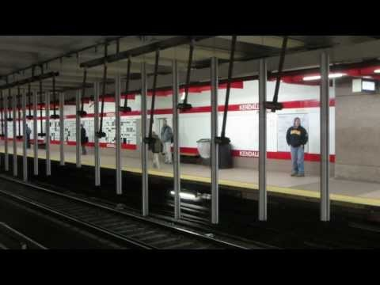
Kendall Square Stop
Opened in 1912 as part of the Cambridge Subway from Park Street to Harvard – 4 years before MIT moved to its current location!
Remodeled in 1987 to accommodate 6-car trains
Between 1986-1988 artist Paul Matisse built the Kendall Band, three interactive sculptures named Pythagoras, Kepler, and Galileo
A group of MIT students partially restored Pythagoras in 2011
Red Line train going over the Longfellow Bridge
Notes:
West Boston Bridge predated the Longfellow bridge

Slide 10
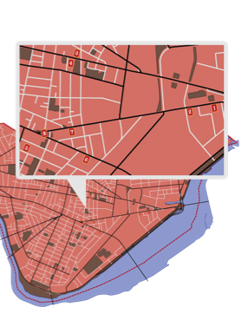
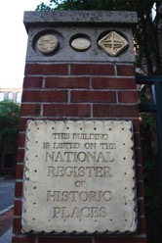
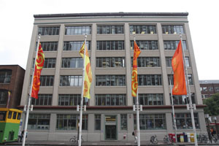
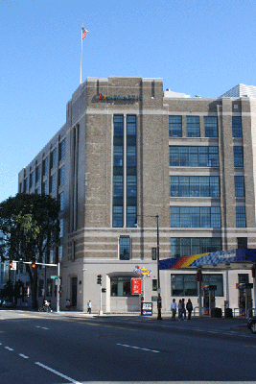
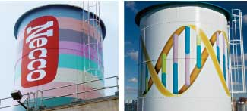
Candy Making in Cambridge
Fox Cross Company (1920-1980)
Charleston Chew
Squirrel Brand Nuts (1890-1999)
Squirrel Nut Zipper
Kennedy Biscuit Company -> Nabisco (1869-present)
Fig Newtons
Oreos
James O. Welch
(1927-1963)
Junior Mints
Sugar Daddies
Sugar Babies
Necco (1847-present)
Necco Wafers
Conversation Hearts
https://cambridgehistory.org/candy/index2.html
Notes:
Fox Cross Company
The candy bar that made them famous wasn’t launched until 1922 when they took vanilla flavored nougat, covered it with milk chocolate, and called it the Charleston Chew, trying to capitalize on the popular dance craze at the time.
Nabisco
The Kennedy Biscuit factory has stood here since 1869; it now stands as condominiums that bear the name Kennedy Biscuit Lofts. Fig Newtons were first made here in 1891 and their shape, taste, and size have not changed since, even as Kennedy Biscuits merged with other bakeries in 1898 to form the National Biscuit Company, which we know as Nabisco, maker of Oreos and other cookies and crackers.
James O Welch
Tootsie Roll still produces more than 15 million Junior Mints a day, all from this location. Tootsie also bought out the Fox Cross company, the first stop on our tour, and continues to make Charleston Chews.
Necco
In 2004 NECCO moved production and headquarters to Revere and the building was occupied by Novartis Biomedical Research and the water tower was redesigned with a double helix. When built in 1927, this factory was the largest in the world devoted to candy making. In fact, many of the features that made the NECCO building state of the art in 1927 also made it ideal for conversion to lab space. Made of concrete instead of steel frame, the building resists vibrations, Floors between 9-14 inches thick can hold as much as 250 pounds per square foot, strong enough to support storage tanks, mixing vats, conveyer belts, and now robotics and screening machinery used in drug research. The Novartis conversion of the factory was a $175 million project partly to remove sugar spores in the pores of the walls and sticky residue from the floors.
NECCO has one of the richest local histories in the industry. It dates back to 1847 when brothers Oliver and Silas Chase patented the first American candy machine and started producing sugar wafers. Early versions of the candy were distributed to Union soldiers during the Civil War. Today, the wafers are believed to be the oldest American product continuously manufactured and still sold in unchanged form. Today, NECCO is the oldest continuously operating candy company in the U.S
Squirrel Brand
Squirrel Brand produced nuts that were carried by Admiral Richard Byrd, who lead the first expedition to reach the South Pole by air. The nuts were also shipped all over the world during WW2.

Slide 11
20 Flagg Street
Rented a room at 20 Flagg St 1890-1893
Du Bois, aged 19
Du Bois with Fisk University classmates

Slide 12
Prospect Hill Tower
Grand Union Flag – first national flag in the United States, first raised at Prospect Hill by George Washington
Prospect Hill became the strongest fortification on the frontline of the American Revolution – it was known as the “Citadel”
Union Square, Somerville, MA
1910 postcard of Prospect Hill Tower
The monument was completed in 1904
Members of Somerville Light Infantry Company during the Civil War – after the war the area was renamed Union Square
Notes:
After a retreat from the Battle of Bunker Hill, c

Slide 13
Bathtub Marys
A history of Catholics in Massachusetts:
1600’s: wars between French and English colonists mirrored religious conflict in Europe
1780: Catholics legally allowed to practice their faith
In the 1840’s many Irish immigrants settled in Boston; by the 1850’s the Irish were the largest ethnic group in the city
“Mary on a half-shell”
“Coffin ships” during the Irish Potato Famine, 1840’s

Slide 14
The Triple Decker
Between 1880 and 1930, 16,000 triple deckers sprang up in Boston
Triple deckers banned due to nativist sentiments, Immigration Restriction League:
Triple deckers today:
Notes:
Between 1880 and 1930, 16,000 triple deckers housing about 192,000 people sprang up in Boston.
Offered a path to working and middle class home ownership
1. Windows are carefully placed. Three-deckers feature multiple street-facing front bays, and most buildings boast windows on all four sides to let in natural light from every angle. As the Dorchester Reporter notes, when three-deckers are lined up next to each other, so are the side windows, allowing for residents to have awkwardly direct sight lines into adjacent units. Oh, hello, neighbor!
2. Columns are a defining quality. Columns are also minimally decorated and support the building’s characteristic porches. Front porch pillars can extend beyond the first floor, framing second- and third-level porches. The columns are part of the several strong vertical lines seen on a three-decker’s facade that chop up living spaces into sections. They cross with horizontal lines at each level, separating each of the three units.
3. If it weren’t for flat roofs, they might look like abnormally tall houses. While three-deckers already resemble three, tiny, stacked houses, their flat roofs make them characteristically urban. “As architecture, they are curious forms, part urban and part suburban,” writes Arthur Krim in The Three-Deckers of Dorchester. “They look like apartments transformed into houses, or perhaps houses overgrown into apartments. They have the flat roofs of the city, but the wooden walls of the country. They appear as row houses transplanted into the suburbs.”
4. Three-deckers are always constructed of wood. While other cities were building row houses made of stone and brick, Boston, Worcester, Fall River, and other New England towns stuck with the relatively inexpensive material early settlers had sworn by. A 1977 Boston Redevelopment Authority report cites that the first wooden three-deckers sprang up in South Boston and Roxbury, where wood wasn’t prohibited by city fire laws. Wood proved to be practical and easy to build with when waves of immigrants came to New England after the Civil War.
5. A single front door leads into the building. The street entrance is almost always situated on a front porch. It provides access to the first-floor unit as well as to a stairway leading to the upper two. There are, of course, rear doors, opening to a three-decker’s hallmark back porches, which are not often visible from the street.
And finally, for the record, Zimmerman confirmed both the terms “three-deckers” and “triple-deckers” are correct.
“I think I tend to say triple-deckers, but I think locally most folks call them three-deckers!” she says.

Slide 15
Central Square Artwork
Notes:
Central square:

Slide 16
Harvard Mass Ave Bridge
Built in 1891, rebuilt in the 1980’s
Postcard (dated between 1916 and 1924)
Length: 364.4 smoots + 1 ear
1 smoot = 5’ 7”
Richard E. Byrd
Notes:
1958 – ollie smoot, frat bros measured him all the way across the bridge, prank

Slide 17
Optional At-Home Activity!
Explore your neighborhood!
Explore a different neighborhood!
Using
!!!

Slide 18
Optional At-Home Activity!
https://www.atlasobscura.com/
Find cool locations and history!

