Slide 1
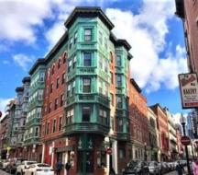
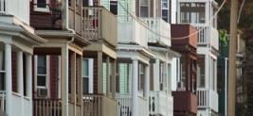
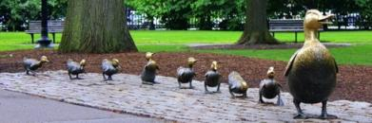
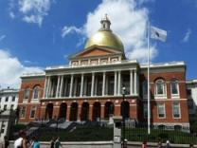
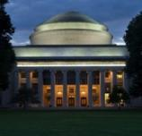
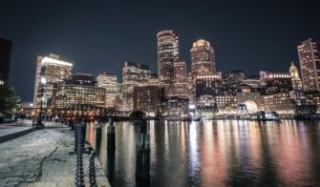
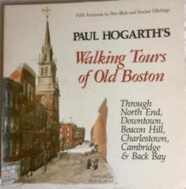

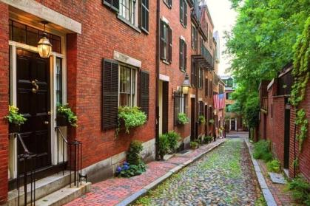
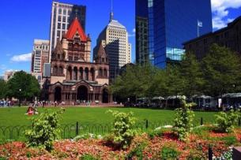
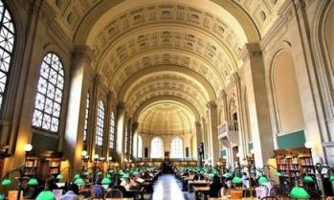
(Virtual) Walking Tours of the Greater Boston Area
SPLASH 2021

Slide 2

Who am I?
Name: Samantha Webster (call me Sam)
Occupation: 5th year doctoral candidate in the Biology Department
Field of Study: Structural Biology/Biochemistry, specifically studying ribosome biogenesis and autophagy
Origin: Boulder, Colorado
Currently live in: Cambridge, Massachusetts
Why am I leading (virtual) walking tours on history and architecture: I consider myself a veteran walker, have always loved history, and before ye olde plague hit I was training to be a volunteer tour guide with Boston by Foot
Notes:
Have lived here for three years now. Moving from Colorado, where everything is relatively new (oldest building I ever visited there was from the 1870s) to here where everything is super old. New perspective.

Slide 3
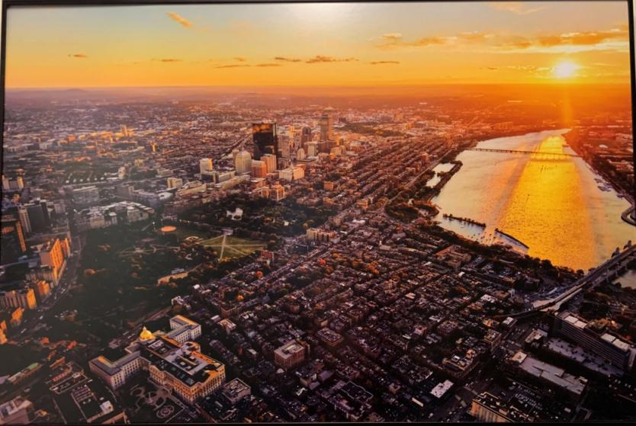

Slide 4
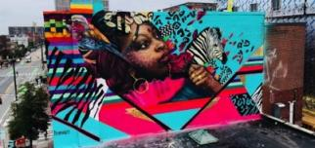
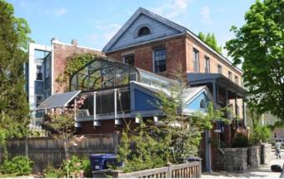
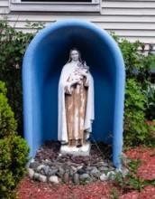
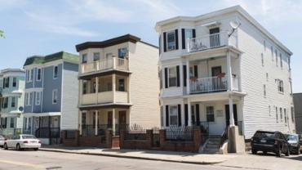
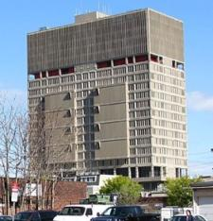
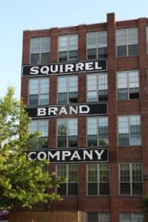
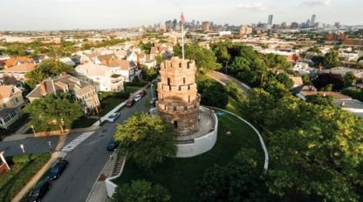
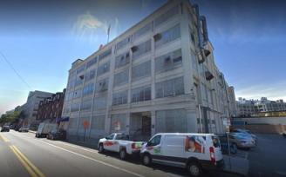
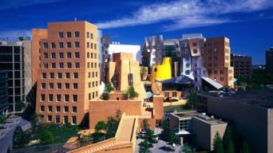
Part 1:
See Sam’s Neighborhood
Notes:
This is week one, no rhyme or reason to what I’m showing you this week except that I like the locations and they’re near me. We’re just boppin’ around this week. Some themes we talk about today will definitely come back in future tours.

Slide 5

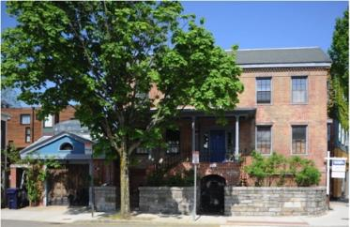
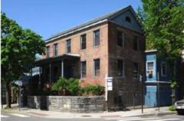
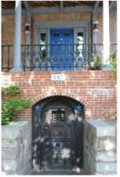
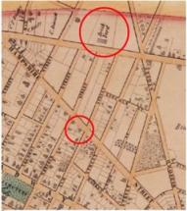
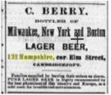
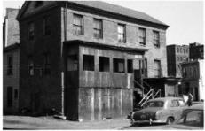
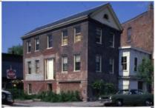
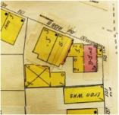
Ivory Sands House
Built in 1839 by Ivory Sands, of the Sands family of brick makers, in the Federal Style
Listed on National Register of Historic Places in 1986
Basement used to bottle beer in the 1880’s; in 1887 listed as one of 113 saloons operating in Cambridge
1934 map showing “Dwelling, Store in Basement”
1854 map shows house location and nearby brick yard
1965
1979

Slide 6

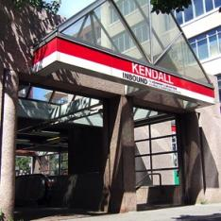
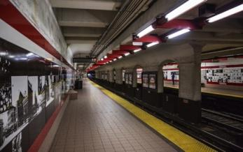
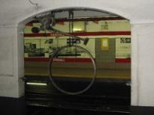
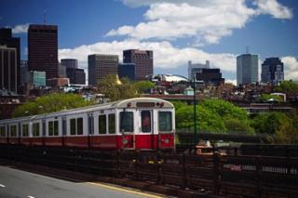
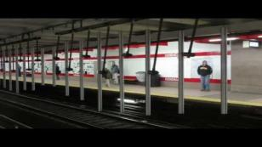
Kendall Square Stop
Opened in 1912 as part of the Cambridge Subway from Park Street to Harvard – 4 years before MIT moved to its current location!
Remodeled in 1987 to accommodate 6-car trains
Between 1986-1988 artist Paul Matisse built the Kendall Band, three interactive sculptures named Pythagoras, Kepler, and Galileo
A group of MIT students partially restored Pythagoras in 2011
Red Line train going over the Longfellow Bridge
Notes:
West Boston Bridge predated the Longfellow bridge

Slide 7
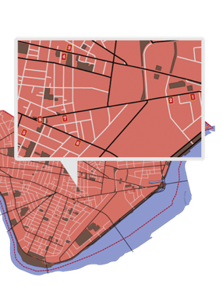
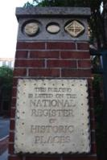
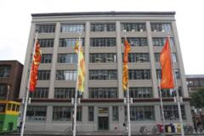
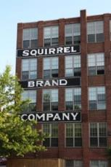
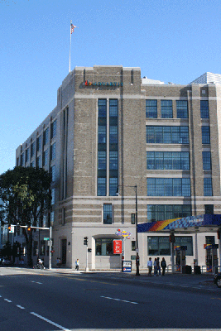
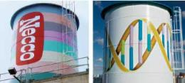
Candy Making in Cambridge
Fox Cross Company (1920-1980)
Charleston Chew
Squirrel Brand Nuts (1890-1999)
Squirrel Nut Zipper
Kennedy Biscuit Company -> Nabisco (1869-present)
Fig Newtons
Oreos
James O. Welch
(1927-1963)
Junior Mints
Sugar Daddies
Sugar Babies
Necco (1847-present)
Necco Wafers
Conversation Hearts
https://cambridgehistory.org/candy/index2.html
Notes:
Fox Cross Company
The candy bar that made them famous wasn’t launched until 1922 when they took vanilla flavored nougat, covered it with milk chocolate, and called it the Charleston Chew, trying to capitalize on the popular dance craze at the time.
Nabisco
The Kennedy Biscuit factory has stood here since 1869; it now stands as condominiums that bear the name Kennedy Biscuit Lofts.
Fig Newtons were first made here in 1891 and their shape, taste, and size have not changed since, even as Kennedy Biscuits merged with other bakeries in 1898 to form the National Biscuit Company, which we know as Nabisco, maker of Oreos and other cookies and crackers.
James O Welch
Tootsie Roll still produces more than 15 million Junior Mints a day, all from this location. Tootsie also bought out the Fox Cross company, the first stop on our tour, and continues to make Charleston Chews.
Necco
In 2004 NECCO moved production and headquarters to Revere and the building was occupied by Novartis Biomedical Research and the water tower was redesigned with a double helix.
When built in 1927, this factory was the largest in the world devoted to candy making. In fact, many of the features that made the NECCO building state of the art in 1927 also made it ideal for conversion to lab space. Made of concrete instead of steel frame, the building resists vibrations, Floors between 9-14 inches thick can hold as much as 250 pounds per square foot, strong enough to support storage tanks, mixing vats, conveyer belts, and now robotics and screening machinery used in drug research.
The Novartis conversion of the factory was a $175 million project partly to remove sugar spores in the pores of the walls and sticky residue from the floors.
NECCO has one of the richest local histories in the industry. It dates back to 1847 when brothers Oliver and Silas Chase patented the first American candy machine and started producing sugar wafers. Early versions of the candy were distributed to Union soldiers during the Civil War. Today, the wafers are believed to be the oldest American product continuously manufactured and still sold in unchanged form. Today, NECCO is the oldest continuously operating candy company in the U.S
Squirrel Brand
Squirrel Brand produced nuts that were carried by Admiral Richard Byrd, who lead the first expedition to reach the South Pole by air. The nuts were also shipped all over the world during WW2.

Slide 8
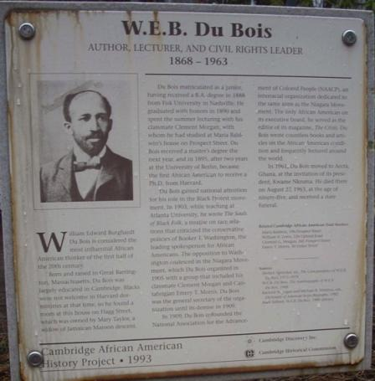
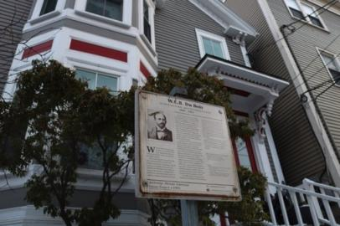
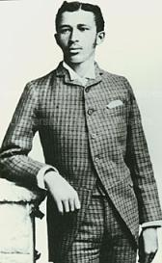
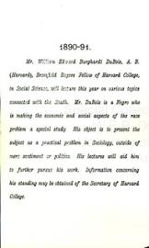
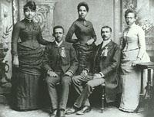
20 Flagg Street
Du Bois, aged 19
Rented a room at 20 Flagg St 1890-1893
Du Bois with Fisk University classmates

Slide 9
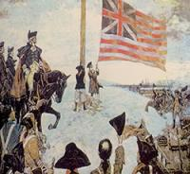
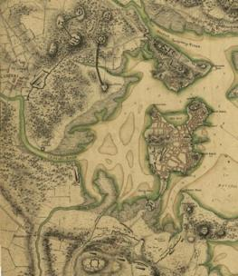
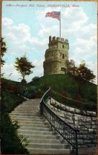
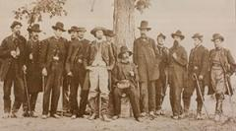
Prospect Hill Tower
Grand Union Flag – first national flag in the United States, first raised at Prospect Hill by George Washington
Prospect Hill became the strongest fortification on the frontline of the American Revolution – it was known as the “Citadel”
Union Square, Somerville, MA
1910 postcard of Prospect Hill Tower
The monument was completed in 1904
Members of Somerville Light Infantry Company during the Civil War – after the war the area was renamed Union Square
Notes:
After a retreat from the Battle of Bunker Hill, c

Slide 10

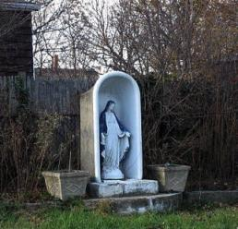
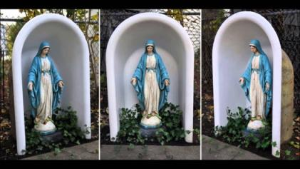


Bathtub Marys
A history of Catholics in Massachusetts:
1600’s: wars between French and English colonists mirrored religious conflict in Europe
1780: Catholics legally allowed to practice their faith
In the 1840’s many Irish immigrants settled in Boston; by the 1850’s the Irish were the largest ethnic group in the city
“Mary on a half-shell”
“Coffin ships” during the Irish Potato Famine, 1840’s

Slide 11







The Triple Decker
Between 1880 and 1930, 16,000 triple deckers sprang up in Boston
Triple deckers banned due to nativist sentiments, Immigration Restriction League:
Triple deckers today:
Notes:
Between 1880 and 1930, 16,000 triple deckers housing about 192,000 people sprang up in Boston.
Offered a path to working and middle class home ownership
1. Windows are carefully placed. Three-deckers feature multiple street-facing front bays, and most buildings boast windows on all four sides to let in natural light from every angle. As the Dorchester Reporter notes, when three-deckers are lined up next to each other, so are the side windows, allowing for residents to have awkwardly direct sight lines into adjacent units. Oh, hello, neighbor!
2. Columns are a defining quality. Columns are also minimally decorated and support the building’s characteristic porches. Front porch pillars can extend beyond the first floor, framing second- and third-level porches. The columns are part of the several strong vertical lines seen on a three-decker’s facade that chop up living spaces into sections. They cross with horizontal lines at each level, separating each of the three units.
3. If it weren’t for flat roofs, they might look like abnormally tall houses. While three-deckers already resemble three, tiny, stacked houses, their flat roofs make them characteristically urban. “As architecture, they are curious forms, part urban and part suburban,” writes Arthur Krim in The Three-Deckers of Dorchester. “They look like apartments transformed into houses, or perhaps houses overgrown into apartments. They have the flat roofs of the city, but the wooden walls of the country. They appear as row houses transplanted into the suburbs.”
4. Three-deckers are always constructed of wood. While other cities were building row houses made of stone and brick, Boston, Worcester, Fall River, and other New England towns stuck with the relatively inexpensive material early settlers had sworn by. A 1977 Boston Redevelopment Authority report cites that the first wooden three-deckers sprang up in South Boston and Roxbury, where wood wasn’t prohibited by city fire laws. Wood proved to be practical and easy to build with when waves of immigrants came to New England after the Civil War.
5. A single front door leads into the building. The street entrance is almost always situated on a front porch. It provides access to the first-floor unit as well as to a stairway leading to the upper two. There are, of course, rear doors, opening to a three-decker’s hallmark back porches, which are not often visible from the street.
And finally, for the record, Zimmerman confirmed both the terms “three-deckers” and “triple-deckers” are correct.
“I think I tend to say triple-deckers, but I think locally most folks call them three-deckers!” she says.

Slide 12









Central Square Artwork
Notes:
Central square:

Slide 13









Part 2:
Boston Through the Ages

Slide 14



Founding of Boston - 1630
Shawmut Peninsula becomes Boston
1630 The first church in Boston was established by John Winthrop’s settlement.
1630 Boston’s first cemetery, King’s Chapel Burying Ground, was founded.
1634 The first tavern/inn was opened in Boston by Puritan settler, Samuel Cole.
1635 Boston Latin School opened; it was the first American public school.
1636 “New College,” or “the College at New Towne,” was founded by vote of the Great and General Court of the Massachusetts Bay Colony. This school would be renamed Harvard College in 1639.

Slide 15



The Puritans
Puritans:
were Protestant (Calvinist) and Congregationalist
had universal male suffrage (*for all “freemen” who were church members) – not a theocracy
had a surprisingly secular court system
cancelled Christmas

Slide 16







Boston Common
Founded 1634
19th century – public park
17th century - literally “common” land for grazing, gathering, graveyard, public executions, etc.
Boston Public Garden
20th, 21st century - place of protest
Notes:
Quaker Mary Dyer, execution 1660. Also hanged a few witches.
Boston Common central burying ground

Slide 17




Faneuil Hall
Public marketplace with meeting space in top floors
Built 1742 – funded by Peter Faneuil
Topical question: Peter Faneuil derived some of his fortune from the slave trade – should the building be renamed?

Slide 18



Old State House
Built 1712
1713-1776: seat of Massachusetts colony government
1776-1798: seat of Massachusetts state government
Site of the Boston Massacre, 1770
Notes:
The central portion contained the chambers for the elected Massachusetts Assembly. This chamber is notable for including public galleries, the first known example of such a feature being included in a chamber for elected officials in the English-speaking world
Lion/unicorn harken back to British symbols

Slide 19




Paul Revere House
Built ~1680
Paul Revere owned the house 1770-1800
Later 19th century – became a tenement that housed Italian immigrants
1902-1908 – refurbished and opened as a museum
Paul Revere was a silversmith and businessman in Boston during the Revolution
He is remembered for his midnight ride thanks to the poem that was written in 1860

Slide 20






Boston and the Abolition Movement
Charles Sumner
Lewis & Harriet Hayden House
Anthony Burns
Samuel Gridley and Julia Ward Howe House

Slide 21

Musical Interlude

Slide 22




Boston and the Civil War
54th Regiment Memorial
Fort Independence at Castle Island

Slide 23



Waves of Immigration

Slide 24





Great Molasses Flood

Slide 25









Part 3:
Designing Boston

Slide 26





City of Squares
Inman Square Redesign

Slide 27


Filling in Boston

Slide 28







How Boston Lost Its Hills
Trimount - 1630
(Mt. Vernon, Beacon Hill, and Pemberton Hill)
Cutting down Beacon Hill – 1807-1828
Notes:
Mt. Vernon, Beacon hill and Pemberton hill, and two other hills the settlers later called Copp’s Hill and Fort Hill
Massachusetts is an Algonquin Indian word which roughly translates to “large hill place” or “at the great hill.”
refers to the Great Blue Hill in Milton, Massachusetts which is an ancient volcano that was last active over 400 million years ago.

Slide 29








Filling in Back Bay
A steam shovel digging out gravel in Needham (~1860's).
A gravel train in a Needham gravel pit (~1860's)
Plymouth Rock – an erratic left over from the last Ice Age

Slide 30







The Public Garden
Public Garden 1850’s – foreground is mud flats
Public Garden 1890’s – Back Bay is now filled in

Slide 31









Make Way For Ducklings
Artist Nancy Schön

Slide 32






Public Transportation
The Omnibus – 1850s-1880s
Constructing Tremont Street Subway Tunnel – finished 1897
MBTA incorporated 1964
Electric Street Cars – 1890s
Boston Elevated Railway – 1910’s
Park Street Station - 1898

Slide 33








Slide 34








Calf Pasture Pumping Station - 1883

Slide 35
Great Molasses Flood

Slide 36




Before
The Big Dig
The Green Monster – 1980s
Construction
Zakim Bridge
After
Notes:
YouTube videos:
https://www.youtube.com/watch?v=eF5aUClwJ9w
https://www.youtube.com/watch?v=-0zAA7GNgWM

Slide 37








Part 4:
Boston Architecture

Slide 38







James Blake House
Dorchester 1661
The house is one of only a few examples of West England country framing in the United States.
The 1748 division plan shows the first known illustration of the Blake House
Probable appearance of the James Blake House when it was built in 1661.
Postcard circa 1920

Slide 39






Medford 1732
Royall House and Slave Quarters

Slide 40




Massachusetts State House
1798
Charles Bulfinch – Federalist Style

Slide 41





Building in Back Bay
“Whole forests from the State of Maine… [had] been put to service in …furnishing pilings and solid foundations.”

Slide 42






Boston Public Library
1895
Notes:
Charles Follen McKim of McKim, Mead, and White was chosen to design a new building at the corner of Dartmouth Street and Boylston Street. It opened in 1895 and cost $2.268 million, with a capacity of 2 million books
Initially funded by Joshua Bates, stipulated that library must be “Free to all”
Italianate building style

Slide 43






John Singer Sargent
Triumph of Religion 1890-1919

Slide 44







Isabella Stewart Gardner Museum
1901

Slide 45





Boston City Hall
1968
‘Brutalism’ – derived from the French béton brut (raw concrete)
Notes:
Michael McKinnell – died recently from coronavirus

Slide 46








Part 5:
Burying Grounds of Greater Boston

Slide 47






Grave Art
Memento mori – remember, you will die.
Graveyard vs. Cemetery vs. Burying Ground?
Graveyard – attached to a church, consecrated ground
Cemetery – not attached to a church, generally speaking a newer invention (19th century), tends to be rural
Burying Ground – Municipal, secular. Puritans had “burying grounds” not graveyards or cemeteries.

Slide 48




King’s Chapel Burying Ground
1630
King's Chapel Burying Ground was founded in 1630 as the first burial ground in the city of Boston. According to custom, the first interment was that of the land's original owner, Isaac Johnson. It was Boston's only burial site for 30 years (1630–1660).
Today there are 505 headstones and 59 footstones remaining from the more than one thousand people buried in the small space since its inception. There are also 78 tombs, of which 36 have markers. This includes the large vault, built as a charnel house, which was converted into a tomb for children's remains in 1833. The earliest tombs are scattered among the grave markers. Most are in tabletop form.

Slide 49





King’s Chapel
1686 (1754)
The King's Chapel congregation was founded by Royal Governor Sir Edmund Andros in 1686 as the first Anglican Church in colonial New England during the reign of King James II. The original King's Chapel was a wooden church built in 1688 at the corner of Tremont and School Streets, where the church stands today. It was situated on the public burying ground, now King’s Chapel Burying Ground, because no resident would sell land for a church that was not Congregationalist (at the time, the Congregational church was the official of Massachusetts).
The King’s Chapel Crypt

Slide 50







Mount Auburn Cemetery
1831
The first garden, or rural, cemetery in the United States. This was a trend in Europe, moving cemeteries out of city centers because of concerns of overcrowding and disease.
As of 2003, 93,000 people were buried in the cemetery.
A favorite spot of bird watchers; over 220 species of birds have been spotted here.

Slide 51







Forest Hills Cemetery
1848
Sprawls over 280 acres, over 100,000 people are buried here
Location of e. e. cummings’ grave, below ↓
The non-denominational cemetery was established as the municipal burial ground – more culturally diverse than Mount Auburn.
One of first cemeteries to integrate burials – sadly did not record race of departed.

Slide 52








Part 6:
Tech Boom! Kendall Square & MIT

Slide 53






William Welles Bosworth
MIT’s Great Dome
1916

Slide 54





MIT Chapel
Eero Saarinen
1955

Slide 55




Green Building
I.M. Pei
Araldo Cossutta
1964
La Grande Voile (The Big Sail)
Alexander Calder

Slide 56




Wiesner Building
1985
I.M. Pei

Slide 57






Kendall Square
BioTech Boom
Eric Lander
Susan Hockfield

Slide 58




Amgen
Est. 1980

Slide 59






Seaport District

Slide 60







The Harborwalk
1984

Slide 61








Harvard Mass Ave Bridge
Built in 1891, rebuilt in the 1980’s
Postcard (dated between 1916 and 1924)
Length: 364.4 smoots + 1 ear
1 smoot = 5’ 7”
Richard E. Byrd
Notes:
1958 – ollie smoot, frat bros measured him all the way across the bridge, prank

