Slide 1
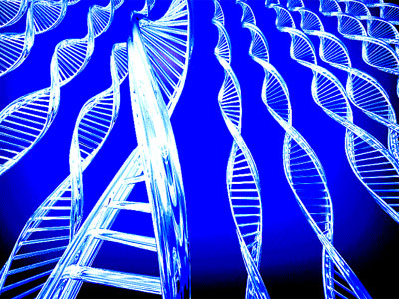
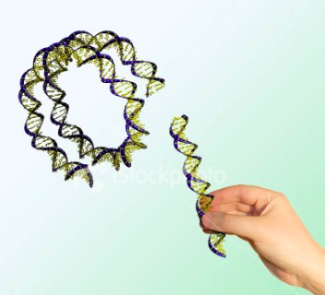
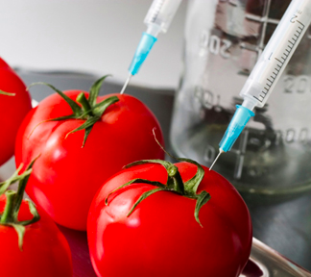
Genetic Engineering

Slide 2
Clip
http://www.bbc.co.uk/programmes/b00plcl4#clips
Notes:
Day of the triffids!

Slide 3
Steps
Isolating the gene of interest
Building a cloning construct
[Gene targeting]
Transformation
Selection
Notes:
But most often the new gene is just inserted randomly (as opposed to gene targeting).

Slide 4
Step 1: Culturing the gene of interest
Animation
Ecoli
Heat shock
Notes:
Animation: http://www.youtube.com/watch?v=AEINuCL-5wc
Start at 1 minute and apologies for the annoying voice.

Slide 5
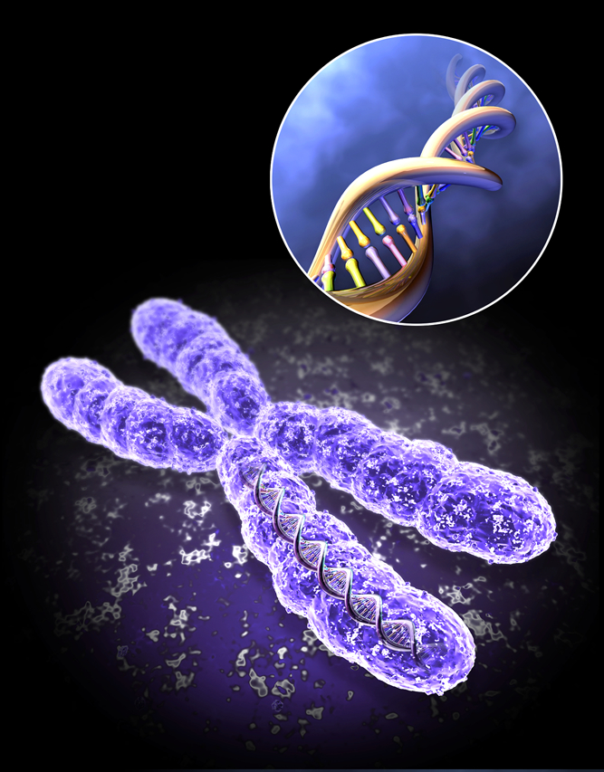
Eukaryotic vs. Plasmid DNA
Notes:
Most bacteria have circular chromosomes, linear is typically found in higher organisms. We use circular pieces of DNA called plasmids as vehicles for genes we want to insert.

Slide 6


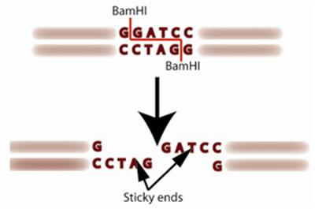
Restriction Enzymes
Endonucleases
Creating “sticky ends”
Like puzzle
pieces
Notes:
What is an enzyme? A protein that carries out a reaction, or assists with a reaction. Endonucleases make cuts in DNA. Anything ending in “ase” cuts. Rnase cuts RNA. Nuclease cuts nucleic acids. Each restriction enzyme, or restriction endonuclease targets a specific DNA sequence.

Slide 7
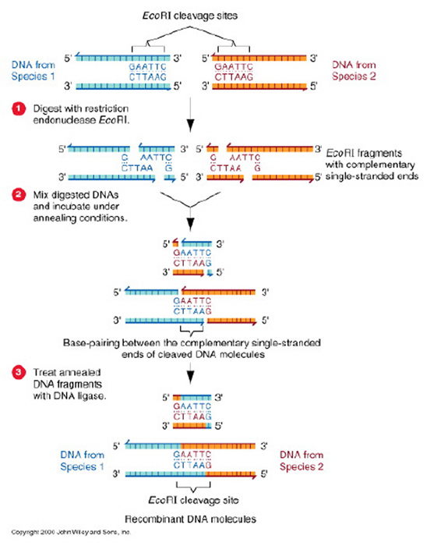

Slide 8
Notes:
Using the right combination of different restriction enzymes you can cut and past different strands of DNA.

Slide 9
Cloning Vector
Restriction enzyme sites as part of a multiple cloning site
Resistance marker or antibiotic resistance marker
Promoter
Notes:
Define vector: A cloning vector is a small piece of DNA into which a foreign DNA fragment can be inserted
Restriction enzymes help insert the foreign DNA by cutting a hole in the vector and cutting the edges of the foreign DNA so that it will fit into the hole in the plasmid.

Slide 10
Cloning Methods
Plasmid
Bacteriophage
Notes:
Lytic = broken open and replicated contents released

Slide 11
Bioethics Concerns
The Future of Food
Monsanto
Patents
Notes:
A little before 11:00 minutes
Salmonella resistance? Jump to 14:40
Then 24.35
Note- we watched a portion of the documentary the future of food and discussed how they use anecdotes and threatening diction to present genetic engineering as “evil” while still accurately reporting the scientific process.

Slide 12


DIY Bio and Biobricks
Notes:
Biobricks is an open source movement to make all genes that people might want to use available in a public registry. To request a gene, or a directory of many genes you order them online and they are provided to you at cost, or Biobricks only charges just enough to keep Biobricks operating, they are not trying to make a profit. This is an attempt to make genetic engineering accessible to non-corporate initiatives.

Slide 13
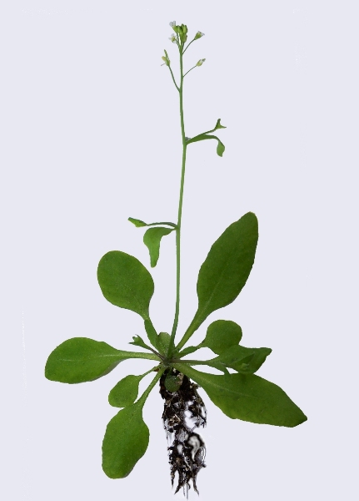
Agrobacterium tumefaciens
Agrobacterium
Gene gun
Horizontal gene transfer
Notes:
Arabidopsis Thaliana is the model organism for plants, like mice and zebrafish and flies are for animals.
Agrobacterium normally causes tumor like growth in infected plants
Horizontal gene transfer. draw phylogenetic tree, google this term if you are curious.
Dip the flower that has the reproductive organs of the plant into an agrobacterium solution and the gene will be inserted into the plants genome.
A gene gun is pretty much what it sounds like. It’s kind of awesome, no?

Slide 14

Three Vehicles
E. coli
DNA construction chassis
Agrobacterium tumefaciens
DNA transfer chassis
Arabidopsis thaliana
Notes:
First you insert the gene (on a plasmid) into ecoli and culture ecoli to make many copies of the gene. Ecoli is easy to grow and work with, it is very well defined so we know how to control it. The plasmids contains the gene and is then extracted and purified from the ecoli and the plasmids are put into agrobacterium. Agrobacterium shoots them into the plant arabidopsis.

Slide 15
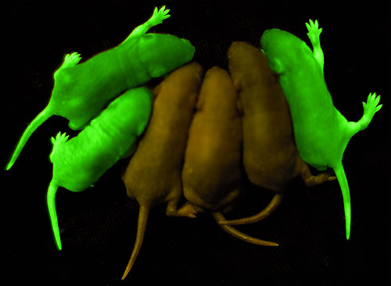
Applications in Research: Fluorescence
Tracking experiments
Expression studies
Notes:
Expression studies: where does a promoter express itself? (promoter is a term from week 1, google if it you are unfamiliar it is a FUNDAMENTAL concept you should be familiar with)
We can engineer green fluorescent protein to certain other promoters and genes and then shine lights on cells (and mice in this case) to see in what tissue this gene is expressed based on which tissue is glowing.

Slide 16
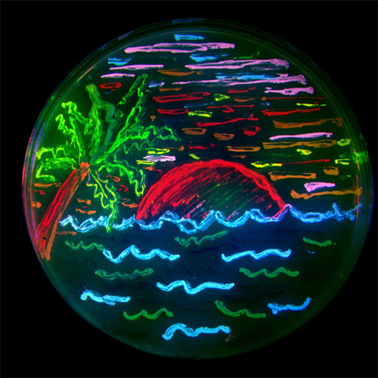
Notes:
We have many many fluorescent proteins nowadays. But back in the 70s we just had the green one. Isn’t it pretty?

Slide 17
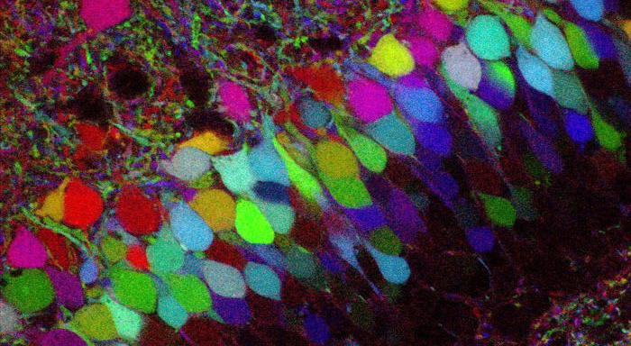
Brainbow
Notes:
Brainbow is awesome! But kind of irrelevant. Colors were randomly attached to neurons so that individual neurons could be distinguished from one another.

Slide 18
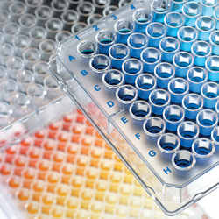
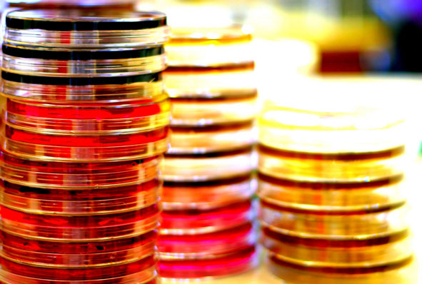
Knock-out and
Knock-in Libraries
Notes:
This is too complicated to explain in these notes, google it if you are curious.

Slide 19
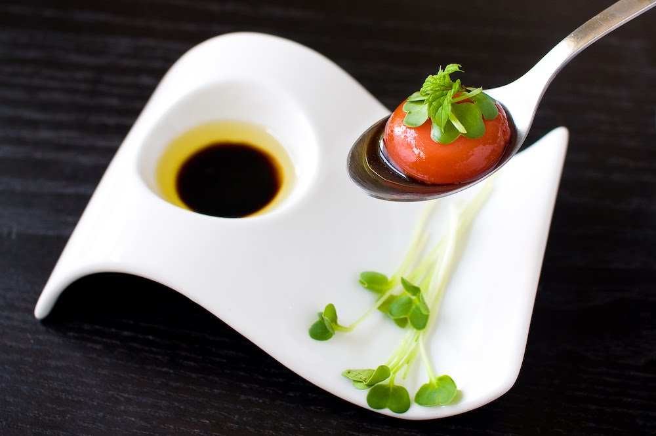
molecular gastronomy
the sweet science
Notes:
Gastronomy: the art and science of good eating, because I wasn’t entirely sure in class.

Slide 20
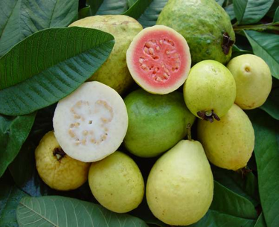
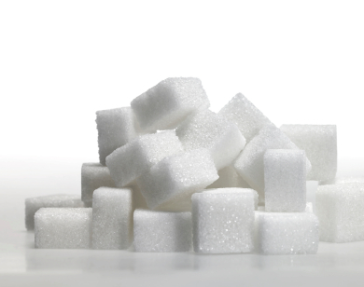
brazzein protein is 2000X
sweeter than sugar
Notes:
Brazzein is a protein isolated from a rare West African fruit. It is 2000X sweeter than sugar and is being considered as a low calorie suger alternative for dieters and diabetics.

Slide 21
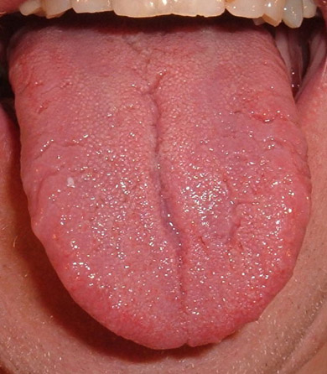
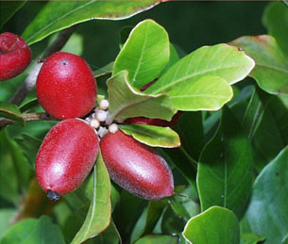
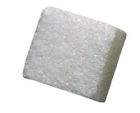
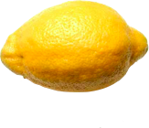
miraculin is a flavor inverter
Notes:
Miraculin- protein that binds to taste buds and makes everything you eat for the next half hour taste sweet.
http://en.wikipedia.org/wiki/Synsepalum_dulcificum

Slide 22
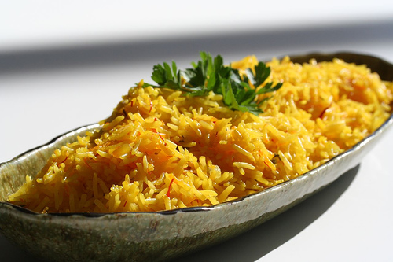
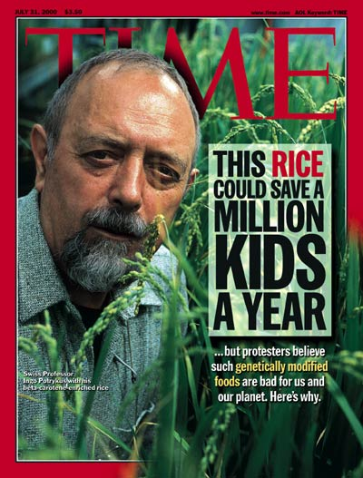
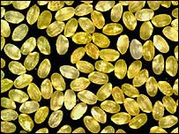
Golden Rice
Notes:
http://www.goldenrice.org/

Slide 23
Vitamin A deficiency
http://goldenrice.org/Content3-Why/why1_vad.html
http://ucbiotech.org/resources/presentations/new_talks/shakespear/shakespeare2.html
http://www.scidev.net/en/opinions/golden-gm-rice-shines-again.html
Notes:
Greenpeace think that people should just eat leafy green vegetables and palm oil. Oh really? Who’s going to pay for that?

Slide 24
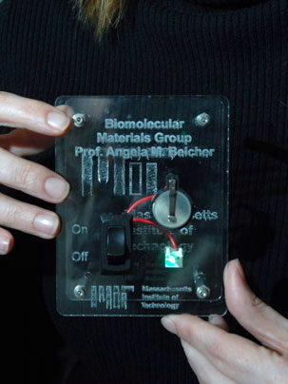
Genetically Engineered Viruses
http://web.mit.edu/newsoffice/2009/virus-battery-0402.html
Notes:
he new virus-produced batteries have the same energy capacity and power performance as state-of-the-art rechargeable batteries being considered to power plug-in hybrid cars, and they could also be used to power a range of personal electronic devices,
MIT team of scientists engineered viruses that could build an anode by coating themselves with cobalt oxide and gold and self-assembling to form a nanowire.
genetically engineered viruses that first coat themselves with iron phosphate, then grab hold of carbon nanotubes to create a network of highly conductive material

Slide 25
RNAi?
PCR and extracting genes
Lac operon
Notes:
We didn’t get to this, don’t worry about it.

