Slide 1
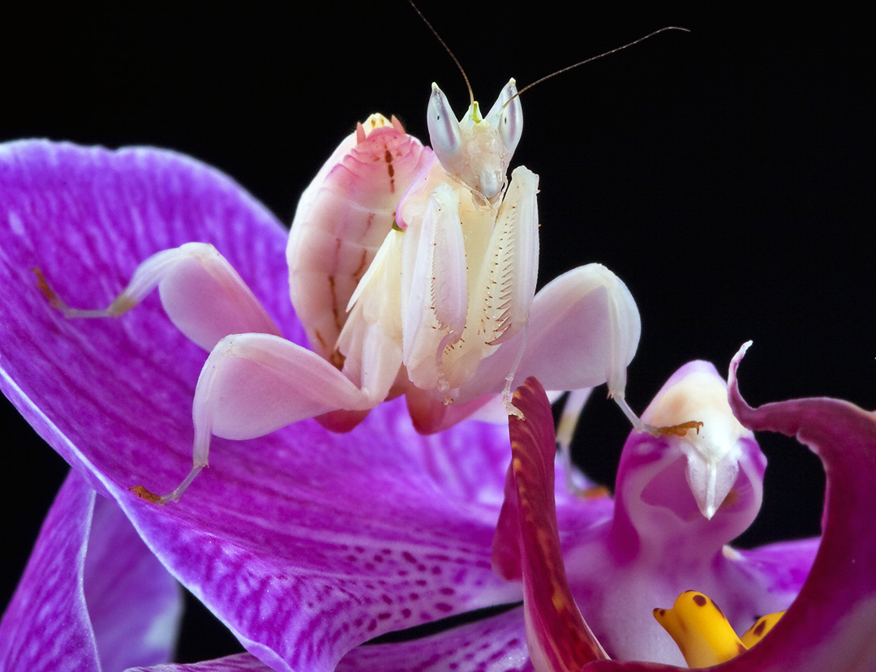
Notes:
The notes start on slide ___, where I left off in lecture.

Slide 2
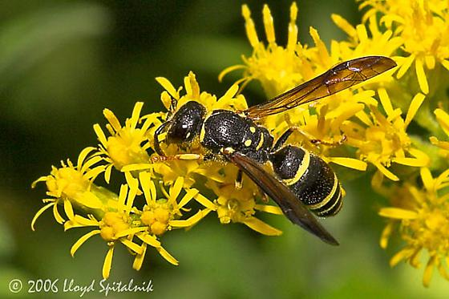

Slide 3
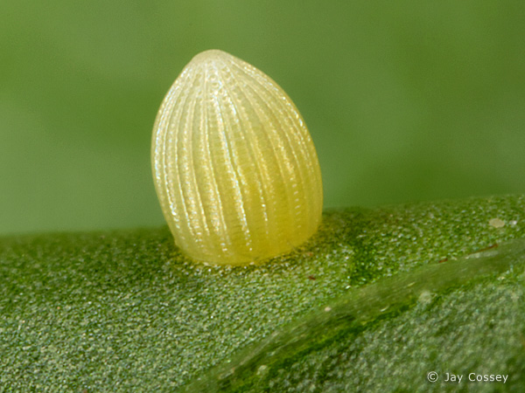

Slide 4
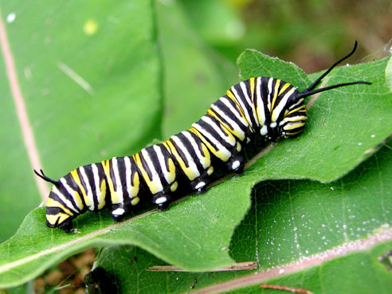

Slide 5
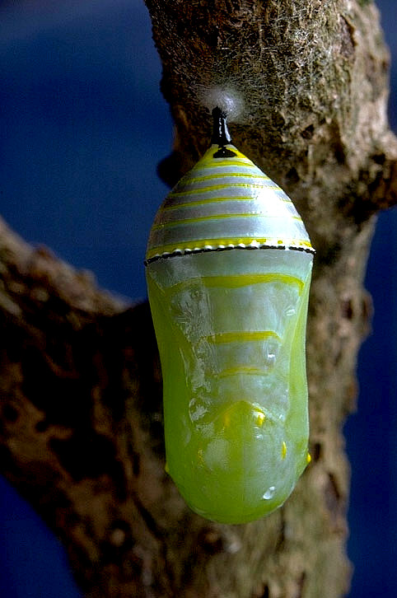

Slide 6
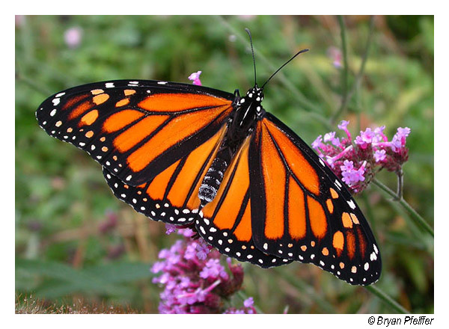

Slide 7
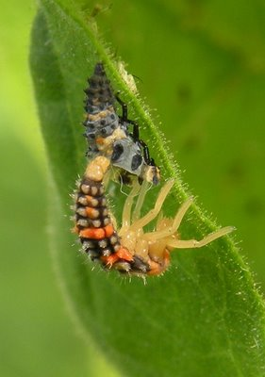

Slide 8
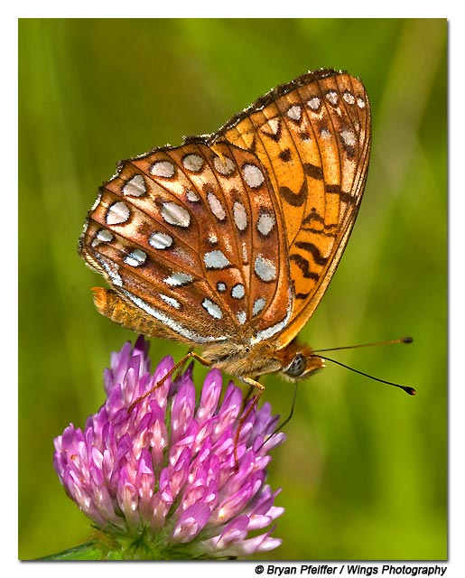

Slide 9
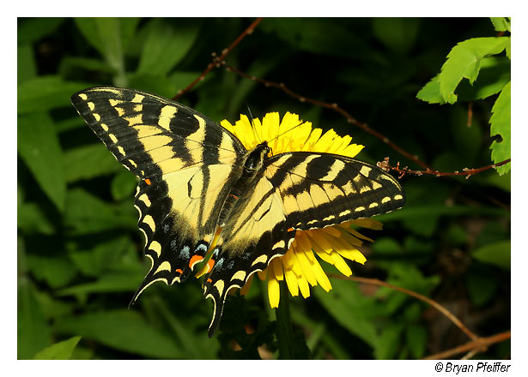

Slide 10
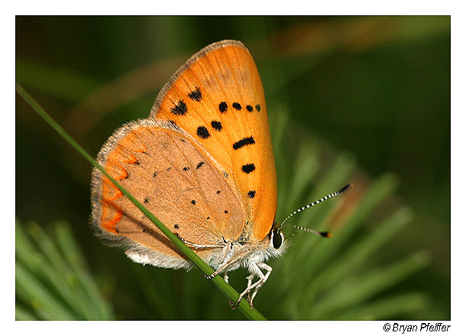

Slide 11
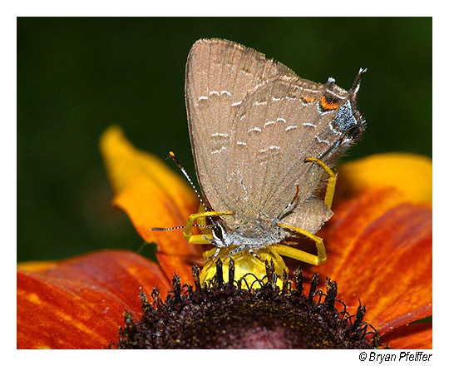

Slide 12
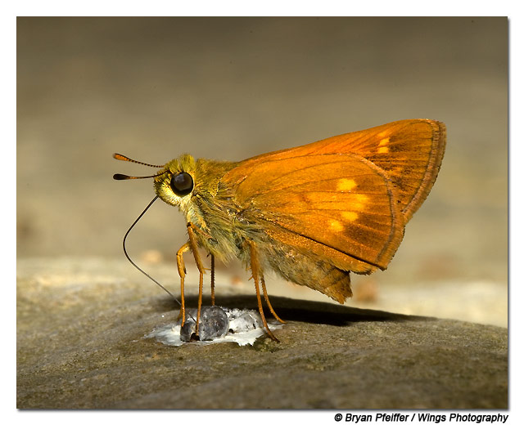

Slide 13
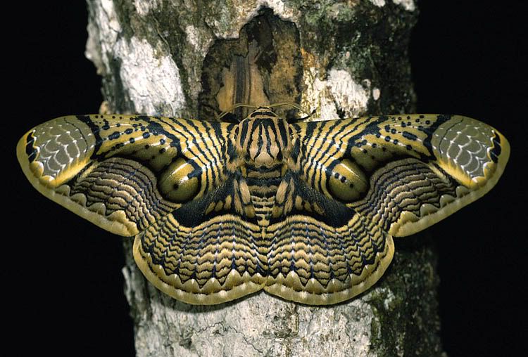

Slide 14
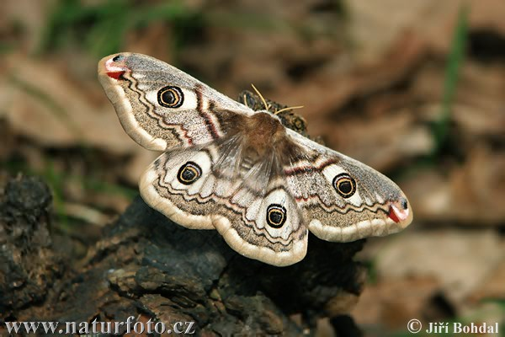

Slide 15
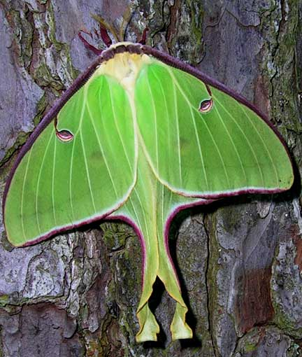

Slide 16
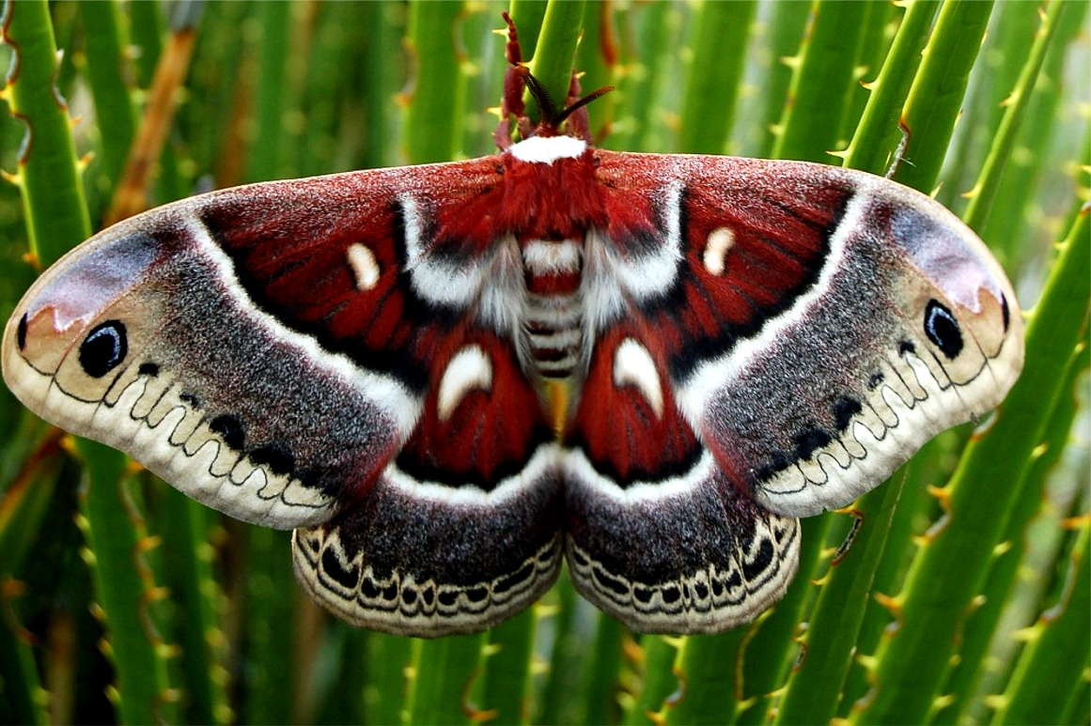

Slide 17
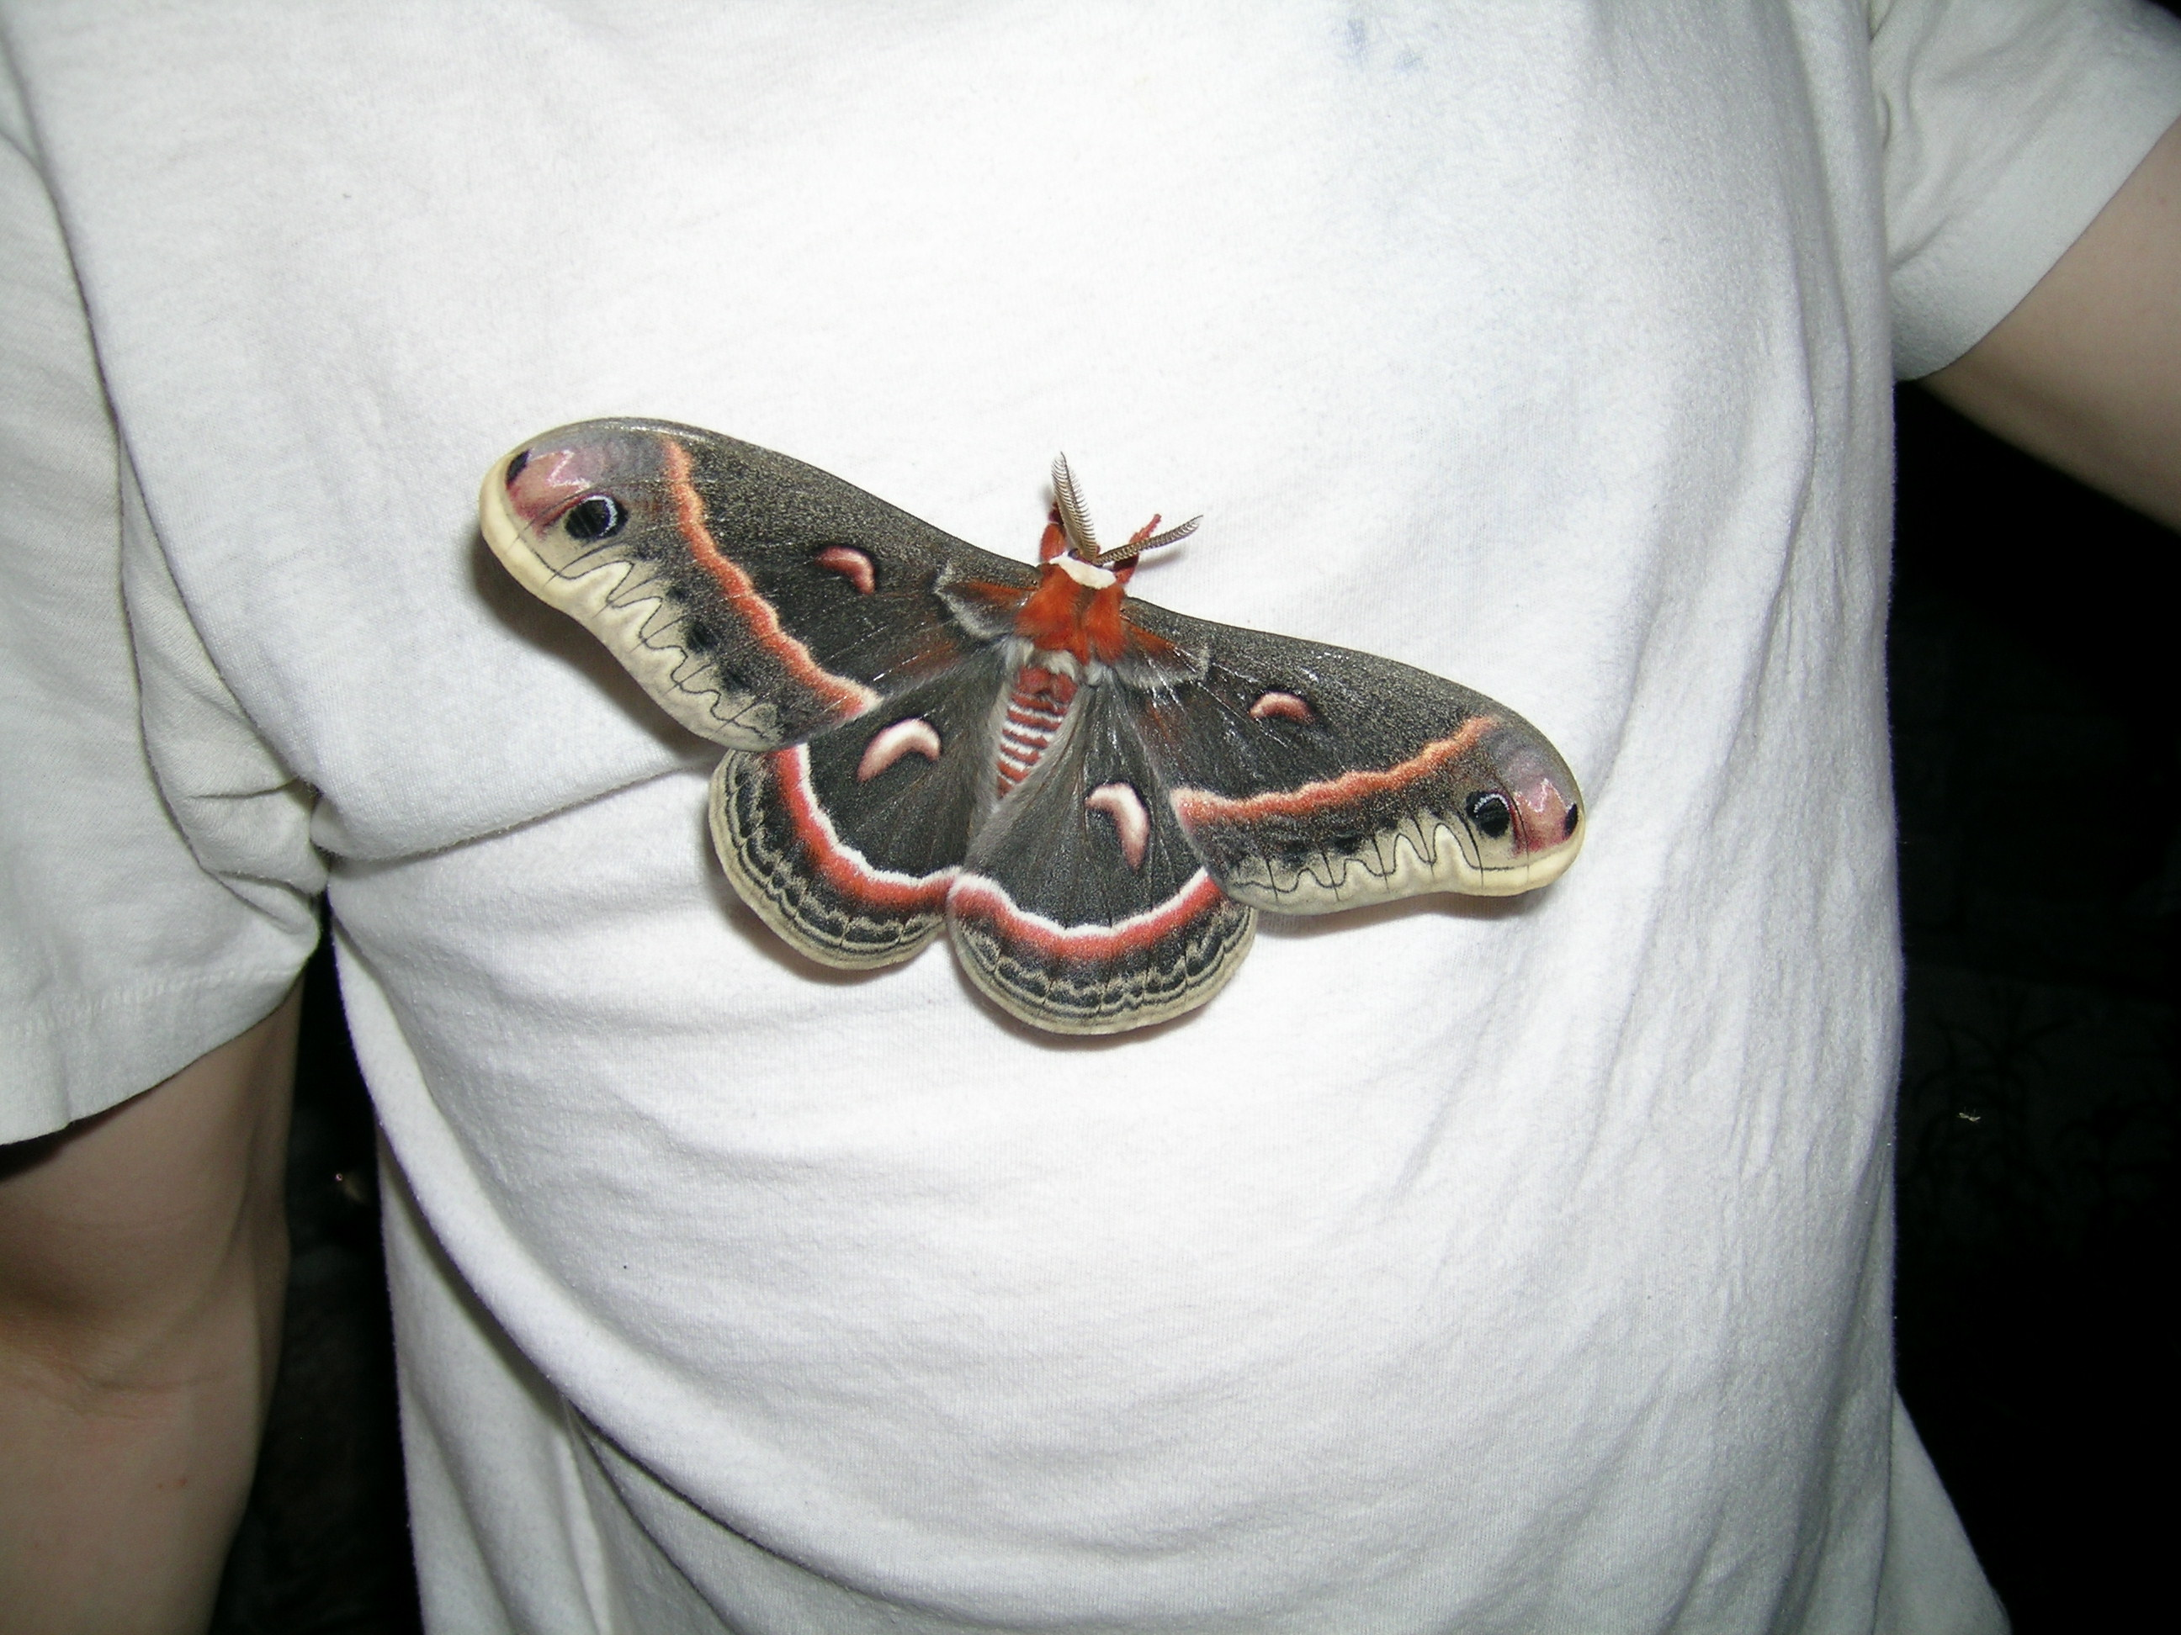

Slide 18
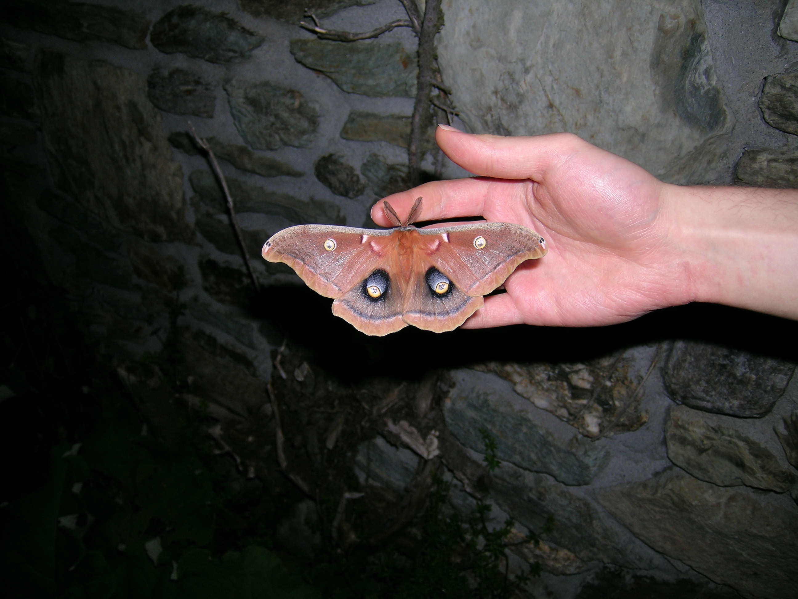

Slide 19
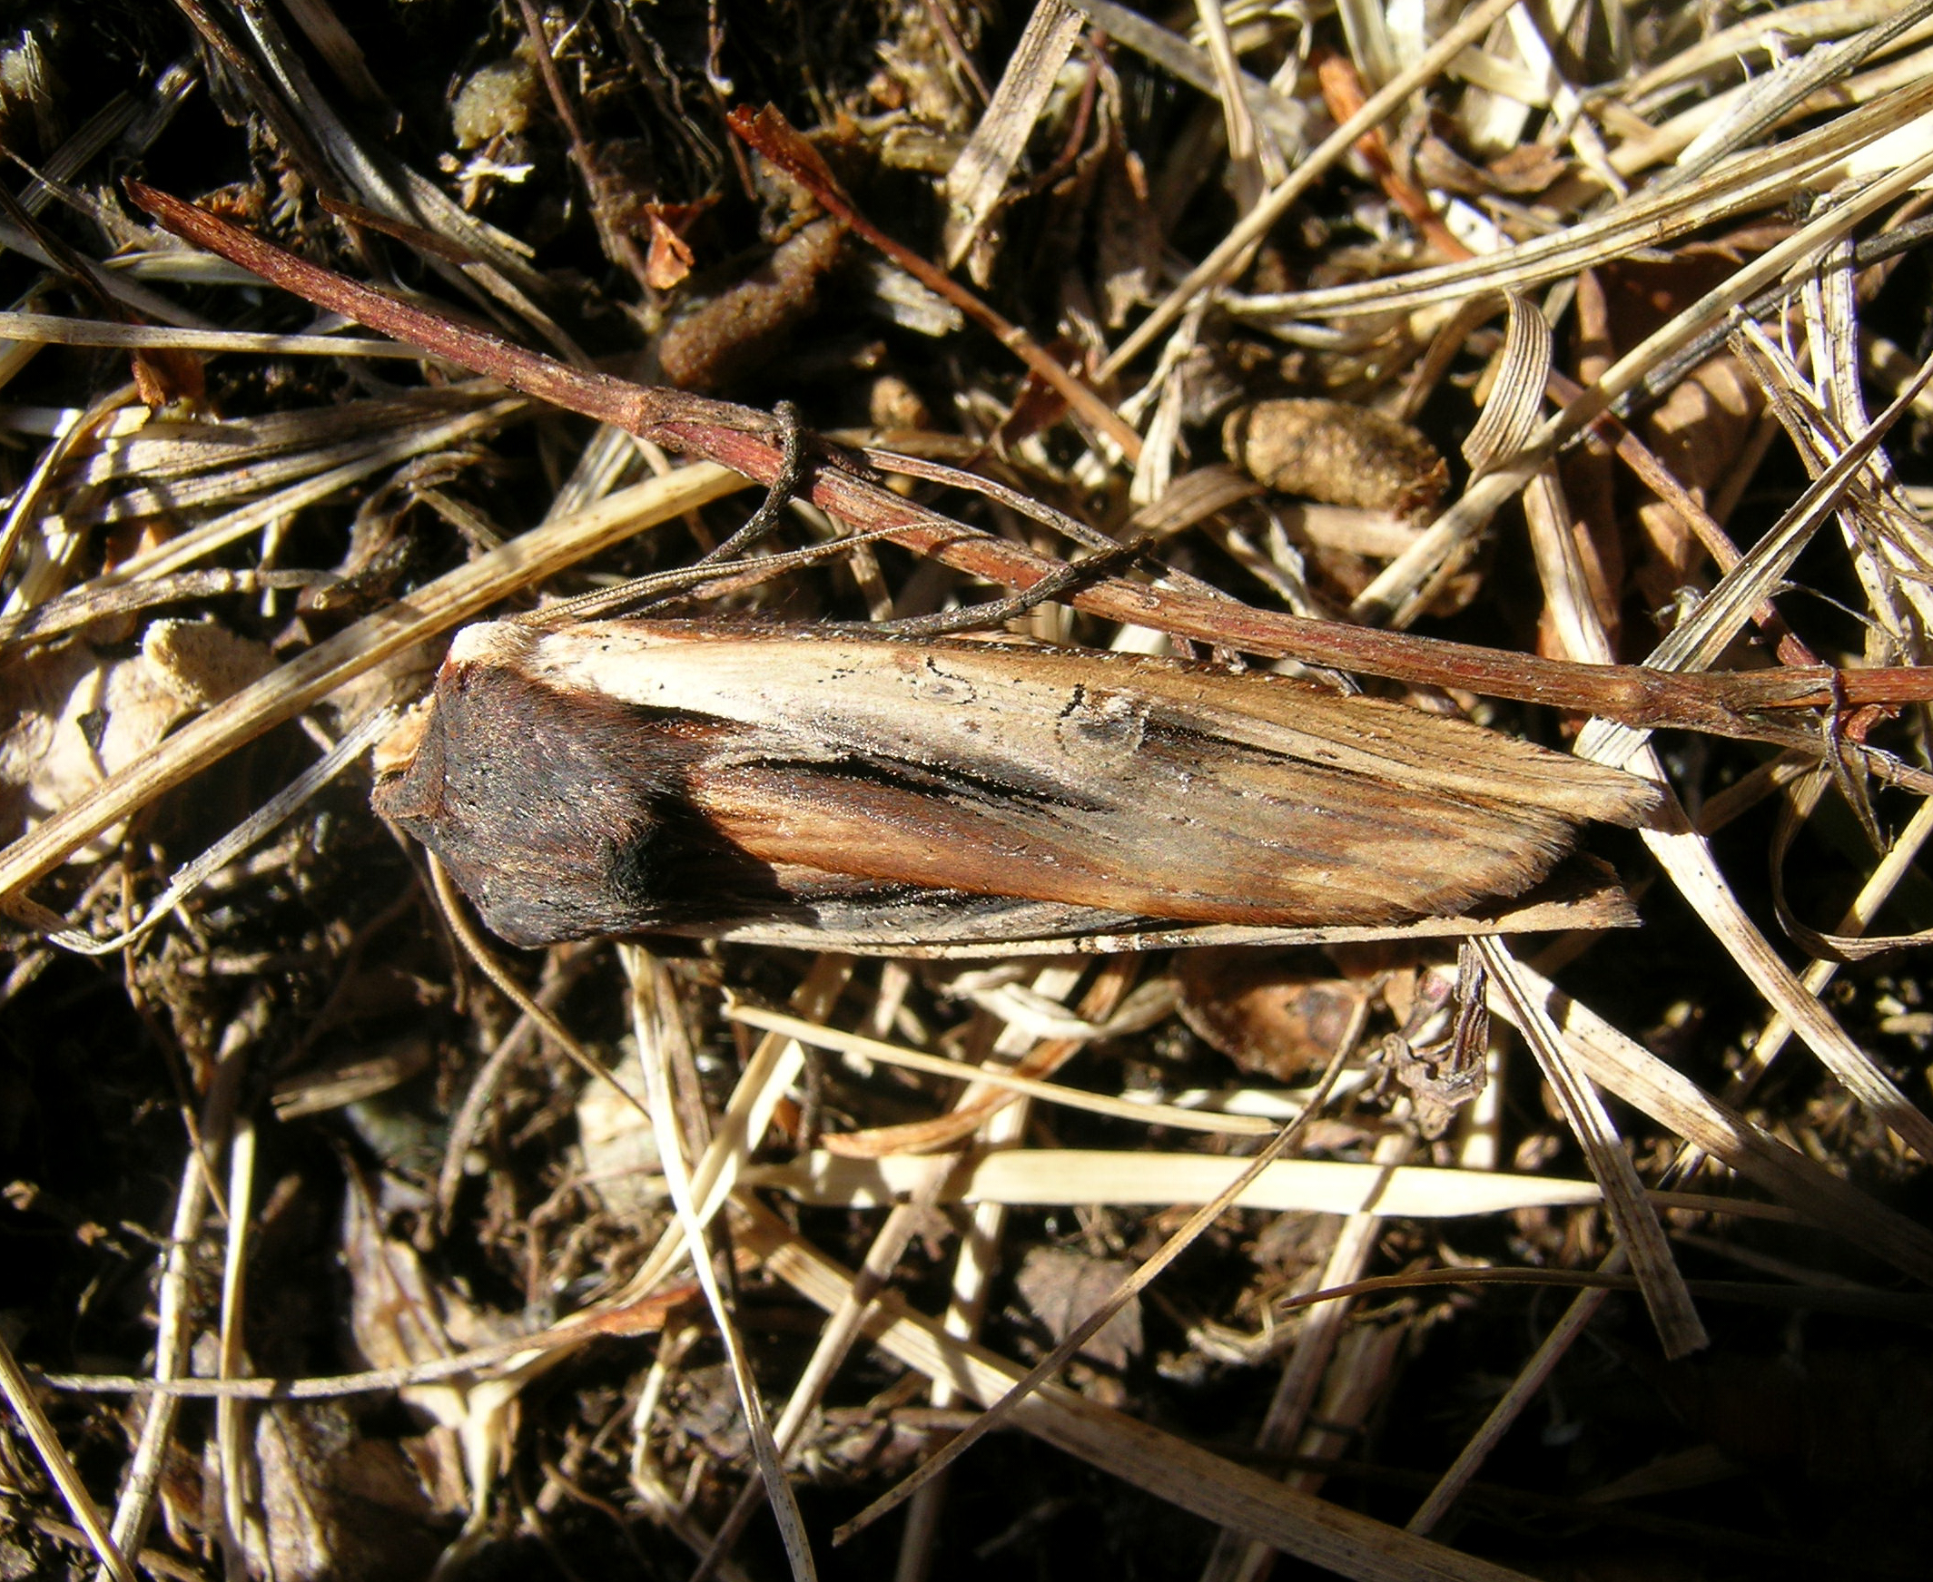

Slide 20
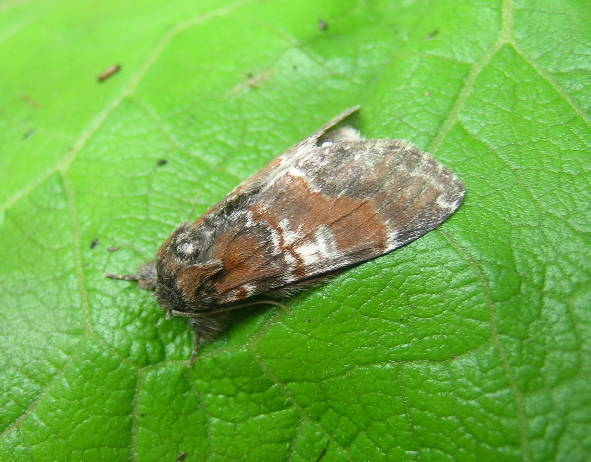

Slide 21
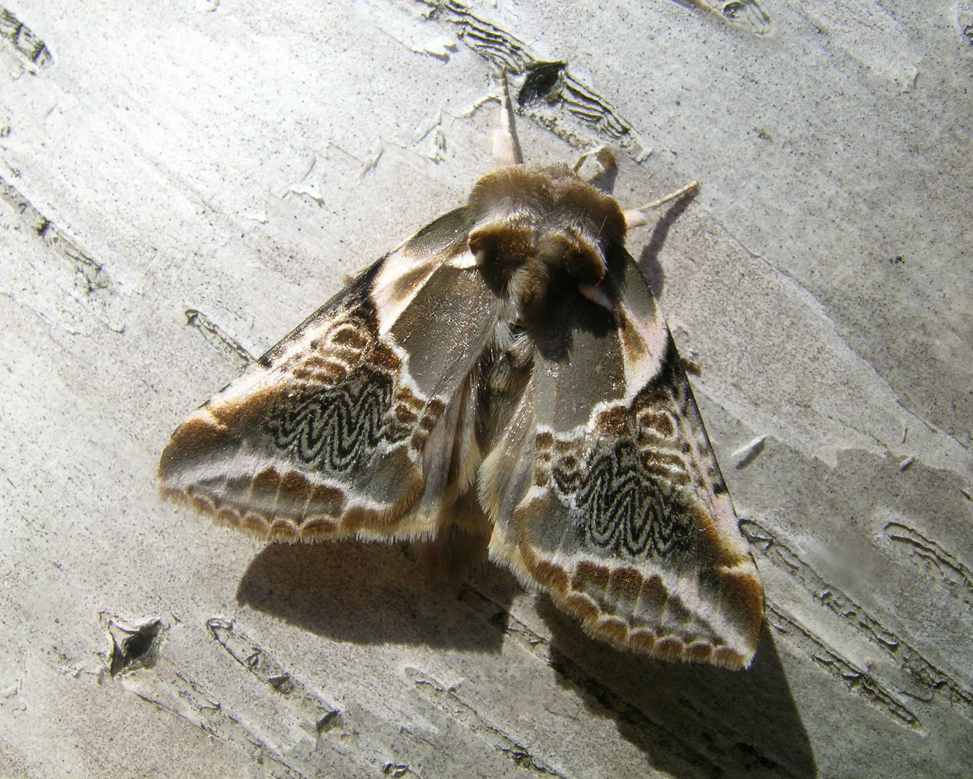

Slide 22
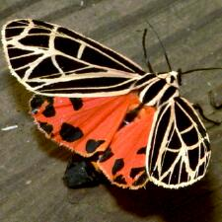

Slide 23
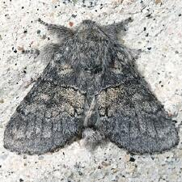

Slide 24
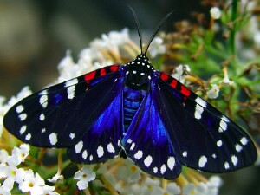

Slide 25
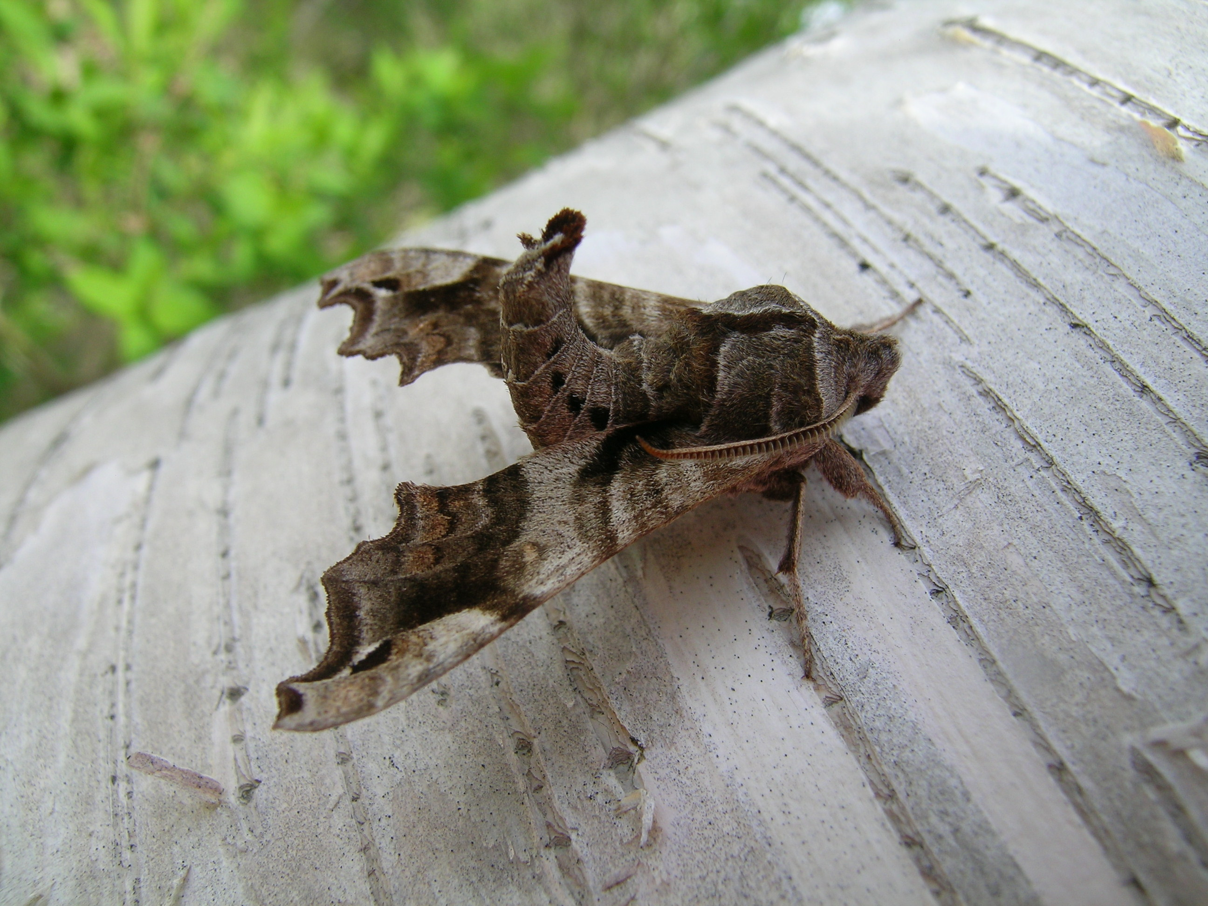

Slide 26
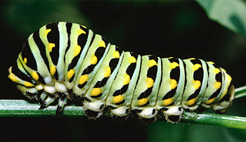

Slide 27
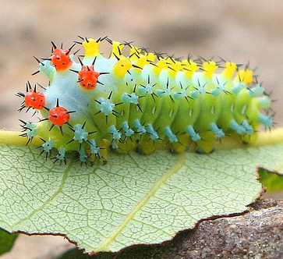

Slide 28
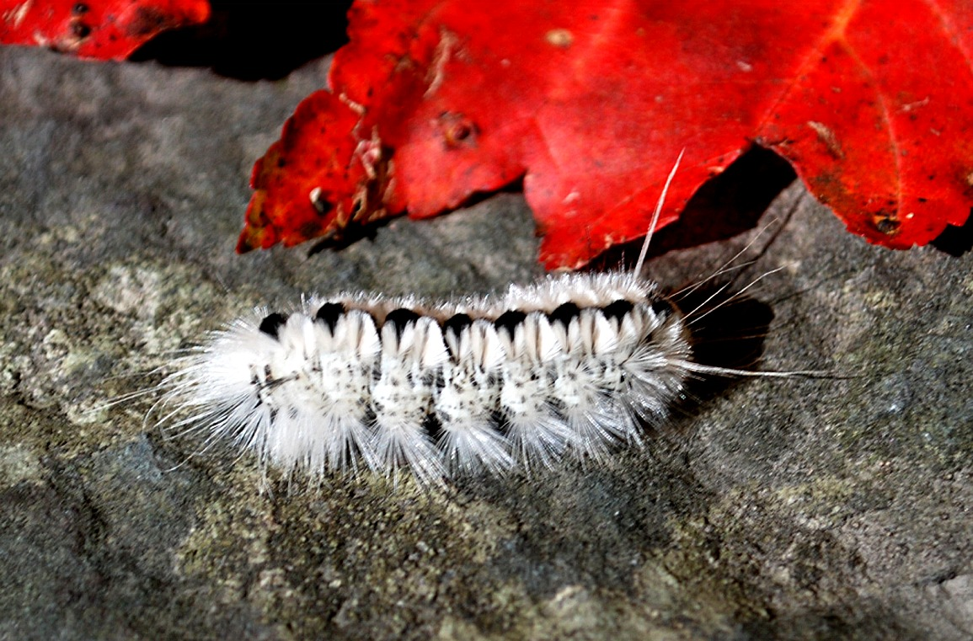

Slide 29
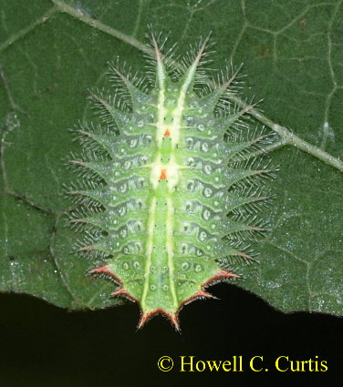

Slide 30
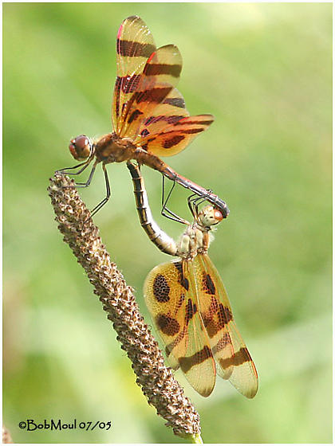

Slide 31
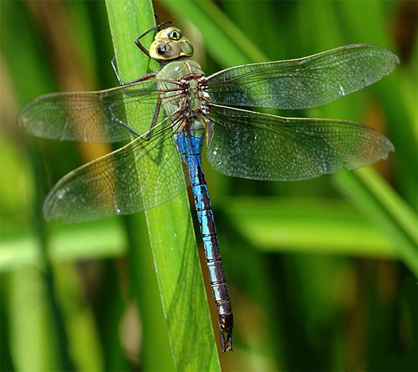

Slide 32
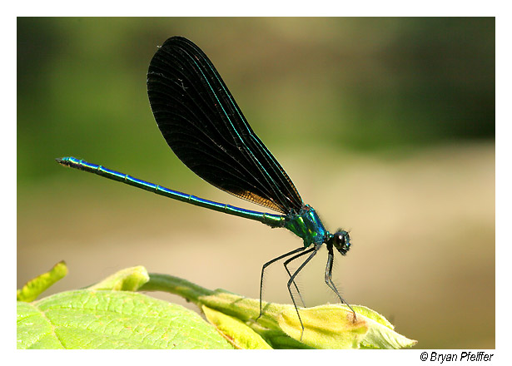

Slide 33
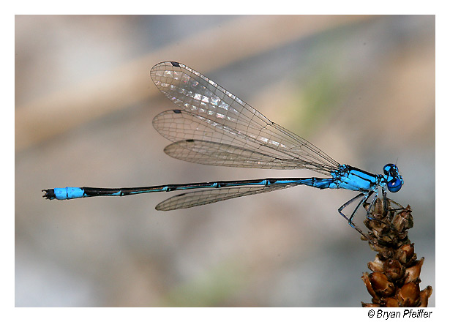

Slide 34
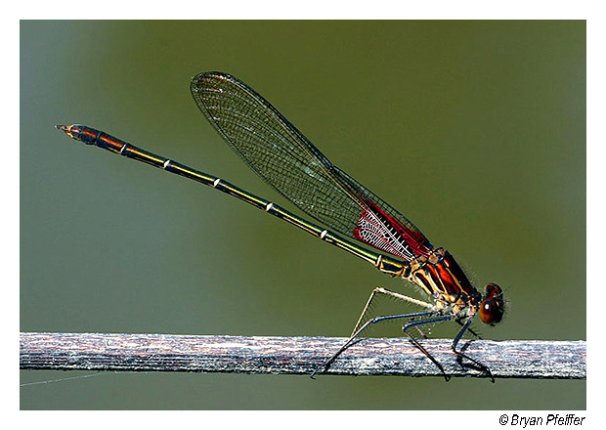

Slide 36
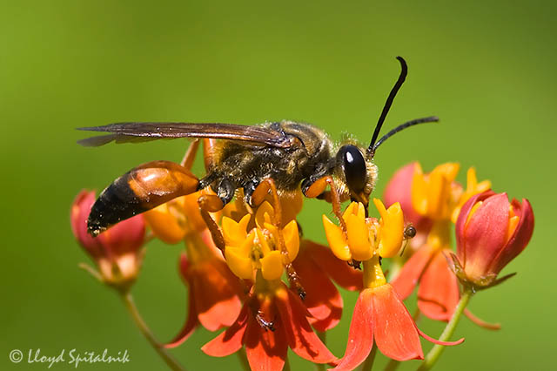

Slide 37
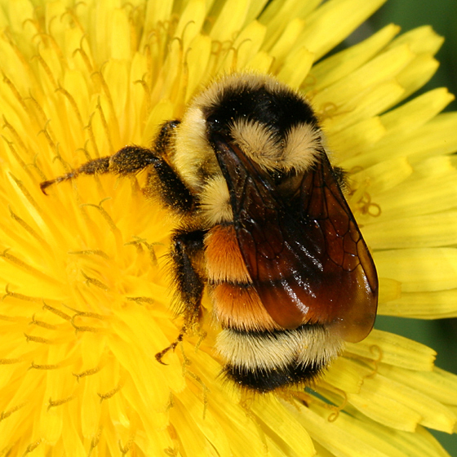

Slide 38
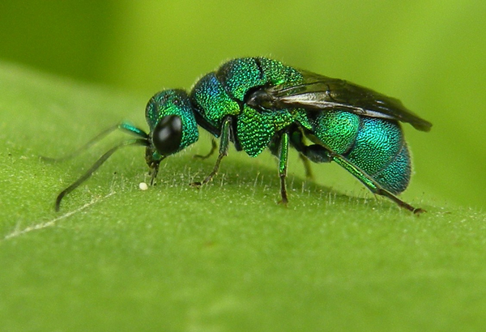

Slide 39
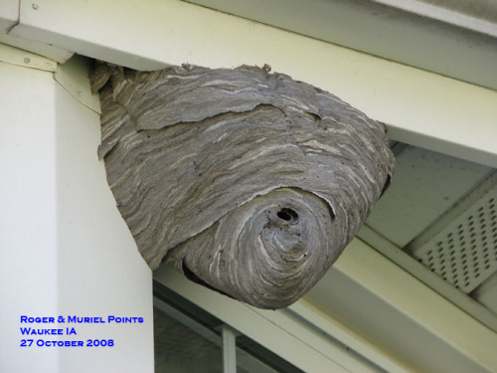

Slide 40
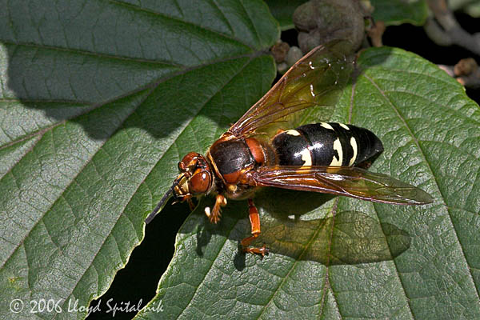

Slide 41
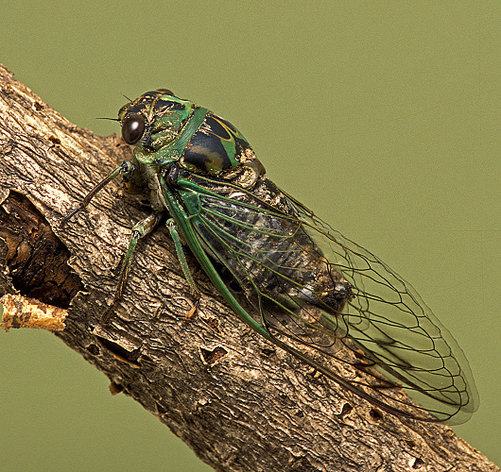

Slide 42
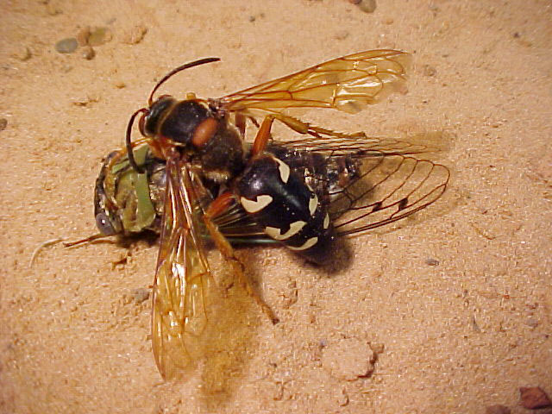

Slide 43
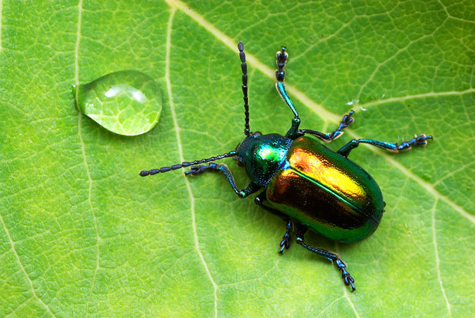

Slide 44
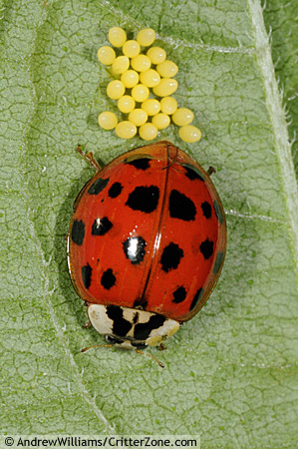

Slide 45
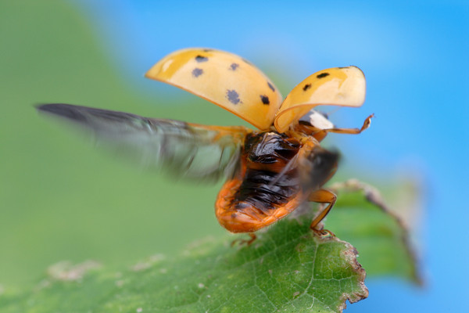

Slide 46
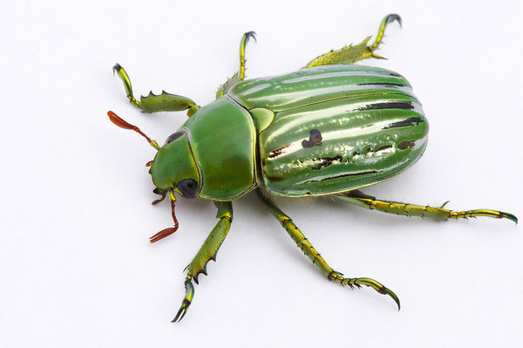

Slide 47
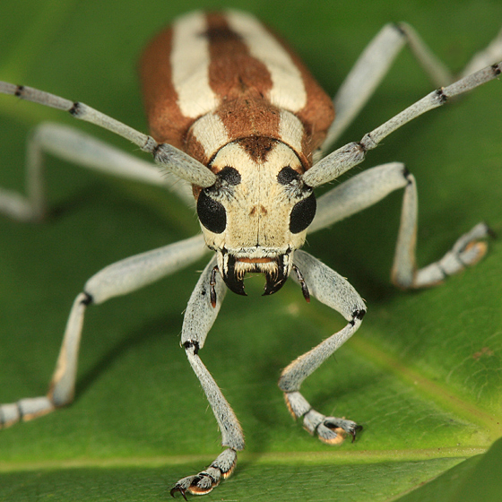

Slide 48
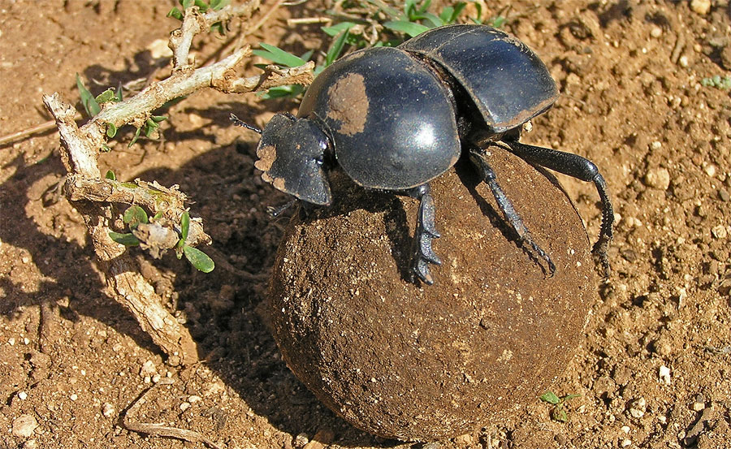

Slide 49
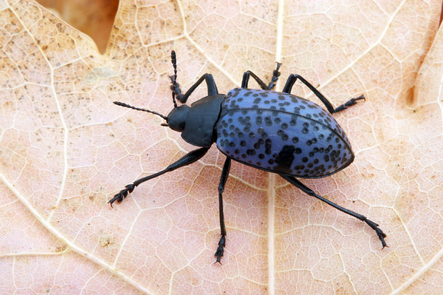

Slide 50
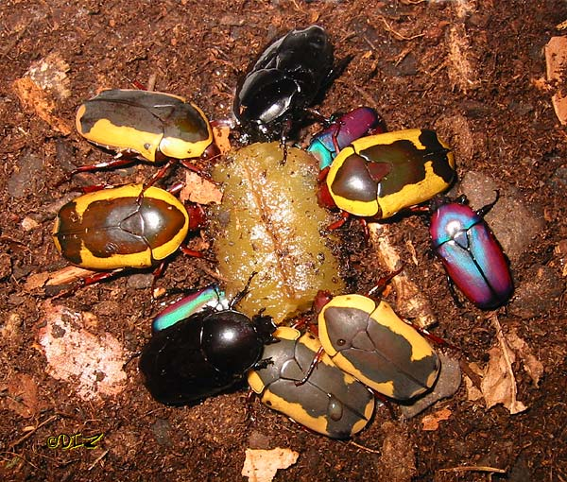

Slide 51
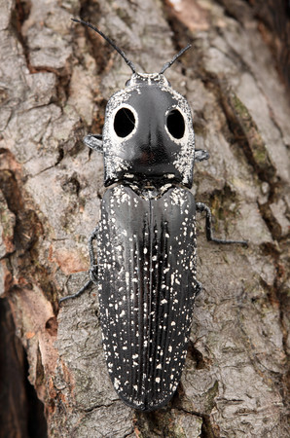

Slide 52


Slide 53


Slide 54


Slide 55


Slide 56


Slide 57


Slide 58


Slide 59


Slide 60


Slide 61


Slide 62


Slide 63


Slide 64


Slide 65


Slide 66


Slide 67


Slide 68


Slide 69


Slide 70


Slide 71


Slide 72


Slide 73


Slide 74


Slide 75


Slide 76


Slide 77


Slide 78


Slide 79


Slide 80


Slide 81


Slide 82


Slide 83


Slide 84


Slide 85


Slide 86


Slide 87


Slide 89


Slide 90


Slide 91


Slide 92


Slide 93


Slide 94


Slide 95


Slide 96


Slide 97


Slide 98


Slide 99


Slide 100


Slide 101


Slide 102


Slide 103


Slide 104


Slide 105


Slide 106


Slide 107


Slide 108


Slide 109

(A) Female Utetheisa emitting defensive froth
González A et al. PNAS 1999;96:5570-5574
©1999 by The National Academy of Sciences
Notes:
(A) Female Utetheisa emitting defensive froth. (Bar = 1 mm.) (B) Outcome of an encounter between a L. ceratiola spider and a PA-free Utetheisa from the − ♀ (− ♂) category. (Bar = 1 cm.)

Slide 110


Slide 111


Slide 113


Slide 114


Slide 115


Slide 116


Slide 117


Slide 118


Slide 119


Slide 120


Slide 121


Slide 122


Slide 123


Slide 125


Slide 126


Slide 128


Slide 129


Slide 130

(A) Beetle withstanding a 2-g pull; brush strokes are causing the beetle to adhere with its tarsi
Eisner T, Aneshansley D J PNAS 2000;97:6568-6573
©2000 by National Academy of Sciences
Notes:
(A) Beetle withstanding a 2-g pull; brush strokes are causing the beetle to adhere with its tarsi. (B) Ventral view of beetle, showing yellow tarsi. (C) Tarsus (numbers refer to tarsomeres). (D) Tarsus in contact with glass (polarized epi-illumination). (E) Same as preceding, in nonpolarized light; contact points of the bristles are seen to be wet. (F) Bristle pads, in contact with glass. (G) Droplets left on glass as part of a tarsal “footprint.” (H and I) Apparatus diagrammed in Fig. 1. In H, beetle is on platform, before lift is applied (horizontal trace on oscilloscope); in I, the lift has been applied (ascending green trace) to point where beetle has detached (return of trace to baseline). [Bars = 1 mm (B), 100 μm (C), 50 μm (D), 10 μm (F), and 50 μm (G).]

Slide 131

(A–C) Normal tarsus, and details thereof; the pads are stuck together in clusters (C), which are arranged in rows (A)
Eisner T, Aneshansley D J PNAS 2000;97:6568-6573
©2000 by National Academy of Sciences
Notes:
(A–C) Normal tarsus, and details thereof; the pads are stuck together in clusters (C), which are arranged in rows (A). (D–F) Comparable with preceding, but of a tarsus cleaned of oil by treatment with methanol/chloroform solution. (G) Comparable with E but with some of the bristles clustered where a droplet of oil has been applied. (H) Portion of tarsus where tips of bristles have been cut off, showing how bristle shafts are stuck together in groups; a substance, presumed to be oil, is seen between the bases of the bristles (upper arrow). Lower arrows point to pores from which tarsal oil is presumed to be secreted. (I) Bristles, in profile view, showing the component parts (shaft, bifurcated tip, pads) and oil pores between their bases. [Bars = 100 μm (A), 20 μm (B), 5 μm (C), 10 μm (I).]

Slide 132


Slide 133


Slide 134


Slide 135


Slide 136


Slide 137


Slide 138


Slide 139


Slide 140


Slide 141


Slide 142


Slide 143


Slide 144


Slide 145


Slide 146


Slide 147


Slide 148


Slide 149


Slide 150


Slide 151


Slide 152


Slide 153


Slide 154


Slide 155


Slide 156


Slide 157


Slide 158


Slide 159


Slide 160


Slide 161


Slide 162


Slide 163


Slide 164


Slide 165


Slide 166


Slide 167


Slide 168


Slide 169


Slide 170


Slide 171


Slide 172


