Slide 1
What’s in a Battery: Week 1

Slide 2
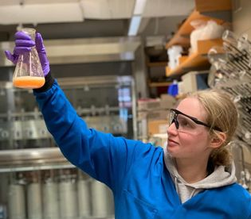
About me

Slide 3
What do batteries do?

Slide 5
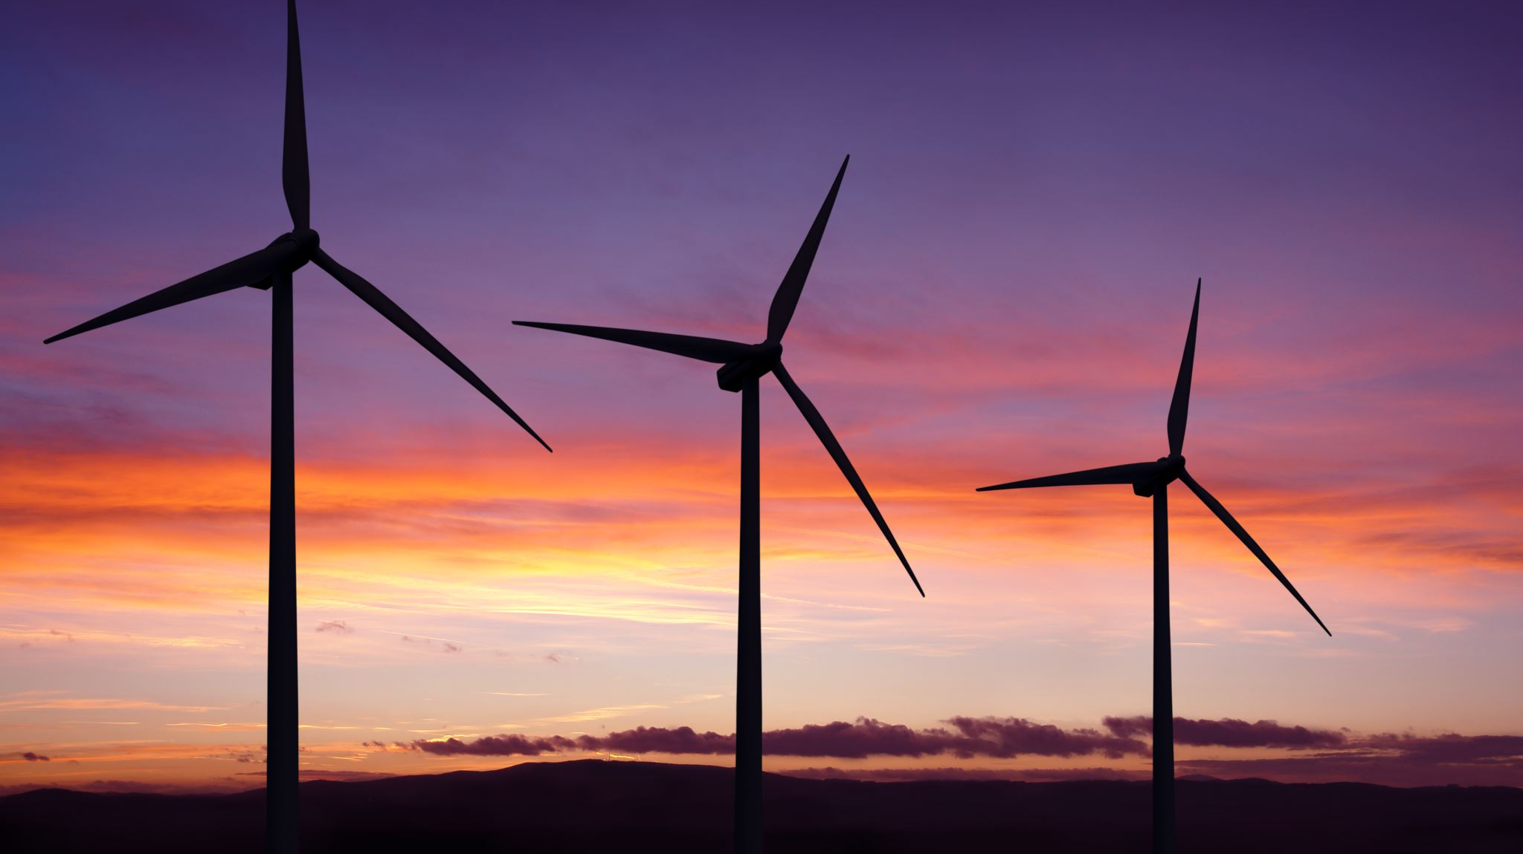
They store energy!

Slide 6
How does energy work?
Potential Energy
Kinetic Energy
Electrical Energy
Chemical Energy

Slide 7
Which of these types of energy can be used for storage

Slide 8
All of them!

Slide 9
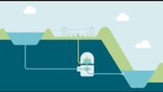
Storing energy with potential energy – pumped hydro
HydroTasmania
Notes:
0:44 to 1.52

Slide 10
Pros
Very cheap
High capacity (only limited by availability of water
High efficiency (75-80%)
Geographically limited
Slow switch between charge and discharge process
Cons
Geographically limited
Slow switch between charge and discharge process

Slide 11
Potential energy can also be stored as pressure
Picture to Sound

Slide 12
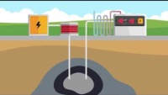
Storing energy with potential energy – pumped hydro
OurFuture.Energy

Slide 13
Pros
Cheap
Technology already exists due to fracking
Utilizes depleted oil and natural gas wells
Scale only limited to size of well
Only inputs are electricity and air
Cons
Geographically limited
Constant pressure changes (charge/discharge) can increase chance of seismic activity
Slow switch between charge and discharge process

Slide 14
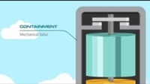
Storing energy with kinetic energy – flywheels
OurFuture.Energy

Slide 15
Pros
Not sensitive to environment (can be used anywhere)
High energy density
Low maintenance
Rapid charge time
Fast charge/discharge switching
Cons
Components are costly
Not scalable for grid-use (would require multiple flywheels in series)
Short discharge times
Potentially hazardous failure

Slide 16
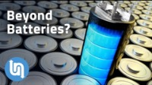
Storing energy with electrical energy – flywheels
Undecided with Matt Ferrell
Notes:
1:20

Slide 17
Pros
Long lifetimes
Very fast discharge
Can be used in conjugation with batteries
Cons
Low energy density
Not great for long-term discharges

Slide 18
Isaac Yap

Slide 19
Storing energy with chemical energy – batteries!
I have electrons and I would like to keep them.
I lost my electrons and I want them back!
Energy
I have electrons I don’t want!
I’m perfectly happy with the number of electrons I have as well
Low energy state
Discharged
Battery is “dead”
High energy state
Charged
Battery is “full”

Slide 20
Looking ahead: Next Week
How do batteries work?
How do we measure the electricity flowing through batteries
How to electrons and atoms work together on an atomic scale to move energy through a battery.
Where do we use batteries and what parameters do we care about
Grid storage, electric vehicles, and consumer electronics all have different requirements
How do we think about energy and power density, capacity fade, and other battery parameters
Deep Dive into lithium-ion batteries
How do they work
Why are they suddenly everywhere
Where are areas of ongoing research?

Slide 21
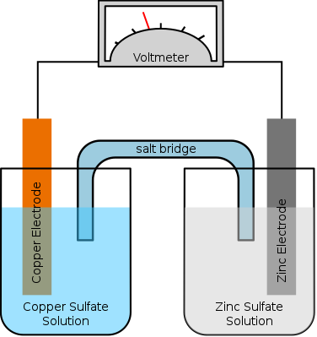
Electron flow
Cu²⁺
Zn²⁺
Gringer, wikicommons

