Slide 1
Egyptian Mythology
Creation to Contendings

Slide 2
Before We Begin…
Important concepts
Polyvalent logic
Netjer
Ma’at
Isfet
Nun

Slide 3
Polyvalent Logic

Slide 4
Netjer
Translated as ‘god’
Can be feminine ‘netjert’ or plural ‘netjeru’
Monolarty: “One godhead, many gods and goddesses”
Individual gods- Names
Syncretized Names: Amun-Ra, Sekhmet-Mut, Aset-Serqet

Slide 5
Ma’at
Order/truth/balance
“perfect state of things towards which one should strive and which is in harmony with Netjer’s intentions” (Hornung 1982: 214, 215)
Can be offered to Netjer, symbolizes partnership of Netjer and man as they work towards ‘maintaining their existence… building a living order that allows space for creative breath’
Constantly being disturbed, must constantly be maintained

Slide 6
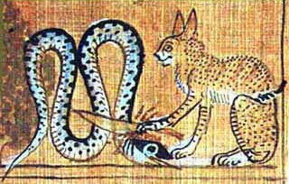
Isfet
Disorder/chaos
Acts of uncreation
Gereg- lying
Binet- oppression
Apep
42 Purifications
Do not steal, do not distort speech, do not murder, do not have sex with another’s spouse, do not damage myself with lies, do not argue without reason

Slide 7
Nun
Primordial watery abyss, from which all gods originated
Possesses healing and dissolving powers
The timeless nonexistent returned to the world when the Nile flooded “The earth is Nun”
Every night darkness returns, “obliterates faces” and dissolves the outlines the existent
Sleeper, who live ‘as if dead’ dwell in Nun, where dreams come from
Groundwater was considered to be a part of Nun

Slide 8
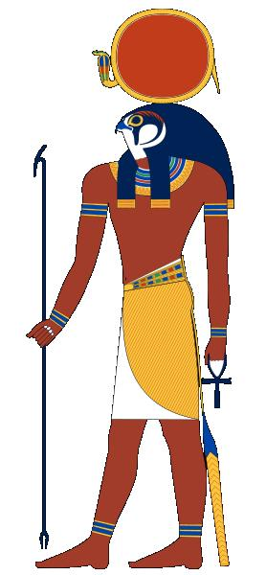
Ra
Lord of All
Center of worship at Iunu (Heliopolis)
Appears in all three realms: earth, heavens, underworld
Kings were called ‘sons of Ra’

Slide 9
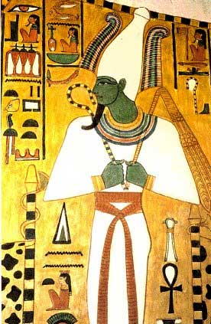
Wesir
Osiris, Ruler of Eternity
Center of worship at Abydos, Busiris
Originally a fertility god associated with Nile flood/harvest
Represented physical salvation

Slide 10
Set
He Whom Before the Sky Shakes
God of storms, the desert, chaos, rage
Vilified after 20th Dynasty, called ‘evil’
Set animal- curved snout, tall squared ears, arrow-like forked tail

Slide 11
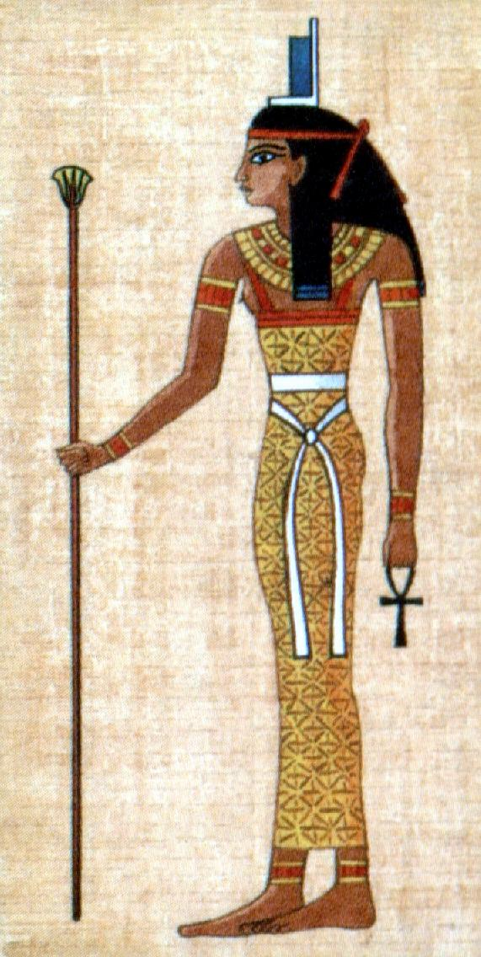
Aset
Isis, Great of Magic
Center of worship: Philae, Iseion
Goddess of magic, love, the dead, mother of the king
Often cited for Her extreme cleverness, used to trick other gods for Her benefit

Slide 12
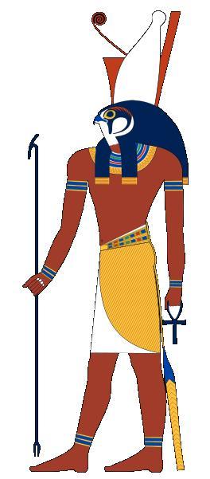
Heru
Heru-sa-Aset, Horus the Younger, Lord of the Sky
Center of worship: Hierakonpolis
God of the sky, associated with kingship

Slide 13
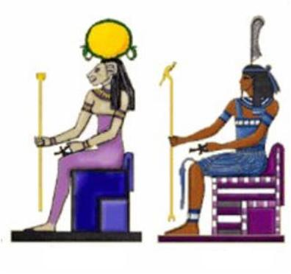
Shu and Tefnut
God of air and goddess of moisture
Shu- ‘emptiness’; clouds are His bones
Tefnut- rules over all moisture: rain, sweat, tears, dew

Slide 14
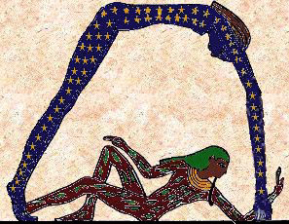
Geb and Nut
God of earth and goddess of sky
Geb- His laughter causes earthquakes, the dead ‘sleep in His house (ie, are buried)
Nut- protector of the dead, gives birth to Ra each day

Slide 15
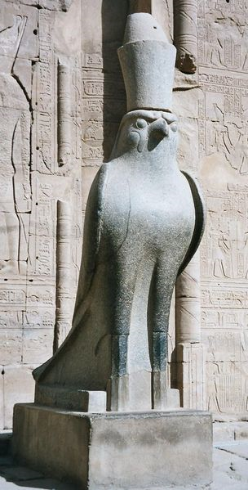
Heru-wer
Horus the Elder
Similar to Heru, god of the sky, associated with kingship
Said to have united Upper and Lower Egypt

Slide 16
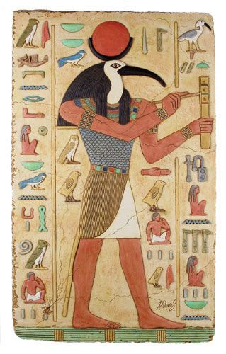
Djehuty
Thoth, Lord of Scribes and Magicians
God of the moon, scribes, knowledge
Invented hieroglyphs
‘Peace of the gods’ is in Him, often acts as a mediator/judge between fighting gods

Slide 17
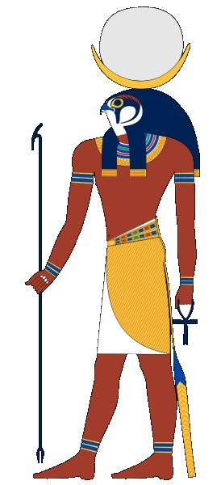
Khonsu
Khonsu- ‘wanderer’
God of the moon
Center of worship: Thebes
Son of Amun and Mut, often depicted as child with sidelock
Or hawk-headed

Slide 18
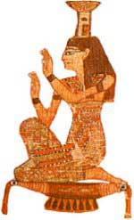
Nebthet
Nephtys, ‘Mistress of the House’, Friend and Protector of the Dead
No temples of Her own
Funerary goddess, mourner
Mother of Yinepu by Wesir, despite being Set’s wife…

Slide 19
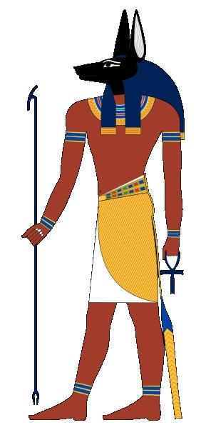
Yinepu
Anubis, ‘Royal Child’, Foremost of the Westerns
God of mummification, guide of the dead
Weighs the deceased’s heart against Ma’at

Slide 20
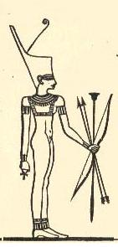
Nit
Neith
One of the most ancient dieties, worshipped since the 1st dynasty
Warrior/mother/ funerary goddess, creatrix; goddess of Lower Egypt

Slide 21
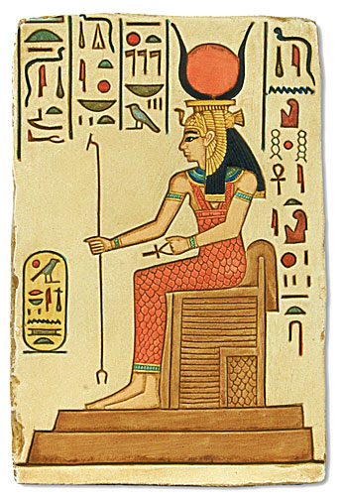
Hethert
Hathor, ‘House of Heru’; wife of Heru
Center of worship: Dendera
Goddess of magic, women, love, the arts, happiness
‘Eye of Ra’, His daughter

Slide 22
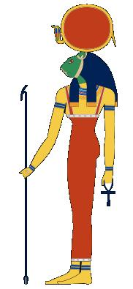
Sekhmet
‘Powerful One’, Lady of Slaughter, Mistress of Life
Goddess of plague/healing, warrior
Was once ordered to punish humans
‘Eye of Ra’, His daughter

Slide 23
Ra’s Children: Shu and Tefnut

Slide 24
Shu and Tefnut’s Children

Slide 25
The Separation

Slide 26
Curses Indeed

Slide 27
Games are Serious Business

Slide 28
One Big Happy Family!

Slide 29
Couples

Slide 30
Aset’s a Clever Girl

Slide 31
The Accident

Slide 32
Wait, What?

Slide 33
Kids Ask the Darnest Things

Slide 34
The Beginning of the End

Slide 35
God to God

Slide 36
Deal? No? Darn…

Slide 37
She Did What?

Slide 38
Exiled

Slide 39
Aset’s Still Clever

Slide 40
And More Clever

Slide 41
And Most Clever

Slide 42
Unhelpful Help

Slide 43
Awkward

Slide 44
Inherited Craftiness

Slide 45
Not Amused

Slide 46
All’s Well That Ends Well?

Slide 47
Books
Conceptions of God in Ancient Egypt: The One and the Many, Erik Hornung
Egyptian Gods and Goddess, George Hart
The Complete Gods and Goddess of Ancient Egypt, Richard H. Wilkinson
The Egyptian Book of the Dead: The Book of Going Forth by Day, Raymond Faulkner
Daily Life of the Egyptian Gods, Dimitri Meeks

Slide 48
Thanks to:
Jade, for convincing me to do this
Josh Shaine, for helping with logistics
Jenny Mattiasson (Temwa), for letting me use her adorable comic strips
And you, wonderful students, for coming! Without your interest, the myths of Egypt would remain unknown~
Senebty!

