Slide 1
Last Week’s Reading Assignments
Review: Macromolecules, Cellular Components and RNA World Hypothesis, Read http://exploringorigins.org/
Preview: Central Dogma- Replication, Transcription and Translation. Structure of DNA, RNA and Protein
The Lac Operon, Transcription factors.
DNA wrapping, histone protein, DNA methylation, DNA acetylation
What is mutation and what causes it? How does the cell try to fix this?
http://www.sparknotes.com/biology/
http://en.wikipedia.org/wiki/DNA_methylation

Slide 2
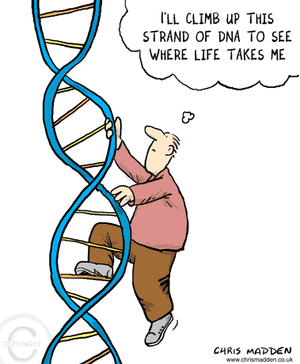
S3690 The Biology of Cancer
HSSP @ Harvard Fall 2010
Lecture 2: The Culprit
Zhi Dong

Slide 3
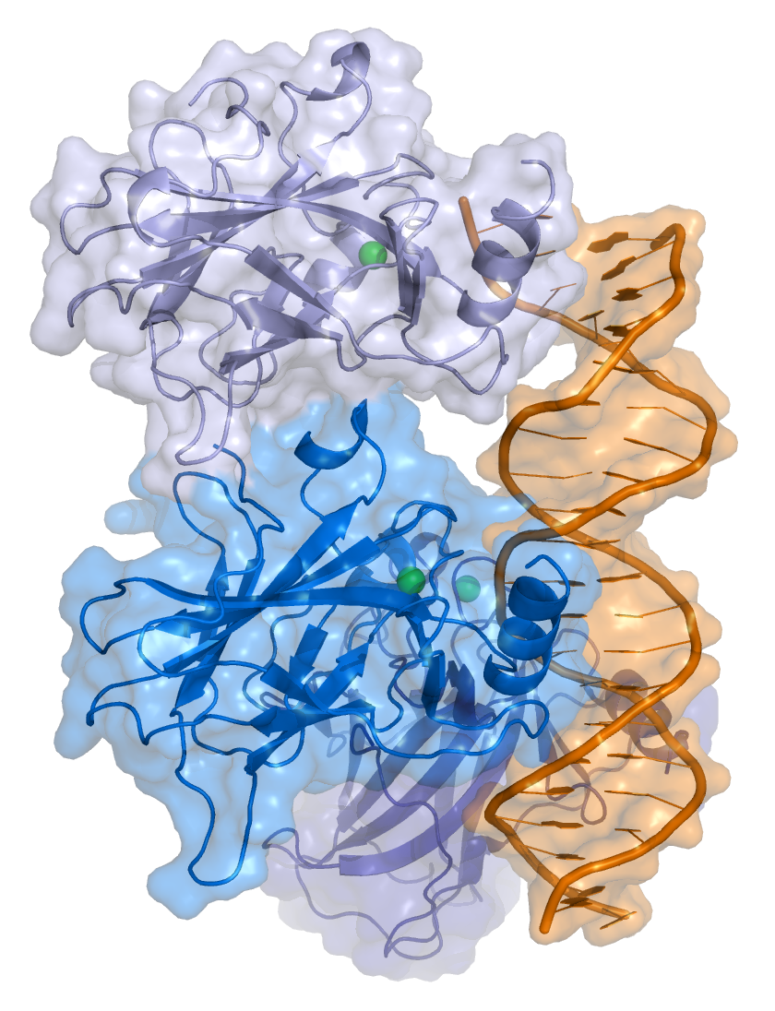
Review Game!
P53 Protein

Slide 4
Lecture Outline
Question: What’s wrong with the cancer cell?
Fundamentals of Biology
  Central Dogma
    DNA Replication
    Transcription
    Translation
  Gene regulation
    The Lac Operon
    Epigenetics (DNA wrapping, DNA methylation, DNA acetylation)
Cancer
  Mutations
  DNA repair mechanisms
  The “Guardian of the Genome”- p53

Slide 5
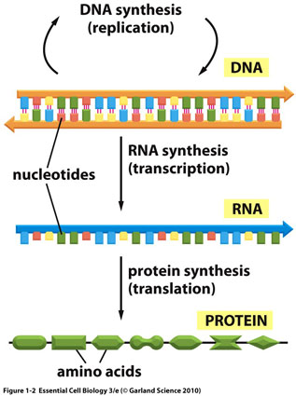
The Central Dogma

Slide 6
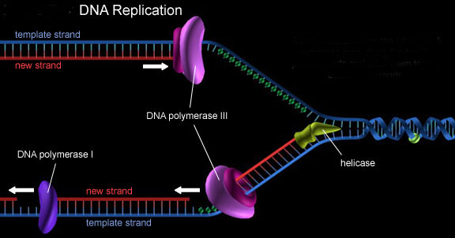
DNA Replication

Slide 7
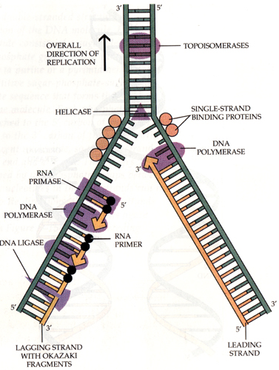

Slide 8
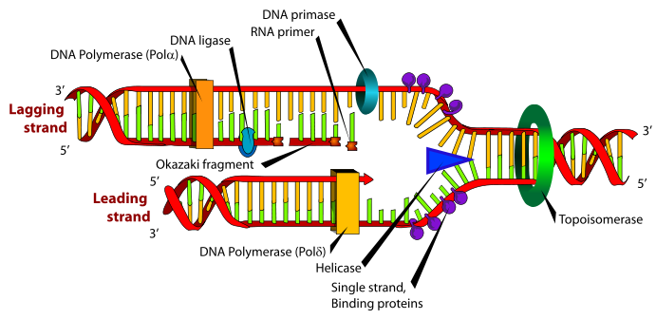
DNA Replication
http://www.youtube.com/watch?v=teV62zrm2P0

Slide 9
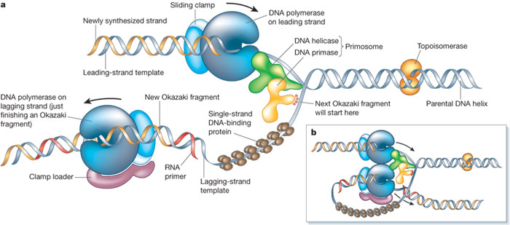
The Trombone Model of DNA Replication
http://www.youtube.com/watch?v=-mtLXpgjHL0&feature=related
http://www.youtube.com/watch?v=4jtmOZaIvS0

Slide 10
DNA Replication Song!
http://www.youtube.com/watch?v=dIZpb93NYlw

Slide 11
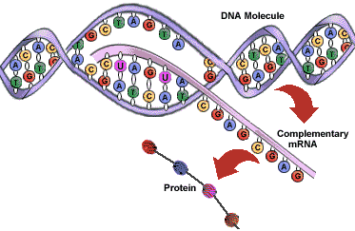
Transcription

Slide 12
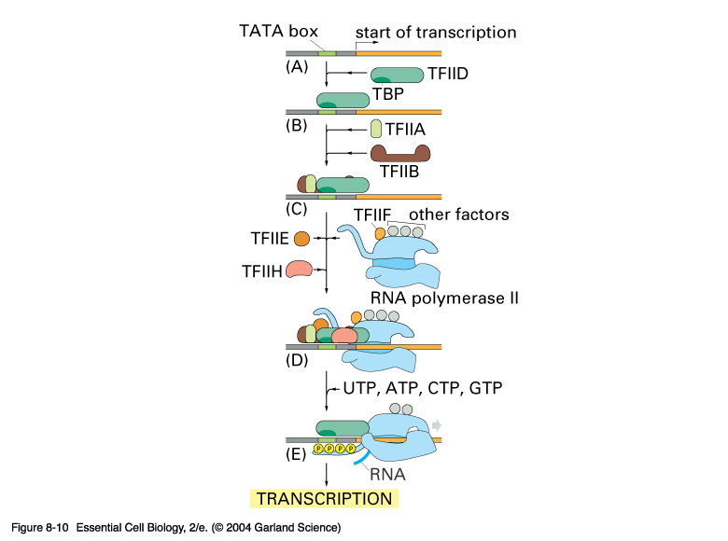
http://www.youtube.com/watch?v=WsofH466lqk
http://www.youtube.com/watch?v=41_Ne5mS2ls

Slide 13
mRNA Processing- Cap and Tail
5’ Modified Guanine Cap
3’ Poly-A Tail
http://www.youtube.com/watch?v=YjWuVrzvZYA

Slide 14
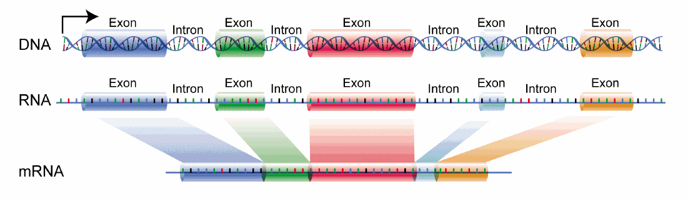
Introns vs. Exons

Slide 15
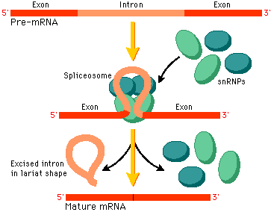
mRNA Processing- Splicing
http://www.youtube.com/user/ndsuvirtualcell#p/u/9/FVuAwBGw_pQ

Slide 16
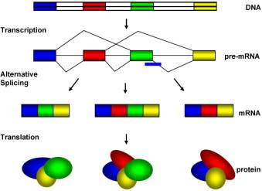
Alternative Splicing

Slide 17
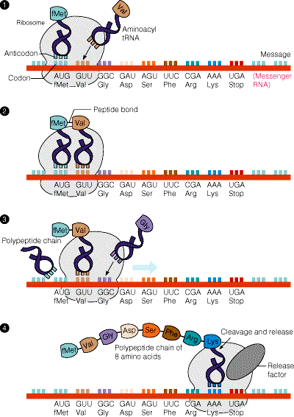
Translation
http://www.youtube.com/watch?v=5bLEDd-PSTQ&feature=related
http://www.youtube.com/watch?v=41_Ne5mS2ls

Slide 18
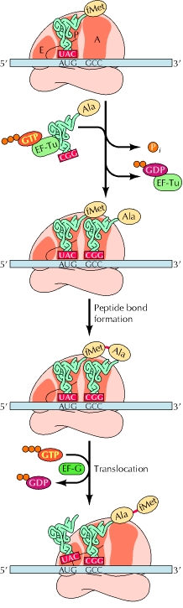
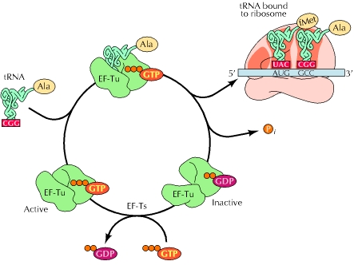
Translation

Slide 19
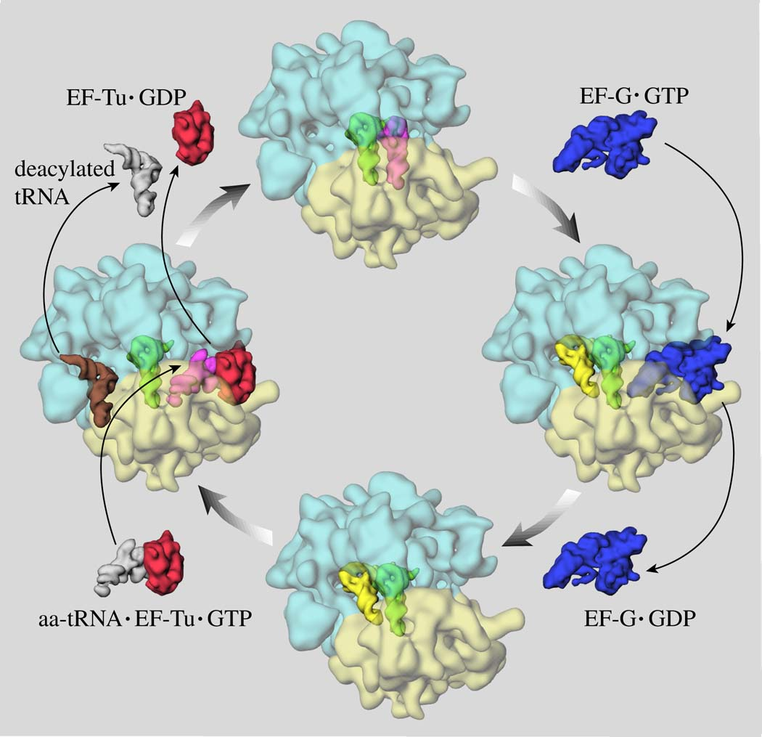

Slide 20
Protein Synthesis
An epic on the cellular level!
http://www.youtube.com/watch?v=u9dhO0iCLww

Slide 21
Putting everything together
The proteins work like machines!
http://www.youtube.com/watch?v=-ygpqVr7_xs

Slide 22
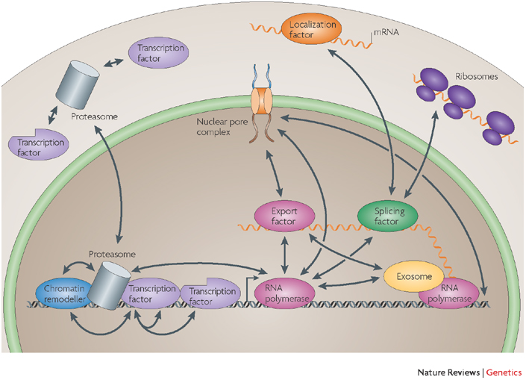
Gene Regulation

Slide 23
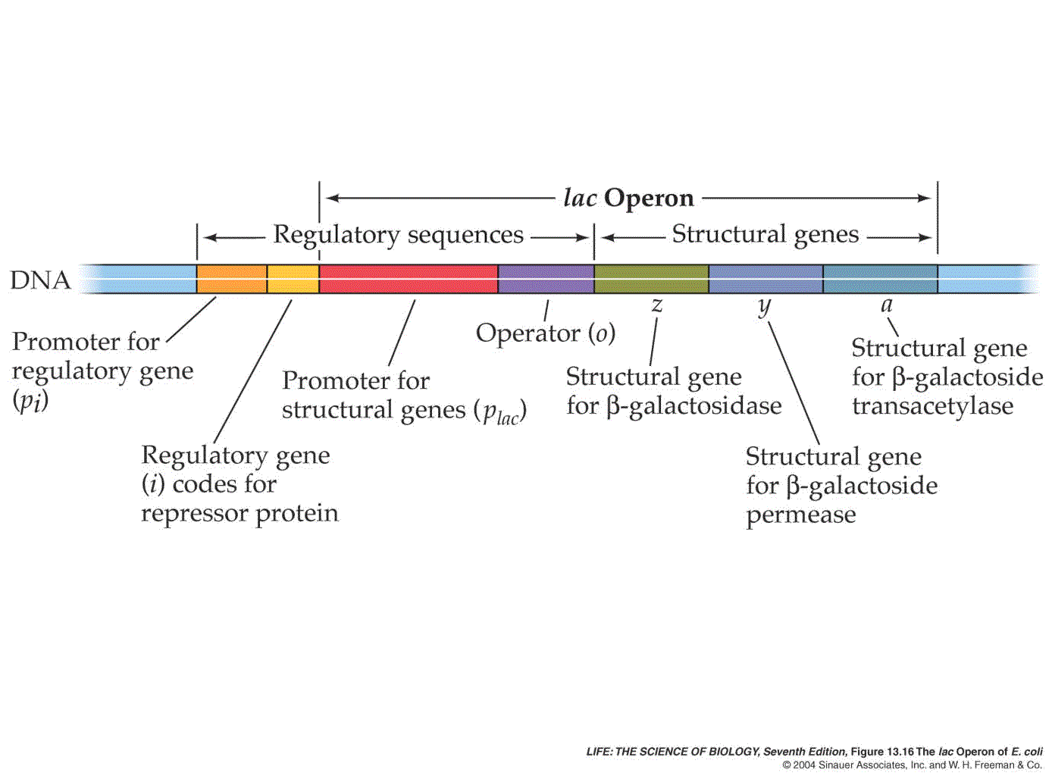
The Lac Operon

Slide 24
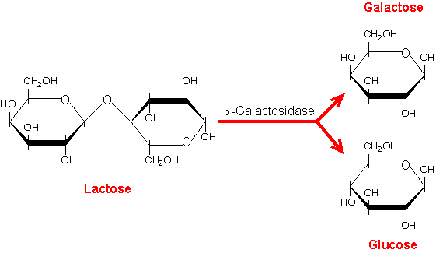
Lac Operon
http://www.youtube.com/watch?v=oBwtxdI1zvk

Slide 25
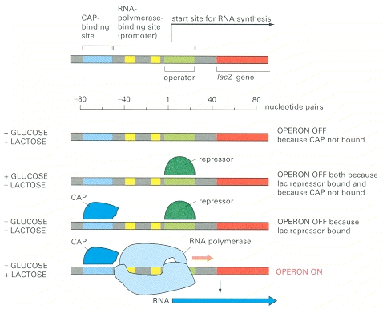
Positive Control of Lac Operon

Slide 26
Epigenetic Control
Epigenetics is the study of inherited changes in phenotype (appearance) or gene expression caused by mechanisms other than changes in the underlying DNA sequence, hence the name epi- (Greek: επί- over, above) -genetics. These changes may remain through cell divisions for the remainder of the cell's life and may also last for multiple generations. However, there is no change in the underlying DNA sequence of the organism;^{[1]} instead, non-genetic factors cause the organism's genes to behave (or "express themselves") differently.
http://en.wikipedia.org/wiki/Epigenetics

Slide 27
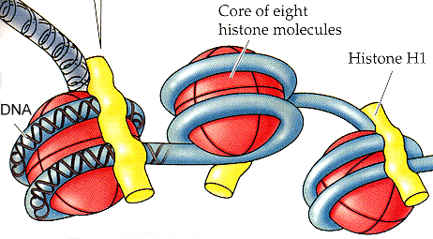
DNA Wrapping and Acetylation
DNA Wrapping
http://www.youtube.com/watch?v=E8NHcQesYl8&feature=related
DNA Acetylation
http://www.youtube.com/watch?v=eYrQ0EhVCYA

Slide 28
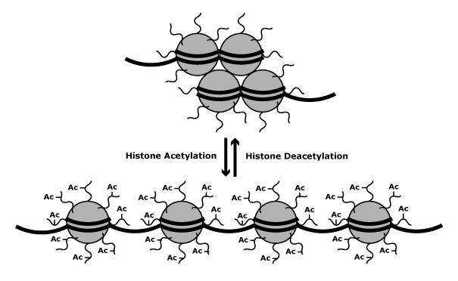

Slide 29
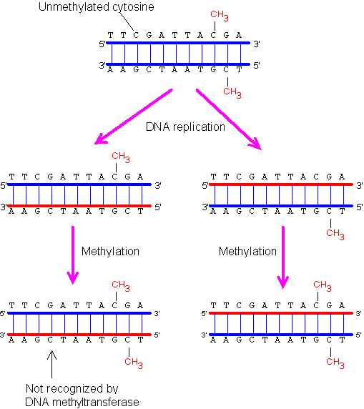
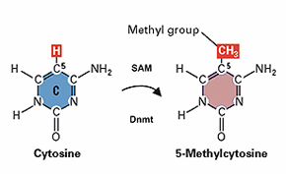
DNA Methylation

Slide 30
DNA Methylation
Does not change sequence of DNA
Can be passed on after cell division
DNA methylation pattern in human is set early in development
Can silence transcription by preventing TF binding
Recruit additional protein (such as HAT and chromatin remodeling protein) to modify histones
Tutor suppressor can be methylated in cancer

Slide 31
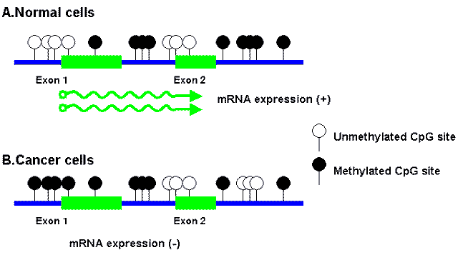

Slide 32
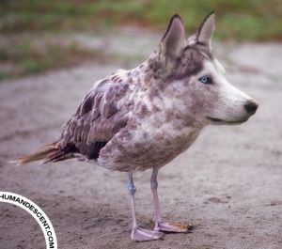
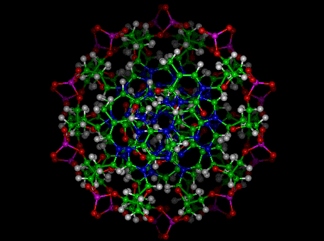
Cancer- Mutations

Slide 33
Discussion
What are the different causes of mutation?
Can mutation be beneficial?

Slide 34
DNA Mutation
“If the DNA were copied badly, we would have diseases such as cancer at a much higher frequency, and we would not get a faithful copy of our parental inheritance. Our species would not be preserved, and we would not live long. If the DNA were copied perfectly, there would be no room for evolution, and the basis for creation of new species with better environmental adaptation would have vanished long ago. The DNA repair system allows a happy medium.…”
Dan Koshland former editor of Sciencemagazine.

Slide 35
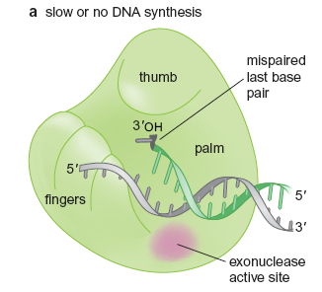
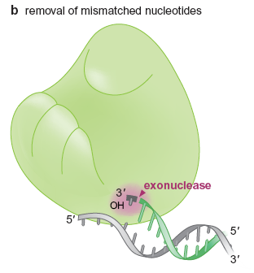
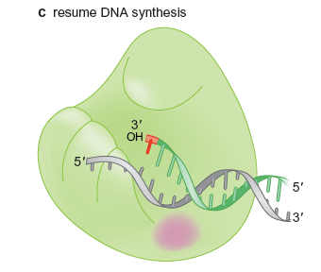
DNA Polymerase proofreads its work

Slide 36
Source of Mutation
Not all replication errors are caught by proofreading
Chemical damage to DNA
Water damage to DNA
Ultraviolet light damage to DNA
Radiation (such as X-Ray) cause break in DNA

Slide 37
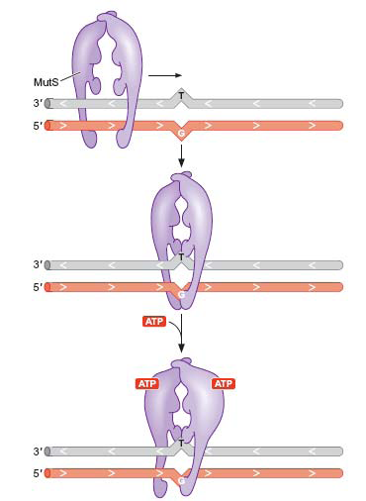
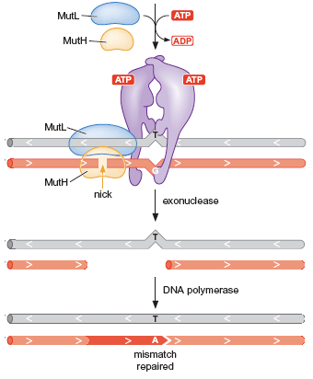
How does the cell fix it?

Slide 38
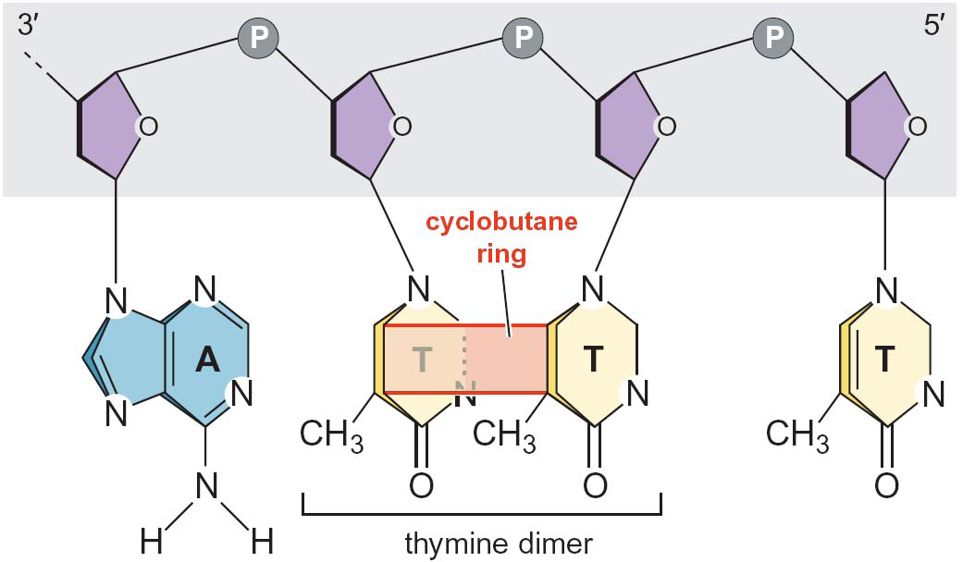
UV Radiation cause dimers to form

Slide 39
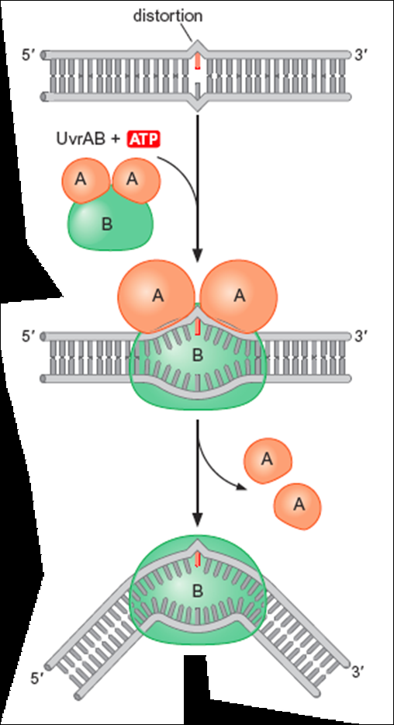
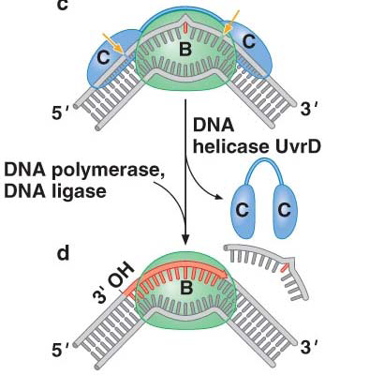

Slide 40
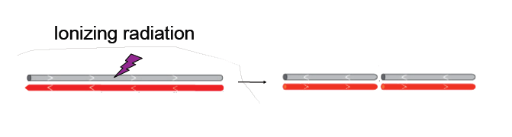
Breaks in DNA

Slide 41
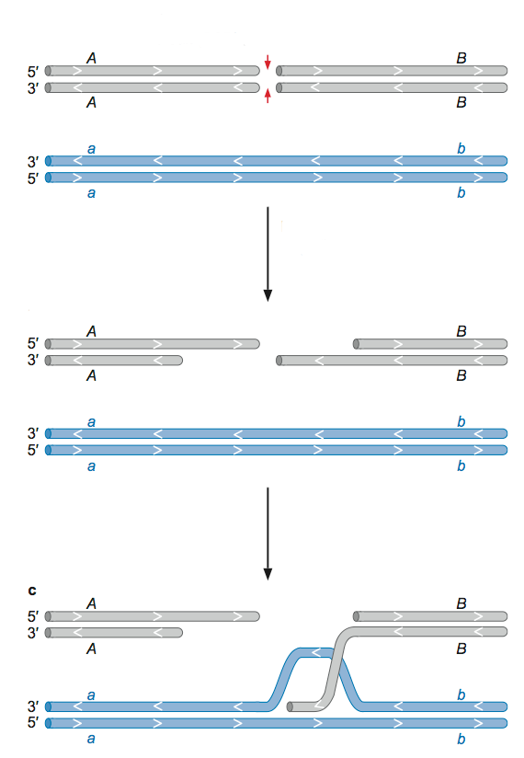
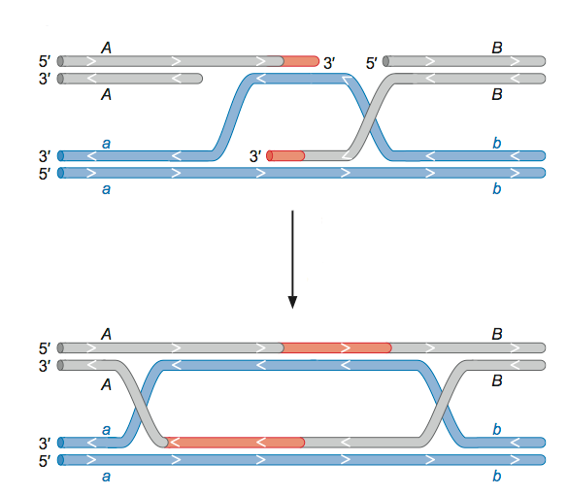
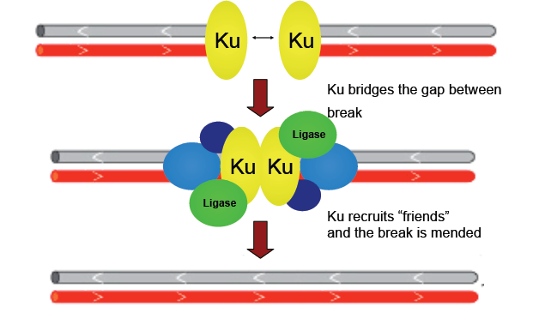

Slide 42
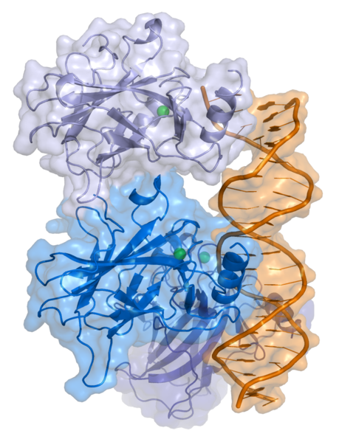
P53 Protein
Tumor Suppressor protein
“Guardian of the Genome” (Lane, 1992)
Disruption of p53 is associated with 50-55% of human cancers
Active DNA repair proteins when DNA is damaged
Induce growth arrest by stopping cell cycle at G1/S checkpoint if DNA is damaged
Initiate apoptosis if DNA cannot be fixed
http://www.youtube.com/watch?v=n_VDMKpxaXw

Slide 43
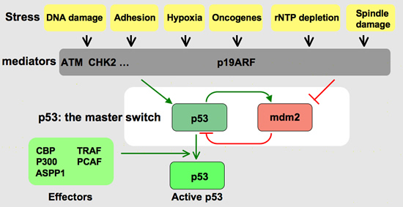

Slide 44
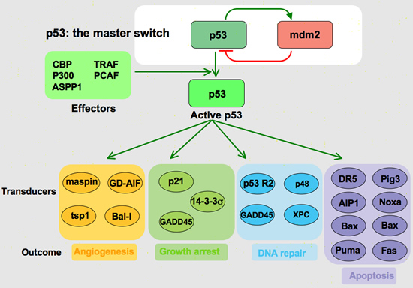

Slide 45
Discussion
What happens when P53 is mutated?

Slide 46
Reading Assignments
Review- Central Dogma, Gene regulation, Mutation and Repair
Check out the P53 website: http://p53.free.fr/index.html
Preview: Cell cycle, stages of mitosis (study on your own)
Protein degradation, lysosome, proteosome, ubiquitination, ubiquitin.
What are some common therapies that is used to treat cancer today?
What is the Knudson Hypothesis?

