Slide 1
The Middle Ages and the Renaissance
The Rise of European Culture

Slide 2
Medieval Culture
Ignorance
Life Expectancy
Pagan vs. Christian
Feudalism
Poor Economy
Vague Nationalities United by Church
Poor Bureaucracies
Art

Slide 3
Crises of the Middle Ages
Crusades
Hundred Year’s War
Great Schism
The Black Plague

Slide 4
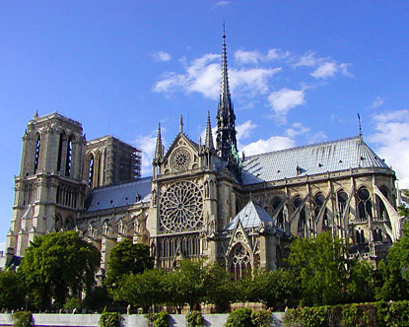
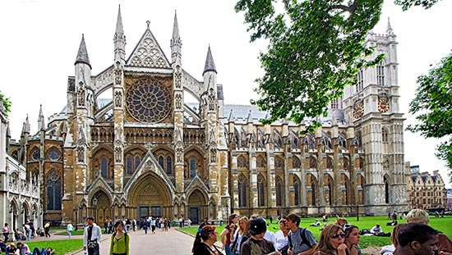
Notre Dame and Westminster Abby

Slide 5
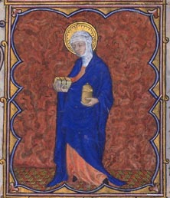
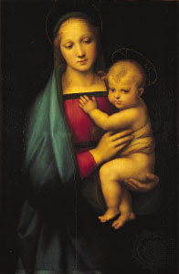
Medieval Art

Slide 6
Video About the Middle Ages
http://www.youtube.com/watch?v=fr8DIg3oHFI

Slide 7
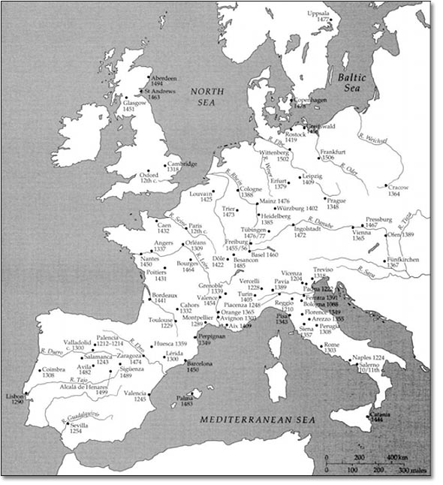
Spread of European Universities

Slide 8
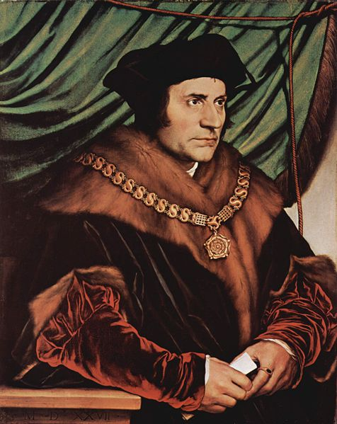
Thomas More
“I think putting thieves to death is not lawful; and it is plain and obvious that it is absurd and of ill consequence to the commonwealth that a thief and a murderer should be equally punished.” - Utopia

Slide 9
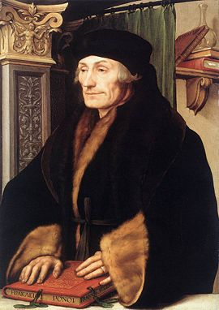
Desiderius Erasmus
“Piety requires that we should sometimes conceal truth…Perhaps we must admit with Plato that lies are useful to the people.”
“‘What?’ asks Peter [gatekeeper of heaven], astounded, ‘Popes with wives and children?’ Pope Julius II, equally surprised replies, ‘No, not wives, but why not children?’” -In Praise of Folly

Slide 10
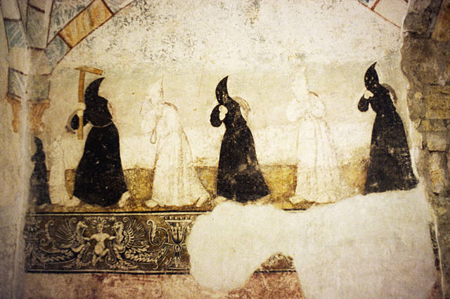
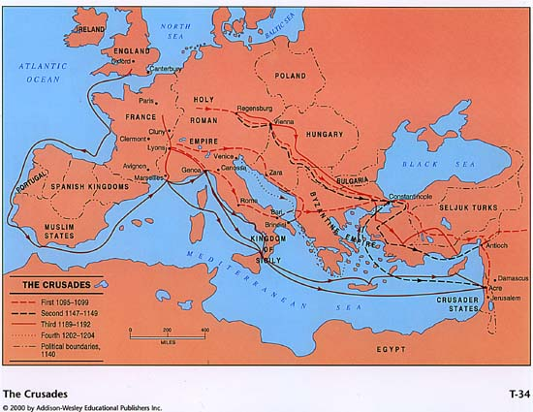
Rise of Cities
Cities built up along crusader routes. They also grew more powerful after the plague, because plague forced cities to organize. Also, after the plague many peasants moved to the cities and found that if they were talented they could get well-paying jobs previously held by plague victims.
Lyons
Vienna
Genoa

Slide 11
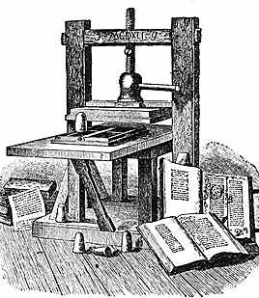
Rise of the Middle Class
The Renaissance and the Reformation were not mass movements. They were led by the newly literate middle and upper classes. The middle class rose thanks to an increase in wealth. Most of them were not fluent, but had been taught pidgin Latin by a lower level clergy, encouraged by parents who realized that education was the future

Slide 12
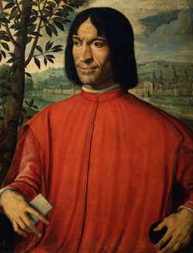
The Rise of the Super Rich
A new entrepreneurial class was emerging in the wake of the plague. These people were often low-level nobility, or even peasants, who figured out how to make money in the new, growing economy. These families managed to accumulate the kind of wealth that was necessary to finance intellectual growth.

Slide 13
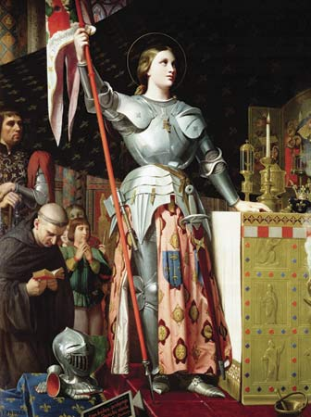
National Unification
Nations began to unify during this era. In France, people began to see themselves not as Normans or Parisians, but as Frenchmen. These newly united nations often rallied around symbols and mythic figures, like Joan of Arc.

Slide 14
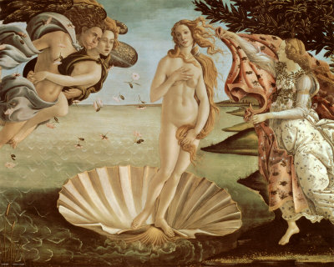
Classicism
Instead of painting religious figures for the church, Renaissance artists were often commissioned to paint secular images for commission. This is called the Birth of Venus, by Botticelli. It was painted for Lorenzo de Medici, a wealthy Florentine duke. Venus was the Roman goddess of love and beauty.

Slide 15
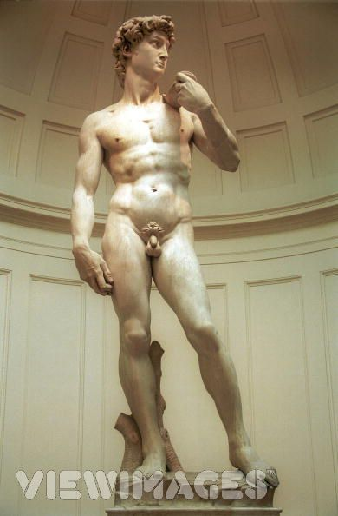
Humanism
This sculpture by Michelangelo, David, glorifies man, not God. Even though David was an ancient Hebrew king, this sculpture has nothing to do with the religious overtones of his story. Instead, it glorifies the human body. The Renaissance was a time when Europeans were starting to realize that the humanity was not condemned to wallow in sin, but it could be great.
This sculpture highlights the proud, optimistic culture of the Renaissance.

Slide 16
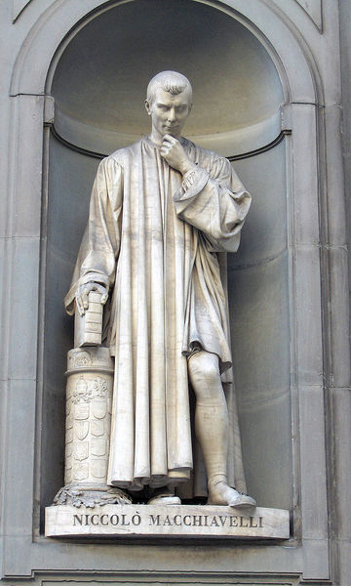
The Prince – by Niccolo Machiavelli
The Prince describes what Machiavelli thinks are qualities that a prince, or leader would need to be effective. Instead of championing piety and sacrifice, Machiavelli wrote truthfully that a good leader must be ruthless and conniving to rule effectively
"It is best to be both feared and loved; however, if one cannot be both it is better to be feared than loved.“
“War is not to be avoided, but is only to be put off to the advantage of others.”

Slide 17
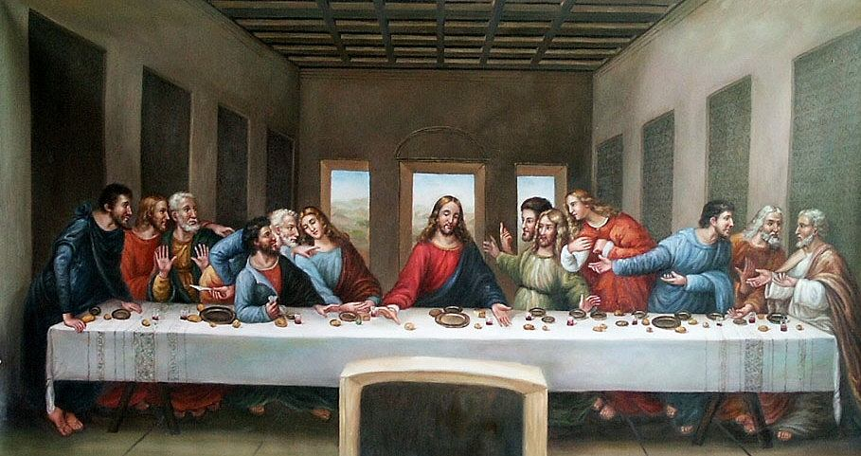
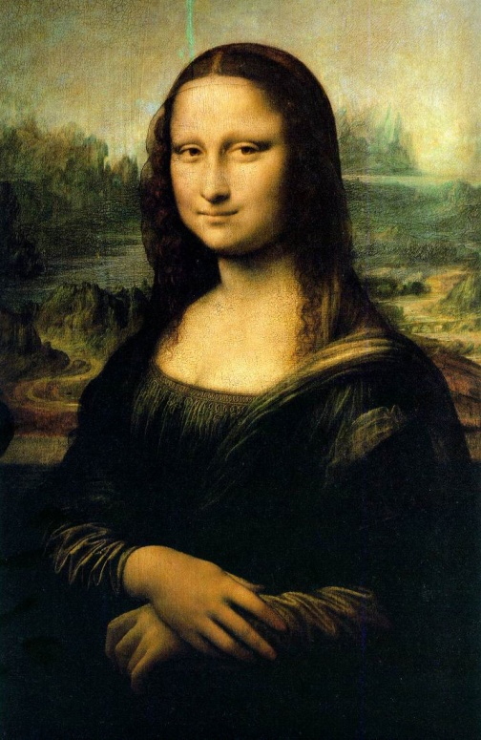
Da Vinci
Leonardo Da Vinci was a true Renaissance man. He was a brilliant engineer, painter and scientist. He is most famous for his painting skills. Above is “The Last Supper” and “The Mona Lisa.” Notice the use of perspective, the personality of the figures painted, and the rich use of color. Also notice the development of spacial relations. Da Vinci carefully organizes the design of the room and the position of the apostles so that the viewers eyes are immediately drawn to Jesus.

Slide 18
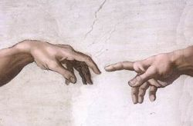
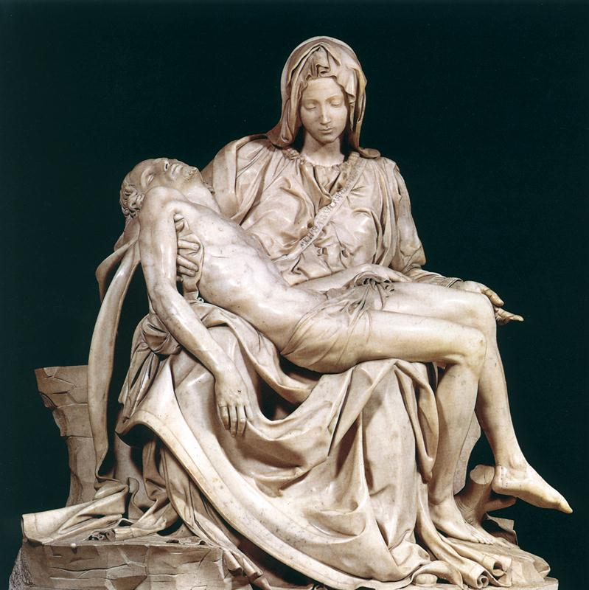
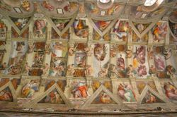
Michelangelo

Slide 19
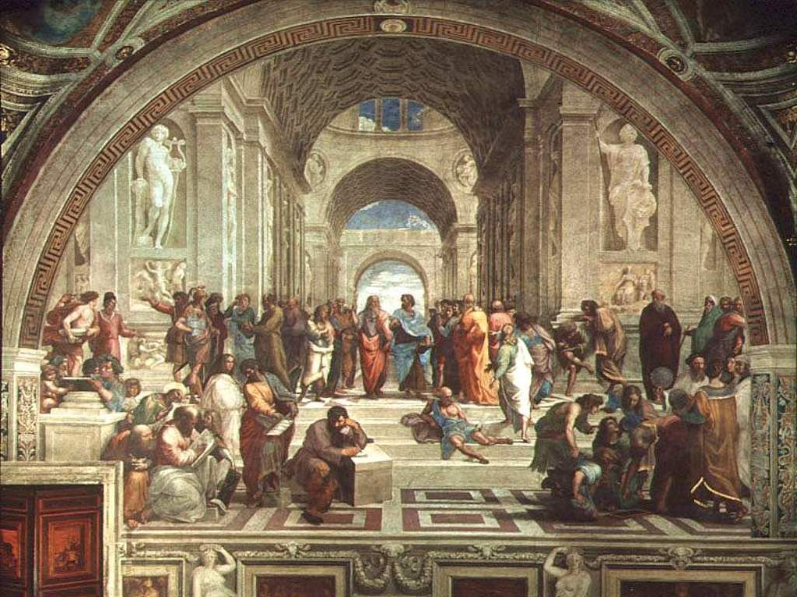
Raphael

