Slide 1
Phonetics
HSSP Week 5

Slide 2
Studying sound systems
Two major branches of linguistics that deal with sound:
Phonetics: how sounds are produced, transmitted, and perceived.
Phonology: how sounds are organized into rule-governed systems.
This week: phonetics; next week: phonology.

Slide 3
What is phonetics?
Usually divided into three branches:
Articulatory phonetics: how sounds are produced
Acoustic phonetics: how sounds are transmitted
Auditory phonetics: how sounds are perceived

Slide 4
What phonetics isn’t, Part 1
Phonetics ≠ how you should speak.
Phonetics is a descriptive science.
Our interest: describing the sounds of the world’s languages, so we can figure out what is, and what isn’t, possible.
Not: telling people how to pronounce words.

Slide 5
What phonetics isn’t, Part 2
Phonetics ≠ spelling
More than one way to spell a sound. (f?)
More than one way to pronounce a letter. (‘s’?)
Number of letters often does not correspond to number of sounds.

Slide 6
The IPA
What we’ve seen: using letters to talk about sounds isn’t such a great idea, and could lead to a lot of confusion.
One solution: the IPA (=International Phonetic Alphabet)
Cross-categorizes sounds on different dimensions, for easy identification
One-to-one correspondence between symbol and sound.
Some practice with the IPA
What is this word: [fʌnɛtɪks]?

Slide 7
Where speech comes from

Slide 8
The larynx

Slide 9
Voiced vs. voiceless
Voiced sounds: vocal folds are vibrating (e.g. /z/)
Voiceless sounds: vocal cords are not vibrating (e.g. /s/)

Slide 10
Vocal cords in action
https://www.youtube.com/watch?v=y2okeYVclQo

Slide 11
The vocal tract

Slide 12
Ways to categorize sounds
Basic distinction: voicing.
Beyond this, we categorize sounds according to the constriction required to produce them.
Place of articulation: the place where constriction occurs
Manner of articulation: the type of constriction

Slide 13
Place of articulation
Categorizes sound based on where the constriction occurs.
What is the difference between /p/ and /k/?
Between /v/ and /z/?

Slide 14
Bilabial

Slide 15
Labiodental

Slide 16
Interdental

Slide 17
Alveolar

Slide 18
Palato-alveolar

Slide 19
Velar

Slide 20
Glottal

Slide 21
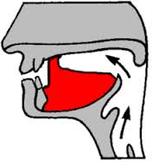
Some other English sounds
/w/: bilabial and velar constrictions
/j/: palatal constriction
/l/: alveolar (and often velar) constriction
/ɹ/: alveolar-ish constriction (retroflex)

Slide 22
Other places of articulation
French uvulars: http://www.phonetics.ucla.edu/course/chapter7/french/french.html
Thai dentals: http://www.phonetics.ucla.edu/course/chapter6/thai/thai.html

Slide 23
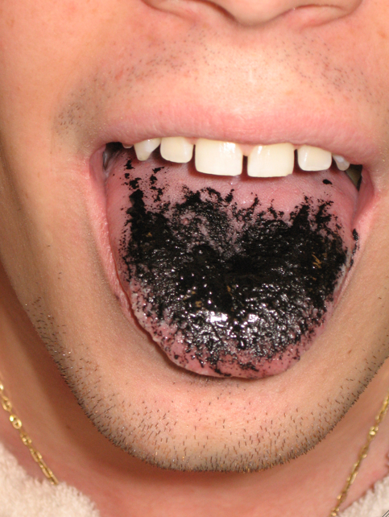
Finding PoA, Part 1
Palatography
Mouth-painting with charcoal and olive oil.
Good technique when you’re doing fieldwork.
https://www.youtube.com/watch?v=8Sh5hFnIuS4

Slide 24
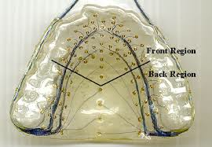
Finding PoA, Part 2
Electropalatography

Slide 25
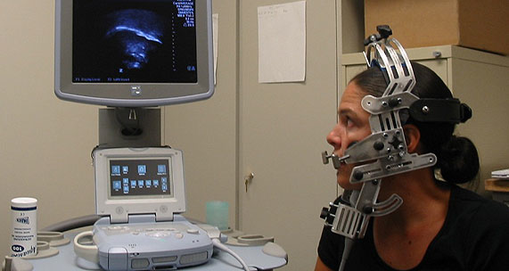
Finding PoA, Part 3
Ultrasound

Slide 26
Manner of articulation
Categorizes sound based on the type/degree of constriction.
What is the difference between /t/ and /s/?
Between /k/ and /a/?
Between /t/ and /l/?

Slide 27
Stops vs. fricatives

Slide 28
Lesser constrictions
Approximants: /j/, /w/, /l/, /ɹ/
Vowels

Slide 29
Degree of constriction summary
Degree of constriction is a continuum:
Total obstruction: stops
Near-total obstruction: fricatives
Some obstruction: approximants
Little or no obstruction: vowels

Slide 30
Nasality
We can also categorize sounds based on whether or not the velum is open, i.e. air is escaping through the nose.
How are /d/ and /n/ alike? How are they different?
/b/ and /m/?

Slide 31
Nasal vs. oral

Slide 32
The velum in action
https://www.youtube.com/watch?v=08RNIuFEVPU

Slide 33
Interim summary
We can classify sounds in at least four ways:
Voicing (/s/ vs. /z/)
Place of articulation (/p/ vs. /t/)
Manner of articulation (/t/ vs. /s/)
Nasality (/b/ vs. /m/)
Looking at how this all fits together: http://www.uiowa.edu/~acadtech/phonetics/

Slide 34
English sounds, in chart form

Slide 35
Airstream mechanisms, Part 1
A basic fact about all English sounds: they are pulmonic egressive (air is pushed from the lungs).
But not all sounds are produced this way…

Slide 36
Airstream mechanisms, Part 2
Glottalic ingressive
Simultaneous constriction and lowering of the larynx, essentially turning your vocal tract into a vacuum. When you release the constriction, air rushes into the mouth.
Sindhi implosives: http://www.phonetics.ucla.edu/course/chapter6/sindhi/sinhi.html

Slide 37
Airstream mechanisms, Part 3
Glottalic egressive
Simultaneous constriction and raising of the larynx, raising air pressure in the vocal tract. When you release the constriction, air rushes out of the mouth.
Lakota ejectives:http://www.phonetics.ucla.edu/course/chapter6/lakhota/lakhota.html

Slide 38
Airstream mechanisms, Part 4
Velaric ingressive
Simultaneous constriction in the front of the mouth and at the velum. Tongue lowers, turning your mouth into a vacuum. When front constriction is released, air rushes in.
Nama clicks:http://www.phonetics.ucla.edu/course/chapter6/nama/nama.html

Slide 39
A bit of auditory phonetics
What we’ve focused on so far: the role of the speaker in communication
But there’s more than this: communication is a complex and dynamic process, involving at least two people, the speaker and the listener.

Slide 40
How communication works
Speaker:
Thinks of what they want to say
Brain tells muscles to contract
Speech sounds are produced.
Listener:
Sound enters through the ear and goes to the brain.
Sound waves parsed into linguistic units
Meaning is recovered
Speech perception: figuring out how sound waves get parsed into linguistic units. (Not an easy task!)

Slide 41
What we’re perceiving, Part 1
Formant structures, i.e. the resonant frequencies that allow us to distinguish one sound from another
Sinewave speech: speech-based signal that has been stripped down to the bare formant frequencies. Not speech, but still understandable (mostly).
http://www.haskins.yale.edu/featured/sws/swssentences/sentences.html

Slide 42
What we’re perceiving, Part 2
A lot of speech perception has to do with sound, but there’s a good bit of evidence that we pay attention to the speaker’s physical gestures, too.
McGurk effect: what you’re perceiving isn’t always what you’re hearing.
http://www.youtube.com/watch?v=aFPtc8BVdJk
http://www.youtube.com/watch?v=G-lN8vWm3m0

