Slide 1
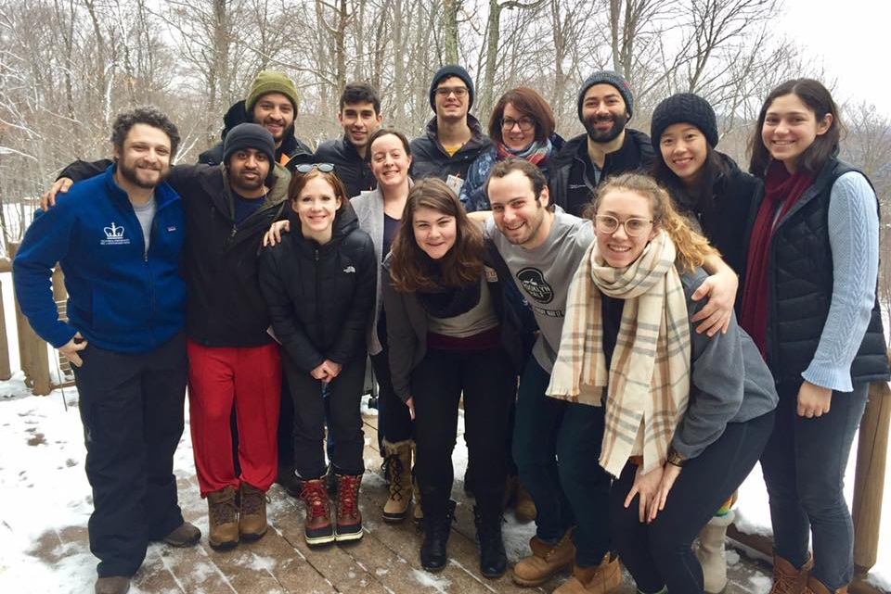
Day 3:
How does the immune system see?
Sarah Nyquist
Andrew Navia
Sam Allon

Slide 2
Which Organs are Commonly Transplanted

Slide 3
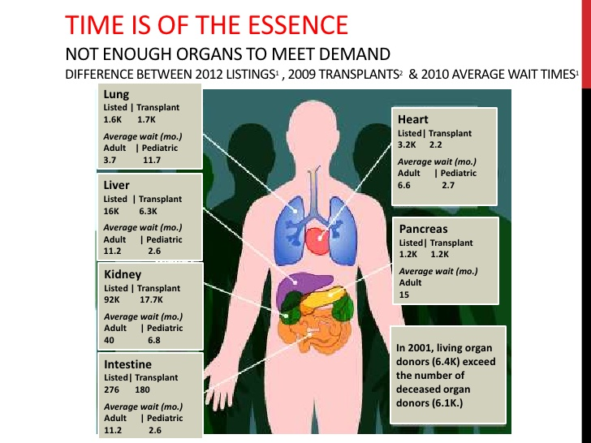
Which Organs are Commonly Transplanted
Slideshare LinkedIn

Slide 4
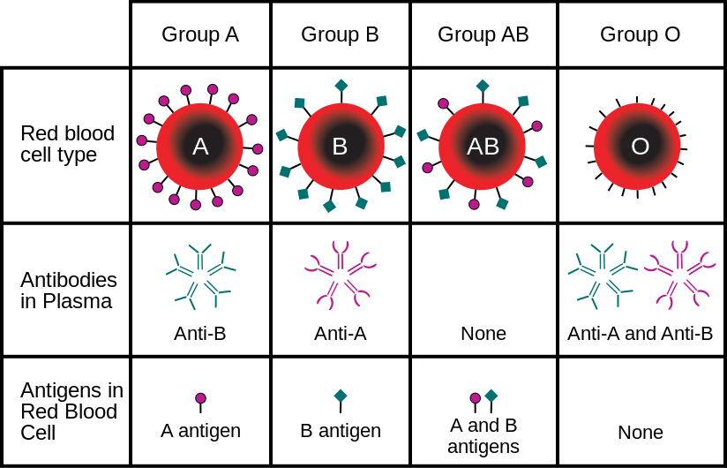
Roadblocks: Blood Type
New York Blood Center
Notes:
Blood is centrifuged and antibodies are left behind. Additionally, serum (with antibodies) are diluted enough to not be harmful

Slide 5
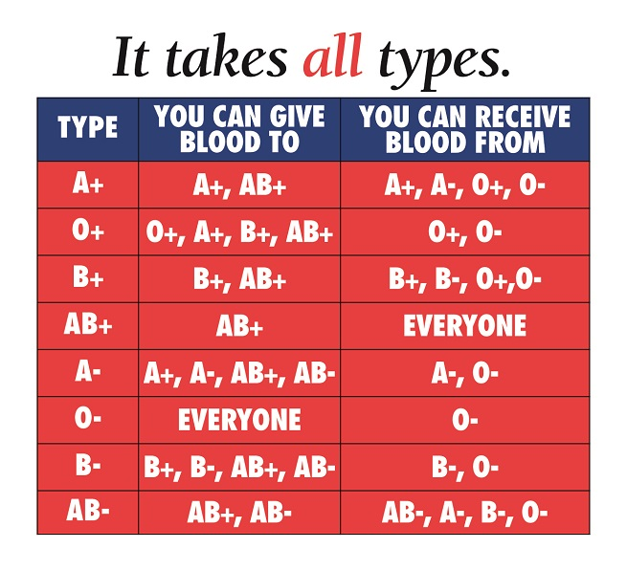
Roadblocks: Blood Type
New York Blood Center
Notes:
If given the wrong blood type your immune system kills new red blood cells. Symptoms: nausea, fever, chills, aches. Test for destroyed red blood cells. Treated with fluids to avoid kidney failure. RhD blood type classification denoted +/-. Different set of surface proteins less related to immune response.

Slide 6
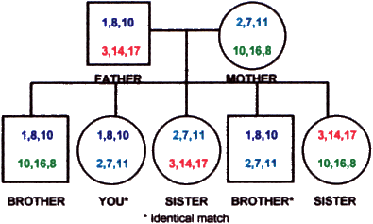
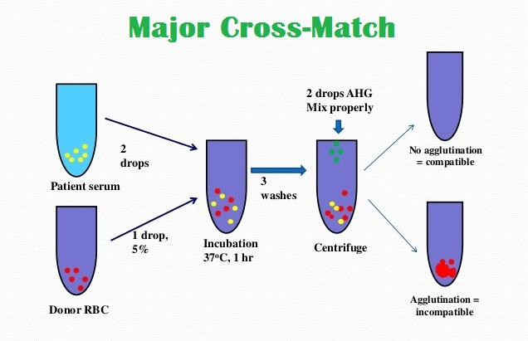
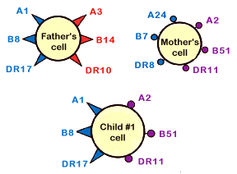
Roadblocks: Human Leukocyte Antigens
Inheritance
Cross Matching
Stanford
Notes:
six proteins, two of each type. HLA A has 59, HLA B has 118, HLA DR has 124. Once overlap is determined, Immune reactivity is checked. Cross checking looks if recipient antibodies attack HLA proteins from donor (mix patient serum with donor white blood cells). On white cells and tissue cells.

Slide 7
Course Outline
Viral and bacteria infections
Zoo of white blood cells
Innate and adaptive recognition
Cancer
Allergy and autoimmunity
Vaccines

Slide 8
3 groups
What do we know about antibodies?

Slide 9
Outline for today’s class
Innate immune recognition
Adaptive immune (B cell) recognition
What antibodies actually do

Slide 10
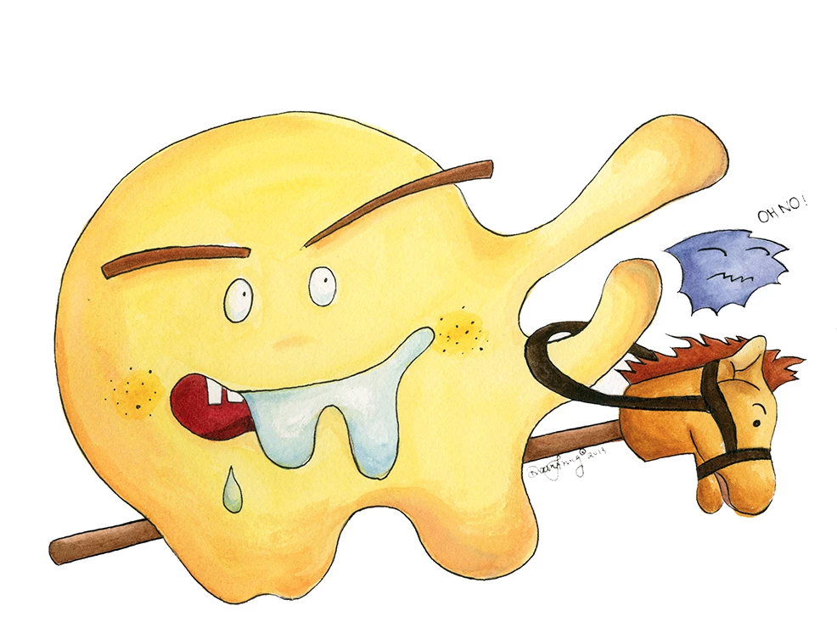
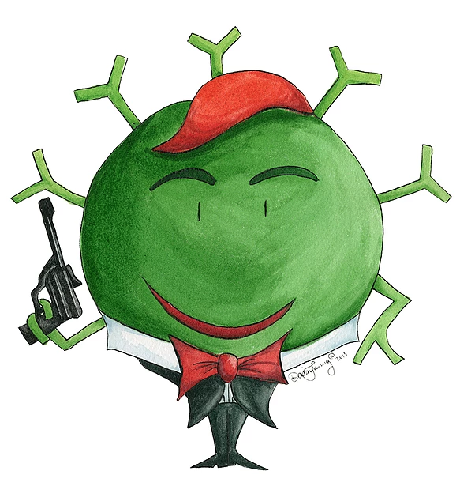
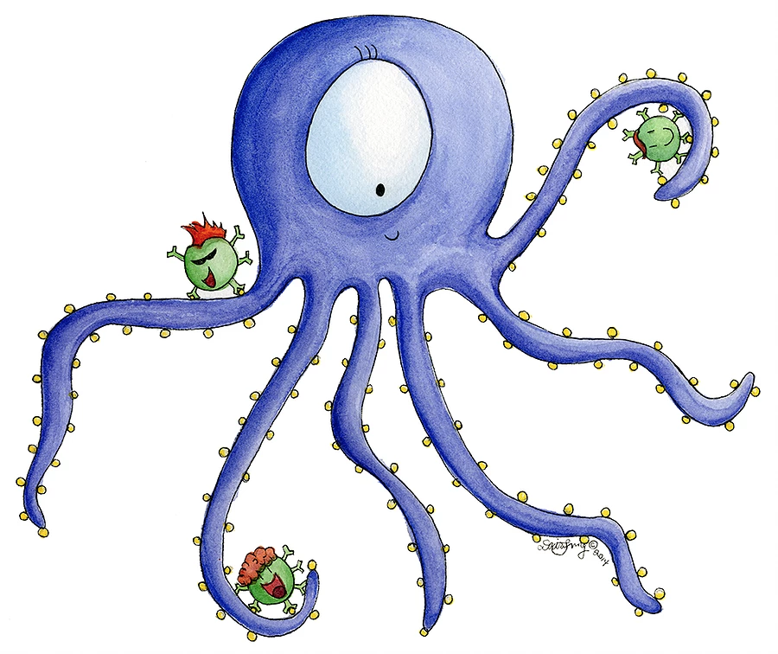
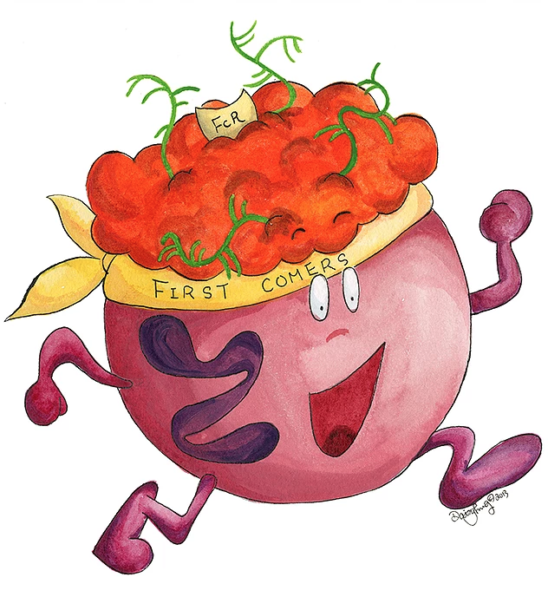
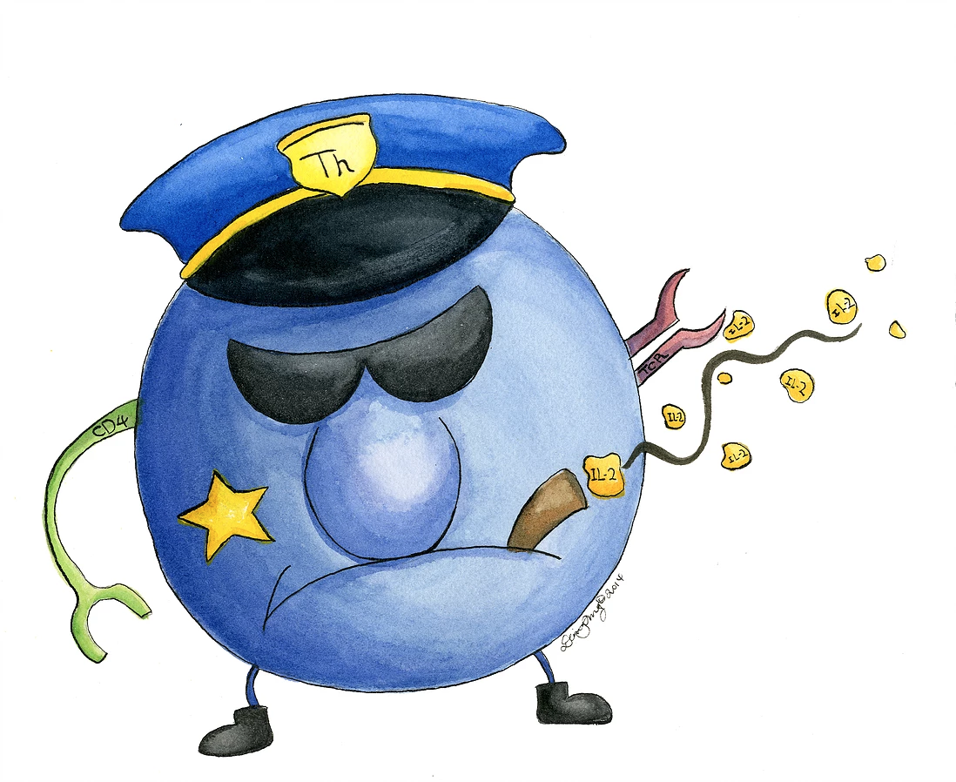
Cell types of the immune system
Innate immune system
Adaptive immune system
Macrophage
B cell
Dendritic cell
Neutrophil
T cell
Daisy Cheung

Slide 11
Innate vs. adaptive immune response
 | Innate response | Adaptive response
At birth | Totally functional | Start from nothing
Speed after infection | Immediate response | Takes a few days
Teamwork | Operates on its own | Needs help from innate response
Memory | Same response every time | Second encounter stronger and faster
What it recognizes | Common features of viruses and bacteria | Specific viruses and bacteria
thetwinapproach.com

Slide 12
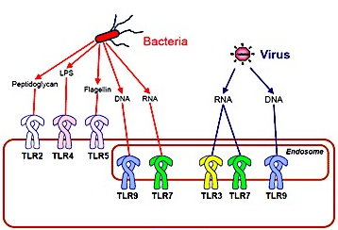
Innate immune receptors detect common features
Macrophage
bsw3.naist.jp

Slide 13
There are WAY more features than just the common ones
ppdictionary.com
pinterest.com

Slide 14
Adaptive immune receptors guess randomly and wait
Naïve B cells
Number of possible B-cell receptors: 10¹³ = 10 trillion
nature.com

Slide 15
When a B cell finds its match, it activates and copies itself
Naïve B cells
Activated B cells
nature.com

Slide 16
Activation leads to antibody secretion and memory
Activated B cells
Antibody secreting cell
Memory B cell

Slide 17
3 groups
Can you guess randomly and wait like a B cell?

Slide 18
Antibodies can’t kill viruses or bacteria. So what do they do?

Slide 19
Antibodies can act like handcuffs
Boundless.com

Slide 20
Antibodies can act like a target for innate immune cells
Boundless.com

Slide 21
Antibodies can’t stop infections occurring inside of cells
?
?
schoolworkhelper.net
Franco et al (2009)

Slide 22
T cells are the masters of stopping intracellular infections
Innate immune system
Adaptive immune system
Macrophage
B cell
Dendritic cell
Neutrophil
T cell
Daisy Cheung

