Slide 1
Dialects and standards
HSSP Week 7, Part II

Slide 2
What is a dialect?
Dialect = cluster of language features that differentiate groups of speakers.
Things dialectologists usually look at:
  Vocabulary
  Pronunciation
  Grammar

Slide 3
What is a language?
Language = ‘a dialect with an army and a navy.’ Social, political factors.
Whether two varieties of speech are called ‘dialects’ or ‘languages’ doesn’t tell us very much about how similar they are.
  Different languages, mutually intelligible: Swedish, Norwegian
  Same language, mutually unintelligible: some dialects of Chinese

Slide 4
Dialects
Our focus: regional dialects, or how people’s speech varies from place to place.
Other dimensions of variation
  gender
  age
  social class
  profession
  ethnicity

Slide 5
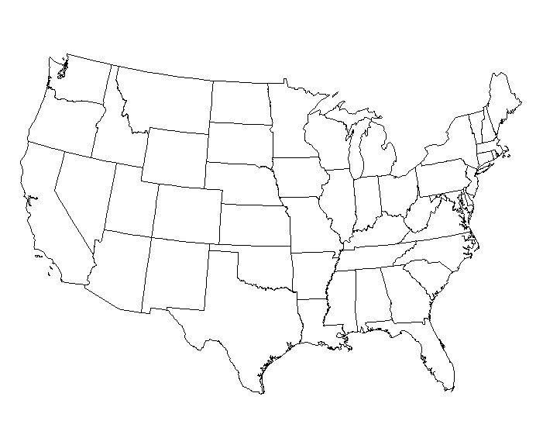
Regional dialects in the US
?

Slide 6
An illustration of dialect boundaries, based on pronunciation:
http://aschmann.net/AmEng/

Slide 7
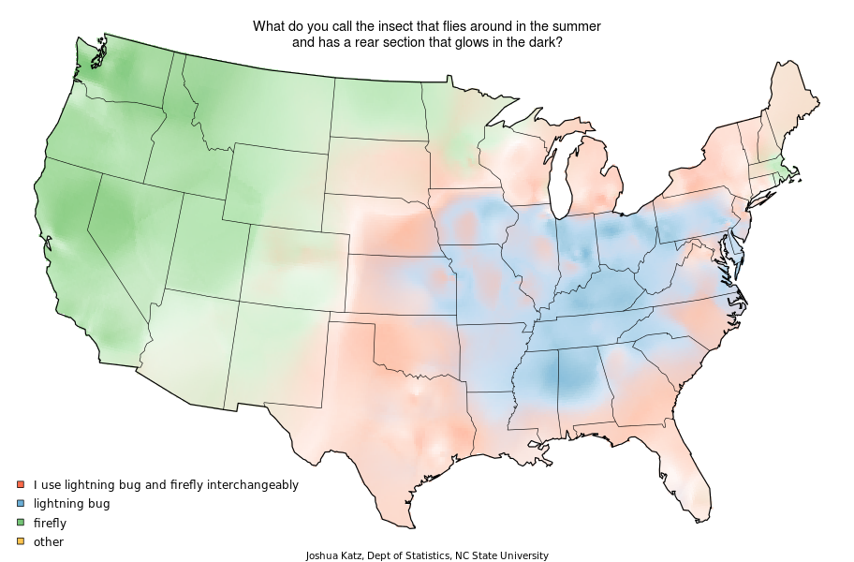
Lightning bug? Firefly?

Slide 8
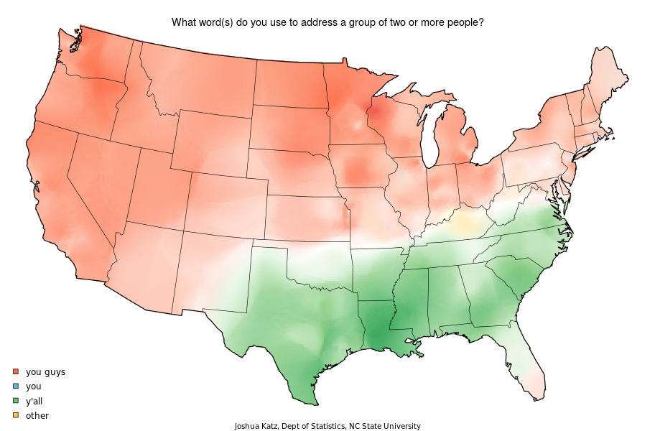
What do you call a group of 2+ people?

Slide 9
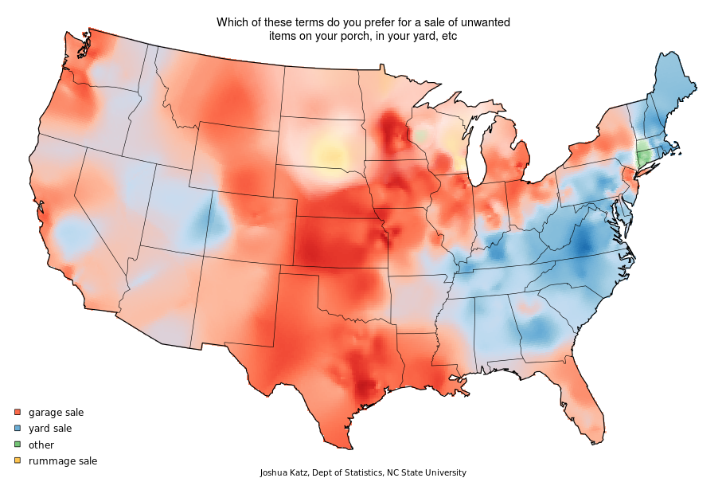
A sale of unwanted items on your porch?

Slide 10
Dialects I: Boston
Siri vs. Boston accent: http://www.youtube.com/watch?v=1wBpSWxPo6o

Slide 11
Non-rhoticity
/ɹ/s are dropped…
  At the ends of words in isolation
  before other consonants
Some examples
  card = [kɑ:d]
  weird = [wiɨd]
  square = [skweə]
  tuner = [tunə]

Slide 12
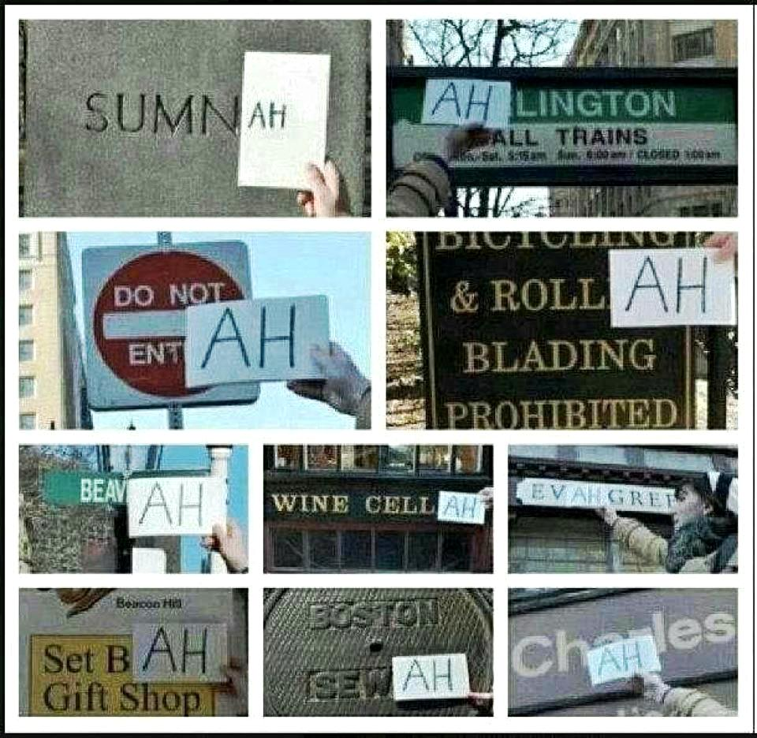
Non-rhoticity = salient

Slide 13
But sometimes /ɹ/ comes back…
Linking /ɹ/: when an r-final word shows up before a vowel-initial word, the r stays.
  car engine
  Park the car in Harvard Yard
Intrusive /ɹ/: under certain circumstances, an r gets inserted in between two vowels
  tuna(r) oil
  Amanda insists

Slide 14
some other Boston things
merry vs. marry vs. Mary
wicked!
Others?

Slide 15
Dialects II: the South
http://www.atlas.mouton-content.com/secure/generalmodules/anae/samples/texas_south/vmcgahey/start.html

Slide 16
Some pronunciation things
Monopthongization: /aɪ/ > [ɑ:]
  For some speakers, only before voiced Cs or at the end of a word (‘ride’ = [rɑ:d], ‘buy’ = [bɑ:], ‘fire’ = [fɑ:r])
  For other speakers, before voiceless Cs too! (‘night’ = [nɑːt], ‘nice white rice’)
Pin-pen merger
Word stress (pólice, cément, Détroit, ínsurance, dísplay, hótel, guítar, úmbrella)

Slide 17
Some grammar
y’all and ain’t
Non-standard past tense forms
  knowed
  choosed
Double modals
  I might could do that
  You might should close the window

Slide 18
Perception of dialects
What do you think when you hear somebody speaking in…
  A really strong Boston accent?
  A really strong Southern accent?
  An English accent?

Slide 19
What is a standard?
Usually we contrast things like ‘Southern American English’ and ‘Boston English’ with ‘Standard American English’
What is SAE?
  Marked by the absence of major dialectal features
  Based on a generalized midwestern accent
  Usually when you say you ‘don’t have an accent’ what you’re saying is that you speak SAE.
Usually, a ‘standard’ = prestige variety of a language, spoken by the rich and powerful

Slide 20
Prestige of the standard
We learn from various places (school mostly, maybe your parents) that SAE is what you should speak if you want to sound educated.
Perception: people who have a ‘strong accent,’ or use things like double modals, didn’t learn English properly.
This last point isn’t true.
  Dialects = just as rule-governed as the standard, just slightly different rules.
  Dialect and intelligence are not linked.

Slide 21
Different methods of enforcing a standard
English: nothing official, just schools, the media, etc…
French: l’Académie française
  40 people (called ‘immortels’)
  Determine what are French words and what aren’t, what is ‘good grammar’ and what isn’t.

Slide 22
Prescriptivism
A lot of the time, so-called ‘rules of grammar’ that you’re taught in school, as part of SAE, are entirely made up.

Slide 23
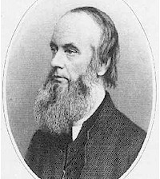
Split infinitives
“But surely, this is a practice entirely unknown to English speakers and writers. It seems to me that we ever regard the to of the infinitive as inseparable from its verb. And, when we have already a choice between two forms of expression, 'scientifically to illustrate' and 'to illustrate scientifically,' there seems no good reason for flying in the face of common usage.”
- Henry Alford, 1864

Slide 24
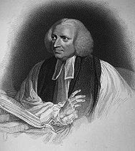
Double negation
Declared sinful by Robert Lowth, 18th century English clergyman, because logically one negation cancels out another.
Double / multiple negation: Romance, Slavic… old English…

Slide 25
Preposition stranding
Robert Lowth strikes again (after John Dryden, a 17th century poet)
"This is an Idiom which our language is strongly inclined to; it prevails in common conversation, and suits very well with the familiar style in writing; but the placing of the Preposition before the Relative is more graceful, as well as more perspicuous; and agrees much better with the solemn and elevated Style."

Slide 26
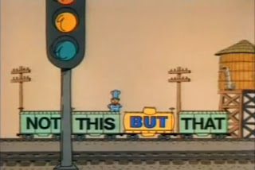
Don’t start a sentence with a conjunction
What many people learn in school = conjunctions should only used to join together elements within a sentence.
But there’s no reason why we can’t use them to join together sentences, too.

Slide 27
Different types of rules
Rules like ‘don’t strand a preposition’ are prescriptive rules: they tell people how they should speak. Usually made up.
What we’ve talked about / what linguists study: descriptive rules, which describe how people actually speak. Part of your grammar.

Slide 28
Food for thought
Do you think it’s important to learn to speak a standard dialect, and to follow prescriptive rules like ‘don’t strand prepositions’?
Why or why not?

