Slide 1
ABC Investing
By Shobha Narasimha
Notes:
-Room: 4-237
2 – 3.30pm

Slide 2
ABC Investing
http://simulator.investopedia.com/

Slide 3
What is Investing?
Why to invest?
What is the catch…..?
                Risk

Slide 4
Risk Of losing money

Slide 5
Things to Consider
Time Horizon
Risk
Rate of return
Risk
Liquidity Risk

Slide 6

Why not keep money under bed?
Inflation
Notes:
`

Slide 7
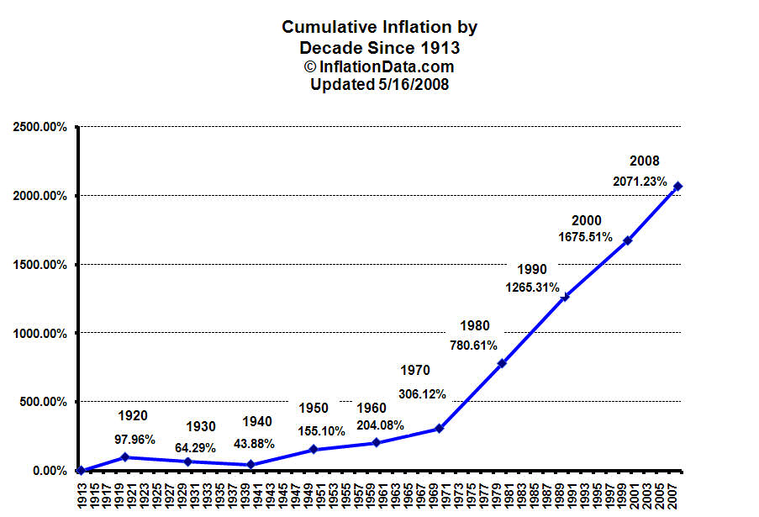
Inflation

Slide 8
Type of Investment
Bank
Checking –
Saving -
CD -
Interest taxable, penalty for early withdrawal

Slide 9
Bonds
Short Term < 3 year
Intermediate Term - 3 – 10 years
Long Term > 10 years

Slide 10
Bonds
Treasury bonds – state tax free, federal tax, $1000 multiples, can be traded
Treasury bills < 1 year
Treasury notes - 1 …10 years
Treasury bonds > 10 years

Slide 11
Bonds
Saving Bonds – Non transferable
TIPS - Inflation adjusted, 5 – 10 years
Municipal bond – federal tax free and tax free for state residents

Slide 12
Saving Bonds
Can be bought directly at treasuarydirect.gov
Low minimum – 25,50,75, 100,200,500
Non transferable
EE bonds and I bonds (Inflation adjusted)
Might be tax free if it is used for higher education

Slide 13
Bonds
Corporate Bond
A……………………………Z alphabet soup
Mortgage Bond

Slide 14
Mutual Fund
Mutual Fund - Bond, Stock, Money Market
Expense ratio
No load fee
Diversification
Vanguard, TRow Price

Slide 15
Where to Buy ?
Discount brokers
Scottrade.com
Etrade.com
www.schwab.com

Slide 16
Portfolio and Asset Allocation

