Slide 1
The Universe at its Two Extremes: Lecture Two
Kavish Gandhi and Yuan Lee
7/7/18

Slide 2
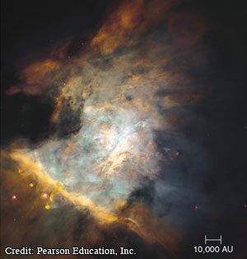
Before Stars
Interstellar medium (ISM): 1 particle/cm³
Molecular clouds, denser parts of ISM: 10⁶ to 10¹⁰ particles/cm³
Composition: 70% H, 28% He, 2% “metals”
Force balance: gravity pushing in, thermal pressure pushing out.
Jeans mass = threshold mass
Notes:
P = nkT, 18M_{sun}T^{1.5}n^{-0.5}
Molecular clouds = very cool, 10-20K, and very dense, mostly hydrogen
Some are “giant molecular clouds”
Pertubrations often cause fragmentation of a cloud, making it especially dense and causing it to collapse

Slide 3
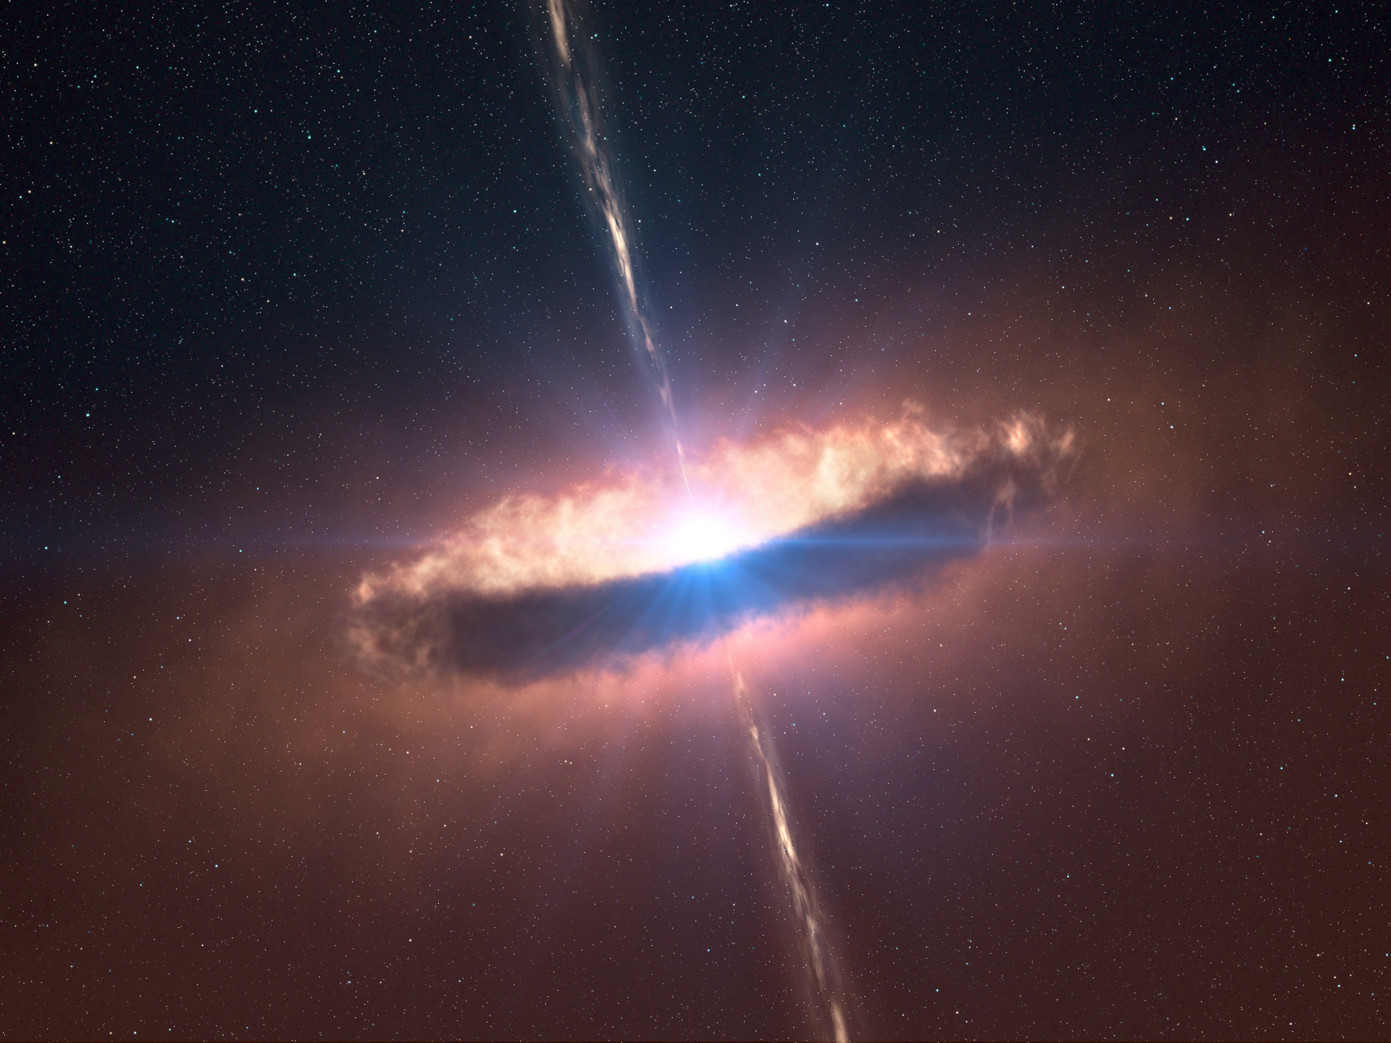
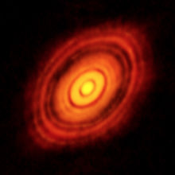
Birth of a star
Molecular cloud exceeds the jeans mass, collapses
Heats up (potential energy --> kinetic energy)
Rotation (angular momentum conservation)
Flattening (due to collisions)
Collapse eventually stops, since thermal pressure increases
We call this a protostar
Notes:
Initially, temperature does not rise especially quickly, since the core is not exceptionally dense.
However, eventually, core becomes opaque to radiation when it is dense enough, so temperature builds up fast, and thus thermal pressure too.
Fusion after a few million years, can burn hydrogen, strong “stellar wind” created to prevent further infall.
Protostars are variable, and can take on a lot of forms. One especially active form is a T Tauri star, high lithium abundance, and a lot of instability, which makes them especially lumjnous and identifiable. We know they are young since, if fusion were taking place, lithium would be destroyed quickly.

Slide 4
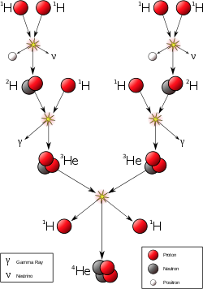
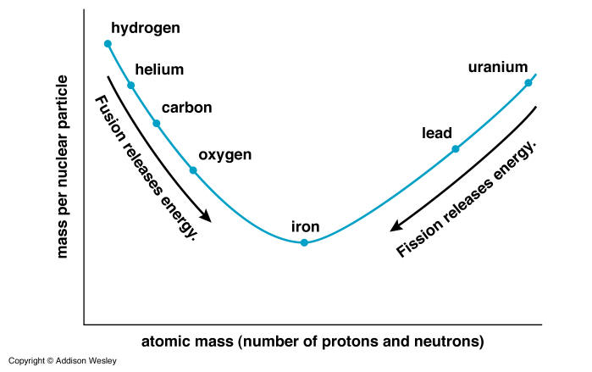
Energy Source: Nuclear Fusion
At sufficiently high temperatures, Coulomb barriers can be overcome: nuclear fusion
Starts with: H + H -> He, hydrogen “burning”
Proton-proton chain (I, II, III), CNO cycle, triple alpha process

Slide 5
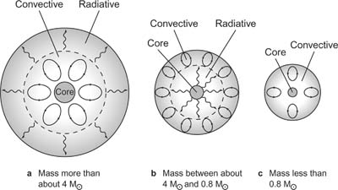
Energy Transport
Two main mechanisms: radiation and conduction
Radiation
Photons take random walk, inversely related to opacity
High opacity when atoms can absorb photons (i.e. atoms not ionized)
Convection
Bulk motion due to temperature difference
High mass: convective core, radiative envelope
Low mass: radiative core, convective envelope
Notes:
CNO cycle is T²⁰, how high mass stars do hydrogen fusion, versus p-p is T⁴, how low mass do it

Slide 6
Equations governing Stellar Structure

Slide 7
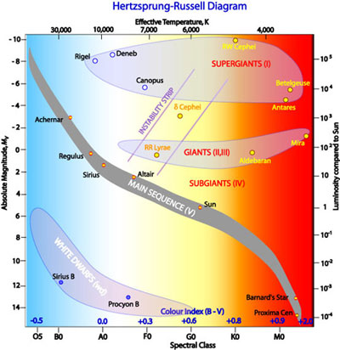
HR Diagram
“Periodic table of stars”
Plots:
Luminosity vs. Temperature
Magnitude vs. Spectral Class
Main sequence:
90% of star’s lifetime
Hydrostatic equilibrium, hydrogen fusion
Giant, supergiant branches

Slide 8
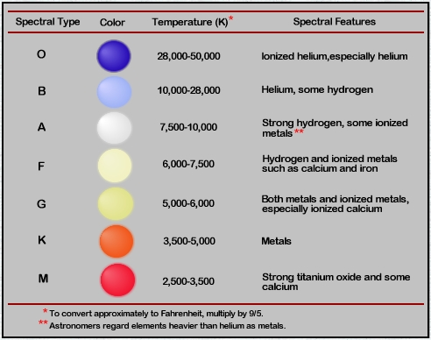
Spectral Type

Slide 9
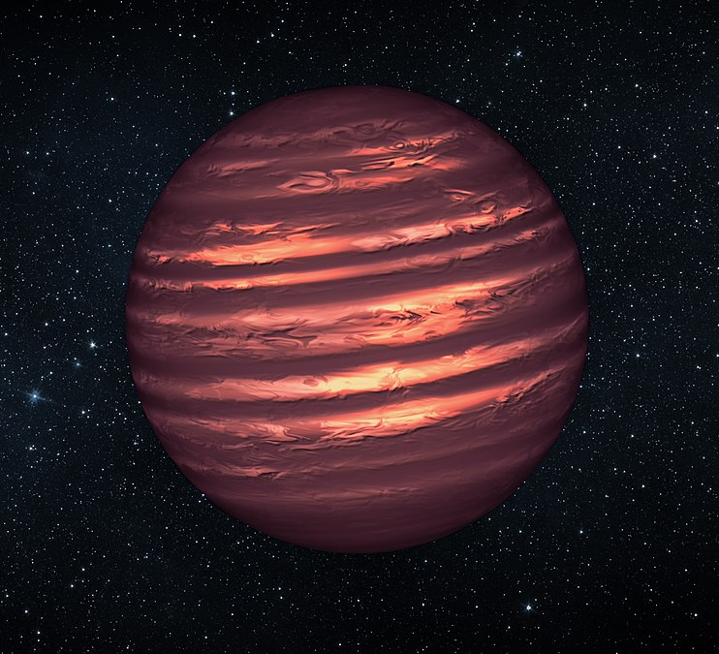
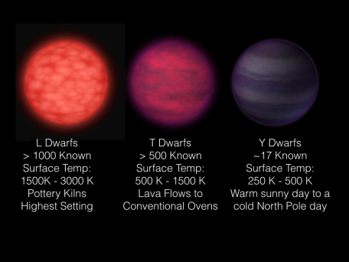
Brown Dwarfs
Hydrogen fusion requires T ≈ 3 million K
If the cloud is too small, the core never reaches this temperature
Star still emits infrared radiation from the initial collapse; called a “brown dwarf”
Bigger than a planet, smaller than a star

Slide 10
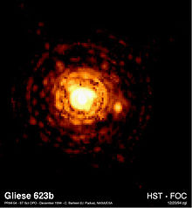
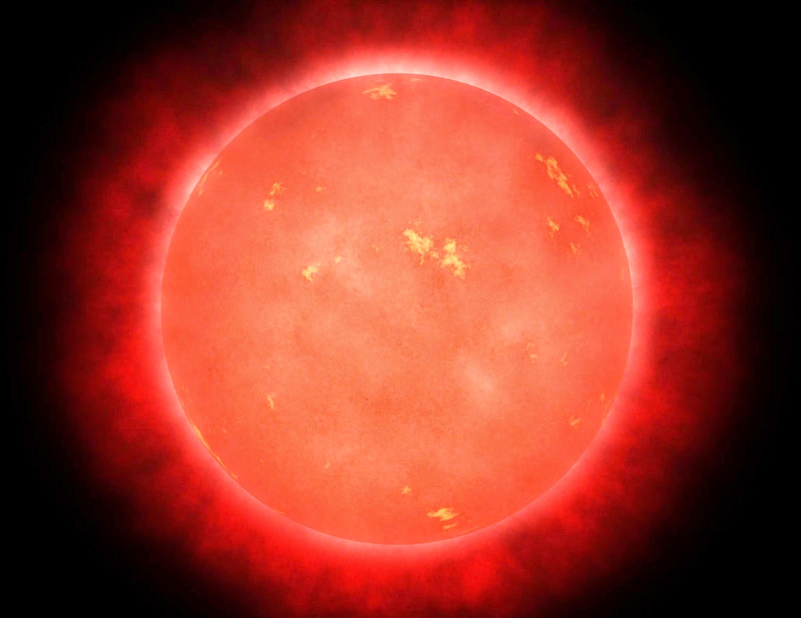
Red Dwarves
Extremely low mass stars that initiate hydrogen fusion
Temperature is low enough that fusion is very slow, main sequence lifetime longer than the age of the universe
Very common, so possible host for habitable planets!

Slide 11
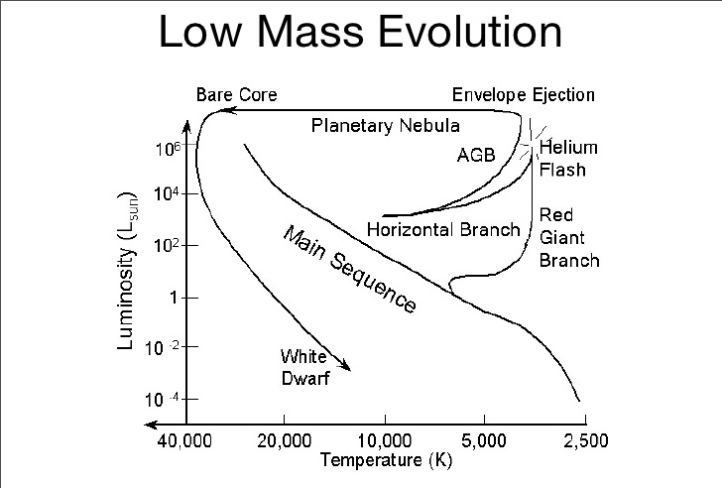
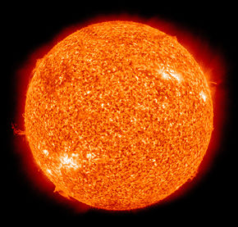
Mid-Sized Stars
When H fuel is exhausted, core collapse → T increases
He fusion in core, H fusion in “shell”
Outward pressure causes outer layers to balloon, temperature drop: red giant
Envelope is ejected by stellar wind, planetary nebula
Small, dense, bright core left behind: white dwarf

Slide 12
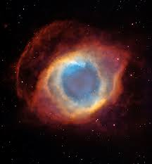
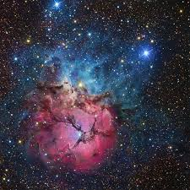
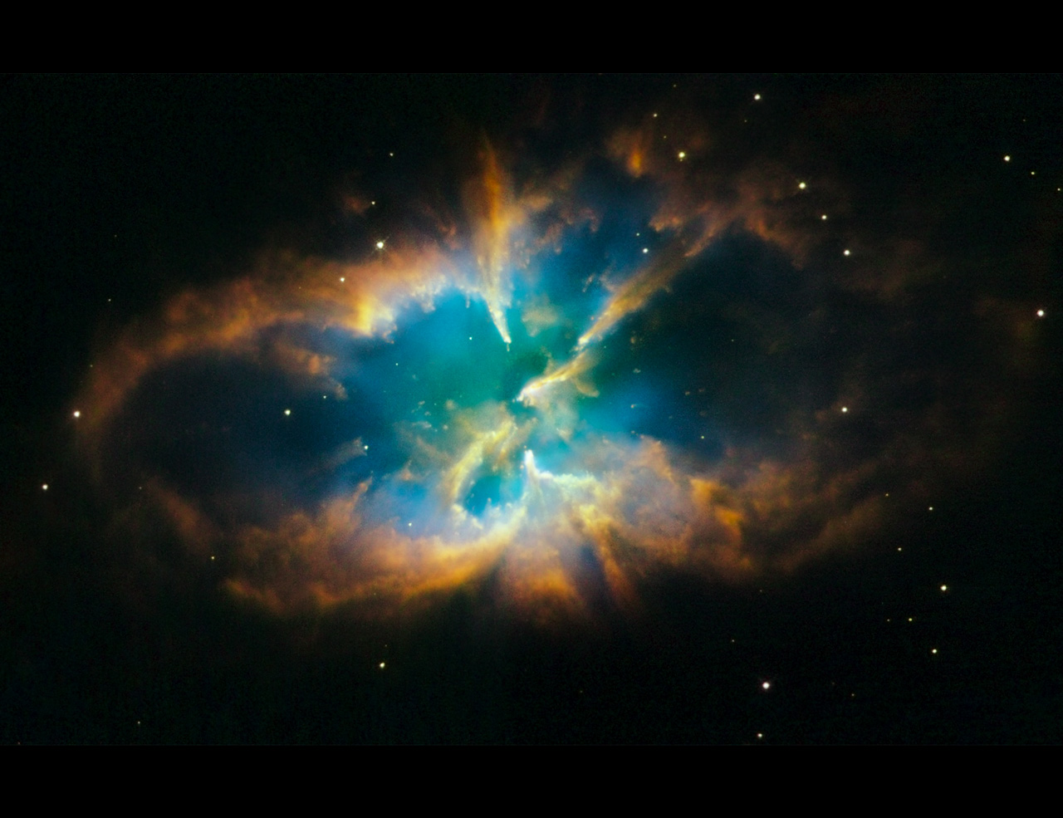
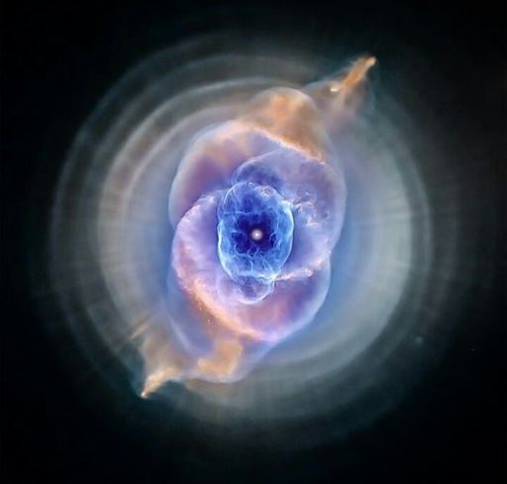
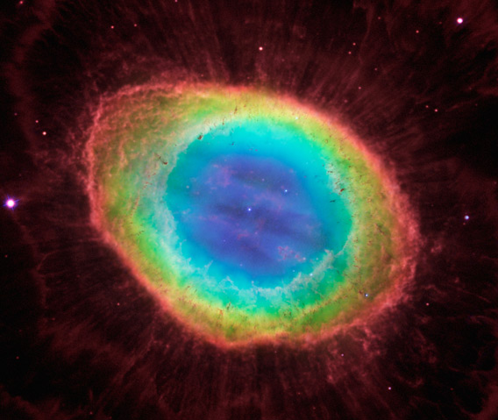
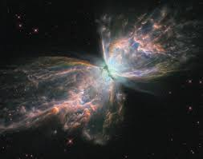
Tangent: Beautiful Planetary Nebulae

Slide 13
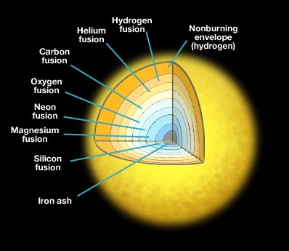
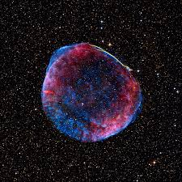
Massive Stars
After H is depleted: He fusion, then C fusion, O fusion, etc., becoming a supergiant
In this process, star expands and contracts, due to imbalance of forces: variable star
Once it reaches iron, fusion is no longer energy-producing.
Eventually, the iron core reaches sufficient size that the core collapses, and the star goes supernova.
Notes:
Mention nucleosynthesis, bouncing past equilibrium in supernovae, type II supernova
Mention electron degeneracy pressure

Slide 14
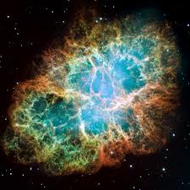
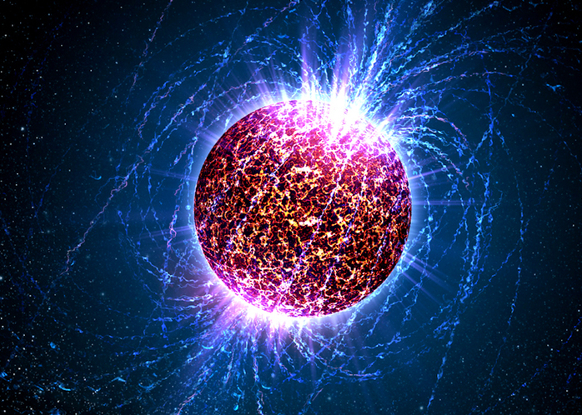
Neutron Stars
Lower mass, extremely dense result of type II supernova
Electron degeneracy limit has been passed; held together by strong nuclear force, “neutron degeneracy”
Very small radius causes high rotational speeds, x-ray radiation along poles: pulsars
Notes:
one teaspoon is one billion tons
Likely superfluid state of matter

Slide 15
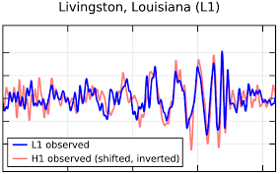
“Stellar” Black Holes
If the mass of the collapsing core is large enough, neutron degeneracy pressure is not enough
Forms a black hole, so dense that light cannot escape
Edge of black hole is known as the event horizon
Also exist supermassive and intermediate black holes

