Slide 1
Weird Atoms and Strange Photons The Quantum Nature of the Universe
Hiro Miyake
Splash!
November 20, 2011

Slide 2
Outline
Strange Photons
  What are photons?
  Is it a wave or a particle?
  Faster-than-light influences?
Weird Atoms
  What are atoms?
  Is it here or is it there? How fast is it going?
  What happens at very cold temperatures?

Slide 3
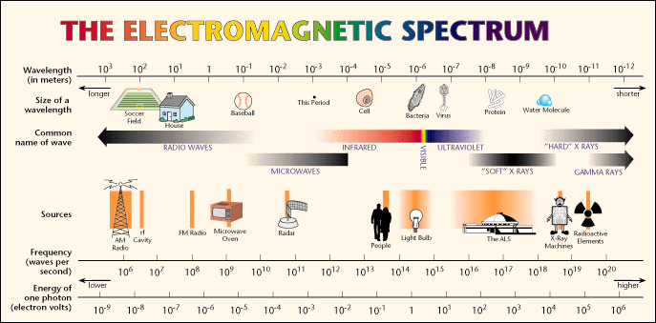
What Are Photons?
Also known as light
  Gamma rays to radiowaves: It’s all light!
http://www.lbl.gov/MicroWorlds/ALSTool/EMSpec/EMSpec2.html

Slide 4
What is Light?

Slide 5
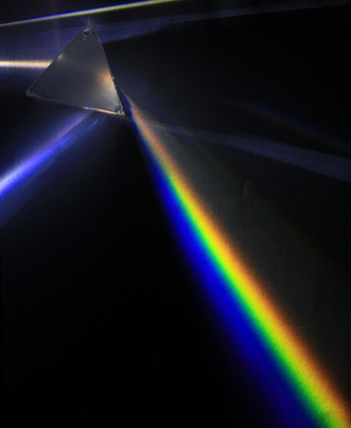
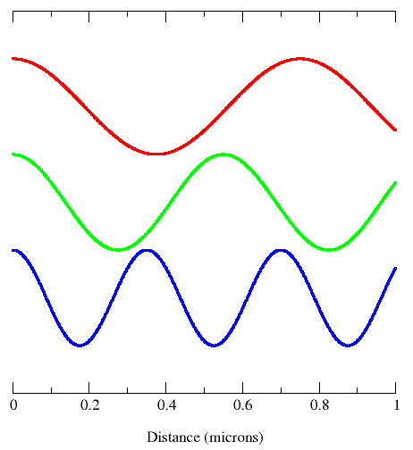
It’s a Wave!
Light can combine and scatter, just like water waves
http://en.wikipedia.org/wiki/Prism_(optics)
http://en.wikipedia.org/wiki/Photon

Slide 6
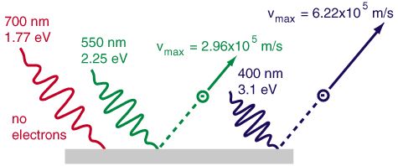
No, It’s a Particle!
Einstein proved it in 1905
  The photoelectric effect
http://hyperphysics.phy-astr.gsu.edu/hbase/mod1.html

Slide 7
Which Is It?

Slide 8
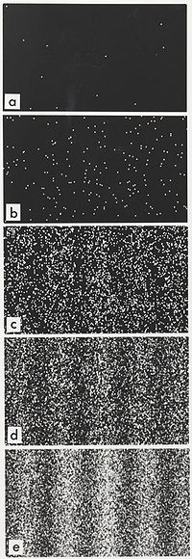
Both Wave and a Particle!
Depends on how you look at it
University of Leiden Video
  http://www.youtube.com/watch?v=MbLzh1Y9POQ
http://en.wikipedia.org/wiki/Double-slit_experiment

Slide 9
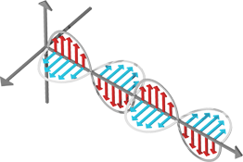
Strange Photons
Photons are really strange
But first, let’s understand polarization of light
Photons have two orthogonal polarizations
Vertical Polarization
Horizontal Polarization
http://missionscience.nasa.gov/ems/02_anatomy.html

Slide 10
Strange Photons II
Suppose two photons are created
  They have two different polarizations, one H and the other V
  We don’t know which is which
Two people, Alice on the left and Bob on the right, can measure the polarization
If Alice measures H, Bob must measure V
A
B

Slide 11
Strange Photons III
You could say that the photons had already decided at the beginning which one was going to be H and V
Say that was setting 1
Now consider setting 2 where Alice and Bob measures H and V along a different axis, call it H’ and V’
If Alice and Bob make the same measurement with setting 2, the results would also be the same, one measures H’ and the other V’

Slide 12
Strange Photons IV
Now consider this
Alice and Bob both start with setting 1 before the photons fly off towards them
Now once the photons fly off, Alice can change her settings to 2
Now if Alice measures, for example, H’, Bob’s measurement can be either H or V
It can only be determined probabilistically
But it used to be that you could always predict what the other would measure based on what one measured

Slide 13
Strange Photons V
Plus, Alice changed her setting after the photons flew off
How could that influence what Bob measures?
But nothing should travel faster than light!
Einstein-Podolsky-Rosen paradox
This has been shown to be really true!
  But no useful information has traveled faster than light

Slide 14
Strange Photons Summary
Photons, or light, is both a wave and a particle
  It all depends on how you look at it
Measuring certain properties of light can influence a measurement farther than what light would need to travel to inform the other measurement
  Faster-than-light influence!
  But doesn’t convey any useful information faster than light

Slide 15
Weird Atoms
Atoms are weird too
Small objects can be everywhere
You can’t know where something is and how fast it’s going at the same time
They can behave like one big wave
Let’s see what all this means...

Slide 16
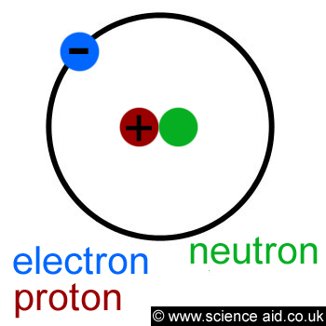
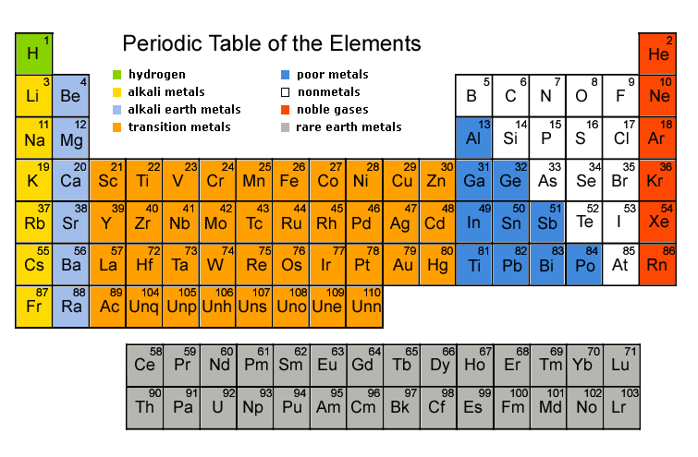
What Are Atoms?
All familiar objects in our universe are made from atoms
Atoms are made from electrons and the nucleus
They are so small, you can’t see them with your naked eye
They have weird properties!

Slide 17
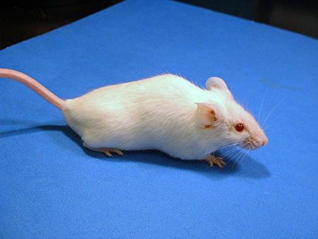
Quantum Weirdness
Small things can be in multiple places at the same time…
Small things can be in multiple places at the same time…
…until you look at them
They can also pass through walls
Notes:
Orbital-type picture

Slide 18

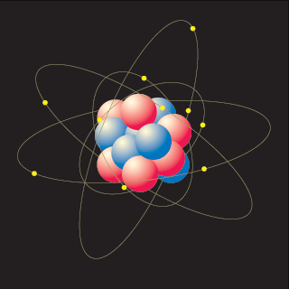
How do you look at something?
Bounce light off it
Suppose its very small….
The light will mess it up!
You only know what it looks like after its messed up
Notes:
Light affects small objects a lot. Position velocity uncertainty.

Slide 19
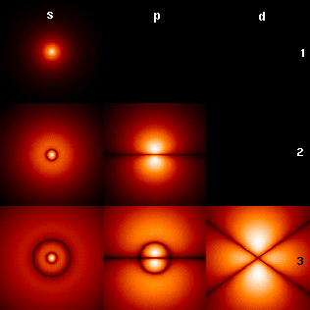
What does this mean?
Small objects exist everywhere
When you look at one, you know where it is, but not how fast its moving!
You can never know everything!
The places where an electron might be
http://en.wikipedia.org/wiki/Hydrogen_atom
Notes:
Stm picture

Slide 20
You can never know exactly where something is and exactly how fast it’s moving at the same time

Slide 21
(How much we don’t know about where it is)
How much “fuzziness” is there?
(How much we don’t know about how fast it is)
(a very small number)
x
≥
(How heavy it is)
For very light objects, we have less information than for heavy objects!
Notes:
Delta x * delta p >= \hbar/2

Slide 22
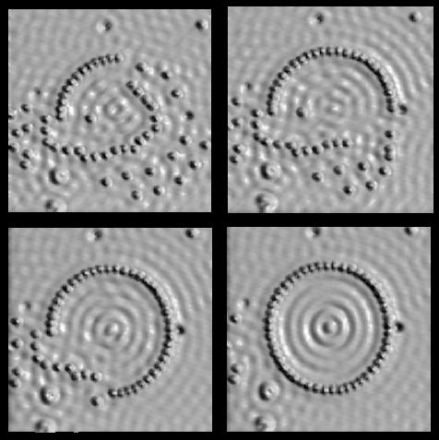
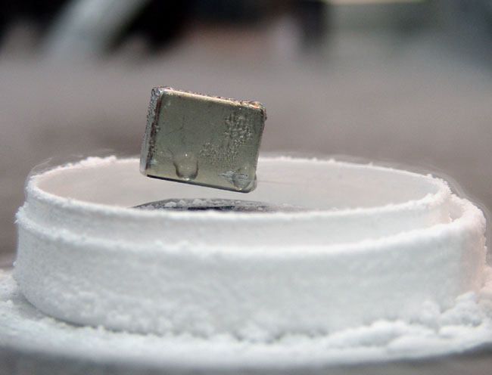
More Implications
The existence of stable atoms
Stars
Life as we know it
Control of atoms
Useful things like superconductors
Scanning tunneling microscope image of iron on copper
http://www.almaden.ibm.com/vis/stm/corral.html
M. F. Crommie, C. P. Lutz, D. M. Eigler, Science 262, 218-220 (1993).

Slide 23
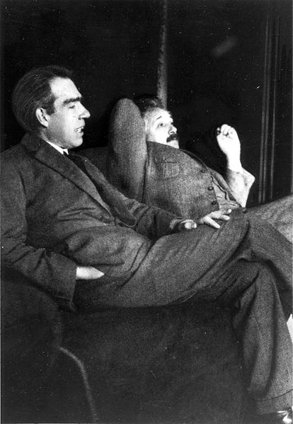
Philosophical Implications
How is it that we can’t know how fast things are moving and where they are at the same time?
Was it really somewhere and moving at some speed before I looked?
Did I change reality by looking?
What does it mean to “look?”
Niels Bohr (Copenhagen Interpretation)
vs.
Albert Einstein (Realist)
http://commons.wikimedia.org/wiki/Image:Niels_Bohr_Albert_Einstein_by_Ehrenfest.jpg

Slide 24
How can you see these weird properties of atoms?
You can make the atoms really COLD!

Slide 25

Why go COLD?
Things different from everyday intuition occur
  You can see individual atoms
  See weird states of matter: Bose-Einstein Condensation (BEC), Superfluidity, superconductivity
http://mrsec.wisc.edu/Edetc/background/STM/

Slide 26
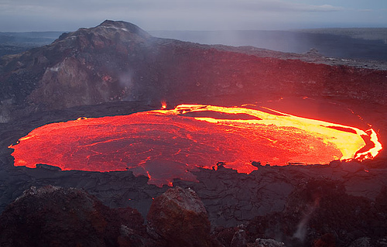

What is temperature?
Motion of atoms
  Fast moving atoms are hot
  Slow moving atoms are cold
http://www.flickr.com/photos/volcanoes/988326099/sizes/m/in/photostream/
http://www.treehugger.com/files/2009/12/melting-polar-ice-raise-sea-levels-4-feet-2100.php

Slide 27
What is “Ultracold”?
Everyday temperatures
    32 °F = 0 °C = 273 Kelvin
Absolute zero
    -460 °F = -273 °C = 0 Kelvin
Typical ultracold temperatures in lab
    100 nanoKelvin, billionth the temperature of a nice day
  Outerspace is 3 Kelvin = -454 °F
    Colder than space by more than a millionth the temperature of space!
What happens at ultracold temperatures?
  All atoms behave like one big atom!

Slide 28
Very Weird Fact About the World
Everything in this world is both a particle and a wave

Slide 29
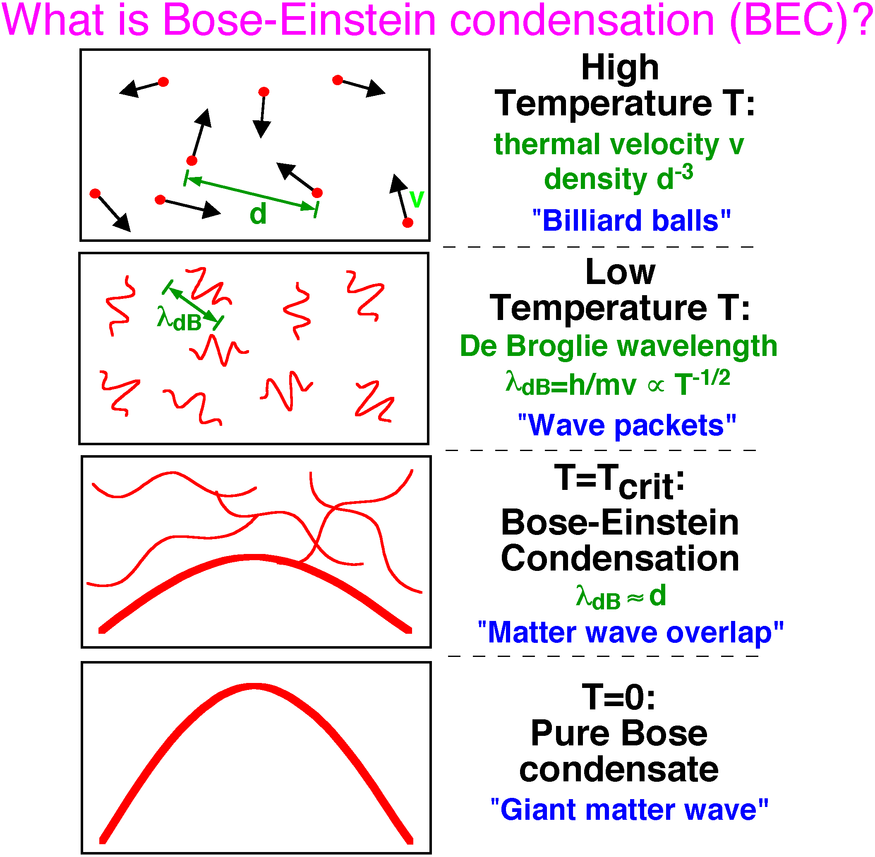
High temperature
Lower temperature
Even lower temperature
Zero temperature
http://cua.mit.edu/ketterle_group/Nice_pics.htm

Slide 30


Laser Cooling of Atoms I
Shine light on atoms to slow them down
  Zeeman slowing

Slide 31
Laser Cooling of Atoms II
Trap atoms in a valley (with light and magnets)
Lower the top of the hill slowly so atoms with a lot of energy escape (evaporative cooling)

Slide 32
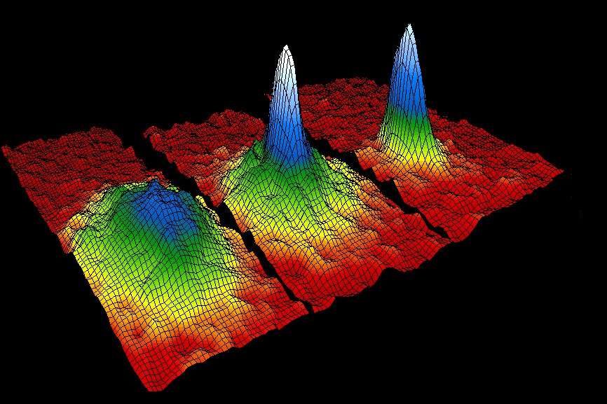
Ultracold Atoms!
All individual atoms act as one giant atom
  Bose-Einstein condensation (BEC)
    2001 Nobel Prize in Physics
http://www.colorado.edu/physics/2000/bec/three_peaks.html

Slide 33
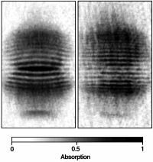
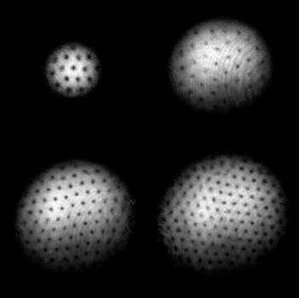
Cool Stuff with a BEC
You can interfere two BECs like a water wave
You can create holes in BECs by rotating it
http://cua.mit.edu/ketterle_group/Nice_pics.htm
http://cua.mit.edu/ketterle_group/projects_2001/vortex_lattice/vortex.htm

Slide 34
Weird Atoms Summary
Atoms make up everyday objects
When objects are as small as atoms, they can exist everywhere until you look at them
You also can’t know where it is and how fast it’s going at the same time
At very low temperatures around 100 nK, atoms can behave as one big matter wave

Slide 35
Summary of Atoms and Photons
Photons are strange
  They are both particles and waves and can influence things faster than light
  But no useful information travels faster than light!
Atoms are weird
  The position and speed cannot be known at the same time and can behave like huge waves of matter at low temperatures
These are many interesting and fun questions to be answered for a long time to come!

Slide 36
Thank you!
hmiyake@mit.edu

