Slide 1
What’s in a Battery: Week 2

Slide 2
Answering questions from last week
How cold does the air in a compressed air energy storage system become when it is compressed?
“Standard multistage air compressors use inter- and after-coolers to reduce discharge temperatures to 300/350°F (149/177°C) and cavern injection air temperature reduced to 110/120°F (43/49°C)”
Learn more: https://energystorage.org/why-energy-storage/technologies/compressed-air-energy-storage-caes/

Slide 3
Review from Week 1: How can we store energy?
We can think of energy as existing in a variety of types.
Kinetic energy (movement)
Potential energy (position or pressure difference)
Electric (movement or positioning of electrons)
Chemical (stored within chemical bonds or intermolecular attractions)
All of these types of energy can be manipulated to store energy
Pumped hydro storage (potential energy)
Compressed air storage (potential energy)
Flywheels (kinetic energy)
Supercapacitors (electrical energy)
Batteries (chemical energy)
Cost, portability, discharge speed, and length of discharge are all important parameters when considering energy storage technologies.

Slide 4
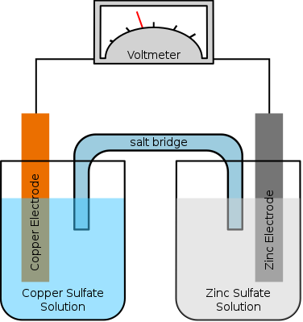
Review from week 1: How do batteries work?
Zn²⁺
Cu²⁺
Notes:
Talk about salt bridge
Talk about oxidation and reduction

Slide 5
Oxidation and Reduction
Oxidation: An atom or molecule lose one or more electrons
Reduction: An atom or molecule gains one or more electrons
These must always exist in pairs – if something is being oxidized something else must be being reduced.
Because of this pair relationship, a molecule that is being oxidized is often called a reducing agent because it is reducing something else. Similarly a molecule being reduced is often called a reducing agent.

Slide 6
Today’s outline
Part 1: How do batteries work
What is reduction potential
What terms do we need to know to talk about batteries
Part 2: Where do we use batteries and why does that matter
Different battery applications
Discussion on how we think about optimizing parameter for different applications
Part 3: Lithium-ion batteries
How does a lithium-ion battery work
Lifecycle of a lithium-ion battery
Future research in lithium ion batteries

Slide 7
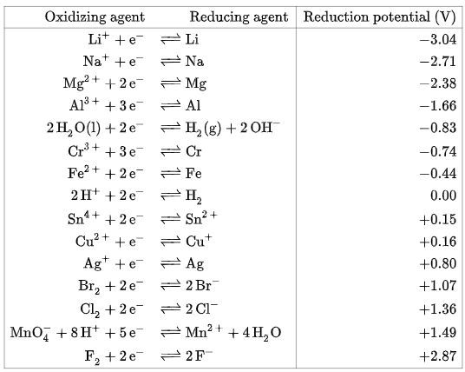
“Wanting” an electron: An introduction to reduction potential
Learn more at: http://hyperphysics.phy-astr.gsu.edu/hbase/Chemical/electrode.html
Notes:
Talk about oxidation reduction terms

Slide 8
Some vocabulary for thinking about batteries
Energy: Capacity for doing work. How much “stuff” a battery can do. Measured in kWh or Joules
Power: Amount of energy that can be released in a set period of time. A device that can release the same amount of energy faster is more powerful. Measured in Watts or kilowatts.
Voltage: Difference in electric potential between two point. A measure of how much electrons want to move from one place to another. Measured in volts.
Charge: The number of electrons (or other charged particles). Measured in coulombs.
Current: The charge passing through an area in a certain amount of time. Measured in amps
Resistance: The amount of resistance to the flow of electrons in some path. Measured in ohms (Ω).
Cathode (May also be called catholyte or posolyte): The side of the battery where reduction is occurring
Anode (May also be called catholyte/anolyte or posyltes/negolytes): The side of the battery where oxidation is occurring

Slide 9
The reduction potentials of some common battery materials
Cathode Materials
Anode Materials
Li⁺_{(aq)} + e⁻ → Li_{(s)} | −3.0 V
PbSO₄ + H⁺ + 2e– → Pb + HSO₄– | -0.356 V
Cd(OH)₂ + 2e⁻ → Cd + 2OH⁻ | -0.403 V
ZnO + H₂O + 2e⁻ --> Zn + 2OH⁻ | -1.28 V
V³⁺ + e⁻ → V²⁺ | -0.26 V
CoO_{2(s)} + H⁺ + e⁻ → CoO(OH)_{(aq)} | +1.1 V
PbO₂ + 3H⁺ + HSO₄– + 2e– → PbSO₄ + 2H₂O | +1.685
H₂O + NiO(OH) + e⁻ → Ni(OH)₂ + OH⁻ | +1.32
2MnO_{2(s)} + H₂O_{(l)} + 2e⁻ → Mn₂O_{3(s)} + 2OH⁻_{(aq)} | +0.15 V
(VO₂)⁺ + 2H⁺ → (VO)²⁺ + H₂O | 1.0 V
Notes:
Lithium ion
Car battery
Nickel cadmeium
zinc/manganese/potassium/graphite
Vandium redox flow
Nickel Metal Hydroxide
“Some of the most common cathode components are Lithium Nickel, Manganese Cobalt Oxide, Nickel Oxide, Cobalt Oxide, Manganese spinel, Iron Phosphate, and Titanate. Among them, Lithium Nickel and Manganese Cobalt Oxide have a higher energy density and cell voltage”
“Currently, the two most commonly used anode materials are those based on carbon (graphite) and lithium alloyed metals. One of the commercialized lithium alloyed metal is the oxide spinel Li4Ti5O12 the structure of which is shown in Fig.4. “

Slide 10
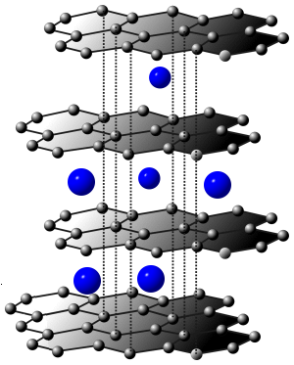
Things to consider
Reduction potentials describe the thermodynamics of an electrochemical reaction, but some molecules with apparently good thermodynamics have poor electrochemical kinetics.
Concerns such as cost, safety, and solubility play into designing batteries with appropriate properties.
Molecules with higher voltage have greater energy density if all else is equal
Molecules can form complexes with metals or intercalate into other materials, or form oxides to make them better electroactive materials
Image credit: http://large.stanford.edu/courses/2014/ph240/crerend2/

Slide 11
Review
Batteries work by processes in which one atom or molecule loses one or more electrons and gives it to another atom or molecule, resulting in an overall lower energy state.
The particular chemicals chosen determine a batteries energy and power density and voltage. They also influence the battery design that will influence the resistance the battery experiences.
We can measure how much a chemical “wants” an electron with reduction potentials. Good batteries often have one electrode with high reduction potential and one with low reduction potential.

Slide 12
Batteries where do we need them?
Grid
Vehicle
Medical devices
Portable electronics

Slide 13
Grid | Vehicles
Medical Devices | Consumer Electronics

Slide 14
Breakout rooms: What characteristics do each of these batteries need
Group One: Grid scale batteries
Group Two: Vehicles
Group Three: Medical Devices
Group 4: Consumer electronics

Slide 15
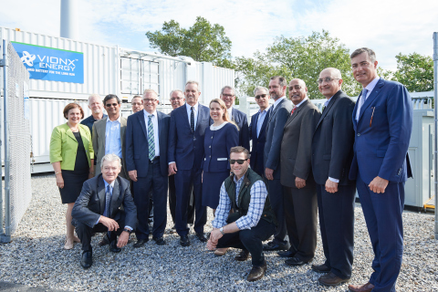
What’s going on with grid-scale storage
Learn more: https://www.businesswire.com/news/home/20171005006381/en/Vionx-National-Grid-and-US-Department-of-Energy-Complete-Installation-of-one-of-the-World%E2%80%99s-Most-Advanced-Flow-Batteries-at-Holy-Name-High-School-Worcester-MA

Slide 16
What’s going on with grid-scale storage
Learn more: https://share.ansi.org/Shared%20Documents/Standards%20Activities/International%20Standardization/CESP/Vionx-Development-of-Energy-Generation-in-Africa-and-Role-of-Long-Duration-Flow-Batteries-Final.pdf

Slide 17
What’s going on with grid-scale storage (2)
Learn more: https://www.tesla.com/blog/introducing-megapack-utility-scale-energy-storage

Slide 18
What’s going on with grid-scale storage (3)
Learn more: https://www.nrel.gov/docs/fy19osti/74426.pdf

Slide 19
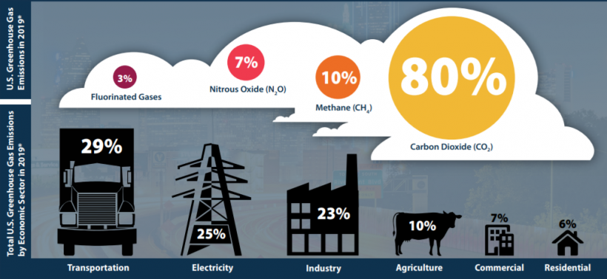
What’s going on with vehicle energy storage
Learn more: https://www.bts.gov/data-spotlight/electric-vehicle-use-grows

Slide 20
What’s going on with vehicle energy storage (2)
Learn more at: https://www.bts.gov/data-spotlight/electric-vehicle-use-grows

Slide 21
What’s going on with vehicle energy storage (3)

Slide 22
What’s going on with medical batteries (1)
Learn more: https://www.acs.org/content/acs/en/pressroom/newsreleases/2016/august/battery-you-can-swallow-could-enable-future-ingestible-medical-devices.html

Slide 23
What’s going on with medical batteries (2)
Learn more: https://www.technologyreview.com/2016/03/22/246385/controlling-diabetes-with-a-skin-patch/

Slide 24
What’s going on with consumer electronics batteries
Learn more: https://cen.acs.org/articles/95/i46/Solid-state-batteries-inch-way.html?ref=search_results

Slide 25
What’s going on with consumer electronics batteries (2)
Learn more: https://cen.acs.org/articles/95/i32/Powering-internet-things.html

Slide 26
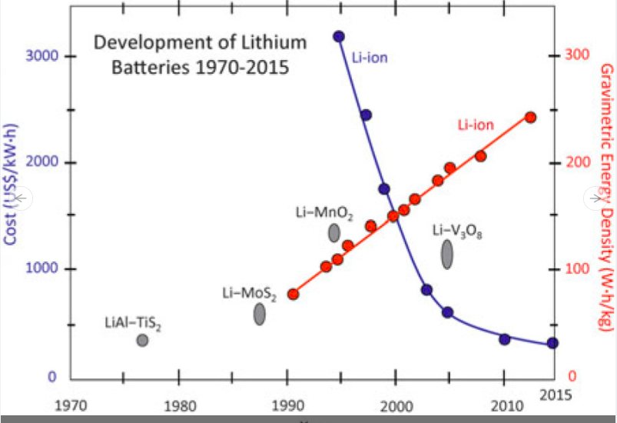
What’s going on with consumer electronics batteries (3)
Image credit: https://arstechnica.com/science/2021/05/eternally-five-years-away-no-batteries-are-improving-under-your-nose/

Slide 27
Takeaway: There’s a lot of sample space for battery design

Slide 28
Part 2: Review
Designing a battery isn’t a single-goal pursuit. Depending on the application there are different aspects you might want to optimize.
For grid scale applications, size is less important but cost, stability, and safety come at a premium
For vehicle applications, energy and power density are crucially important and charging speed is also a consideration.
For medical applications, flexibility and low-toxicity are required
For consumer batteries, think about cost, size, and environmental footprint

Slide 29
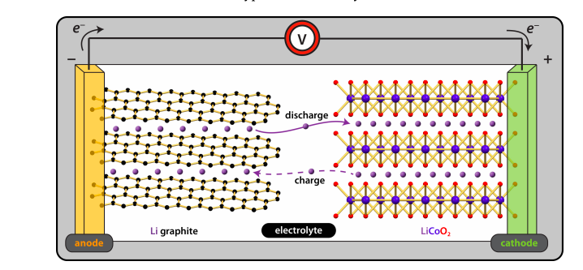
Part 3: Lithium ion batteries
Image credit: https://www.ionicviper.org/system/files/Li%20Battery%20Exercise_0.pdf

Slide 30
Growth of Lithium ion batteries over time

Slide 31
Why are they growing so fast?
Learn more: https://eps.fiu.edu/wp-content/uploads/2017/01/14.A-Review-of-Cathode-and-Anode-Materials-for.pdf

Slide 32
Where are Li batteries used
Cars
Phones and laptops
Grid storage
Lithium (but not usually lithium ion) batteries are used in pacemakers

Slide 33
How does a lithium ion battery work
Notes:
2 to 4:30

Slide 34
Visualization of a lithium ion battery

Slide 35
How are lithium ion batteries made

Slide 36
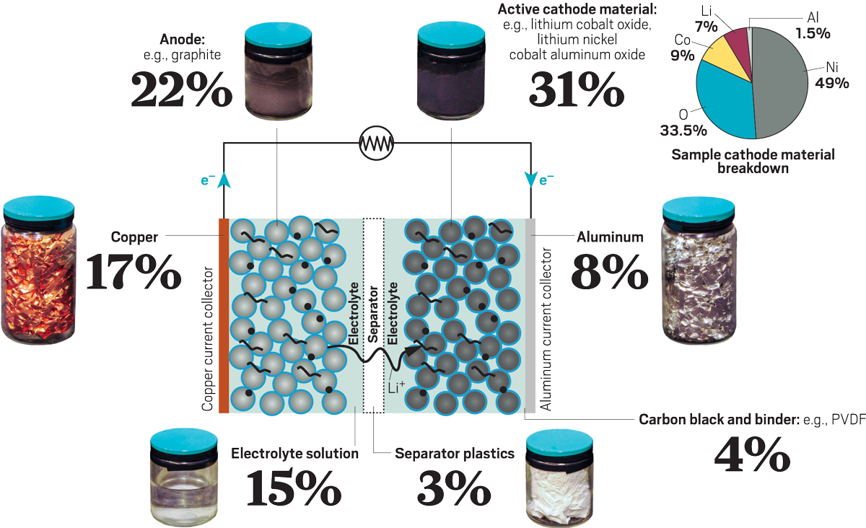
What does end of life of a lithium ion battery look like
Credit: Mitch Jacoby/C&EN
Source: Argonne National Laboratory.
Right now 5% of batteries are recycled.
2 million metric tons of batteries are expected to reach end-of-life each year by 2030.
High temperature smelting and recycling process.
Difficulties associated with economics of starting materials and variety of different materials used in batteries
Learn more at: https://cen.acs.org/materials/energy-storage/time-serious-recycling-lithium/97/i28

Slide 37
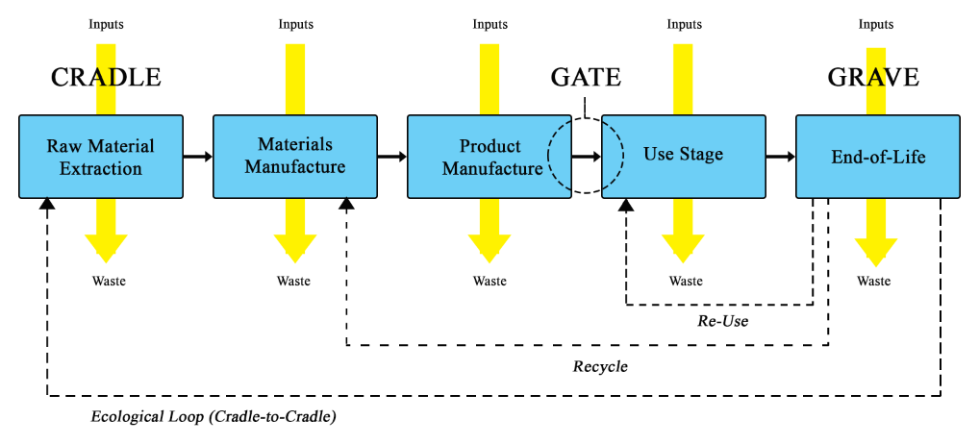
Analyzing cost/environmental impact across a batteries life span
Image credits: wikicommons user: MtW17
https://www.mdpi.com/2313-0105/5/2/48

Slide 38
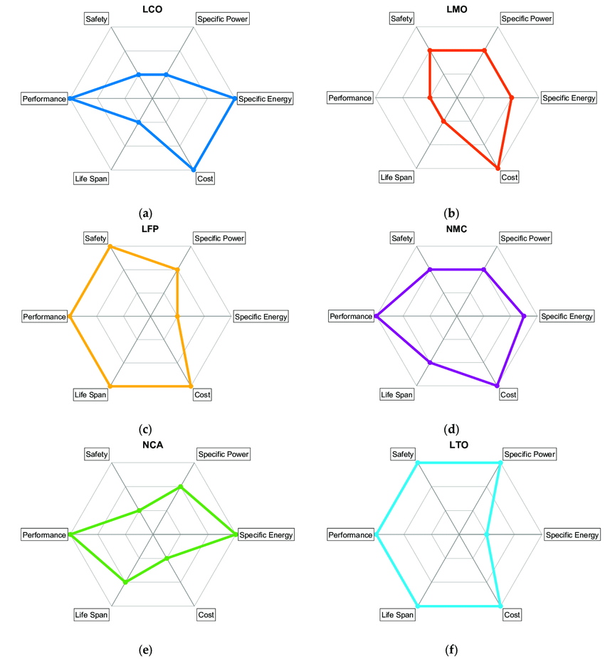
Areas of research in lithium batteries: Catholytes
Lithium-ion batteries use a lot of different catholytes and this is likely to continue to be developed
Lithium Nickel
Manganese Cobalt Oxide
Nickel Oxide
Cobalt Oxide
Manganese spinel
Iron Phosphate
Titanate
Changing electrolyte material for something cheaper or safer
Replacing graphite with another compound
Exploring alternative battery technologies
Learn more: https://www.nature.com/articles/s41467-020-19991-4

Slide 39
Areas of research in lithium batteries: safety
Learn more: https://www.scientificamerican.com/article/how-lithium-ion-batteries-grounded-the-dreamliner/

Slide 40
Areas of research in lithium batteries: safety
Follow up video: https://www.youtube.com/watch?v=Zgj0U6HFbvU

Slide 41
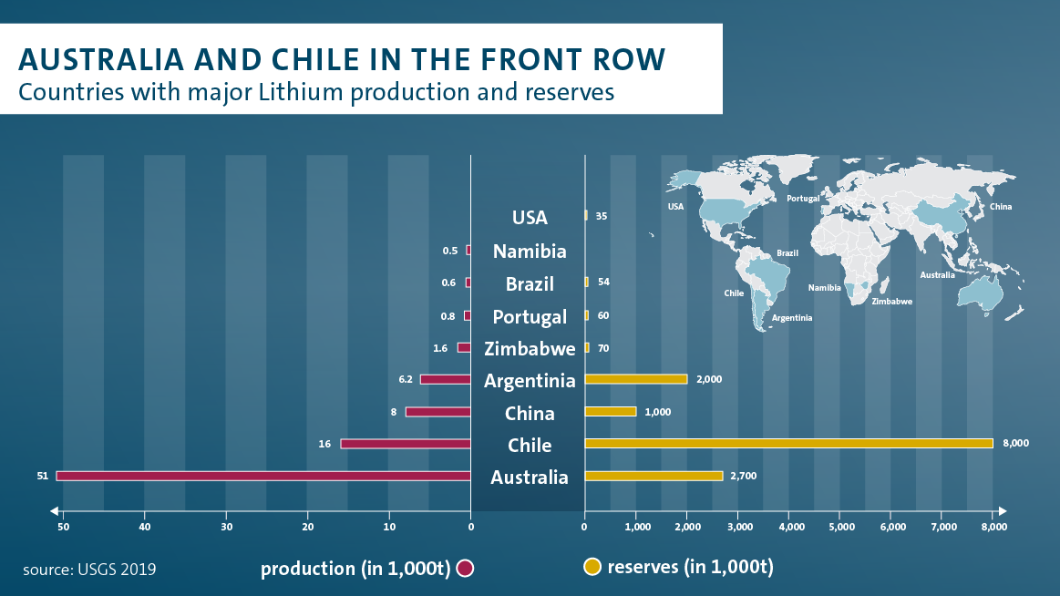
Geopolitical aspects of battery technology
Learn more: https://www.volkswagenag.com/en/news/stories/2020/03/lithium-mining-what-you-should-know-about-the-contentious-issue.html
https://www.statista.com/statistics/264928/cobalt-mine-production-by-country/
Notes:
https://www.volkswagenag.com/en/news/stories/2020/03/lithium-mining-what-you-should-know-about-the-contentious-issue.html

Slide 42
Part 3: Review
Lithium batteries are rapidly growing in affordability, use, and research interest
Lithium-ion batteries are work by ferrying lithium ions between some metal cathode and a graphite anode
Ongoing research is needed for recycling, safety, and battery chemicals.

Slide 43
Review
Part 1: Pairs of atoms or molecules form batteries by exchanging electrons. The voltage is determined by the reduction potential of each molecule.
Part 2: There are a variety of parameters that determine what sort of applications a battery is best suited for, including energy, power, and voltage. Common battery applications are in grid-scale storage, vehicles, medical devices, and consumer electronics
Part 3: Lithium ion batteries are a growing technology that work by moving a lithium ion between a metal complex and graphene through an organic electrolyte

Slide 44
Next week
Next week we will discuss less-mature battery technologies including:
Flow batteries
Metal-air batteries
Solid-state batteries
Sodium or potassium batteries
Molten metal batteries

