Slide 1
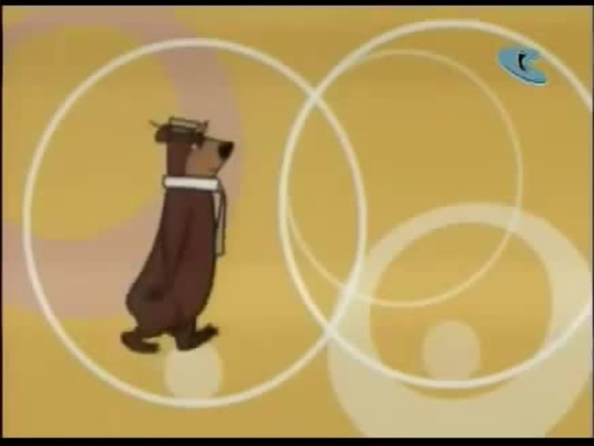

Ancient Astronomy
Ethan Vo

Slide 2
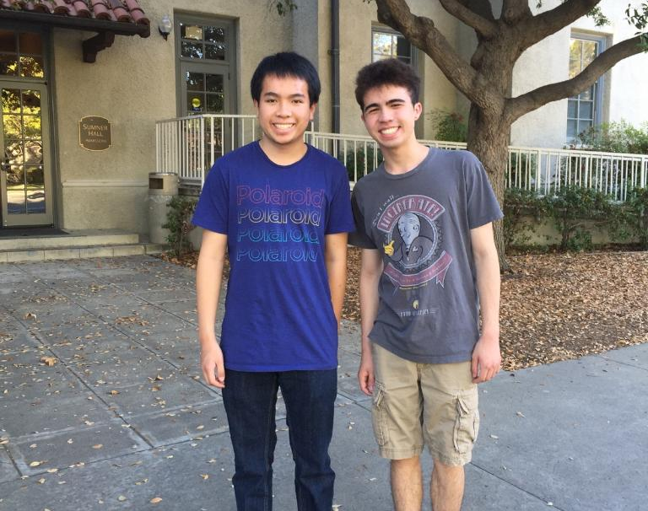
About Myself
MIT Sophomore majoring in Physics and Mathematics/Computer Science
Grew up in Hawaii and lived in Oahu
Participated in math team, science bowl, science olympiad in high school
Tutored in Mathcounts/physics
President of MIT INSPIRE – humanities competition for high school students
Like Samoyeds and swimming

Slide 3


Slide 4
Content/Structure of Class
Six lectures – cover major areas of physics and historical importance from ancient times to 20th century
Lectures will mostly be in chronological order but will also mostly focus on one particular area of physics.
The history of physics is huge! Lectures will emphasize breadth and move fast.
No homework – will instead suggest readings for those interested

Slide 5
Tentative Schedule
Lecture 1 – Ancient/Medieval – Mechanics/Astronomy
Lecture 2 – Renaissance – Mechanics
Lecture 3 – 16th to 20th century – Thermodynamics/Optics
Lecture 4 – 17th to 20th century – E&M/Relativity
Lecture 5 – 20th century – Quantum Mechanics
Lecture 6 – 20th century – Nuclear/Modern Physics

Slide 6
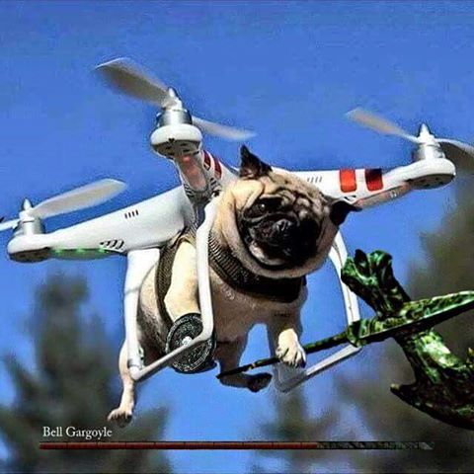
Reminder – You can leave at any time!
Even if my feelings will be slightly hurt

Slide 7

What is science?

Slide 8
Two Major Views on Science
Scientific Realism
  “Science aims to give us, in its theories, a literally true story of what the world is like; and acceptance of a scientific theory involves the belief that it is true.“ (van Fraassen, 1980)
Constructive Empiricism
  “Science aims to give us theories which are empirically adequate; and acceptance of a theory involves as belief only that it is empirically adequate.” (van Fraassen, 1980)

Slide 9

How does scientific progress occur?

Slide 10
Viewpoints on Scientific Progress
Accumulation – Science is a body of knowledge which increases over time (popular view)

Slide 11
Viewpoints on Scientific Progress
Accumulation – Science is a body of knowledge which increases over time (popular view)
Revolution – Thomas Kuhn (1962) argued instead that science was advanced by revolutions which he called paradigm shifts (contested view but popular among academics)

Slide 12
Viewpoints on Scientific Progress
Accumulation – Science is a body of knowledge which increases over time (popular view)
Revolution – Thomas Kuhn (1962) argued instead that science was advanced by revolutions which he called paradigm shifts (contested view but popular among academics)
Evolution – Inspired by Darwinian evolution, this view argues that there are an abundance of scientific theories but only the most “fit” survive

Slide 13
Early Beginnings: Egypt and Mesopotamia
Egyptian geometry and astronomy
  Construction of pyramids, volume of frustum
  Prediction of future events – overflow of Nile river
  365 day calendar – Sothis cycle
  Geographically isolated
Mesopotamian math and astronomy
  Pythagorean triples
  Passed astronomical charts to Chaldeans
  Surrounded by nomadic tribes
Knowledge will set foundation for Greeks

Slide 14
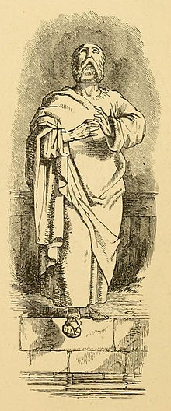
Thales of Miletos (625-547 BCE)
First thinker to explain phenomenon through natural laws
Believed that everything was composed ultimately of water
Predicted solar eclipse of May 28, 585 BCE
Founder of geometry
  Predicted heights and ships of pyramids using shadows
  Thales’ theorem

Slide 15
Beliefs on Matter
Anaximander (610-546 BCE) – apeiron
Anaximenes (585-525 BCE) – wind
Heraclitus (535-475 BCE) – fire
Parmenides – change does not exist, everything is homogeneous
Empedocles (490-430 BCE) – four elements
Democritus (460-370 BCE) – Hey Parmenides!

Slide 16
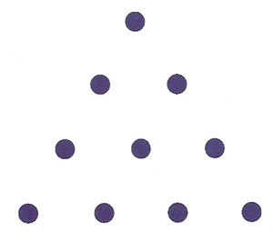

Aesthetic Beauty
Pythagoreans
  Harmony of the integers in music
  $\sqrt{2}$
  Earth is a sphere, cosmos
  Tetractys and the pentagram
  Mysticism and cult practices
Plato (424-348 BCE)
  Model the four elements as platonic solids
  Chemical formulas, $A=F_{2}$
Euclid (~300 BCE) – father of geometry

Slide 17
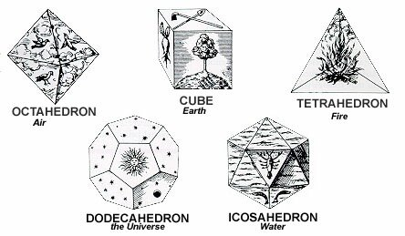

Slide 18
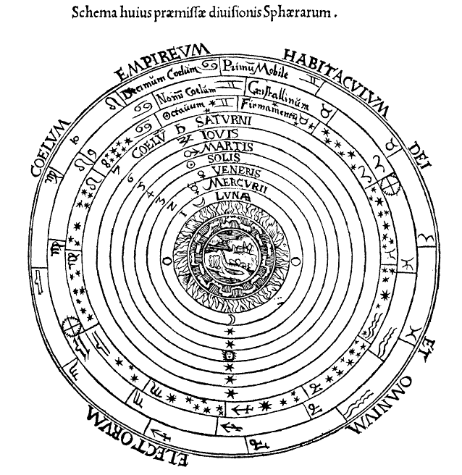
Aristotle (384-322 BCE)
Will influence all of physics for the next millennium
Four causes of phenomena
  Efficient, material, formal, final
Divided the universe into two separate spheres (sublunary and the rest)
  Sublunary sphere is imperfect and governed by peripatetic dynamics
  The upper heavens are perfect and beautiful (the rules do not apply here)
Five elements

Slide 19
Peripatetic dynamics (naïve and wrong!)
What is the natural way one might think about motion?

Slide 20

Peripatetic dynamics (naïve and wrong!)
What is the natural way one might think about motion?
  Motion has an effective cause - force
  Separate forces into three classes – living, natural, and violent
Imagine pushing a cart
  The force we give must overcome a resistance $R$ and is greater depending on how fast the cart moves, $v$.
  Therefore, Aristotle guessed $F=vR$
  Motion is a process! Need a force to maintain motion
  The force also must touch the object at all times

Slide 21
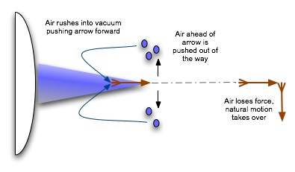
Aristotle vs. the arrow
How does an arrow fly if nothing touches it after you let it go?
Aristotle:

Slide 22
Archimedes (287-212 BCE)
Mathematician, scientist, and engineer
Famous for buoyancy and Eureka!
Classified five simple machines
  Lever, pulley, wheel and axle, screw, wedge
Many legends – heat death ray, giant claws
Rigorous proof of ideas
  Proof of area of parabolic region, stability of paraboloid in water
  Challenge!

Slide 23
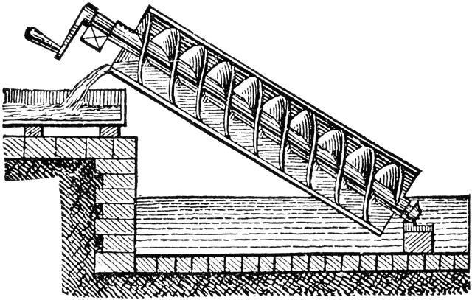

Slide 24
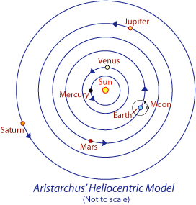
Unexpected Visionary – Aristarchus (320 – 250 BCE)
Aristarchus believed in a heliocentric universe
  Logic: why should the Sun, which was known to be bigger than the Earth, revolve around something smaller?
  Earth revolves around own axis
  Calculated size of sun and moon using trigonometry
  Most of work lost, knowledge comes from brief mention by Aristotle
Largely ignored, not heretical

Slide 25
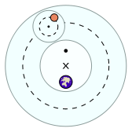
Ptolemy (100-170 CE) and the Almagest
Aristotle’s universe did not provide any relation to observational data
  Main issue: perfect circular orbits do not fit with measurements!
  Goal: Maintain circular motion while being close to observed data
Ptolemy’s universe:
  Geocentric(?)
  Deferent – offset of circular orbit
  Epicycle – circle within a circle
  Equant – uniform motion around imaginary point

Slide 27

But what about China?

Slide 28
East Asian Philosophies
Confucianism – backwards contributions to science
Taoism – rejected artificiality
  Machines/technology is sneaky and cunning
  Astronomy – Emperor Yao
Buddhism
  Actually very rational and logical
  However expressed no interest for understanding the natural world
Mathematics – algebraic equations/number theory/geometry

Slide 29
But what about society?

Slide 30
The Halting of Scientific Progress
Greek thinkers had complete disregard for practical applications of their work
  Science is a curiosity, fit for free people, and should not be practical at all
  Practicality is for slaves!
Disconnect between science and technology
Collapse of the Roman empire and invasions from other regions
Rise of astrology, Christianity, and mysticism

Slide 31
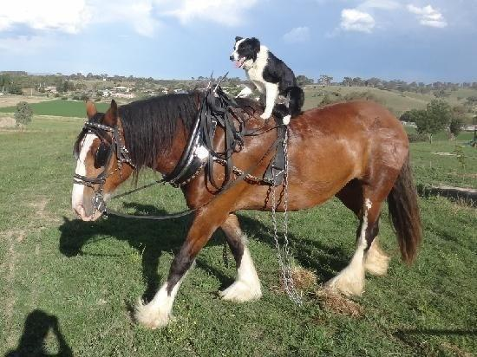
Feudalism in the Middle Ages
Nobles and serfs
  Lack of a rigid class structure (king sometimes a figurehead)
  Serfs and farming – technological revolution
    Work was highly prized!
    Horse collar
    Heavy plow/cycle crops
    Water mills and canals
    Eyeglasses

Slide 32
Religion – Safe Haven for Science?
Christian Monasteries
  Ireland – relatively secluded
  Irish monks emphasized both physical labor and inventions to serve God
  Attacks on Aristotle by the church
Universities – scholars from monasteries
  Seven liberal arts and the seven manual arts
Islam (~622 CE) and the Arab transmission
  Gatekeeper of Greek knowledge, Arabic translations
  Caliph Umar

Slide 33

Advancements in Mathematics/Science
Arab mathematics/science still continued
  Attacks on Ptolemaic system
  Additional epicycles?
  Arabic numerals!
  Algebra and algorithms, Al-Khwarizmi
Fibonacci (1170-1250 CE)
  Fibonacci numbers
  Algebraic techniques, $x^{3}+2x^{2}+10x=20$

Slide 34
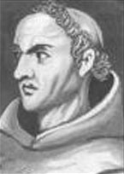

Jean Buridan (1300-1358 CE)
Attack on peripatetic dynamics
Impetus theory
  Aristotle’s arrow example is stupid
    If you pushed a ship, the original push is not keeping it in motion
    Critical of Aristotle!
  Impetus, $F=mv$
  Applied theory to planets moving, no need for gods
    Law of inertia!
    Applying terrestrial laws to the heavens
  Buridan vs. the arrow

Slide 35
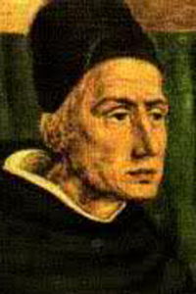
Nicole Oresme (1320 -1382 CE)
Disrespected Aristotle completely
Refuted Buridan’s arguments in a visionary way
  Decomposed arrow’s velocity into horizontal and vertical components
Oresme vs. the eternal return
  The alignment of the planets
  Solution predates Poincare by ~500 years!

Slide 36
Next time: Renaissance

